Slide 1
Phylogenetic Tree of Bacterial Chemotaxis
H. Kruize & K. Kort

Slide 2
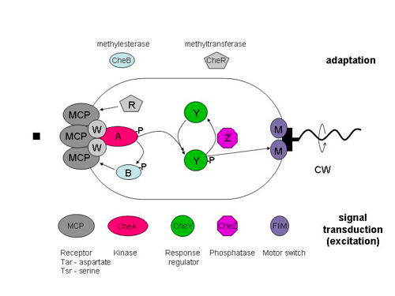
Introduction
Source: http://www.rowland.harvard.edu/labs/bacteria/projects/fret.php

Slide 3
Aim
Generate an automated pipeline to generate a phylogenetic tree to
Investigate differences between chemotactic proteins of different species.
Obtain insights in the evolution of bacterial chemotaxis.

Slide 4
Methods
Data retrieval from the MiST2.2 online database (manually)
Multiple Sequence Alignment (MSA)
MAFFT
MUSCLE
Tree construction: Neighbor Joining
MEGA
Phylip
Tree visualization
Phylip
Biopython
Python wrapper

Slide 5
Challenges
Automated data retrieval from MiST
MSA visualization
Deciding which aligner to use
Adapting MSA ouput for tree construction method
Big changes needed to prepare the file for the tree construction
Pitfalls:
Arguments used by methods
How input files are read by methods

Slide 6
Data retrieval: MiST2.2 database
<print screen MiST shopping card>
And
<print screen html version of the database>?

Slide 7
MSA: MUSCLE or MAFFT
MAFFT Pro Con
MUSCLE Pro Con

Slide 8
Tree construction: MEGA or Phylip
MEGA Pro Con
Phylip Pro Con

Slide 9
Result
Input: 10 DNA or Protein sequences from random species for CheZ (Toy input)

Slide 10
Prospective

Slide 11
Conclusion

Slide 12
Thank you for your attention!
Are there any questions?

