Slide 1
Phylogenetic Tree of Bacterial Chemotaxis
H. Kruize & K. Kort

Slide 2
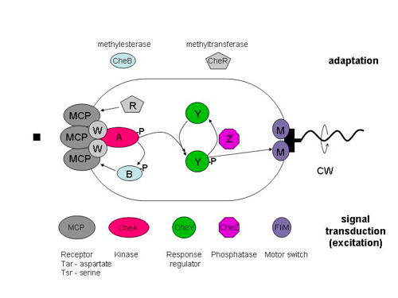
Introduction
Source: http://www.rowland.harvard.edu/labs/bacteria/projects/fret.php

Slide 3
Aim
Generate an automated pipeline to generate a phylogenetic tree to:
Investigate differences between chemotactic proteins of different species.
Obtain insights in the evolution of bacterial chemotaxis.

Slide 4
Methods
Python wrapper using:
Data retrieved from the MiST2.2 online database (manually)
Multiple Sequence Alignment (MSA)
MAFFT or
MUSCLE
Tree construction: Neighbor Joining
MEGA or
Phylip
Tree visualization
Phylip or
Biopython

Slide 5
Difficulties
Challenges:
MSA visualization
Deciding which aligner to use
Adapting MSA ouput for tree construction method
Big changes needed to prepare the file for the tree construction
Pitfalls:
Arguments used by methods
How input files are read by methods

Slide 6
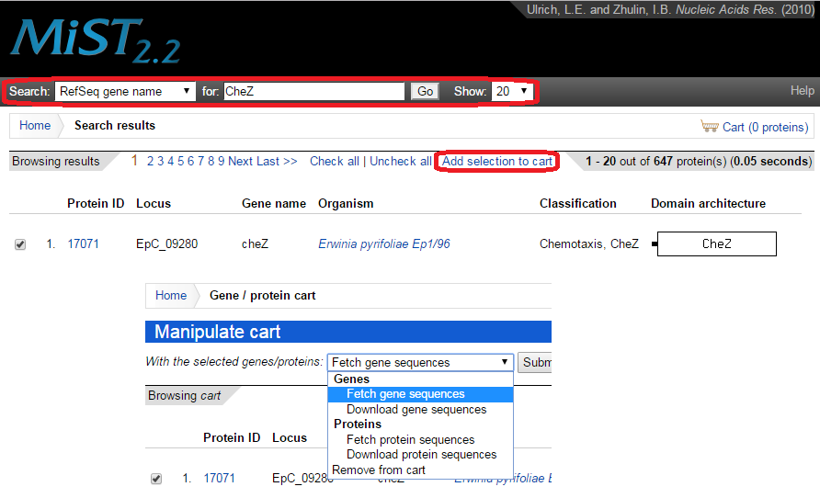
Data retrieval: MiST2.2 database

Slide 7
MSA: MUSCLE or MAFFT
MUSCLE:
Accepts .faa and .fnt format
However output format not compatible with Phylip
MSA give gappy alignments
MAFFT:
Also accepts .faa and .fnt format
Again output format not compatible with Phylip
MSA had minimal amount of gaps
Better alignment options through terminal arguments

Slide 8
Tree construction: MEGA or Phylip
MEGA:
Claimed to be able to run from terminal, however this opened a GUI.
This breaks the fully automated pipeline.
Phylip:
Is fully run from the terminal.
Easy to use, with limited terminal arguments

Slide 9
Reformatting MSA to Phylip
Phylip accepts a different format from what MAFFT produces.
MAFFT output: | Phylip input:
(MAFFT version) | [Sequence number] [Sequence length]
| Seq_name sequence
|
Seq_name sequence | Second block
*--* * -
Second block

Slide 10
Phylip tree building + visualisation
Phylip builds a distance matrix from the reformatted MSA output.
This is used to calculated the final phylogenetic tree.
One last step is to visualise the tree data generated by Phylip.
This is done by using Biopythons package Phylo.

Slide 11
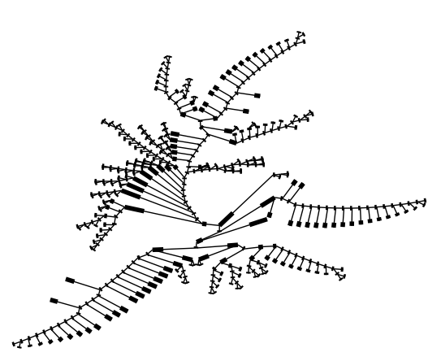
Result
Input: 222 (DNA or) Protein sequences from random species for CheV.
Protein phylogenetic tree:

Slide 12
Conclusion and Prospective
Conclusion:
We were able to set up an automated pipeline to generate phylogenetic trees.
Prospective:
Optimizing phylogenetic tree visualisation.
More tests are needed:
The CheV DNA phylogenetic tree construction failed due to unknown error.

Slide 13
Thank you for your attention!
Are there any questions?

