Slide 1
Catheter Segmentation with U-Net family
Task:
Multi-class image segmentation
Kaijie.Yang ID:201690423
Problem
Models
Pipeline
Evaluation
Core metric:
Mean Dice / Mean IoU
Focus: What kind of u-net model or model parameter configuration can effectively perform the segmentation task on the CathAction dataset?
Outcome:
Training results of different models
Statement of Ethical Compliance:
Data Category: No more than B
Participant Category: 0
Notes:
Hello Dr. Chen, my project is titled "Catheter Segmentation with U-Net family". My name is kaijie.yang. In this project, I focus on exploring what kind of u-net model or model parameter configuration can effectively perform the segmentation task on the CathAction dataset. As you can see, the evaluation method for this project is to examine the Mean Dice / Mean IoU of the model training. The final prediction results are output, and these two parameters are used to evaluate the quality of the model.

Slide 2
1. Project overview
Motivation, target outcome, and the main contribution
Motivation
Original objectives
Major conclusion
• Accurate segmentation of catheters or wire in the X-ray image dataset is challenging. The dataset has a weak structure, low contrast, and is easily confused with the background.
• To verify whether mainstream segmentation models can effectively perform the task of segmenting the target image.
• Build a repeatable training and evaluation workflow for semantic segmentation.
• Compare stronger U-Net family models on the same dataset split and metrics one by one.
• Use visualization software to output model predictions.
• R2U-net currently offers the best segmentation performance.
• The Attention algorithm did not perform well on the dataset, and was even worse than the original U-net.
Notes:
The first part I want to introduce is the project overview. First, the motivation: Accurate segmentation of catheters or wires in the x-ray image dataset is challenging. The dataset has weak structure, low contrast, and is easily confused with the background. I also want to verify whether mainstream segmentation models can effectively perform the task of segmenting the target image.
The next part is my Original objectives,build a Repeatable training and evaluation workflow for semantic segmentation. Meanwhile, compare stronger U-Net family models on the same dataset split and metrics one by one. And use visualisation software to show model predictions.
And the last part is my Major conclusion. I found that R2U-net currently offers the best segmentation performance. And the Attention algorithm did not perform well on the dataset, and was even worse than the original U-net in some aspects.

Slide 3
2. Dataset(CathAction) and training setup
What the codebase actually trains and measures
Dataset facts
Preprocessing pipeline
phantom_train
14,737
Input images
+ masks
(datacheck.py )
Resize
to 768*768 or 512*512
Augmentation
flip / affine / noise
Tensor +
normalisation
phantom_test
3,685
animal_train
4,021
animal_test
2,012
The datacheck.py program performs data verification:
• Check if the number of images and masks in the training set is consistent. The code first reads the image set and the label set, and then checks the number of files in both folders is the same.
• Randomly sample and check if the mask data format is normal. Check if the tag files are three-class or two-class files, and mark any problematic files.
The dataset contains X-ray images of artificial tubes and biomimetic X-ray images, with the label files consisting of 2-class and 3-class classification files.
Notes:
The next part is Dataset and training setup.The CathAction dataset contains X-ray images of artificial tubes and biomimetic X-ray images, with the label files consisting of 2-class and 3-class classification files.For example, in a 3 class file, class 1 is the background, class 2 is the catheter, and class 3 is the wire.
Regarding the preprocessing pipeline, the first step is to input images and masks, which are checked by the datacheck Python program. The images are then resized to a specific resolution to suit different models. Next, the data undergoes a data processing flow including augmentation, flipping, affine removal, and noise reduction. Finally, tensor and normalization adjustments are performed.
About the data check program, it checks if the number of images and masks in the training set is consistent. The code first reads the image set and the mask set, and then checks the number of files in both folders is the same. At the same time, it will randomly sample and check if the mask data format is normal. Check if the tag files are three-class or two-class files, and mark any problematic files.

Slide 4
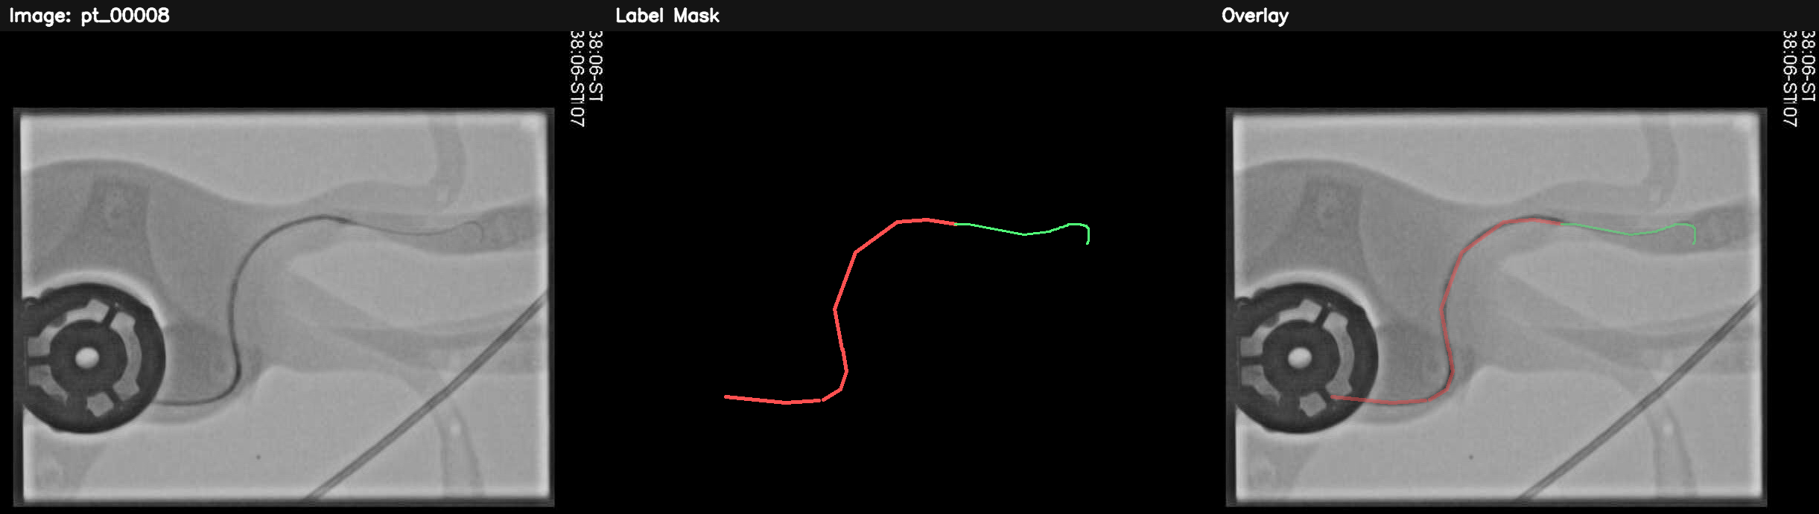
Silicone Phantom Model of Human Blood Vessels:

Slide 5
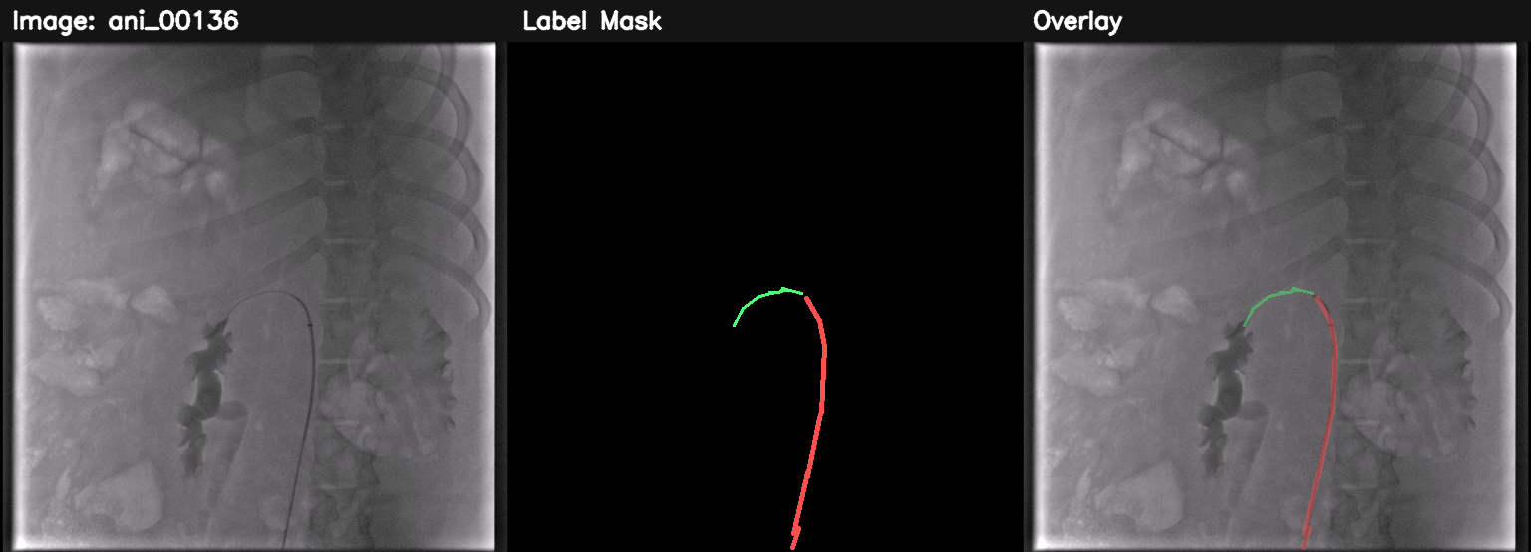
Animal experimental data:

Slide 6
3. Model progression
Four different U-net model training schemes
U-Net
R2U-Net
Attention U-Net
Attention R2U-Net
Baseline encoder-decoder with skip connections
Adds recurrent residual blocks to refine features
Applies attention gates to filter skip features
Combines recurrence and attention for a stronger final design
Design logic：
Training result verification：
• Each model underwent parameter tuning and adaptation on the CathAction dataset, and was trained and debugged extensively to achieve its optimal performance.
• A simple front-end program is used to demonstrate the predictive performance of the trained model.
Notes:
The third part is model progression. This project used four different u-net algorithms, each with its own characteristics and suitable for different training tasks.
A more detailed design involved each model undergoing parameter tuning and adaptation on the CathAction dataset, and being extensively trained and debugged to achieve optimal performance. For verifying the predictive capabilities of the trained models, this project includes a simple front-end program.

Slide 7
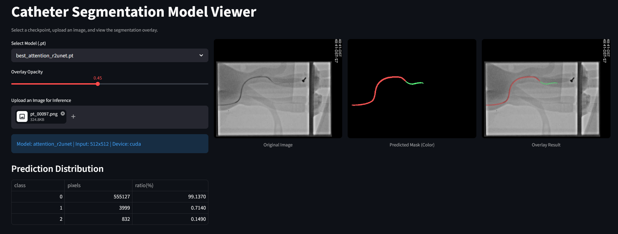
Front-end program demonstration：

Slide 8
4. Final software product
From raw data to trained checkpoint and test evaluation
1. Data loader
What I would emphasise in the :
1
Read the CathAction dataset, clean the data, and then input it into the program for training.
• The codebase is modular: dataset, architecture, loss, training loop and evaluation are clearly separated. • The project moved from a baseline to a family of stronger architectures while keeping the same task and metrics. • The final product easier to extend with new datasets, losses or checkpoints.
2. Train models
2
Separate to train U-Net, R2U-Net, Attention U-Net and Attention R2U-Net.
3
3. Save best model
Validation Dice is monitored and the best checkpoint is stored automatically.
Input
images
Model
checkpoint
Dice
IoU
4. Evaluate on test set
4
A separate script loads a checkpoint and reports per-class Dice and IoU.
Notes:
In the final software product part, I will explain the basic framework of the program's operation. The first is Data loader, this part read the CathAction dataset, cleans the data, and then inputs it into the program for training. The next is the train models, separate to train U-Net, R2U-Net, Attention U-Net and Attention R2U-Net. Meanwhile, the Save best model part will catch the best solution in the different epochs. Finally the model will be tested on the Evaluate program, and show their score.
In this part, I would emphasize something. The codebase is modular: dataset, architecture, loss, training loop and evaluation are clearly separated. At the same time, the project moved from a baseline to a family of stronger architectures while keeping the same task and metrics. And about the product, it is easier to extend with new datasets, losses or checkpoints.

Slide 9
5. What went well, and what did not go exactly to plan?
A good marker-facing reflection for the video
What went well
What changed
Current limitation
• A complete end-to-end segmentation workflow was implemented: preprocessing, training, checkpointing and testing.
• A clear model training plan, with progressively advancing model versions.
• Since different types of U-Net exhibit varying performance on the training set, their fit to the cathaction dataset warrants further investigation.
• Instead of stopping at one U-Net baseline, it expanded into a controlled comparison of four variants.
•To find a prediction model that is better suited to X-ray images and to find an algorithmic solution.
• The accuracy improvement trend is not significant, which seems to be because the model and dataset have reached their limits, making further optimization impossible.
• The performance optimization mentioned in the research proposal is very difficult to achieve, and such a task cannot be completed at this stage of learning.
Notes:
In the final part, there are some interesting questions. The first is what went well. To be honest, a complete end-to-end segmentation workflow was implemented: preprocessing, training, checkpointing and testing. And a clear model training plan, with progressively advancing model versions, is a very important part of this project.Meanwhile, since different types of U-Net exhibit varying performance on the training set, their fit to the cathaction dataset warrants further investigation.
Compared to the initial research, this project added the following: We no longer used a single model architecture; it expanded into a controlled comparison of four variants. And we found a prediction model that is better suited to X-ray images and an algorithmic solution.
Finally is the current limitation. The research results show that the accuracy improvement trend is not significant, which seems to be because the model and dataset have reached their limits, making further optimisation impossible. Meanwhile, the performance optimisation mentioned in the research proposal is very difficult to achieve, and such a task cannot be completed at this stage of learning.

