Slide 1

Business Intelligence
Optimizing
for
RETAIL ANALYTICS

Slide 2
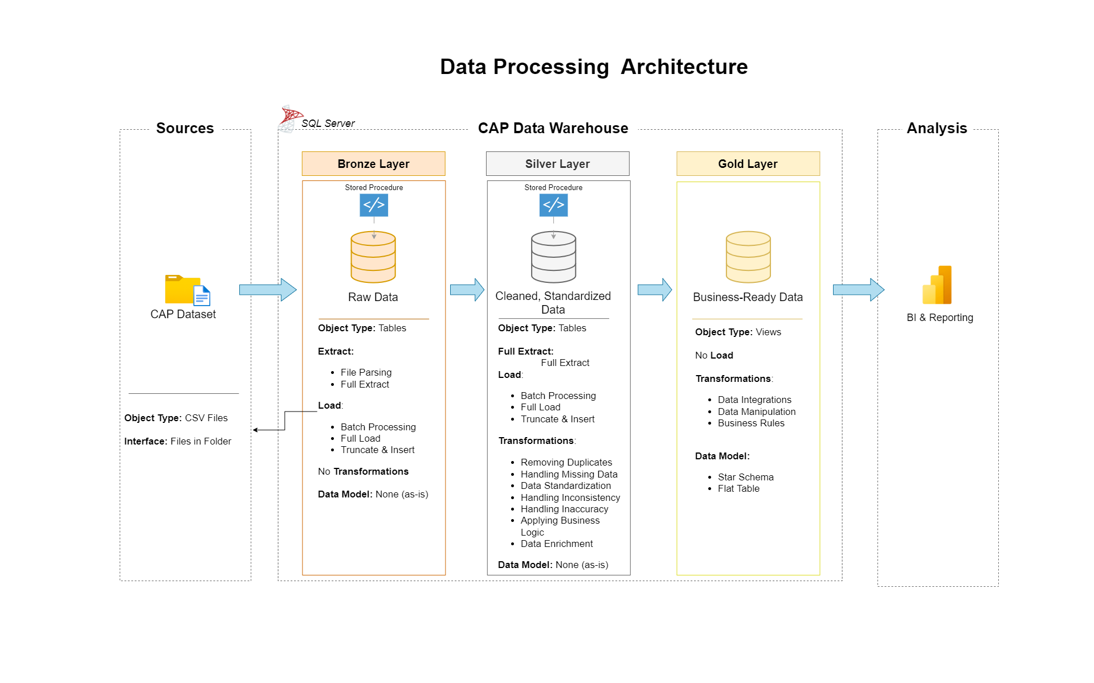
Data Warehouse Development
Server:
SQL Server
Database Name:
CAP – Submitted as “CAP.bak”
Warehouse Infrastructure:
Medallion Architecture
(3 Layers)
Schemas:
Bronze
Silver
Gold
Script to create CAP Data Warehouse:
“ddl_cap.sql”

Slide 3
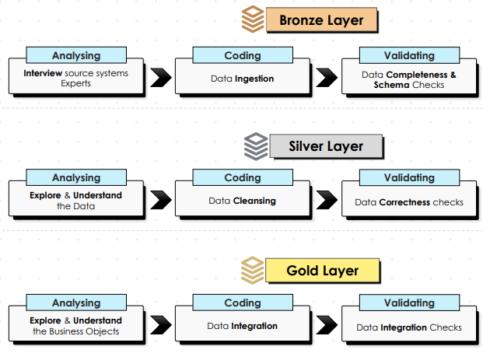
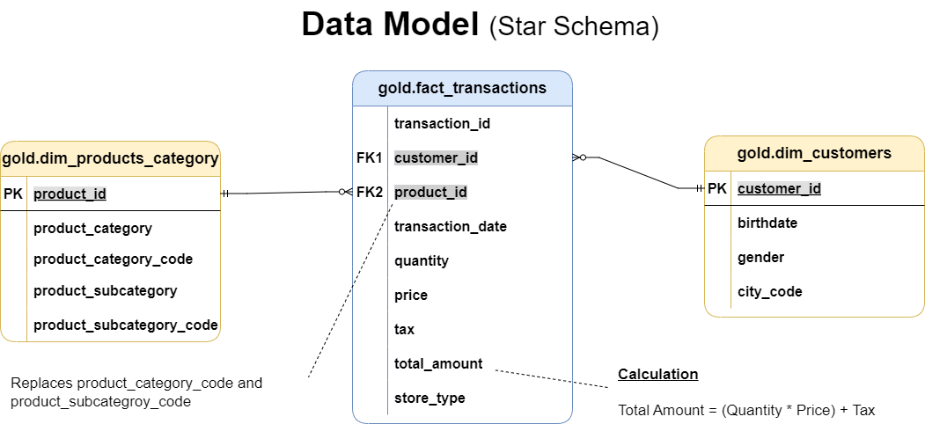
Warehouse Coding Activities
Scripts (Bronze Layer) – ET, Extract and Transform:
ddl_bronze.sql – creates empty tables
proc_load_bronze.sql – extracts data from the source.
Scripts (Silver Layer) – ETL, Extract, Transform and Load:
ddl_silver.sql – creates empty tables
proc_load_silver.sql – extracts, transforms, and loads data from the bronze Layer
Exploration:
qcheck_bronze.sql – checks before transformations
qcheck_silver.sql – checks after transformation
Scripts (Gold Layer):
ddl_gold.sql – creates views of fact and dimension tables of data model from integration.
Business-Ready!

Slide 4
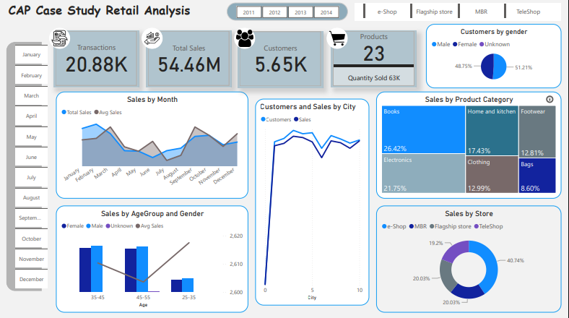
Dashboard and Report Development
Tool:
Power BI
Connection with SQL Server:
“IMPORT” mode for speed and flexibility
Automation for Daily Data Updates:
Schedule Refresh
Key Insights:
Sales Trend
Leading
February
Age range 35-45
Male gender
City 3
Books
e-shop
Following
March
Age range 45-55
Female gender
City 4
Electronics
Flagship Store & MBR
Trailing
June
Age range 25-35
Unknown gender
City 0
Bags
Teleshop
Recommendation for Future Sales:
1. Leading and Following Classes
Maintain Existing Marketing Strategy
2. Trailing and Other Classes:
Introduce Rigorous Marketing
Incentivize Patronage is possible

Slide 5
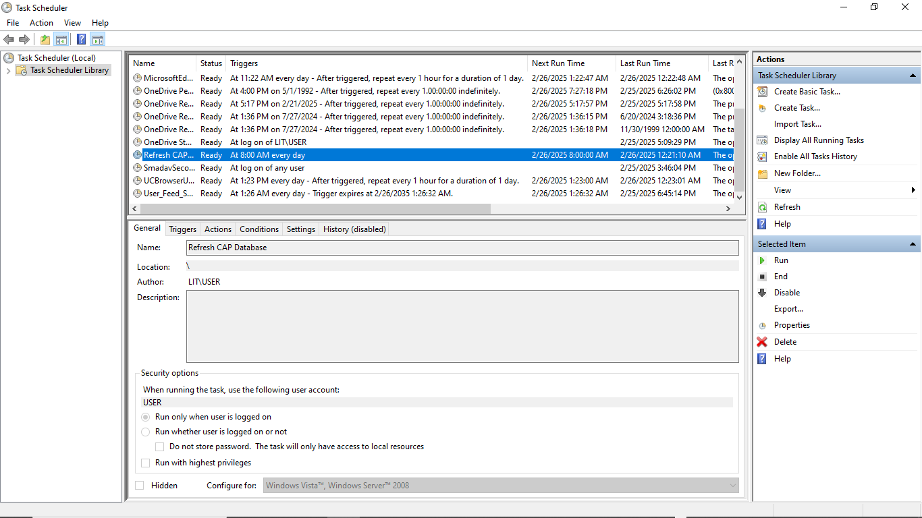
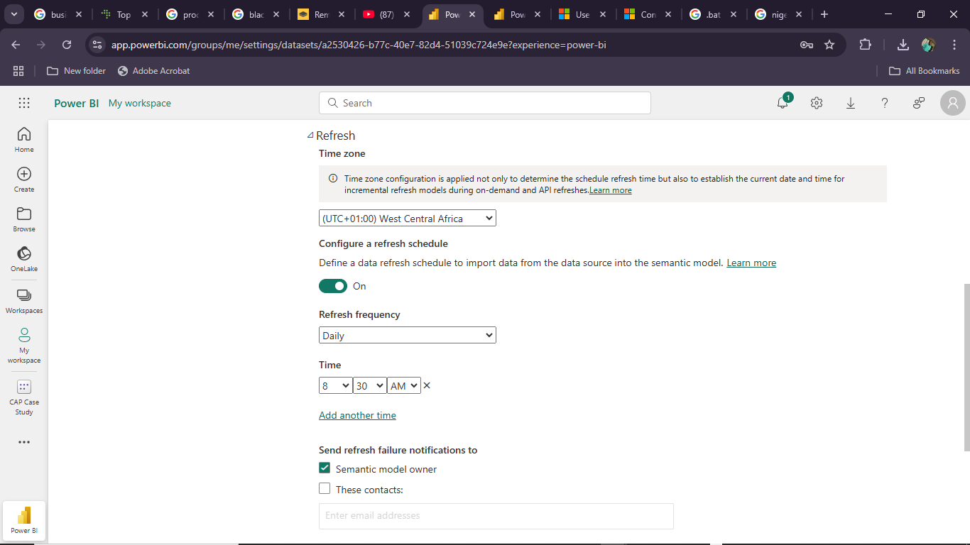
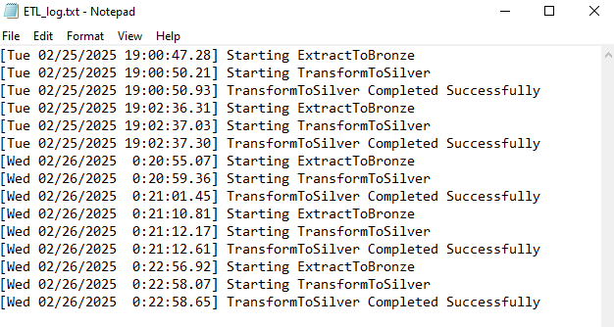
Automation for Daily Data Updates
Medium:
Window Task Scheduler
Script:
“RunCAPJob.bat” gets updated data from the source files into the CAP database and keeps activity log in “ETL_log.txt”
Schedule:
8:00 AM Everyday
(Daily SOB)
Power BI Visuals Refresh Schedule:
8:30 AM Everyday
(After Data Update)

