Slide 1
LOSSY IMAGE COMPRESSION WITH COMPRESSIVE AUTOENCODERS

Slide 2
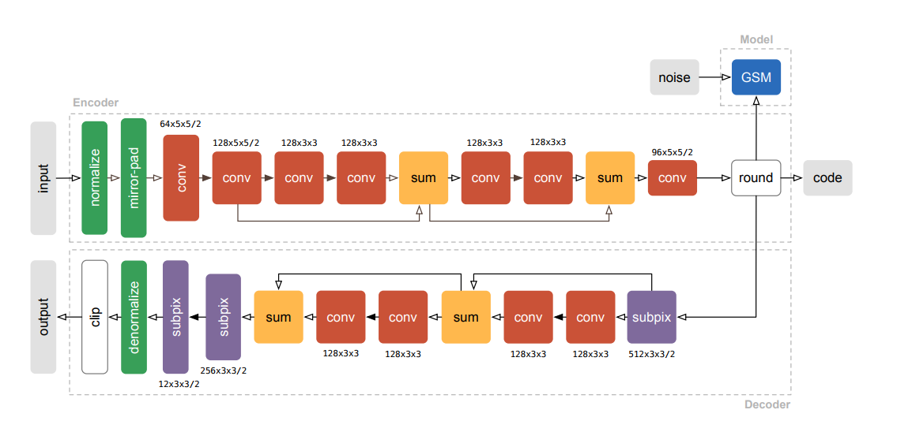
Encode
Round
Entropy
Decode
Forward、backward不一样

Slide 3
Rate distortion control: β、λ(fine gained)

Slide 4
问题
为什么不直接用浮点数（主要误差来源）
Subpixel convolution是什么
参数共享

Slide 5
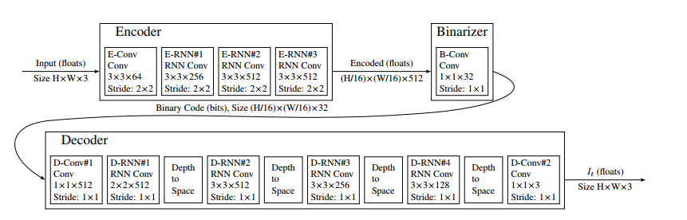
Full Resolution Image Compression with Recurrent Neural Networks
Rate distortion control: 迭代次数
特点：比特/扭曲率可以在训练完成后调整

Slide 6



问题
Loss function:
Residual dimesion:

Slide 7

VARIABLE RATE IMAGE COMPRESSION WITH RECURRENT NEURAL NETWORKS
Encode
Round
Decode
问题：第一篇中Round的梯度消失问题

Slide 8
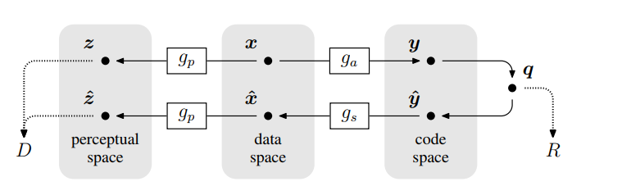
END-TO-END OPTIMIZED IMAGE COMPRESSION
跟第一篇类似，同样不能实时调整rate-distortion trade-off
问题：nonlinear指的是什么

Slide 9
汇总问题
损失函数：跟人眼的特异性无关
Mobile profession区别

