Slide 1

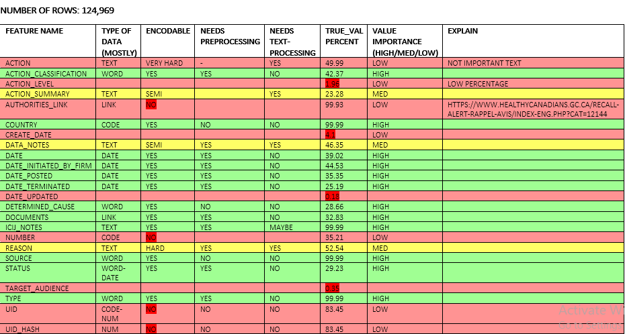

DATA BASE ANALYSIS AND FEATURE SELECTION (Phase 1)
1
devices
Database
functionalities
events
Database
presentation
manufacturers
Pre-processing
Word document named as databases_informations
num_rows
perc_true_col
perc_exactvalue
Encodable Features
num_rows
perc_true_col
perc_exactvalue
whole_look
single_data_presentation
risk_normalization
Type of Data
Encodable
Pre-processing
Text-processing
True Value Percent
Importance
Text
Features

Slide 2

ENCODER AND KEYWORD BULDER (Phase 1)
2
Encodable Features
Classification
Risk_class
Country
Action classification and …
Keywords
Encoded Features
Dental
Sklearn.preprocessing
LabelEncoder()
Radiology
Keywords Recognition
Neurological
TF-IDF: sklearn.feature_extraction TfidfVectorizer
Remove Useless Keywords
Normalization
Word2Veb
Text Processing
Nltk
Textblob
Cardio
Vascular
Text Features
Dental
Radiology
Clinical Chemistry
…
Neurological
Cardio
vascular
Description
Name
Action summary
Reason
and …
removing digits
Upper case to lower case
Removing symbols
Removing enter spaces
Lemmatization
Parsed and tokenized Text Features
Medical Devices

Slide 3
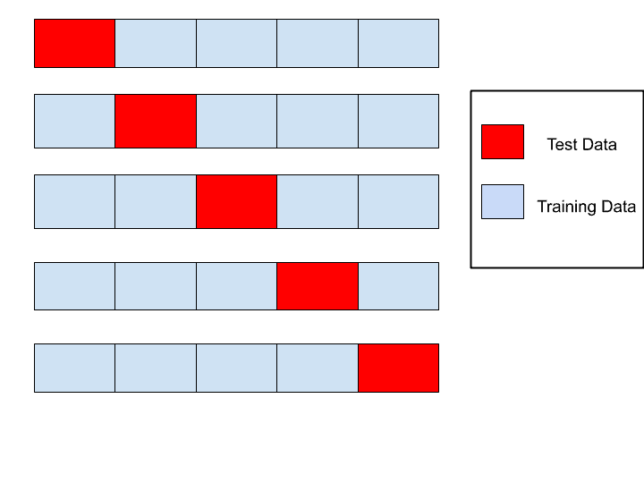

ENCODER AND KEYWORD BULDER
3
Cross-validation
Parsed and tokenized Txt Features
Encoded Labeled Data
Keywords
Classification Algorithms
Decision Tree
Random Forest
Gradient Boosting
Naive Bayes
AdaBoost
Neural Net
Specific score correspond to each class
Test and Evaluation
Encodable Features
Full encoded data base
Let’s do prediction
Balanced score correspond to each class
Encodable Features

Slide 4
Statistics and Results
4
Number of true records: 71719
Number of all records: 191727
Including 3 types of features
16 outcome category
Target Variable: Y
Encodable Features
Machine Learning Features
1
2
Classification | risk_class | country | manufacturer_id | implanted | manu_source | eve_source | determined_cause | status | type | Action_classification | icij_notes
Immunology and Microbiology Devices | Cardiovascular Devices | Anesthesiology Devices | Hematology and Pathology Devices | General Hospital and Personal Use Devices | Clinical Chemistry and Clinical Toxicology Devices | General and Plastic Surgery Devices | Gastroenterology-Urology Devices
Neurological Devices | Orthopedic Devices | Ophthalmic Devices | Radiology Devices | Dental Devices | Physical Medicine Devices | Obstetrical and Gynecological Devices | Ear, Nose, and Throat Devices
Text features converted to normalized scores
3
4
Date features separated to day, moth and year
y_init_firm | m_init_firm | d_init_firm
y_posted | m_posted | d_posted
1
2
3
4
5
Accuracy: 28% → 35% → 68% →75% → 93%
Hyperparameter Tuning
5

Slide 5
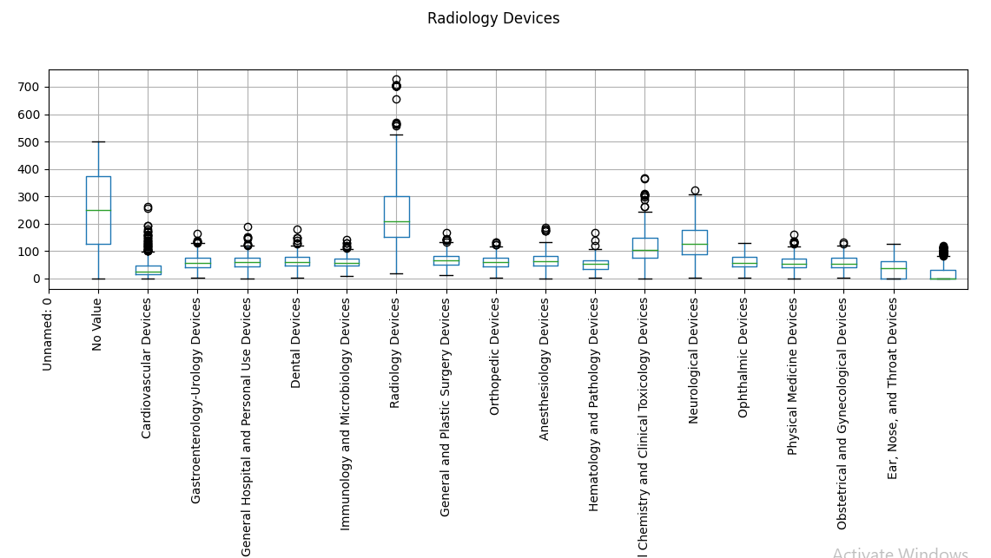
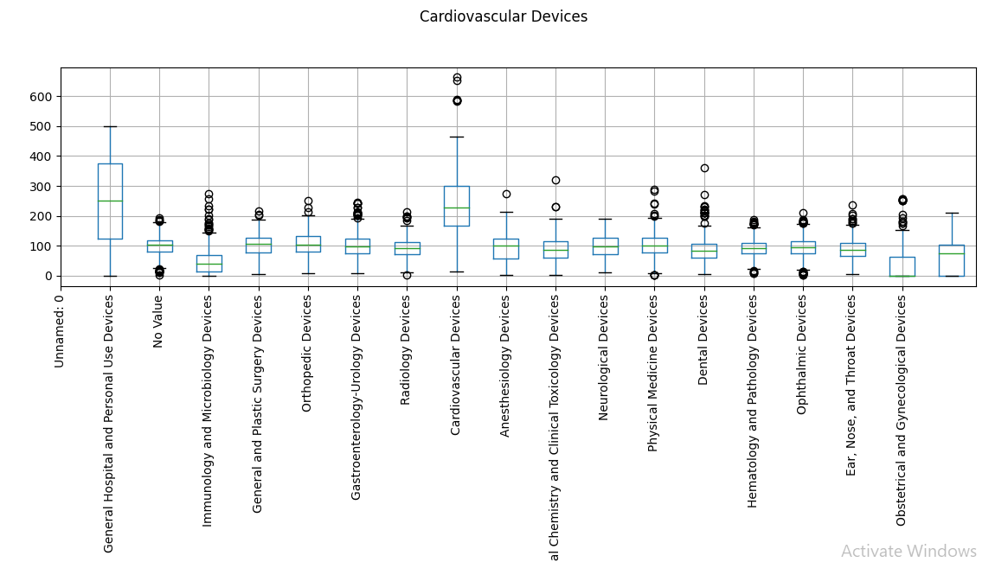
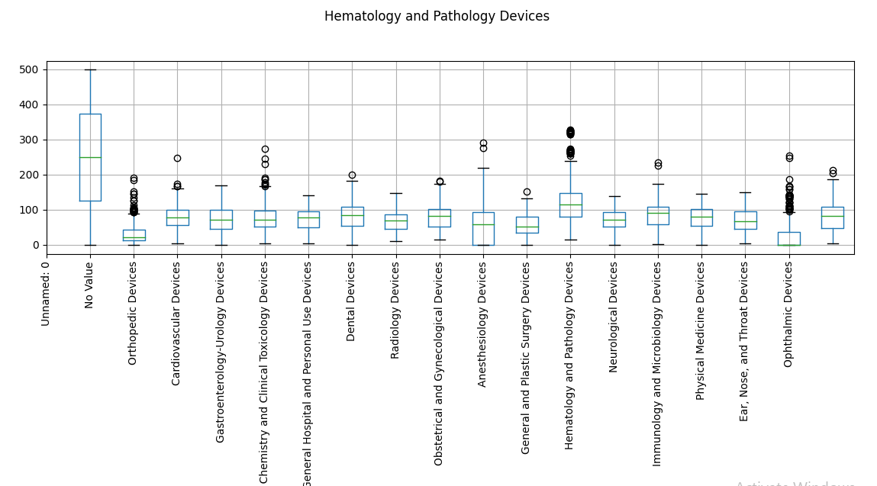
Machine Learning Results
4
Neural Net : [39.3781372 39.37644664]
AdaBoost : [78.32682655 82.29733121]
Naive Bayes : [79.74065811 79.1516774 ]
Decision Tree : [91.33017289 91.0399063 ]
Random Forest : [93.77300613 93.61108787]

Slide 6
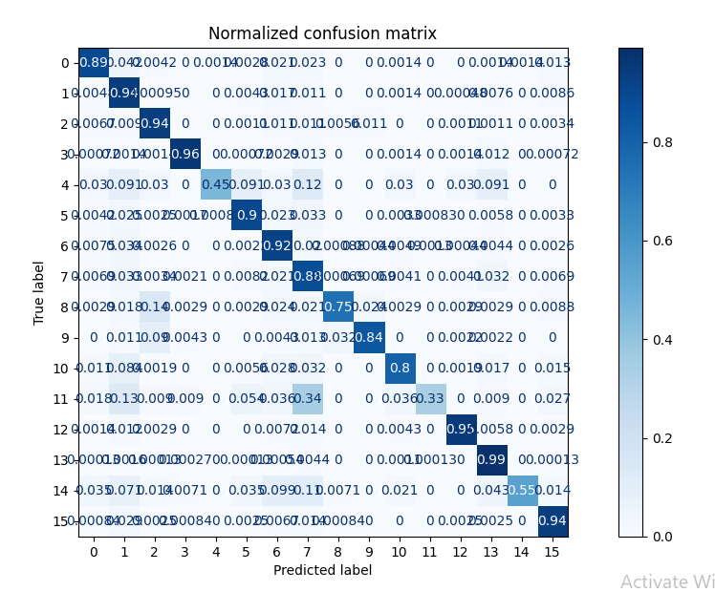
Machine Learning Results

Slide 7

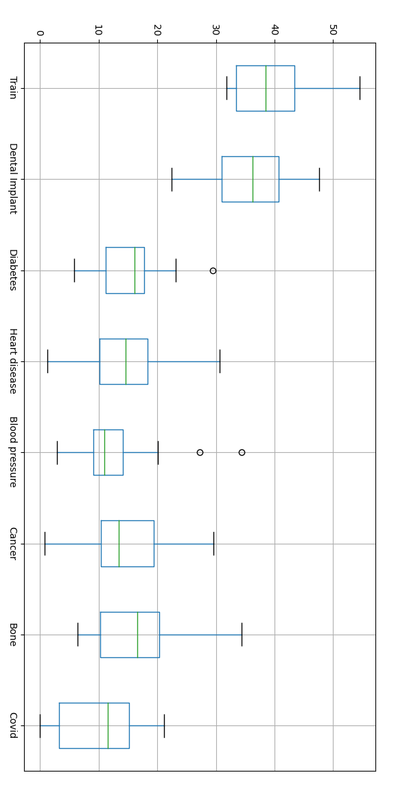
DENTAL IMPLANT PAPERS
5
Manually I selected 60 dental implant papers
removing digits
Upper case to lower case
Removing symbols
Removing enter spaces
Lemmatization
Any subject papers
Keywords Recognition
TF-IDF: sklearn.feature_extraction TfidfVectorizer
Remove Useless Keywords
Normalization
Word2Veb
Dental Implant
Keywords
Threshold

Slide 8
USER INTERFACE
6

