Slide 1

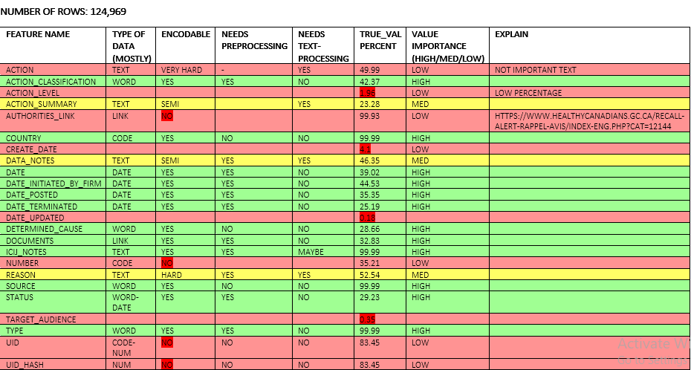

DATA BASE ANALYSIS AND FEATURE SELECTION (Phase 1)
1
devices
Database
functionalities
events
Database
presentation
manufacturers
Pre-processing
Word document named as databases_informations
num_rows
perc_true_col
perc_exactvalue
Encodable Features
num_rows
perc_true_col
perc_exactvalue
whole_look
single_data_presentation
risk_normalization
Type of Data
Encodable
Pre-processing
Text-processing
True Value Percent
Importance
Text
Features

Slide 2

ENCODER AND KEYWORD BULDER (Phase 1)
2
Encodable Features
Classification
Risk_class
Country
Action classification and …
Keywords
Encoded Features
Dental
Sklearn.preprocessing
LabelEncoder()
Radiology
Keywords Recognition
Neurological
TF-IDF: sklearn.feature_extraction TfidfVectorizer
Remove Useless Keywords
Normalization
Word2Veb
Text Processing
Nltk
Textblob
Cardio
Vascular
Text Features
Dental
Radiology
Clinical Chemistry
…
Neurological
Cardio
vascular
Description
Name
Action summary
Reason
and …
removing digits
Upper case to lower case
Removing symbols
Removing enter spaces
Lemmatization
Parsed and tokenized Text Features
Medical Devices

Slide 3
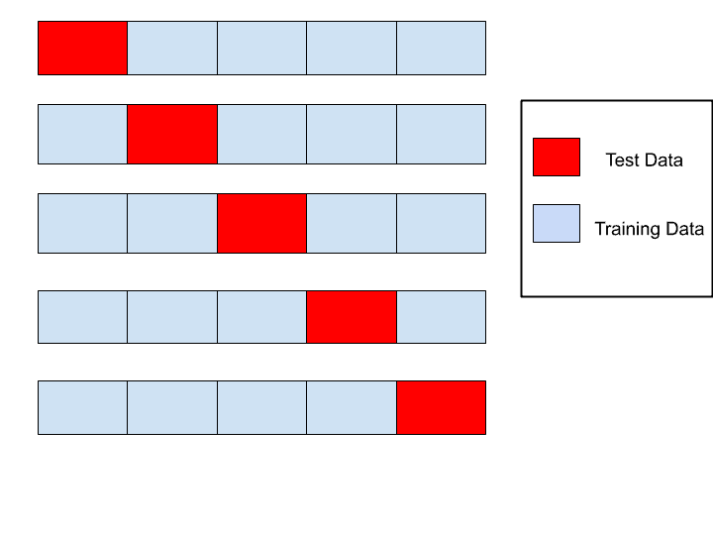

ENCODER AND KEYWORD BULDER
3
Cross-validation
Parsed and tokenized Txt Features
Encoded Labeled Data
Keywords
Classification Algorithms
Decision Tree
Random Forest
Gradient Boosting
Naive Bayes
AdaBoost
Neural Net
Specific score correspond to each class
Test and Evaluation
Encodable Features
Full encoded data base
Let’s do prediction
Balanced score correspond to each class
Encodable Features

Slide 4
Statistics and Results
4
event_id action_classification eve_country device_id determined_cause documents icij_notes eve_source status type url classification_x implanted risk_class dev_country manufacturer_id manu_source Immunology and Microbiology Devices Cardiovascular Devices Anesthesiology Devices Hematology and Pathology Devices General Hospital and Personal Use Devices Clinical Chemistry and Clinical Toxicology Devices General and Plastic Surgery Devices Gastroenterology-Urology Devices Neurological Devices Orthopedic Devices Ophthalmic Devices Radiology Devices Dental Devices Physical Medicine Devices Obstetrical and Gynecological Devices Ear, Nose, and Throat Devices y_init_firm m_init_firm d_init_firm y_posted m_posted d_posted

Slide 5

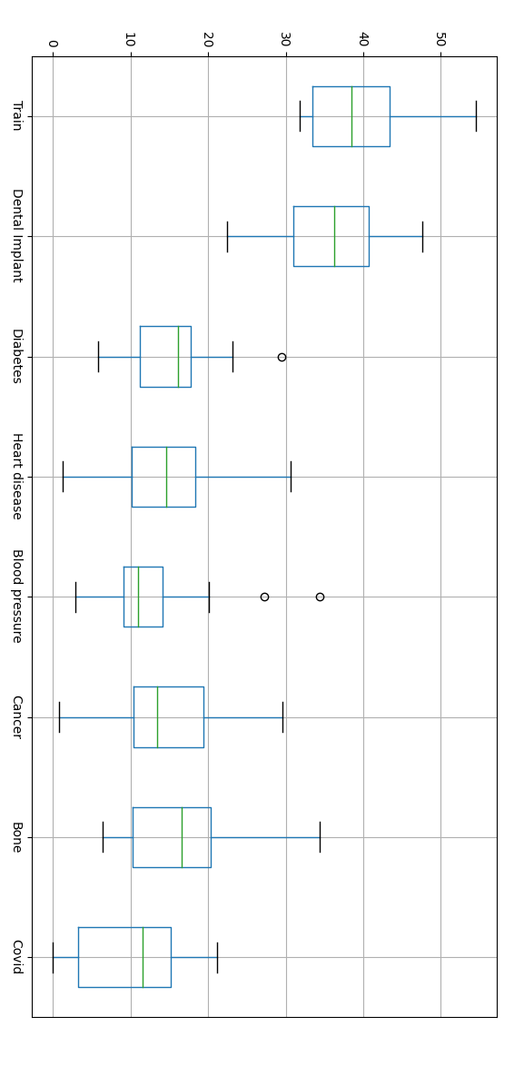
DENTAL IMPLANT PAPERS
5
Manually I selected 60 dental implant papers
removing digits
Upper case to lower case
Removing symbols
Removing enter spaces
Lemmatization
Any subject papers
Keywords Recognition
TF-IDF: sklearn.feature_extraction TfidfVectorizer
Remove Useless Keywords
Normalization
Word2Veb
Dental Implant
Keywords

Slide 6
USER INTERFACE
6

