Slide 1
Runtime Support
Runtime
CMPT 379: Compilers
Instructor: Anoop Sarkar
anoopsarkar.github.io/compilers-class

Slide 2
Runtime Support
Management of runtime resources
Correspondence between:
Static (compile-time) structures
Dynamic (run-time) structures
Storage organization
Using memory to store data structures of the executing program

Slide 3
Invoke the Program
Execution of the program is initially under the control of the operating system
When program is invoked:
The OS allocates space for the program
The code is loaded into part of the memory
The OS jumps to the entry point (i.e., main)

Slide 4
Memory
High address
code
Compiler is responsible for:
Generating code
Orchestrating use of the data area
Memory
Data space
Low address

Slide 5
Procedure Activation
Two assumptions about programming languages
Execution is sequential; control moves from one point in a program to another in a well-defined order
Violated by concurrency
When a procedure is called, control always returns to the point immediately after the call
Violated by exceptions

Slide 6
Procedure Activation
An invocation of procedure P is an activation of P
The lifetime of an activation of P is
All the steps to execute P
Including all the steps in procedures P calls

Slide 7
Procedure Activation
The lifetime of a variable x is the portion of execution in which x is defined (until x is de-allocated)
Note that
Lifetime is a dynamic (run-time) concept
Scope is a static concept

Slide 8
Activation Trees
Observation
When P calls Q, then Q returns before P returns
Lifetimes of procedure activations are properly nested
Activation lifetimes (sequence of function calls) can be depicted as a tree: activation tree

Slide 9
Activation Tree
int Q(int m, int n) {
if (n > m) {
int i = P(m, n);
Q(m, i-1); Q(i+1, n);
}
}
Start
Q(1,9)
P(1,9)
Q(1,3)
Q(5,9)
P(1,3)
Q(1,0)
Q(2,3)
P(5,9)
Q(5,5)
Q(7,9)
P(2,3)
Q(2,1)
Q(3,3)
P(7,9)
Q(7,7)
Q(9,9)

Slide 10
Activation Tree
The activation tree depends on run-time behavior
The activation tree may be different for every program input
Since activations are properly nested, a stack can track currently active procedures

Slide 11
Stack of Active Procedures
int Q(int m, int n) {
if (n > m) {
int i = P(m, n);
Q(m, i-1); Q(i+1, n);
}
}
stack
Start
Q(1,3)
P(1,3)
Q(1,3)
P(1,3)
Stack does not keep track of entire activation tree, just active procedures

Slide 12
Stack of Active Procedures
int Q(int m, int n) {
if (n > m) {
int i = P(m, n);
Q(m, i-1); Q(i+1, n);
}
}
stack
Start
Q(1,3)
Q(1,0)
Q(1,3)
P(1,3)
Q(1,0)
Stack does not keep track of entire activation tree, just active procedures

Slide 13
Stack of Active Procedures
int Q(int m, int n) {
if (n > m) {
int i = P(m, n);
Q(m, i-1); Q(i+1, n);
}
}
stack
Start
Q(1,3)
Q(2,3)
Q(1,3)
P(2,3)
P(1,3)
Q(1,0)
Q(2,3)
P(2,3)
Stack does not keep track of entire activation tree, just active procedures

Slide 14
Stack of Active Procedures
int Q(int m, int n) {
if (n > m) {
int i = P(m, n);
Q(m, i-1); Q(i+1, n);
}
}
stack
Start
Q(1,3)
Q(2,3)
Q(1,3)
Q(2,1)
P(1,3)
Q(1,0)
Q(2,3)
P(2,3)
Q(2,1)
Stack does not keep track of entire activation tree, just active procedures

Slide 15
Stack of Active Procedures
int Q(int m, int n) {
if (n > m) {
int i = P(m, n);
Q(m, i-1); Q(i+1, n);
}
}
stack
Start
Q(1,3)
Q(2,3)
Q(1,3)
Q(3,3)
P(1,3)
Q(1,0)
Q(2,3)
P(2,3)
Q(2,1)
Q(3,3)
Stack does not keep track of entire activation tree, just active procedures

Slide 16
Memory Organization
High address
code
stack
Memory
Low address

Slide 17
Activation Records
The information needed to manage one procedure activation is called an activation record or frame
If procedure F calls G, then G’s frame contains info about F and G
F is suspended until G complete, at which point F resumes
G’s frame contains information needed to
Complete execution of G
Resumes execution of F

Slide 18
Activation Records / Frames
A frame contains:
Control link (pointer to the caller frame)
Local data
Snapshot of machine state (important registers)
Return address
Link to global data
Parameters passed to function
Return value for the caller

Slide 19
High address
Result of f(…)
Arguments(a₁,…a_{N})
Stack frame for function f(a₁,…a_{N})
Frame Pointer
Local and temporary data
Caller FP
Call g(a₁,…a_{M})
Return address
code
Stack Pointer
Low address

Slide 20
High address
Result of f(…)
Arguments(a₁,…a_{N})
Stack frame for function f(a₁,…a_{N})
Frame Pointer
Local and temporary data
Caller FP
Call g(a₁,…a_{M})
Return address
code
Result of g(…)
Stack Pointer
Low address

Slide 21
High address
Result of f(…)
Arguments(a₁,…a_{N})
Stack frame for function f(a₁,…a_{N})
Frame Pointer
Local and temporary data
Caller FP
Call g(a₁,…a_{M})
Return address
code
Result of g(…)
Arguments(a₁,…a_{M})
Stack Pointer
Low address

Slide 22
High address
Result of f(…)
Arguments(a₁,…a_{N})
Stack frame for function f(a₁,…a_{N})
Frame Pointer
Local and temporary data
Caller FP
Call g(a₁,…a_{M})
Return address
code
Result of g(…)
Stack frame for function g(a₁,…a_{M})
Arguments(a₁,…a_{M})
Local and temporary data
Caller FP
Return address
code
Stack Pointer
Low address

Slide 23
High address
Result of f(…)
Arguments(a₁,…a_{N})
Stack frame for function f(a₁,…a_{N})
Local and temporary data
Caller FP
Return address
code
Result of g(…)
Stack frame for function g(a₁,…a_{M})
Arguments(a₁,…a_{M})
Frame Pointer
Local and temporary data
Caller FP
Return address
code
Stack Pointer
Low address

Slide 24
High address
Result of f(…)
Arguments(a₁,…a_{N})
Stack frame for function f(a₁,…a_{N})
Local and temporary data
Caller FP
Return address
code
Result of g(…)
Stack frame for function g(a₁,…a_{M})
Arguments(a₁,…a_{M})
Frame Pointer
Local and temporary data
Caller FP
Return address
code
Stack Pointer
Low address

Slide 25
High address
Result of f(…)
Arguments(a₁,…a_{N})
Stack frame for function f(a₁,…a_{N})
Frame Pointer
Local and temporary data
Caller FP
Return address
code
Result of g(…)
Stack frame for function g(a₁,…a_{M})
Arguments(a₁,…a_{M})
Local and temporary data
Caller FP
Return address
code
Stack Pointer
Low address

Slide 26
High address
Result of f(…)
Arguments(a₁,…a_{N})
Stack frame for function f(a₁,…a_{N})
Frame Pointer
Local and temporary data
Caller FP
Return address
code
Stack Pointer
Result of g(…)
Arguments(a₁,…a_{M})
Local and temporary data
Caller FP
Return address
Low address

Slide 27
High address
Result of f(…)
Arguments(a₁,…a_{N})
Stack frame for function f(a₁,…a_{N})
Frame Pointer
Local and temporary data
Caller FP
Return address
code
Stack Pointer
Low address

Slide 28
Activation Record Organization
There is nothing special about this organization
Can rearrange order of frame elements
Can divide caller/callee responsibilities differently
An organization is better if it improves execution speed or simplifies code generation
Real compilers hold as much of the frame as possible in registers
Especially the method result and arguments

Slide 29
Global Variables
All references to a global variable point to the same object
Cannot store a global in an activation record
Globals are assigned a fixed address once
Variables with fixed address are “statically allocated”
Depending on the language, there may be other statically allocated values

Slide 30
Memory Organization
High address
code
Static Data
Memory
stack
Low address

Slide 31
Heap Allocation
Any value that outlives the procedure that creates it cannot be kept in activation record
int* foo() {int * bar = new int[size]; return bar;}
The bar value must survive de-allocation of foo’s activation record
Languages with dynamically allocated data use a heap to store dynamic data

Slide 32
Memory organization
The code area contains object code
For many languages, fixed size and read only
The static area contain data (not code) with fixed addresses (e.g., global data)
Fixed size, may be readable or writable
The stack contains and AR for each currently active procedure
Each AR usually fixed size, contains locals
Heap contains all other data
In C, heap is managed by malloc and free

Slide 33
Heap and Stack Management
Both the heap and stack grow
Must take care that they do not grow into each other
Solution: start heap and stack at opposite ends of memory and let them grow towards each other

Slide 34
Memory Organization
High address
code
Static Data
Memory
Stack
Stack Pointer
Heap allocation pointer
Heap
Low address

Slide 35
Alignment
Most modern machines are 32 or 64 bit
8 bits in a byte
4 or 8 bytes in a word
Machines are either byte or word addressable
Data is word aligned if it begins at a word boundary
Most machines have some alignment restrictions
Or performance penalties for poor alignment

Slide 36
Padding
Example: String
“Hello”
Takes 6 characters (including a terminating \0)
To word align next word, add 2 padding characters
The padding is not part of the string, it is unused memory
H | e | l | l | o | \0

Slide 37
Padding
Compilers may insert unused bytes called "padding bytes" after structure members to ensure that each member is appropriately aligned.
struct widget {
char m1;
int m2;
char m3;
};
On a word aligned machine:
add 3 bytes of padding
after m1 and m3

Slide 38
Summary
Run-time support for functions
Dealing with (potentially infinite) recursion
Activation records for each function invocation
Storage allocation for activation records in recursive function calls
Stack allocation is easiest to implement while retaining recursion
Functional PLs use heap allocation

Slide 39
Extra Slides

Slide 40
Storage Allocation for Functions
Stack Allocation √
Storage for recursive functions is organized as a stack: last-in first-out (LIFO) order
Activation records are associated with each function activation
Activation records are pushed onto the stack when a call is made to the function
Size of activation records can be fixed or variable

Slide 41
Storage Allocation for Functions
Stack Allocation √
Sometimes a minimum size is required
Variable length data is handled using pointers
Locals are deleted after activation ends
Caller locals are reinstated and execution continues
C, Pascal and most modern programming languages

Slide 42
Storage Allocation for Functions
Heap Allocation
In some special cases stack allocation is not possible
If local variables must be retained after the activation ends
If called activation outlives the caller
Anything that violates the last-in first-out nature of stack allocation e.g. closures in Lisp and other functional PLs

Slide 43
Storage Allocation for Functions
Function Composition: (f•g)(x) = f(g(x))
class Compose {
fun sq (int x) { return (x * x); }
fun f (fun m) { return (m•h); }
fun h () { return sq; }
fun g (fun z) { return (sq•z); }
int main() {
fun v = g•h;
print_int((v())(3));
}
}

Slide 44
Storage Allocation for Functions
Function Composition: (f•g)(x) = f(g(x))
class Compose {
fun sq (int x) { return (x * x); }
fun f (fun m) { return (m•h); }
fun h () { return sq; }
fun g (fun z) { return (sq•z); }
int main() {
fun v = g•h;
callout(“print_int”, (v())(3));
}
}
v = g•h
v() = (g•h)()
v() = g(h())
v() = g(sq)
v() = (sq•sq)
v()(3) = (sq•sq)(3)
v()(3) = (sq(sq(3))

Slide 45
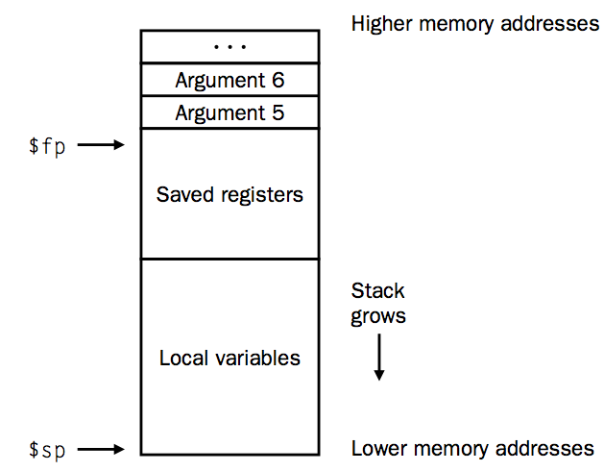
MIPS Stack frame
Frame pointer
In MIPS, Argument 1-4 are provided to the function in registers $a0-$a3
Return address in $ra
Stack pointer

Slide 46
#include <stdio.h>
main ()
{
int n = 10;
printf("The factorial of 10 is %d\n", fact(n));
}
int fact (int n)
{
if (n < 1)
return(1);
else
return(n * fact(n - 1));
}

Slide 47
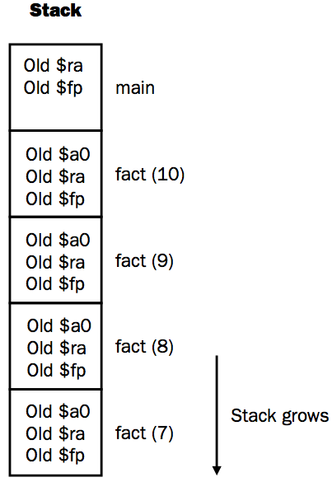
$a0(=10) saved in stack
return address in main

Slide 48
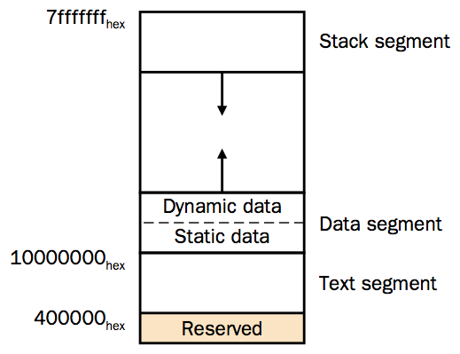
MIPS Run-time Memory

Slide 49

MIPS Stack frame

Slide 50
MIPS stack frame
4
$a0
$a1
4
16
$a2
4
$a3
4
$ra
$fp
(n*4)($fp)
for param n
$fp
$sp

Slide 51
Parameter Passing Conventions
Differences based on:
The parameter represents an r-value (the rhs of an expr)
An l-value
Or the text of the parameter itself
Call by Value
Each parameter is evaluated
Pass the r-value to the function
No side-effect on the parameter

Slide 52
Parameter Passing Conventions
Call by Reference
Also called call by address/location
If the parameter is a name or expr that is an l-value then pass the l-value
Else create a new temporary l-value and pass that
Typical example: passing array elements a[i]

Slide 53
Parameter Passing Conventions
Copy Restore Linkage
Pass only r-values to the called function (but keep the l-value around for those parameters that have it)
When control returns back, take the r-values and copy it into the l-values for the parameters that have it
Fortran
Call by Name
Function is treated like a macro (a #define) or in-line expansion
The parameters are literally re-written as passed arguments (keep caller variables distinct by renaming)

Slide 54
Parameter Passing Conventions
Lazy evaluation
In some languages, call-by-name is accomplished by sending a function (also called a thunk) instead of an r-value
When the r-value is needed the function is called with zero arguments to produce the r-value
This avoids the time-consuming evaluation of r-values which may or may not be used by the called function (especially when you consider short-circuit evaluation)
Used in lazy functional languages

Slide 55
Parameter Passing Conventions
Call-by-need
Similar to lazy evaluation, but more efficient
To avoid executing similar r-values multiple times, some languages used a memo slot to avoid repeated function evaluations
A function parameter is only evaluated when used inside the called function
When used multiple times there is no overhead due to the memo table
Haskell

