Slide 1
Lexical Analysis
LEX2: Regular Expressions
CMPT 379: Compilers
Instructor: Anoop Sarkar
anoopsarkar.github.io/compilers-class

Slide 2
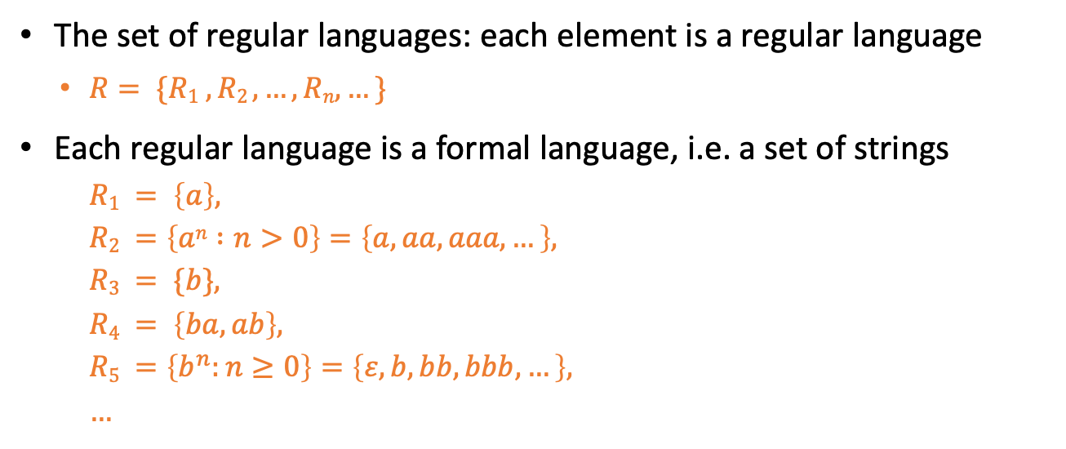
Regular Languages
The set of regular languages: each element is a regular language
$R= \{R1 , R2 , …, Rn,…\}$
Each regular language is a formal language, i.e. a set of strings
$$R1 = \left\{a\right\},$$
$$R2 =\left\{an :n>0\right\}=\left\{a, aa, aaa, …\right\},$$
$$R3 = \{b\},$$
$$R4 = \left\{ba, ab\right\},$$
$$R5 =\left\{b^{n}:n≥0\right\}=\left\{ε, b, bb, bbb, …\right\},$$
$$…$$

Slide 3
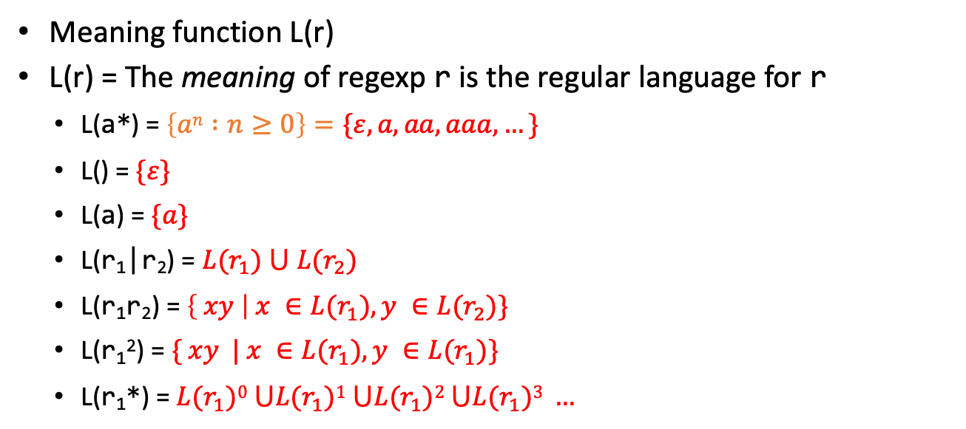
Regular Expressions and Regular Languages
Meaning function L(r)
L(r) = The meaning of regexp r is the regular language for r
L(a*) = $\left\{an :n≥0\right\}=\{ε, a, aa, aaa, …\}$
L() = $\{ε\}$
L(a) = $\{a\}$
L(r₁|r₂) = $L(r_{1}) ⋃ L(r_{2})$
L(r₁r₂) = $\left\{ xy \right| x ∈L(r_{1}), y ∈L(r_{2})\}$
L(r₁²) = $\{ xy | x ∈L(r_{1}), y ∈L(r_{1})\}$
L(r₁*) = $L(r_{1})0 ⋃L(r_{1})1 ⋃L(r_{1})2 ⋃L(r_{1})3 …$

Slide 4
Integer: a non-empty sequence of digits
digit =
(0|1|2|3|4|5|6|7|8|9)
{digit}{digit}*
{digit}+

Slide 5
Identifier: sequence of letters or digits, starting with a letter
digit =
[0-9]
letter =
[a-zA-Z]
{letter}({letter}|{digit})*

Slide 6
Whitespace: a non-empty sequence of blanks, newlines and tabs
(" "|"\t"|"\n")+

Slide 7
Pattern definition for numbers
digit = [0-9]
digits = [0-9]+
opt_frac = ("."{digits})?
opt_exp = ((e|E)(\+|\-)?{digits})?
num = {digits}{opt_frac}{opt_exp}
345, 345.04 , 2e-7, 2e7, 2e+7, 3.14e5

Slide 8
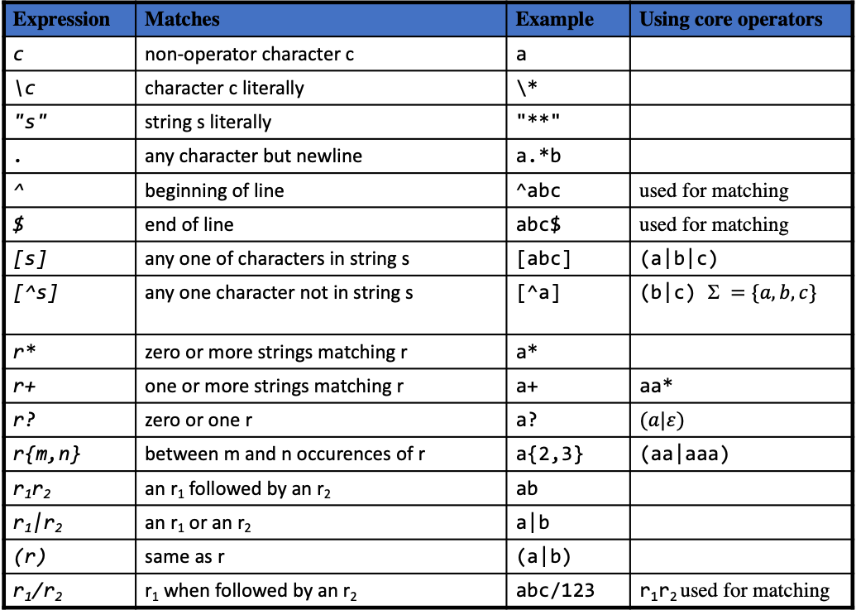
Lex regular expressions
Expression | Matches | Example | Using core operators
c | non-operator character c | a
\c | character c literally | \*
"s" | string s literally | "**"
. | any character but newline | a.*b
^ | beginning of line | ^abc | used for matching
$ | end of line | abc$ | used for matching
[s] | any one of characters in string s | [abc] | (a|b|c)
[^s] | any one character not in string s | [^a] | (b|c) $ =\{a,b,c\}$
r* | zero or more strings matching r | a*
r+ | one or more strings matching r | a+ | aa*
r? | zero or one r | a? | $$(a|ε)$$
r{m,n} | between m and n occurences of r | a{2,3} | (aa|aaa)
r₁r₂ | an r₁ followed by an r₂ | ab
r₁|r₂ | an r₁ or an r₂ | a|b
(r) | same as r | (a|b)
r₁/r₂ | r₁ when followed by an r₂ | abc/123 | r₁r₂ used for matching

Slide 9
Regular Expressions for Lexical Analysis

Slide 10
Regular Expressions for Lexical Analysis
Write a regexp pattern for each token:
R₁:T_INTCONSTANT = {digit}+
R₂:T_DOUBLE = “double“
R₃:T_IDENTIFIER = {letter}({letter}|{digit})+
and so on …
Construct an ordered list R containing all t regexps.
R = [R_{1,} R_{2,} R_{3, …,} R_{t}]
The order of regexps is important and provided as part of the lexer definition

Slide 11




Regular Expressions for Lexical Analysis
R₁:T_INTCONSTANT
R₂:T_DOUBLE
d
o
u
b
l
e
6
Max Munch: Longest match wins
R₃:T_IDENTIFIER
d
o
u
b
l
e
1
2
8
…
Start position
Next Start position
Input String:
d
o
u
b
l
e
1
2
=
…
$$x1$$
$$x2$$
$$x3$$
…
$$xn$$

Slide 12
Regular Expressions for Lexical Analysis
Break ties by choosing the regexp that is earlier in the list (higher priority) which is T_DOUBLE in this case.
R₁:T_INTCONSTANT
R₂:T_DOUBLE
d
o
u
b
l
e
6
R₃:T_IDENTIFIER
d
o
u
b
l
e
6
…
Start position
Next Start position
Input String:
d
o
u
b
l
e
=
…
$$x1$$
$$x2$$
$$x3$$
…
$$xn$$

Slide 13




Regular Expressions for Lexical Analysis
What if no regexp matches?
Create a new Error regexp that matches any input.
Put the Error regexp as the last in the list (the lowest priority).
So when it matches we know there was a lexical analysis error.
R₁:T_INTCONSTANT
R₂:T_DOUBLE
R₃:T_IDENTIFIER
…
Start position
Input String:
“
‘
\t
\v
…
$$x1$$
$$x2$$
$$x3$$
…
$$xn$$

Slide 14
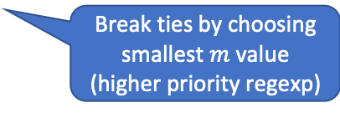

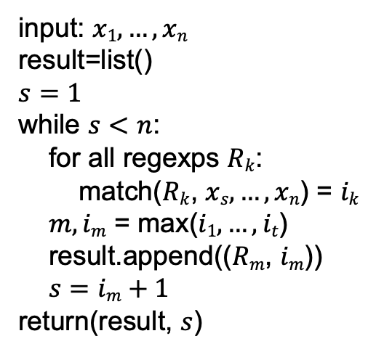



Regular Expressions for Lexical Analysis
input: $x1,…,xn$
result=list()
$$s=1$$
while $s<n$:
for all regexps $Rk$:
match($Rk$, $xs,…,xn$) = $ik$
$m,im$ = max($i1,…,it$)
result.append(($Rm$, $im$))
$s=im+1$
return(result, $s$)
Q: Provide the list of tokens for the input 1double1 (using the token definitions from slide 10)
R₁:T_INTCONSTANT
R₂:T_DOUBLE
R₃:T_IDENTIFIER
…
Break ties by choosing smallest $m$ value (higher priority regexp)
Input String:
$$x1$$
$$x2$$
$$x3$$
…
$$xn$$

Slide 15
Regexps in Lexical Analysis
Regular expressions are a concise notation for string patterns
Use in lexical analysis requires small extensions
Maximal munch to handle ambiguous matches
Break ties using priority ordering
Handle errors
A good algorithm for lexical analysis will:
Require only single pass over the input
Few operations per character (lookup table for matching a regexp)

