Slide 1
Introduction to Compilers
IN4: Stages of a Compiler
CMPT 379: Compilers
Instructor: Anoop Sarkar
anoopsarkar.github.io/compilers-class

Slide 2
Building a compiler
Programming languages have a lot in common
Do not write a compiler for each language
Create a general mathematical model for the structure of all languages
Implement a compiler using this model
Write a compiler for writing compilers!

Slide 3
Building a compiler
Each language compiler is built using a compiler-compiler:
yacc = yet another compiler compiler
bison = version of yacc from the GNU project (GNU is not Unix)
Code generation produces an intermediate assembly language
This intermediate language is shared across different computer architectures (x86, MIPS, ARM, etc.)
Code optimization ideas can also be shared across languages

Slide 4
Building a compiler
The cost of compiling and executing should be managed
No program that violates the definition of the language should escape
No program that is valid should be rejected

Slide 5
Building a compiler
Requirements for building a compiler:
Symbol-table management
Error detection and reporting
Stages of a compiler:
Analysis (front-end)
Synthesis (back-end)

Slide 6
Stages of a Compiler
Analysis (Front-end)
Lexical analysis
Syntax analysis (parsing)
Semantic analysis (type-checking)
Synthesis (Back-end)
Intermediate code generation
Code optimization
Code generation

Slide 7
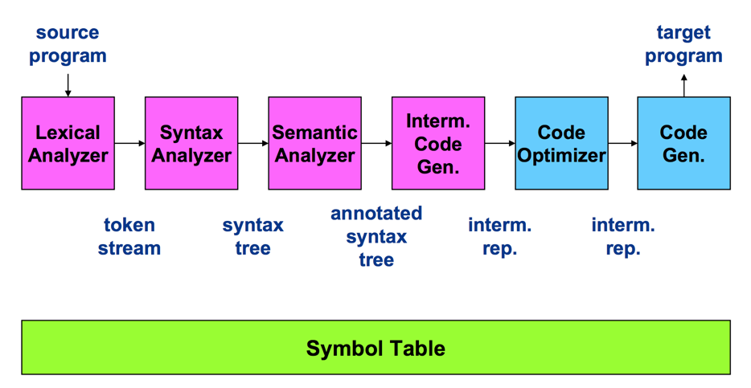
Stages of a Compiler

Slide 8
Compiler Front-end

Slide 9
Lexical Analysis
Q: What should be the token for a binary subtract operator: “-”?
Also called scanning, take input program string and convert into tokens
Example
T_DOUBLE
(“double”)
T_IDENT
(“f”)
T_OP
(“=”)
T_IDENT
(“sqrt”)
double f = sqrt(-1);
T_LPAREN
(“(”)
T_OP
(“-”)
T_INTCONSTANT
(“1”)
T_RPAREN
(“)”)
T_SEP
(“;”)

Slide 10
Syntax Analysis
Also called parsing
Describe the set of strings that are programs using a grammar
Structural validation
Create a parse tree or derivation

Slide 11
Parse tree for sqrt(-1)
Expression
FuncCall
T_IDENT
T_LPAREN
Expression
T_RPAREN
sqrt
(
)
UnaryExpression
Q: Draw a parse tree for sqrt(sqrt(256))
T_OP
Expression
-
T_INTCONSTANT
1

Slide 12
Abstract Syntax Tree
Notation is similar to function calls. e.g. Foo(a,b)
MethodCall (
sqrt,
UnaryExpr( UnaryMinus,
Number(1)
)
)
sqrt(-1)
Q: How many nodes in the abstract syntax tree compared to the (concrete) syntax tree in the previous slide?

Slide 13
Semantic analysis
“does it make sense”? Checking semantic rules,
Is there a main function?
Is variable declared?
Are operand types compatible? (coercion)
Do function arguments match function declarations?
Type checking
Static vs. run-time semantic checks
Array bounds, return values do not match definition

Slide 14
Compiler Back-end

Slide 15
Source -> abstract syntax tree
extern void print_int(int);
class C {
bool foo() { return(true); }
int main() {
if (foo()) {
print_int(1); }
}
}

Slide 16
Source -> abstract syntax tree
Program(
ExternFunction(print_int,VoidType,VarDef(IntType)),
Class( C,
None,
Method( foo,
BoolType,
None,
MethodBlock( None,
ReturnStmt(BoolExpr(True)))),
Method( main,
IntType,
None,
MethodBlock(
None,
IfStmt( MethodCall(foo,None),
Block( None,
MethodCall(print_int,Number(1))),
None)))))

Slide 17
Intermediate representation
; ModuleID = 'C'
declare void @print_int(i32)
define i1 @foo() {
entry:
ret i1 true
}
define i32 @main() {
entry:
br label %ifstart
ifstart: %calltmp = call i1 @foo()
br i1 %calltmp, label %iftrue, label %end
iftrue: call void @print_int(i32 1)
br label %end
end:
ret i32 0
}

Slide 18
Intermediate representation
declare void @print_int(i32)
define i32 @main() {
entry:
br label %ifstart
define i1 @foo() {
entry:
ret i1 true
}
ifstart: %calltmp = call i1 @foo()
br i1 %calltmp, label %iftrue, label %end
iftrue: call void @print_int(i32 1)
br label %end
end:
ret i32 0
}

Slide 19
Assembly language output from IR
.section __TEXT,__text,regular,pure_instructions
.globl _foo
.align 4, 0x90
@foo
.cfi_startproc
%entry
mov al, 1
ret
.cfi_endproc
.globl _main
.align 4, 0x90
x86 assembly
@main
.cfi_startproc
%entry
push rax
Ltmp0:
.cfi_def_cfa_offset 16
call _foo
test al, 1
je LBB1_2
%iftrue
mov edi, 1
call _print_int
%end
xor eax, eax
pop rdx
ret
.cfi_endproc

Slide 20
Code optimization
; ModuleID = 'C'
declare void @print_int(i32)
define i32 @main() {
entry:
br label %ifstart
ifstart:
call void @print_int(i32 1)
br label %end
end:
ret i32 0
}

Slide 21
Code Optimization
x86 assembly
.section __TEXT,__text,regular,pure_instructions
.macosx_version_min 10, 11
.globl _main
.p2align 4, 0x90
_main:
.cfi_startproc
## BB#0:
pushq %rax
Ltmp0:
.cfi_def_cfa_offset 16
movl $1, %edi
callq _print_int
xorl %eax, %eax
popq %rcx
retq
.cfi_endproc

Slide 22
Stages of a Compiler

Slide 23
Demo: compiler for the expr language

Slide 24
Wrap Up
Analysis/Synthesis
Translation from string to executable
Divide and conquer
Build one component at a time
Theoretical analysis will ensure we keep things simple and correct
Create a complex piece of software

