Slide 1
Top-down Parsing
TD2: LL(1) Parsing
CMPT 379: Compilers
Instructor: Anoop Sarkar
anoopsarkar.github.io/compilers-class

Slide 2
Parsing - Roadmap
Parser:
decision procedure: builds a parse tree
Top-down vs. bottom-up
LL(1) – Deterministic Parsing
recursive-descent
table-driven
LR(k) – Deterministic Parsing
LR(0), SLR(1), LR(1), LALR(1)
Parsing arbitrary CFGs – Polynomial time parsing

Slide 3
Top-Down vs. Bottom Up
Grammar:
S → A B
A → c | ε
B → cbB | ca
Input String: ccbca
Top-Down/leftmost |  | Bottom-Up/rightmost
S ⇒ AB ⇒ cB ⇒ ccbB ⇒ ccbca | S→AB A→c B→cbB B→ca | ccbca ⇐ Acbca ⇐ AcbB ⇐ AB ⇐ S | A→c B→ca B→cbB S→AB

Slide 4
Leftmost derivation for id + id * id
E → E + E
E → E * E
E → ( E )
E → - E
E → id
E ⇒ E + E
⇒ id + E
⇒ id + E * E
⇒ id + id * E
⇒ id + id * id
E ⇒*_{lm} id + E \* E

Slide 5
Predictive Top-Down Parser
Knows which production to choose based on single lookahead symbol
Need LL(1) grammars
First L: reads input Left to right
Second L: produce Leftmost derivation
1 : one symbol of lookahead
Cannot have left-recursion
Must be left-factored (no left-factors)
Not all grammars can be made LL(1)

Slide 6
LL(1) Parser
In recursive-descent
for each non-terminal and input token, many choices of production to use
Backtracking to remove bad choices
In LL(1)
for each non-terminal and each token, only one production
S →* 𝝎 A 𝜷 and next input token: t
A →𝜶 is the only production
𝝎 𝜶 𝜷

Slide 7
Left Factoring
Consider this grammar
E → T + E | T
T → id | id * T | ( E )
Hard to predict because
For T two productions start with id
For E it is not clear how to predict
The grammar must not have left-recursion
The grammar should be left-factored

Slide 8


Left Factoring
In general, for rules
Left factoring is achieved by the following grammar transformation:

Slide 9
Left Factoring
Recall the grammar
E → T + E | T
T → id | id * T | ( E )
Factor out common prefixes for productions
E → T X
X → + E | ε
T → id Y | ( E )
Y → * T | ε

Slide 10
Predictive Parsing Table
Can be specified via 2D tables
One dimension for current (leftmost) non-terminal to expand
One dimension for next token
Each table entry contains one production
Productions
1 | E → T X
2 | X → ε
3 | X → + E
4 | T → ( E )
5 | T → id Y
6 | Y → * T
7 | Y → ε
 | + | * | ( | ) | id | $
E |  |  | T X |  | T X
X | + E |  |  | ε |  | ε
T |  |  | ( E ) |  | id Y
Y | ε | * T |  | ε |  | ε

Slide 11
Predictive Parsing Table
Consider [E, id] entry
When current non-terminal is E and the next input is id, use production E → T X
Productions
1 | E → T X
2 | X → ε
3 | X → + E
4 | T → ( E )
5 | T → id Y
6 | Y → * T
7 | Y → ε
 | + | * | ( | ) | id | $
E |  |  | T X |  | T X
X | + E |  |  | ε |  | ε
T |  |  | ( E ) |  | id Y
Y | ε | * T |  | ε |  | ε

Slide 12
Predictive Parsing Table
Consider [Y, +] entry
When current non-terminal is Y and the next input is + , get rid of Y
Y can be followed by + only if Y → ε
Productions
1 | E → T X
2 | X → ε
3 | X → + E
4 | T → ( E )
5 | T → id Y
6 | Y → * T
7 | Y → ε
 | + | * | ( | ) | id | $
E |  |  | T X |  | T X
X | + E |  |  | ε |  | ε
T |  |  | ( E ) |  | id Y
Y | ε | * T |  | ε |  | ε

Slide 13
Predictive Parsing Table
Blank entries indicate error situations
Consider [E, *] entry
There is no way to derive a string starting with * from non-terminal E
Productions
1 | E → T X
2 | X → ε
3 | X → + E
4 | T → ( E )
5 | T → id Y
6 | Y → * T
7 | Y → ε
 | + | * | ( | ) | id | $
E |  |  | T X |  | T X
X | + E |  |  | ε |  | ε
T |  |  | ( E ) |  | id Y
Y | ε | * T |  | ε |  | ε

Slide 14
Predictive Parsing
Method similar to recursive descent, except
For each non-terminal S
We look at the next token a
And chose the production shown at entry [S,a]
We use a stack to keep track of pending non-terminals (frontier of parse tree)
We reject when we encounter an error state
We accept when we encounter end-of-input and empty stack

Slide 15
Table-Driven Parsing
Stack: to keep track
of pending non-terminals
in the derivation
(leaves in parse tree)
stack.push($); stack.push(S); a = input.read(); forever do begin X = stack.peek(); if X = a and a = $ then return SUCCESS; elsif X = a and a != $ then stack.pop(X); a = input.read(); elsif X != a and X ∈ N and M[X,a] not empty then stack.pop(X);
stack.push(M[X,a]); /* M[X, a] = Y₁…Y_{n} */ else ERROR! end
X⟶Y₁…Y_{n}

Slide 16
Trace “id*id”
 | + | * | ( | ) | id | $
E |  |  | T X |  | T X
X | + E |  |  | ε |  | ε
T |  |  | ( E ) |  | id Y
Y | ε | * T |  | ε |  | ε
Stack
Input
Action
E
E $
id*id$
T X
T X $
id*id$
id Y
T
X
id Y X $
id*id$
terminal
Y X $
*id$
* T
id
Y
ε
* T X $
*id$
terminal
T X $
id$
id Y
*
T
id Y X $
id$
terminal
Y X $
$
ε
id
Y
X $
$
ε
$
$
Accept!
ε

Slide 17
When to pick Y → ε?
Productions
1 | E → T X
2 | X → ε
3 | X → + E
4 | T → ( E )
5 | T → id Y
6 | Y → * T
7 | Y → ε
Choice between Y → * T and Y → ε
FIRST(*T) = { * }
For Y → ε we compute FOLLOW(Y)
FOLLOW(Y) = ?
FOLLOW(Y) = FOLLOW(T)
FOLLOW(T) = ( FIRST(X) – {ε} ) + FOLLOW(E)
FOLLOW(T) = { + , ) , $ }
FOLLOW(Y) = { + , ) , $ }

Slide 18
Predictive Parsing table
Given a grammar produce the predictive parsing table
We need to to know for all rules A → α | β the lookahead symbol
Based on the lookahead symbol the table can be used to pick which rule to push onto the stack
This can be done using two sets: FIRST and FOLLOW

Slide 19
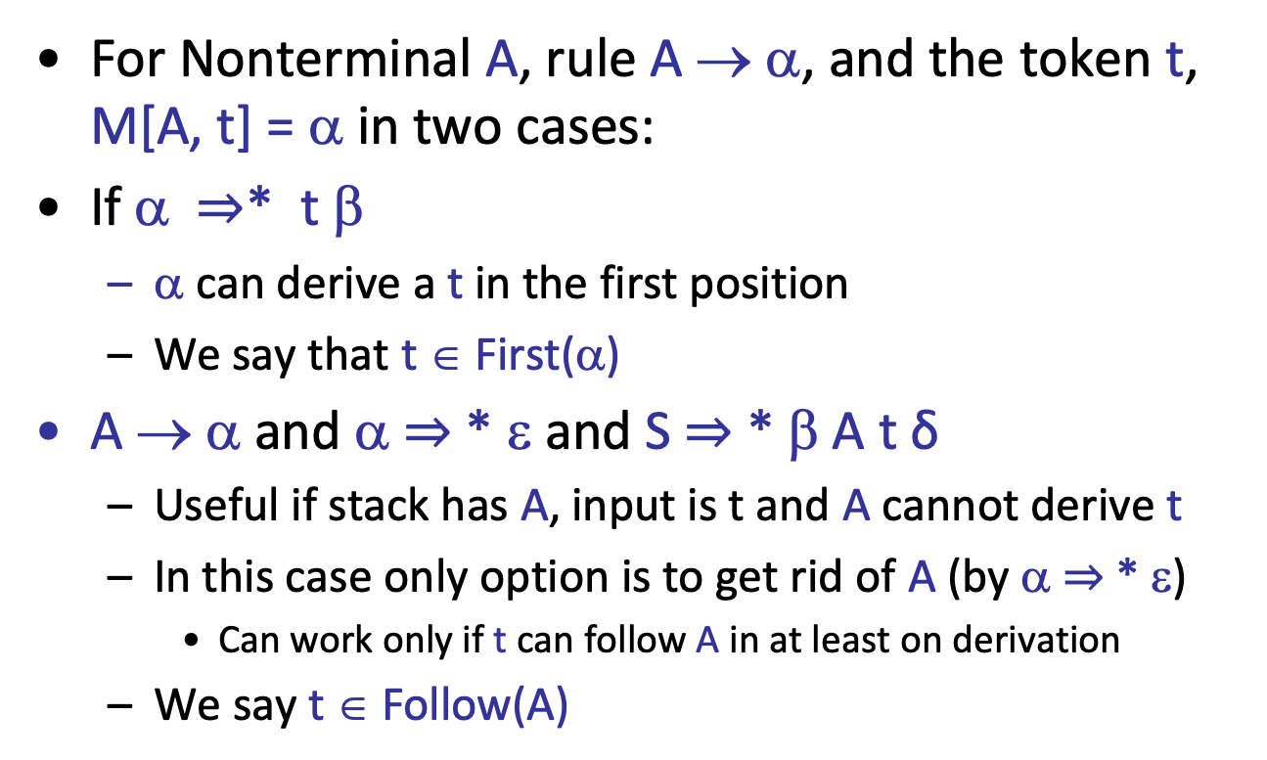
Predictive Parsing Table
For Nonterminal A, rule A → α, and the token t, M[A, t] = α in two cases:
If α $⇒$* t β
α can derive a t in the first position
We say that t ∈ First(α)
A → α and α $⇒$* ε and S $⇒$* β A t δ
Useful if stack has A, input is t and A cannot derive t
In this case only option is to get rid of A (by α $⇒$* ε)
Can work only if t can follow A in at least on derivation
We say t ∈ Follow(A)

Slide 20

FIRST and FOLLOW

Slide 21
Conditions for LL(1)
Necessary conditions:
no ambiguity
no left recursion
Left factored grammar
A grammar G is LL(1) if - whenever A → α | β
First(α) ∩ First(β) = ∅
α ⇒* ε implies !(β ⇒* ε)
α ⇒* ε implies First(β) ∩ Follow(A) = ∅

Slide 22
ComputeFirst(α: string of symbols)
// assume α = X₁ X₂ X₃ … X_{n} if X₁ ∈ T then First[α] := {X₁} else begin i:=1; First[α] := ComputeFirst(X₁)\{ε}; while X_{i} ⇒* ε do begin if i < n then First[α] := First[α] ∪ ComputeFirst(X_{i+1})\{ε}; else First[α] := First[α] ∪ {ε}; i := i + 1; end end
Recursion in computing FIRST
causes problems when faced with
recursive grammar rules

Slide 23
ComputeFirst; modified
foreach X ∈ T do First[X] := {X};
foreach p ∈ P : X → ε do First[X] := {ε};
repeat foreach X ∈ N, p : X → Y₁ Y₂ Y₃ … Y_{n} do begin i:=1; while Y_{i} ⇒* ε and i <= n do begin First[X] := First[X] ∪ First[Y_{i}]\{ε}; i := i+1; end
if i = n+1 then First[X] := First[X] ∪ {ε};
until no change in First[X] for any X;

Slide 24
ComputeFirst; modified
foreach X ∈ T do First[X] := X;
foreach p ∈ P : X → ε do First[X] := {ε};
repeat foreach X ∈ N, p : X → Y₁ Y₂ Y₃ … Y_{n} do begin i:=1; while Y_{i} ⇒* ε and i <= n do begin First[X] := First[X] ∪ First[Y_{i}]\{ε}; i := i+1; end
if i = n+1 then First[X] := First[X] ∪ {ε};
until no change in First[X] for any X;
Non-recursive FIRST computation
works with left-recursive grammars.
Computes a fixed point for FIRST[X]
for all non-terminals X in the grammar.
But this algorithm is very inefficient.

Slide 25
First Sets
Productions
1 | E → T X
2 | X → ε
3 | X → + E
4 | T → ( E )
5 | T → id Y
6 | Y → * T
7 | Y → ε
First(+) = {+}
First(*) = {*}
First( ‘(‘ ) = {‘(’}
First( ‘)’ ) = {‘)’}
First(id) = {id}
First(E) = ?
First(T) ⊆ First(E)
First(T) = {id, ‘(‘}
First(E) = {id, ‘(‘}
First(X) = {+, ε}
First(Y) = {*, ε}

Slide 26
Follow Sets
Algorithm sketch
Add $ to Follow(S)
For each production A ⟶ α X β
Add First(β) – {ε} to Follow(X)
For each A ⟶ α X β where ε ∈ First(β)
Add Follow(A) to Follow(X)
Repeat steps 2-3 until no follow set grows

Slide 27
ComputeFollow
Follow(S) := {$};
repeat
foreach p ∈ P do case p = A → αBβ begin Follow[B] := Follow[B] ∪ ComputeFirst(β)\{ε}; if ε ∈ First(β) then Follow[B] := Follow[B] ∪ Follow[A]; end
case p = A → αB Follow[B] := Follow[B] ∪ Follow[A];
until no change in any Follow[N]

Slide 28
Follow Sets. Example
Follow(E) = {$, )}
Follow(X) = {$, )}
Follow(T) = {+, $, )}
Follow(Y) = {+, $, )}
Follow(‘(‘) = {(, id}
Follow(‘)‘) = {+,$, )}
Follow(+) = {(, id}
Follow(*) = {(, id}
Follow(id) = {*,+,$,)}
Productions
1 | E → T X
2 | X → ε
3 | X → + E
4 | T → ( E )
5 | T → id Y
6 | Y → * T
7 | Y → ε
Follow(E)⊆ Follow(X)
Follow(X)⊆ Follow(E)
First(X)-{ε}⊆ Follow(T)
Follow(E)⊆ Follow(T)
Follow(Y)⊆ Follow(T)
Follow(T)⊆ Follow(Y)

Slide 29
Building the Parse Table
Compute First and Follow sets
For each production A → α
For each t ∈ First(α)
M[A,t] = α
If ε ∈ First(α), for each t ∈ Follow(A)
M[A,t] = α
If ε ∈ First(α) and $ ∈ Follow(α)
M[A,$] = α
All undefined entries are errors

Slide 30
Predictive Parsing Table
First(E) = {id, ‘(‘}
Follow(E) = {$, )}
First(X) = {+, ε}
Follow(X) = {$, )}
First(T) = {id, ‘(‘}
Follow(T) = {+, $, )}
First(Y) = {*, ε}
Follow(Y) = {+, $, )}
Productions
1 | E → T X
2 | X → ε
3 | X → + E
4 | T → ( E )
5 | T → id Y
6 | Y → * T
7 | Y → ε
 | + | * | ( | ) | id | $
E
X
T
Y
T X
T X
+ E
ε
ε
( E )
id Y
ε
* T
ε
ε

Slide 31
Example First/Follow
S → AB
A → c | ε
B → cbB | ca
Not an LL(1) grammar
First(A) = {c, ε}
Follow(A) = {c}
Follow(A) ∩
First(c) = {c}
First(B) = {c}
First(cbB) =
First(ca) = {c}
Follow(B) = {$}
First(S) = {c}
Follow(S) = {$}

Slide 32
Converting to LL(1)
S → AB
A → c | ε
B → cbB | ca
Note that grammar
is regular: c? (cb)* ca
c (c b c b … c b) c a
(c b c b … c b) c a
c c (b c b … c b c) a
c (b c b … c b c) a
S → cAa
A → cB | B
B → bcB | ε
same as:
c c? (bc)* a

Slide 33
Verifying LL(1) using F/F sets
S → cAa
A → cB | B
B → bcB | ε
First(A) = {b, c, ε}
Follow(A) = {a}
First(B) = {b, ε}
Follow(B) = {a}
First(S) = {c}
Follow(S) = {$}

Slide 34
Building the Parse Table
Compute First and Follow sets
For each production A → α
foreach a ∈ First(α) add A → α to M[A,a]
If ε ∈ First(α) add A → α to M[A,b] for each b in Follow(A)
If ε ∈ First(α) add A → α to M[A,$] if $ ∈ Follow(α)
All undefined entries are errors

Slide 35
Predictive Parsing Table
Productions
1 | T → F T’
2 | T’ → ε
3 | T’ → * F T’
4 | F → id
5 | F → ( T )
FIRST(T) = {id, (}
FIRST(T’) = {*, ε}
FIRST(F) = {id, (}
FOLLOW(T) = {$, )}
FOLLOW(T’) = {$,)}
FOLLOW(F) = {*,$,)}
 | * | ( | ) | id | $
T |  | T → F T’ |  | T → F T’
T’ | T’ → * F T’ |  | T’ → ε |  | T’ → ε
F |  | F → ( T ) |  | F → id

Slide 36
Revisit conditions for LL(1)
A grammar G is LL(1) iff - whenever A → α | β
First(α) ∩ First(β) = ∅
α ⇒* ε implies !(β ⇒* ε)
α ⇒* ε implies First(β) ∩ Follow(A) = ∅
No more than one entry per table field

Slide 37
Error Handling
Reporting & Recovery
Report as soon as possible
Suitable error messages
Resume after error
Avoid cascading errors
Phrase-level vs. Panic-mode recovery

Slide 38
Panic-Mode Recovery
Skip tokens until synchronizing set is seen
Follow(A)
garbage or missing things after
Higher-level start symbols
First(A)
garbage before
Epsilon
if nullable
Pop/Insert terminal
“auto-insert”
Add “synch” actions to table

Slide 39
Summary so far
LL(1) grammars, necessary conditions
No left recursion
Left-factored
Not all languages can be generated by LL(1) grammar
LL(1) – Parsing: O(n) time complexity
recursive-descent and table-driven predictive parsing
LL(1) grammars can be parsed by simple predictive recursive-descent parser
Alternative: table-driven top-down parser

Slide 40
Extra Slides

Slide 41
ComputeFirst on Left-recursive Grammars
ComputeFirst as defined earlier loops on left-recursive grammars
Here is an alternative algorithm for ComputeFirst
Compute non left-recursive cases of FIRST
Create a graph of recursive cases where FIRST of a non-terminal depends on another non-terminal
Compute Strongly Connected Components (SCC)
Compute FIRST starting from root of SCC to avoid cycles

Slide 42
ComputeFirst on Left-recursive Grammars
Each Strongly Connected Component can have recursion
But the connections between SCC means that (by defn) what we have now is a directed acyclic graph – hence without left recursion
Unlike top-down LL parsing, bottom-up LR parsing allows left-recursive grammars, so this algorithm is useful for LR parsing

Slide 43
ComputeFirst on Left-recursive Grammars
S → BD | D
D → d | Sd
A → CB | a
C → Bb | ε
B → Ab | b
Compute
Strongly
Connected
Components
FIRST₀[A] := {a}
FIRST₀[C] := {}
FIRST₀[B] := {b}
FIRST₀[S] := {b, d}
FIRST₀[D] := {d}
S
D
C
B
A
2 SCCs: e.g. consider B-A-C
FIRST[B] := FIRST₀[B] + ComputeFirst(A)
FIRST[A] := FIRST₀[A] + ComputeFirst(C )
FIRST[A] := FIRST[A] + FIRST₀[B]
FIRST[C] := FIRST₀[C] + FIRST₀[B]
FIRST[C] := FIRST[C] + {ε}

Slide 44
Examples
S → A B C
A→ a | ε
B→ b B | ε
C → c | ε
Is this LL(1)?
S → F
F→ A ( B ) | B A
A→ x | y
B → a B | b B | ε
Is this LL(1)?

Slide 45
Transition Diagram
c
A
a
S → cAa
S:
A → cB | B
c
B
A:
B
b
c
B
B → bcB | ε
B:
ε

