Slide 1
CMPT 379 Compilers
IN4: Stages of a Compiler
Anoop Sarkar
http://anoopsarkar.github.io/compilers-class/

Slide 2
Introduction to Compilers
IN4: Stages of a Compiler
CMPT 379: Compilers
Instructor: Anoop Sarkar
anoopsarkar.github.io/compilers-class

Slide 3
Building a compiler
Programming languages have a lot in common
Do not write a compiler for each language
Create a general mathematical model for the structure of all languages
Implement a compiler using this model

Slide 4
Building a compiler
Each language compiler is built using this general model (so-called compiler compilers)
yacc = yet another compiler compiler
Code optimization ideas can also be shared across languages

Slide 5
Demo: compiler for the expr language

Slide 6
Building a compiler
The cost of compiling and executing should be managed
No program that violates the definition of the language should escape
No program that is valid should be rejected

Slide 7
Building a compiler
Requirements for building a compiler:
Symbol-table management
Error detection and reporting
Stages of a compiler:
Analysis (front-end)
Synthesis (back-end)

Slide 8
Stages of a Compiler
Analysis (Front-end)
Lexical analysis
Syntax analysis (parsing)
Semantic analysis (type-checking)
Synthesis (Back-end)
Intermediate code generation
Code optimization
Code generation

Slide 9
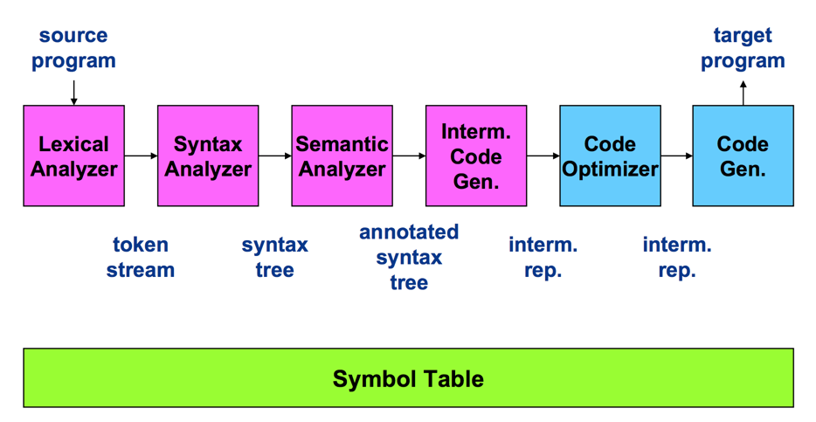
Stages of a Compiler

Slide 10
Compiler Front-end

Slide 11
Lexical Analysis
Also called scanning, take input program string and convert into tokens
Example:
T_DOUBLE (“double”) T_IDENT (“f”) T_OP (“=“) T_IDENT (“sqrt”) T_LPAREN (“(“)
T_OP (“-”) T_INTCONSTANT (“1”) T_RPAREN (“)”) T_SEP (“;”)
double f = sqrt(-1);

Slide 12
Syntax Analysis
Also called parsing
Describe the set of strings that are programs using a grammar
Structural validation
Create a parse tree or derivation

Slide 13
Parse tree for sqrt(-1)
Expression
FuncCall
T_IDENT
T_LPAREN
Expression
T_RPAREN
sqrt
(
)
UnaryExpression
T_OP
Expression
-
T_INTCONSTANT
1

Slide 14
Abstract Syntax Tree
sqrt(-1):=
MethodCall (
sqrt,
UnaryExpr( UnaryMinus,
Number(1)
)
)

Slide 15
Semantic analysis
“does it make sense”? Checking semantic rules,
Is there a main function?
Is variable declared?
Are operand types compatible? (coercion)
Do function arguments match function declarations?
Type checking
Static vs. run-time semantic checks
Array bounds, return values do not match definition

Slide 16
Compiler Back-end

Slide 17
Source -> abstract syntax tree
extern void print_int(int);
class C {
bool foo() { return(true); }
int main() {
if (foo()) {
print_int(1); }
}
}

Slide 18
Source -> abstract syntax tree
Program(
ExternFunction(print_int,VoidType,VarDef(IntType)),
Class( C,
None,
Method(foo,
BoolType,
None,
MethodBlock( None,
ReturnStmt(BoolExpr(True)))),
Method( main,
IntType,
None,
MethodBlock( None,
IfStmt(MethodCall(foo,None),
Block(None,
MethodCall(print_int,Number(1))),
None)))))

Slide 19
Intermediate representation
; ModuleID = 'C'
declare void @print_int(i32)
define i1 @foo() {
entry:
ret i1 true
}
define i32 @main() {
entry:
br label %ifstart
ifstart: %calltmp = call i1 @foo()
br i1 %calltmp, label %iftrue, label %end
iftrue: call void @print_int(i32 1)
br label %end
end:
ret i32 0
}
Translation from IR to machine specific assembly

Slide 20
Intermediate representation
declare void @print_int(i32)
define i32 @main() {
entry:
br label %ifstart
define i1 @foo() {
entry:
ret i1 true
}
ifstart: %calltmp = call i1 @foo()
br i1 %calltmp, label %iftrue, label %end
iftrue: call void @print_int(i32 1)
br label %end
end:
ret i32 0
}

Slide 21
Assembly language output from IR
x86 assembly
.section __TEXT,__text,regular,pure_instructions
.globl _foo
.align 4, 0x90
@foo
.cfi_startproc
%entry
mov al, 1
ret
.cfi_endproc
.globl _main
.align 4, 0x90
@main
.cfi_startproc
%entry
push rax
Ltmp0:
.cfi_def_cfa_offset 16
call _foo
test al, 1
je LBB1_2
%iftrue
mov edi, 1
call _print_int
%end
xor eax, eax
pop rdx
ret
.cfi_endproc

Slide 22
Code optimization
; ModuleID = 'C'
declare void @print_int(i32)
define i32 @main() {
entry:
br label %ifstart
ifstart:
call void @print_int(i32 1)
br label %end
end:
ret i32 0
}

Slide 23
Code Optimization
x86 assembly
.section __TEXT,__text,regular,pure_instructions
.macosx_version_min 10, 11
.globl _main
.p2align 4, 0x90
_main:
.cfi_startproc
## BB#0:
pushq %rax
Ltmp0:
.cfi_def_cfa_offset 16
movl $1, %edi
callq _print_int
xorl %eax, %eax
popq %rcx
retq
.cfi_endproc

Slide 24
Stages of a Compiler

Slide 25
Wrap Up
Analysis/Synthesis
Translation from string to executable
Divide and conquer
Build one component at a time
Theoretical analysis will ensure we keep things simple and correct
Create a complex piece of software

