Slide 1
Lexical Analysis
LEX6: NFA to DFA
CMPT 379: Compilers
Instructor: Anoop Sarkar
anoopsarkar.github.io/compilers-class

Slide 2
Building a Lexical Analyzer
Token ⇒ Pattern
Pattern ⇒ Regular Expression
Regular Expression ⇒ NFA
NFA ⇒ DFA
DFA ⇒ Table-driven implementation of DFA

Slide 3
ε-closure
ε-closure(3) =
{3,4,6}
ε-closure(s)= all states reached by following only ε-transitions
ε-closure(7) =
{7,8,9,3,4,6}
ε
ε
4
0
ε
4
5
2
ε
3
8
ε
9
0
0
3
8
9
10
11
ε
1
6
7
ε
5
7
1
ε
ε
ε
ε
0
ε
12
13
14
((0|1)*00)|0

Slide 4
ε-Closure (T: set of states)
push all states in T onto stack initialize ε-closure(T) to T while stack is not empty do begin pop t off stack for each state u with u ∈ move(t, ε) do if u ∉ ε-closure(T) do begin add u to ε-closure(T) push u onto stack end end

Slide 5
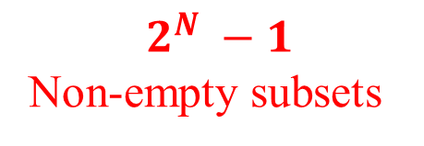
Simulating NFAs
An NFA may be in many states at any time
How many different states?
1
state
input
0
0
{A}
100
A
B
C
{A}
100
0
{A,B}
100
s
{A,B,C}
100
|S|=N No. of states
$$2^{N} −1$$
Non-empty subsets
|s|
possible states in each step
≤ N

Slide 6

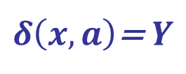

NFA to DFA Conversion
NFA
DFA
states
start
final
transition
S
X $⊆$ S
q₀
ε-closure(q₀)
F $⊆$ S
$δ\left(x,a\right)$= $Y$
q₀
ε
ε

Slide 7
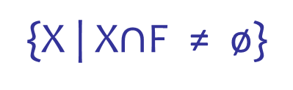
NFA to DFA Conversion
NFA
DFA
states
start
final
transition
S
X $⊆$ S
q₀
ε-closure(q₀)
F $⊆$ S
{X | X$∩$F ≠ ø}
$δ\left(x,a\right)$= $Y$
state
input
{A}
100
1
{A}
100
0
0
A
B
C
{A,B}
100
0
{A,B,C}
100

Slide 8
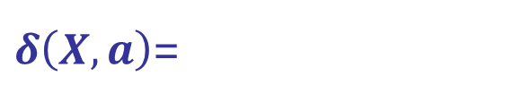
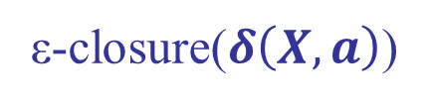
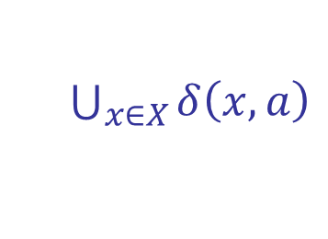

NFA to DFA Conversion
NFA
DFA
states
start
final
transition
S
X $⊆$ S
q₀
ε-closure(q₀)
F $⊆$ S
{X | X$∩$F ≠ ø}
$δ\left(X,a\right)$=
$δ\left(x,a\right)$= $Y$
$\bigcup_{x∈X}{δ\left(x,a\right)}$
X
a
ε-closure($δ\left(X,a\right)$)
a
ε
DFAedge(X,a)=$\text{ε}\text{−}\text{closure}\text{(}\bigcup_{x∈X}{δ\left(x,a\right)})$
a

Slide 9
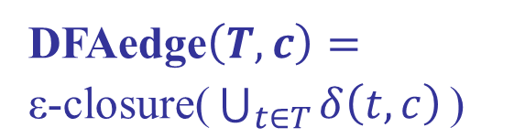
DFA construction
Dstates = {}, Dtrans = []
add ε-closure(q₀) to Dstates unmarked while ∃ unmarked T ∈ Dstates do mark T; for each symbol c do U := DFAedge(T,c); if U ∉ Dstates then add U to Dstates unmarked Dtrans[T, c] := U;
DFAedge$\left(T,c\right)=\text{ε}\text{−}\text{closure}\text{(}\bigcup_{t∈T}{δ\left(t,c\right)}\text{)}$

Slide 10
NFA to DFA
ε
0
ε
ε
4
5
ε
ε
0
0
2
3
8
9
10
11
ε
1
6
7
1
ε
ε
ε
ε
ε
ε
0
12
13
14

Slide 11
ε-closure(q₀)
[1, 2, 3, 4, 6, 9, 12]
ε
0
ε
ε
4
5
ε
ε
0
0
2
3
8
9
10
11
ε
1
6
7
1
ε
ε
ε
ε
ε
ε
0
12
13
14

Slide 12
DFAedge(ε-closure(q₀), 0)
[1, 2, 3, 4, 6, 9, 12]
ε
0
ε
ε
4
5
ε
ε
0
0
2
3
8
9
10
11
ε
1
6
7
1
ε
ε
ε
ε
ε
ε
0
12
13
14

Slide 13
DFAedge(ε-closure(q₀), 0)
[1, 2, 3, 4, 6, 9, 12]
[3,4,5,6,
8,9,10,
13,14]
0
ε
0
ε
ε
4
5
ε
ε
0
0
2
3
8
9
10
11
ε
1
6
7
1
ε
ε
ε
ε
ε
ε
0
12
13
14

Slide 14
[1, 2, 3, 4, 6, 9, 12]
[3,4,5,6,
8,9,10,
13,14]
DFAedge(ε-closure(q₀), 1)
0
1
[3,4,6,
7,8,9]
ε
0
ε
ε
4
5
ε
ε
0
0
2
3
8
9
10
11
ε
1
6
7
1
ε
ε
ε
ε
ε
ε
0
12
13
14

Slide 15
DFAedge([3,4,5,6…,14], 0)
[1, 2, 3, 4, 6, 9, 12]
[3,4,5,6,
8,9,10,
13,14]
[3,4,5,6,
8,9,11,10
14]
0
0
1
[3,4,6,
7,8,9]
ε
0
ε
ε
4
5
ε
ε
0
0
2
3
8
9
10
11
ε
1
6
7
1
ε
ε
ε
ε
ε
ε
0
12
13
14

Slide 16
DFA for ((0|1)*00)|0
[3, 4, 5, 6, 8, 9, 10, 13, 14]
0
0
0
[3, 4, 5, 6, 8, 9, 10, 11, 14]
[1, 2, 3, 4, 6, 9, 12]
1
1
0
0
1
[3, 4, 6, 7, 8, 9]
[3, 4, 5, 6, 8, 9, 10]
1
1

Slide 17
Minimization of DFAs
0
0
[3, 4, 5, 6, 8, 9, 10, 11, 14]
[1, 2, 3, 4, 6, 9, 12]
1
0
0
1
[3, 4, 6, 7, 8, 9]
[3, 4, 5, 6, 8, 9, 10]
1
1

Slide 18
Minimization of DFAs
1
0
1
0
0
[3, 4, 5, 6, 8, 9, 10, 11, 14]
0
1
1
0
0
[3, 4, 6, 7, 8, 9]
[3, 4, 5, 6, 8, 9, 10]
1
1

Slide 20
NFA to DFA Conversion
Conversion method closely follows the NFA simulation algorithm
Instead of simulating, we can collect those NFA states that behave identically on the same input
Group this set of states to form one state in the DFA

Slide 21
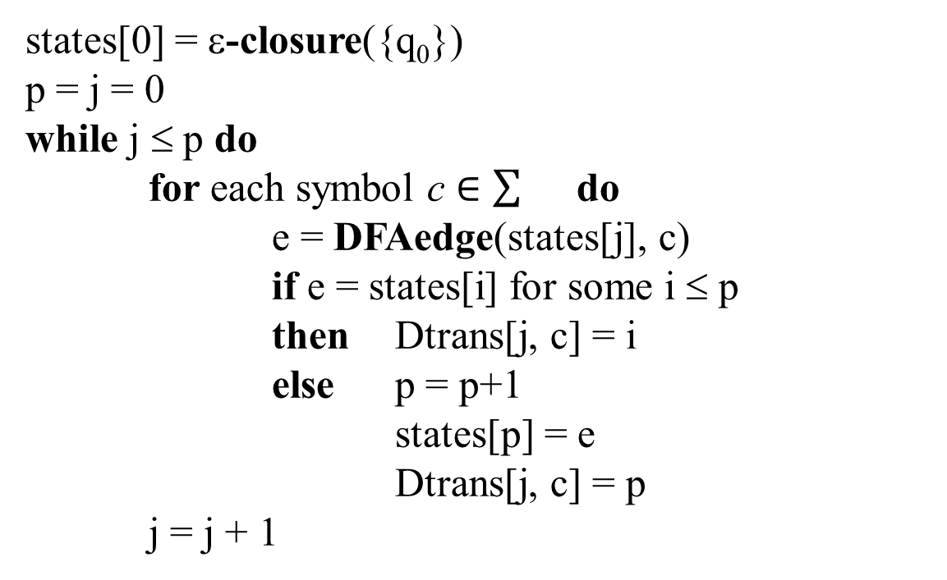
NFA to DFA
states[0] = ε-closure({q₀})
p = j = 0
while j ≤ p do
for each symbol c $∈\sum{}$ do
e = DFAedge(states[j], c)
if e = states[i] for some i ≤ p
then Dtrans[j, c] = i
else p = p+1
states[p] = e
Dtrans[j, c] = p
j = j + 1

