Slide 1
Syntax Directed Translation for LR Parsers
LR6: Syntax Directed Translation for LR Parsers
CMPT 379: Compilers
Instructor: Anoop Sarkar
anoopsarkar.github.io/compilers-class

Slide 2
Syntax directed Translation
Models for translation from parse trees into intermediate code
Representation of translations
Attribute Grammars (semantic actions for CFGs)
Tree Matching Code Generators
Tree Parsing Code Generators

Slide 3
Attribute Grammars
Syntax-directed translation uses a grammar to produce code (or any other “semantics”)
We are generalizing context-free grammars
Each grammar symbol is associated with an attribute
An attribute can be anything: a string, a number, a tree, any kind of record or object

Slide 4
Attribute Grammars
A CFG can be viewed as a function that relates strings to derivations (aka parse trees)
Similarly, an attribute grammar is a way of relating strings with attributes (or “meanings”)
Attribute grammars are a method to decorate or annotate the parse tree with the desired output attributes

Slide 5
Expr concrete syntax tree
E → T + E
E → T
T → c
T → c * T
T → ( E )
Input: 4+3*5
E
T
E
+
c
T
c.lexval=4
c
*
T
c.lexval=3
c
c.lexval=5

Slide 6
Expr concrete syntax tree
E → T + E
E → T
T → c
T → c * T
T → ( E )
Input: 4+3*5
E
T.val=4
T
E
+
c
T
c.lexval=4
c
*
T
T.val=5
c.lexval=3
c
c.lexval=5

Slide 7
Expr concrete syntax tree
E → T + E
E → T
T → c
T → c * T
T → ( E )
Input: 4+3*5
E
T.val=4
T
E
+
c
T
T.val=15
c.lexval=4
c
*
T
T.val=5
c.lexval=3
c
c.lexval=5

Slide 8
Expr concrete syntax tree
E → T + E
E → T
T → c
T → c * T
T → ( E )
Input: 4+3*5
E
T.val=4
T
E
E.val=15
+
c
T
T.val=15
c.lexval=4
c
*
T
T.val=5
c.lexval=3
c
c.lexval=5

Slide 9
Expr concrete syntax tree
E → T + E
E → T
T → c
T → c * T
T → ( E )
Input: 4+3*5
E.val=19
E
T.val=4
T
E
E.val=15
+
c
T
T.val=15
c.lexval=4
c
*
T
T.val=5
c.lexval=3
c
c.lexval=5

Slide 10
Syntax directed definition
T → c
{ $$.val = $1.lexval; }
T → c * T
{ $$.val = $1.lexval * $3.val ; }
E → T
{ $$.val = $1.val; }
E → T + E
{ $$.val = $1.val + $3.val; }
T → ( E )
{ $$.val = $2.val; }

Slide 11
Flow of Attributes in Expr
Consider the flow of the attributes in the E syntax-directed defn
The lhs attribute is computed using the rhs attributes
Purely bottom-up:
compute attribute values of all children (rhs) in the parse tree
And then use them to compute the attribute value of the parent (lhs)

Slide 12
Synthesized Attributes
Synthesized attributes are attributes that are computed purely bottom-up
A grammar with semantic actions (or syntax-directed definition) can choose to use only synthesized attributes
Such a grammar plus semantic actions is called an S-attributed definition

Slide 13
Inherited Attributes
Synthesized attributes may not be sufficient for all cases that might arise for semantic checking and code generation
Consider the (sub)grammar:
Var-decl → Type IdList ;
Type → int | bool
IdList → ID
IdList → ID , IdList

Slide 14
Example input: int x, y, z ;
Var-decl → Type IdList
Type → int | bool
IdList → ID
IdList → ID , IdList
Var-decl
Type
IdList
;
int
ID
,
IdList
x
ID
,
IdList
y
ID
z

Slide 15
Example input: int x, y, z ;
Var-decl
Type
Type.val=int
IdList
IdList.val=int
;
int
ID
,
IdList
x
ID
,
IdList
y
ID
z

Slide 16
Example input: int x, y, z ;
Var-decl
Type
Type.val=int
IdList
IdList.val=int
;
int
ID
,
IdList
IdList.val=int
x
ID.val=int
ID
,
IdList
y
ID
z

Slide 17
Example input: int x, y, z ;
Var-decl
Type
Type.val=int
IdList
IdList.val=int
;
int
ID
,
IdList
IdList.val=int
x
ID.val=int
ID
,
IdList
IdList.val=int
y
ID
ID.val=int
z

Slide 18
Example input: int x, y, z ;
Var-decl
Type
Type.val=int
IdList
IdList.val=int
;
int
ID
,
IdList
IdList.val=int
x
ID.val=int
ID
,
IdList
IdList.val=int
y
ID
ID.val=int
z
ID.val=int

Slide 19
Flow of Attributes in Var-decl
How do the attributes flow in the Var-decl grammar?
ID takes its attribute value from its parent node
IdList takes its attribute from its left sibling Type
or IdList takes its attribute from its parent IdList

Slide 20
Syntax-directed definition
Var-decl → Type IdList ;
{$2.in = $1.val; }
Type → int
{ $$.val = int; }
| bool
{ $$.val = bool; }
IdList → ID
{ $1.val = $0.in; }
IdList → ID , IdList
{ $1.val = $0.in; $3.in = $0.in; }
Top-down (inheriting from the left-hand side) uses $0
Bottom-up (sending a value to the left-hand-side) uses $$

Slide 21
Inherited Attributes
Inherited attributes are attributes that are computed at a node based on attributes from siblings or the parent
Typically we combine synthesized attributes and inherited attributes
Q: It is possible to convert the grammar into a form that only uses synthesized attributes?
Var-decl → Type-list ID ;
Type-list → Type-list ID ,
Type-list → Type
Type → int | bool
int x, y, z ;

Slide 22
Removing Inherited Attributes
Var-decl → Type-list ID ;
Type-list → Type-list ID ,
Type-list → Type
Type → int | bool
Var-decl.val=int
Var-decl
Type-list.val=int
Type-list
ID
;
Type-list.val=int
Type-list
ID
,
Type-list.val=int
Type-list
ID
,
Type
int x, y, z ;
int

Slide 23
Removing inherited attributes
Var-decl → Type-List ID ;
{ $$.val = $1.val; }
Type-list → Type-list ID ,
{ $$.val = $1.val; }
Type-list → Type
{ $$.val = $1.val; }
Type → int
{ $$.val = int; }
| bool
{ $$.val = bool; }

Slide 24
Direction of inherited attributes
Consider the syntax directed defns:
A → L M
{ $1.in = $0.in; $2.in = $1.val; $$.val = $2.val; }
A → Q R
{ $2.in = $0.in; $1.in = $2.val; $$.val = $1.val; }
Problematic definition: $1.in = $2.val
Incompatible with incremental processing (left to right parsing)

Slide 25
L-attributed Definitions
A syntax-directed definition is L-attributed if for each production A → X₁..X_{j-1}X_{j}..X_{n} , for each j=1 …n, each inherited attribute of X_{j} depends on:
The attributes of X₁...X_{j-1}
The inherited attributes of A
These two conditions ensure left to right and depth first parse tree construction
Every S-attributed definition is L-attributed
Notes:
The attributes of an L-attributed definition can always be evaluated in depth-first order.

Slide 26
LR parsing and attribute grammars
LR parsing is inherently left to right
Attributes can be stored on the stack used by shift-reduce parsing
For synthesized attributes: when a reduce action is invoked, store the value on the stack based on value popped from stack
For inherited attributes: transmit the attribute value when executing the goto function

Slide 27
Example: Synthesized Attributes
T → F { $$.val = $1.val; }
T → T * F
{ $$.val = $1.val * $3.val; }
F → id
{ val := id.lookup();
if (val) { $$.val = $1.val; }
else { error; }
}
F → ( T ) { $$.val = $2.val; }

Slide 28
Productions
1 | T → F
2 | T → T*F
3 | F → id
4 | F → (T)
Reduce 1
F
F
1: T → F •
$ Accept
Reduce 2
2: S’ → T • T → T • * F
4: T → T * F •
T
0: S’ → • T T → • F T → • T * F F → • id F → • ( T )
F
Reduce 3
id
*
8: F → id •
3: T → T * • F F → • id F → • ( T )
id
id
(
5: F → ( • T ) T → • F T → • T * F F → • id F → • ( T )
7: F → ( T ) •
)
*
(
Reduce 4
T
6: F → ( T • ) T → T • * F
(

Slide 29
Trace “(id_{val=3})*id_{val=2}”
Stack | Input | Action | Attribute Stack
0 0 5 0 5 8 0 5 1 0 5 6 0 5 6 7 | ( id ) * id $ id ) * id $ ) * id $ ) * id $ ) * id $ * id $ | Shift 5 Shift 8 Reduce 3 F→id, pop 8, goto [5,F]=1 Reduce 1 T→ F, pop 1, goto [5,T]=6 Shift 7 Reduce 4 F→ (T), pop 7 6 5, goto [0,F]=1 | a.Push(id.val==3); { $$.val = $1.val } a.Push(a.Pop==3); { $$.val = $1.val } a.Push(a.Pop==3); { $$.val = $2.val } 3 pops; a.Push(3)

Slide 30
Trace “(id_{val=3})*id_{val=2}”
Stack | Input | Action | Attribute Stack
0 1 0 2 0 2 3 0 2 3 8 0 2 3 4 0 2 | * id $ * id $ id $ $ $ $ | Reduce 1 T→F, pop 1, goto [0,T]=2 Shift 3 Shift 8 Reduce 3 F→id, pop 8, goto [3,F]=4 Reduce 2 T→T * F pop 4 3 2, goto [0,T]=2 Accept | { $$.val = $1.val } a.Push(a.Pop==3) a.Push(*) a.Push(id.val==2) a.Push(a.Pop==2) { $$.val = $1.val * $3.val; } 3 pops; a.Push(3*2==6) return(6)

Slide 31
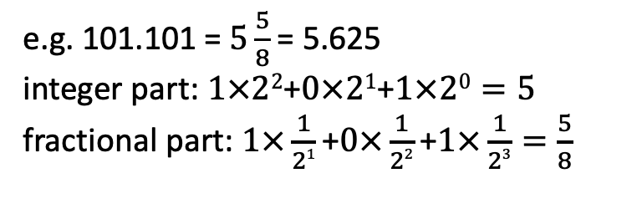
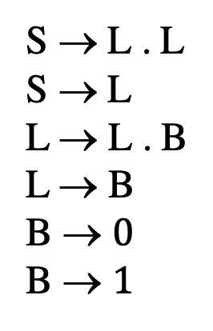
Practice question
S → L . L
S → L
L → L . B
L → B
B → $0$
B → $1$
This grammar generates binary floating-point numbers, e.g. 101.101
Q: Write down an attribute grammar (syntax directed translation) that converts the input binary into decimal.
e.g. 101.101 = $5\frac{5}{8}$= 5.625
integer part: $1×22\text{+}0×21\text{+}1×20=5$
fractional part: $1×\frac{1}{21}\text{+}0×\frac{1}{22}\text{+}1×\frac{1}{23}=\frac{5}{8}$

Slide 32
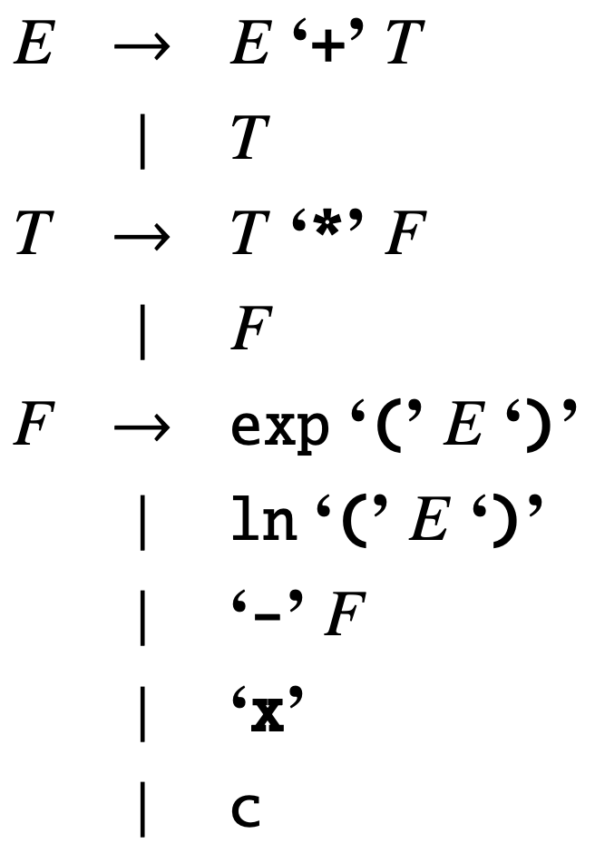
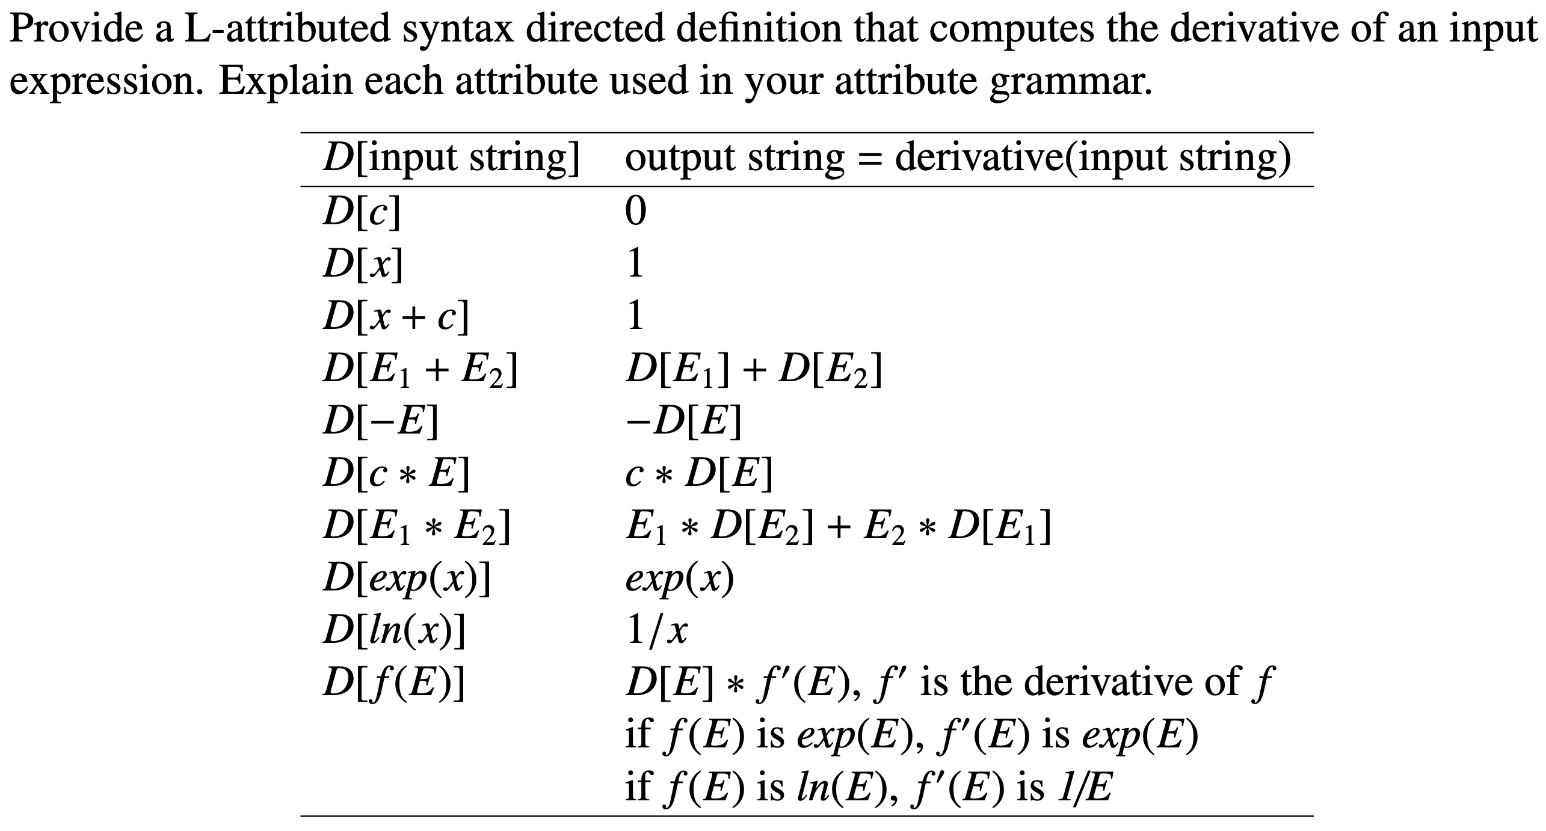
Practice question
c stands for any integer constant

Slide 33
Extra Slides

Slide 34
Example: Inherited Attributes
E → T R
{ $2.in = $1.val; $$.val = $2.val; }
R → + T R
{ $3.in = $0.in + $2.val; $$.val = $3.val; }
R → ε { $$.val = $0.in; }
T → ( E ) { $$.val = $1.val; }
T → id { $$.val = id.lookup; }

Slide 35
Productions
1 | E → T R
2 | R → + T R
3 | R → ε
4 | T → (E)
5 | T → id
Reduce 3
Reduce 1
1: E → T • R R → • + T R R → ε •
R
2: E → T R •
+
T
4: R → + • T R T → • ( E ) T → • id
T
(
3: T → ( • E ) E → • T R
T → • ( E )
T → • id
(
(
0: S’ → • E E → • T R T → • ( E ) T → • id
+
T
id
id
id
5: R → + T • R R → • + T R R → ε •
7: T → id •
E
Reduce 5
8: S’ → E •
Reduce 3
6: R → + T R •
Reduce 0
R
Reduce 2

Slide 36
Productions
1 | E → T R
2 | R → + T R
3 | R → ε
4 | T → (E)
5 | T → id
Reduce 3
Reduce 1
1: E → T • R R → • + T R R → ε •
R
2: E → T R •
+
T
4: R → + • T R T → • ( E ) T → • id
T
(
3: T → ( • E ) E → • T R
T → • ( E )
T → • id
(
(
0: S’ → • E E → • T R T → • ( E ) T → • id
)
+
10
T
9
E
R4
id
id
id
5: R → + T • R R → • + T R R → ε •
7: T → id •
E
Reduce 5
8: S’ → E •
Reduce 3
6: R → + T R •
Reduce 0
R
Reduce 2

Slide 37
Trace “id_{val=3}+id_{val=2}”
Productions
1 | E → T R { $2.in = $1.val; $$.val = $2.val; }
2 | R → + T R { $3.in = $0.in + $2.val; $$.val = $3.val; }
3 | R → ε { $$.val = $0.in; }
4 | T → (E) { $$.val = $1.val; }
5 | T → id { $$.val = id.lookup; }
Stack | Input | Action | Attributes
0 0 7 0 1 0 1 4 0 1 4 7 0 1 4 5 | id + id $ + id $ + id $ id $ $ $ | Shift 7 Reduce 5 T→id pop 7, goto [0,T]=1 Shift 4 Shift 7 Reduce 5 T→id pop 7, goto [4,T]=5 Reduce 3 R→ ε goto [5,R]=6 | { $$.val = id.lookup } { pop; attr.Push(3) $2.in = $1.val $2.in := (1).attr } ______________________________________________ { $$.val = id.lookup } { pop; attr.Push(2); } ______________________________________________ { $3.in = $0.in+$1.val (5).attr := (1).attr+2 $$.val = $0.in $$.val = (5).attr = 5 }

Slide 38
Trace “id_{val=3}+id_{val=2}”
Stack | Input | Action | Attributes
0 0 7 0 1 0 1 4 0 1 4 7 0 1 4 5 | id + id $ + id $ + id $ id $ $ $ | Shift 7 Reduce 5 T→id pop 7, goto [0,T]=1 Shift 4 Shift 7 Reduce 5 T→id pop 7, goto [4,T]=5 Reduce 3 R→ ε goto [5,R]=6 | { $$.val = id.lookup } { pop; attr.Push(3) $2.in = $1.val $2.in := (1).attr } ______________________________________________ { $$.val = id.lookup } { pop; attr.Push(2); } ______________________________________________ { $3.in = $0.in+$1.val (5).attr := (1).attr+2 $$.val = $0.in $$.val = (5).attr = 5 }

Slide 39
Trace “id_{val=3}+id_{val=2}”
Stack | Input | Action | Attributes
0 1 4 5 6 0 1 2 0 8 | $ $ $ | Reduce 2 R→ + T R Pop 4 5 6, goto [1,R]=2 Reduce 1 E→ T R Pop 1 2, goto [0,E]=8 Accept | { $$.val = $3.val pop; attr.Push(5); } _____________________________________________ { $$.val = $3.val pop; attr.Push(5); } _____________________________________________ { $$.val = 5 attr.top = 5; }

Slide 40
LR parsing with inherited attributes
A → c { $$.val = $0.in }
Bottom-Up/rightmost
Consider:
S→AB
{ $1.in = ‘x’;
$2.in = $1.val }
B→cbB
{ $$.val = $0.in + ‘y’; }
ccbca ⇐ Acbca
⇐ AcbB
⇐ AB
⇐ S
A→c
B→ca
B→cbB
S→AB
line 3
Parse stack at line 3:
[‘x’] A [‘x’] c b B
Parse stack at line 4:
[‘x’] A B
$1.in = ‘x’
$2.in = $1.val
[‘xy’]

