Slide 1
Static Single Assignment Form
SSA Form 2
CMPT 379: Compilers
Instructor: Anoop Sarkar
anoopsarkar.github.io/compilers-class

Slide 2
SSA Form
Conversion from a Control Flow Graph (created from 3-address code) into SSA Form is not trivial
SSA creation algorithms:
Original algorithm by Cytron et al. 1986
Lengauer-Tarjan algorithm (see the Tiger book by Andrew W. Appel for more details)
Harel algorithm

Slide 3
Conversion to SSA Form
Simple idea: add a φ function for every variable at a join point
A join point is any node in the control-flow graph with more than one predecessor
But: this is wasteful and unnecessary.

Slide 4
Conversion to SSA Form
b1 is never used, stmt can be deleted
1: a := 0
1: a1 := 0
2: a3 := φ (a2, a1)
b1 := φ (b0, b2)
c2 := φ (c0, c1)
b2 := a3 + 1
c1 := c2 + b2
a2 := b2 * 2
if a2 < N
2: b := a + 1
c := c + b
a := b * 2
if a < N
3: return c
3: return c2

Slide 5
Conversion to SSA Form
b2 changes in each loop. SSA is not functional programming!
1: a := 0
1: a1 := 0
2: a3 := φ (a2, a1)
b1 := φ (b0, b2)
c2 := φ (c0, c1)
b2 := a3 + 1
c1 := c2 + b2
a2 := b2 * 2
if a2 < N
2: b := a + 1
c := c + b
a := b * 2
if a < N
3: return c
3: return c2

Slide 6
Conversion to SSA Form (with minimal φ functions)

Slide 7
Dominance Relation
X dominates Y if every path from the start node to Y goes through X
D(X) is the set of nodes that X dominates
X strictly dominates Y if X dominates Y and X ≠ Y

Slide 8
Dominance Relation
D(5)={6,7,8}
1:
2:
5:
9:
3:
6:
7:
10:
11:
4:
8:
12:
5 strictly dominates 6, 7, 8
13:

Slide 9
Dominance Relation
D(5)={6,7,8}
1:
2:
5:
9:
3:
6:
7:
10:
11:
4:
8:
12:
5 strictly dominates 6, 7, 8
13:

Slide 10
Dominance Property of SSA
Essential property of SSA form is the definition of a variable must dominate use of the variable:
If variable a is used in a φ function in block X, then definition of a dominates every predecessor of X
If a is used in a non-φ statement in block X, then the definition of a dominates X.

Slide 11
Dominance Relation
1:
a=0
2:
5:
9:
3:
6:
7:
10:
11:
4: a3=φ(a1,a2)
8:
12:
13:

Slide 12
Dominance Relation
1:
2:
5:
a=0
9:
3:
6:
7:
10:
11:
4:
8: b = a
12:
13:

Slide 13
Dominance Frontier
X strictly dominates Y if X dominates Y and X ≠ Y
Dominance Frontier (DF) of node X is the set of all nodes Y such that:
X dominates a predecessor of Y, and
X does not strictly dominate Y

Slide 14
Dominance Frontier
D(5)={6,7,8}
1:
S(6)={4,8}
2:
5:
9:
S(7)={8,12}
S(8)={5,13}
3:
6:
7:
10:
11:
4:
8:
12:
DF(5) = {4,12,5,13}
13:

Slide 15
Dominance Frontier
Algorithm to compute DF(X):
Local(X) := set of successors of X that X does not immediately dominate
Up(X) := if X dominates K, Up(X) is the set of nodes in DF(K) that are not dominated by X.
DF(X) := Union of Local(X) and ( Union of Up(K) for all K that are children of X )

Slide 16
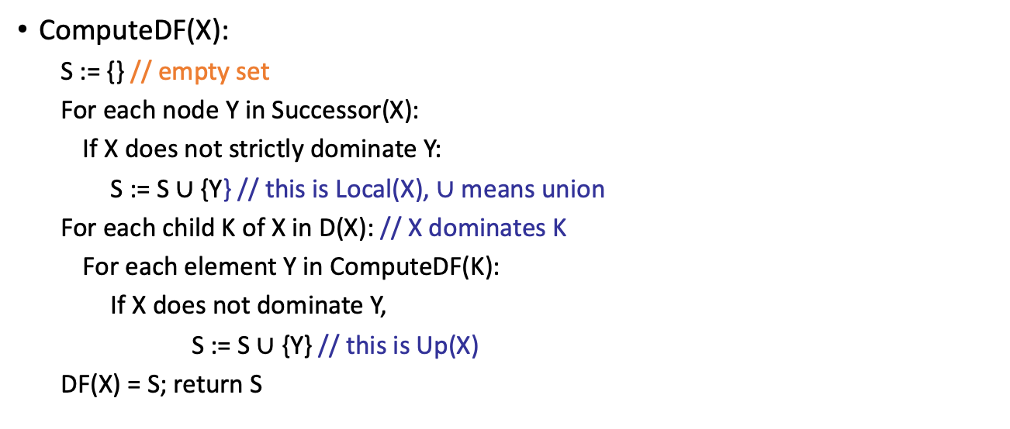
Dominance Frontier
ComputeDF(5)
1:
2:
5:
9:
{6,7}
3:
6:
7:
10:
11:
ComputeDF(X):
S := {} // empty set
For each node Y in Successor(X):
If X does not strictly dominate Y:
S := S $∪$ {Y} // this is Local(X), $∪$ means union
For each child K of X in D(X): // X dominates K
For each element Y in ComputeDF(K):
If X does not dominate Y,
S := S $∪$ {Y} // this is Up(X)
DF(X) = S; return S
4:
8:
12:
13:
{}
{6,7,8}
{4,8}
{8,12}
{5,13}
{4,12,5,13}
⌫
⌫

Slide 17
Dominance Frontier
Dominance Frontier Criterion
If node X contains definition of some variable a, then any node Y that uses a in the set DF(X) needs a φ function for a.
Iterated Dominance Frontier
Since a φ function is itself a definition of a new variable, we must iterate the DF criterion until no nodes in the CFG need a φ function.

Slide 18
Placing φ Functions
DF(3)={7}
1: V:=_; W:=_
2:
3: V:=_
Empty boxes indicate uses of variables V, W
4:
5: W:=_
6:
7:

Slide 19
Placing φ Functions
DF(3)={7}
1: V:=_; W:=_
DF(5)={6}
2:
3: V:=_
4:
5: W:=_
6:
7: V:= φ(V,V)

Slide 20
Placing φ Functions
DF(3)={7}
1: V:=_; W:=_
DF(5)={6}
2:
3: V:=_
4:
5: W:=_
6: W:= φ(W,W)
7: V:= φ(V,V)

Slide 21
Placing φ Functions
DF(6)={7}
1: V:=_; W:=_
2:
3: V:=_
4:
5: W:=_
6: W:= φ(W,W)
7: V:= φ(V,V); W:= φ(W,W)

Slide 22
Rename Variables
DF(6)={7}
1: V1:=_; W1:=_
2:
3: V2:=_
4:
5: W2:=_
6: W3:= φ(W1,W2)
7: V3:= φ(V1,V2); W4:= φ(W1,W3)

Slide 23
Summary
Compute the dominance frontier for each node in the flowgraph
For each node X place a φ function in each node that is in the dominance frontier for X
Iterate the dominance frontier algorithm above for each new variable assignment in each φ function added in the previous step
The end result: 3-address code converted into Static Single Assignment (SSA) form

