Slide 1
Lexical Analysis
LEX4: Regexps as Automata
CMPT 379: Compilers
Instructor: Anoop Sarkar
anoopsarkar.github.io/compilers-class

Slide 2
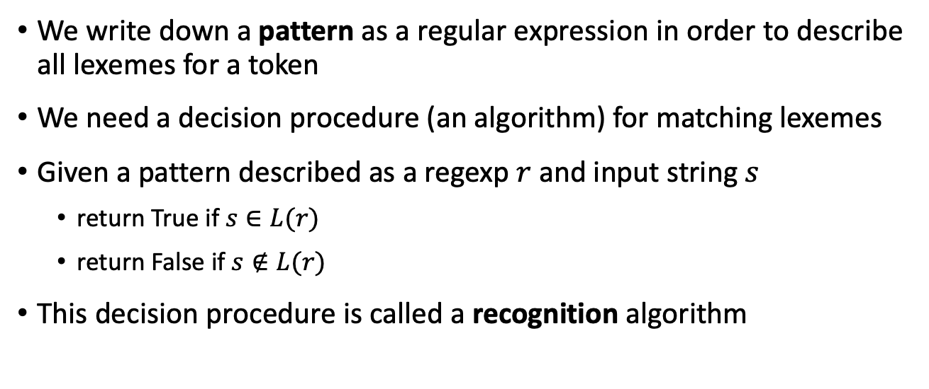
Regular Expressions
We write down a pattern as a regular expression in order to describe all lexemes for a token
We need a decision procedure (an algorithm) for matching lexemes
Given a pattern described as a regexp $r$ and input string $s$
return True if $s∈L(r)$
return False if $s∉L(r)$
This decision procedure is called a recognition algorithm

Slide 3
Regular Expressions
We will do this by compiling the regular expression into a data structure called a finite state automata (FA)
Finite state automata can be:
Deterministic (DFA)
Non-deterministic (NFA)
DFA and NFA each have their own recognition algorithm for matching against an input string.

Slide 4
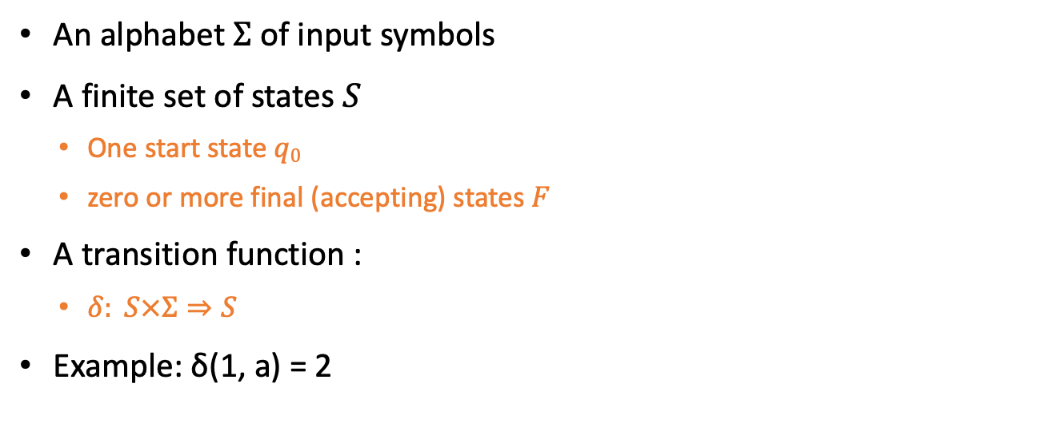
Finite State Automata
An alphabet $Σ$ of input symbols
A finite set of states $S$
One start state $q0$
zero or more final (accepting) states $F$
A transition function :
$δ: S×Σ⇒S$
Example: δ(1, a) = 2
a
1
2

Slide 5
FA: Example 1
A finite automaton that accepts only ‘1’
state
input
1
A
1
A
B
Accept
B
1
A
0
Reject
Language of a FA: set of accepted strings
A
1 0
B
1 0
Reject

Slide 6
FA: Example 2
A finite automaton accepting any number of 1’s followed by a single 0
1
0
A
B

Slide 7
FA: Example 3
What regular expression does this automaton accept?
1
1
0
A
0
B
0
C
1
A: start state
C: final state
Answer: (0|1)*00

Slide 8
FA simulation == recognition algorithm
1
1
0
A
0
B
0
C
1
state
input
Input string: 00100
A
00100
B
00100
C
00100
A
00100
B
00100
C
00100
Accept

Slide 9

ε-move
Another kind of transition: $ε$-moves
ε
A
B
state
input
A
x₁ x₂ x₃
B
x₁ x₂ x₃

Slide 10
Deterministic Finite Automata (DFA)
Rule 1: One transition per input per state
a
2
1
Invalid
a
3
Rule 2: No ε-moves

Slide 11



Nondeterministic Finite State Automata (NFA)
a
2
Can have multiple transitions for same symbol from a state
1
Allowed!
a
3
a
$$ε$$
2
Can have $ε$-moves
1
$$ε$$
3
a

Slide 12

Nondeterministic Finite State Automata (NFA)
A DFA takes only one path through the state graph (per input)
a
b
c
1
2
3
4
a
NFA can choose the path!
a
An NFA accepts the input if any one of the paths leads to a final state.
$$ε$$

Slide 13
Nondeterministic Finite State Automata (NFA)
An NFA can reach multiple states simultaneously
1
state
input
0
0
{A}
100
A
B
C
{A}
100
0
{A,B}
100
Q: Draw an NFA for regexp (0|1)(0|1)*
Q: Write down the regexp for this NFA.
{A,B,C}
100

Slide 14
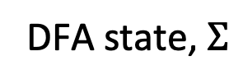
Nondeterministic to Deterministic
The Subset Construction converts an NFA into a DFA
1
DFA state, $Σ$
DFA state
0
0
A
B
C
{A}, 0
{A, B}
0
{A}, 1
{A}
1
{A, B}, 0
{A, B, C}
{A,B}
{A, B}, 1
{A}
1
0
0
{A}
{A, B, C}, 0
{A, B, C}
0
{A,B,C}
{A, B, C}, 1
{A}
1

Slide 15
Nondeterministic to Deterministic
1
{A,B}
1
0
0
{A}
0
{A,B,C}
1
1
1
0
0
0
1

Slide 16
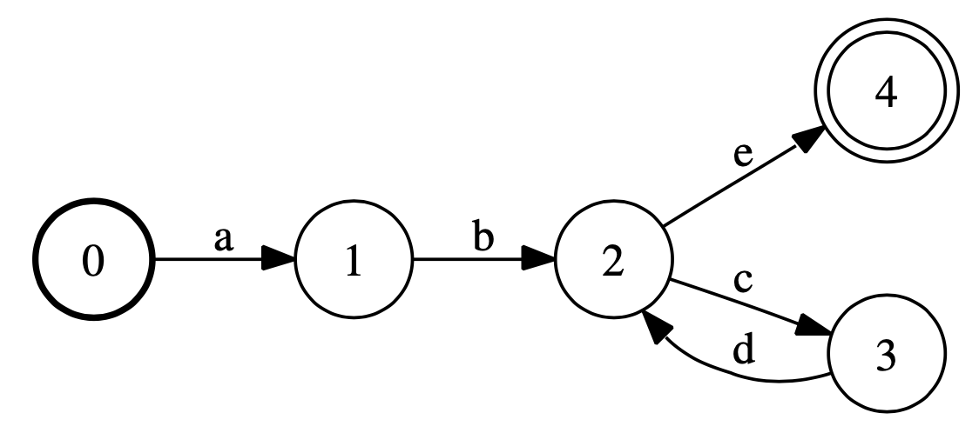
Q: Write down the regexp for this DFA.

Slide 17
NFAs vs DFAs
NFAs and DFAs recognize the same set of languages
Regular languages, the languages L(r) where r is a regular expression
DFAs are faster to execute
There are no choices to consider – it is deterministic (hence the name)
DFAs usually have fewer states than NFAs
But in a worst-case analysis, DFAs can be larger than NFAs
Exponentially larger

Slide 18
Extra Slides

Slide 19
Nondeterministic Finite State Automata (NFA)
1
1
A
0
B
0
Q: Draw an NFA for regexp (0|1)(0|1)*

Slide 20
Nondeterministic to Deterministic
1
1
A
0
B
DFA state, $Σ$
DFA state
{A}, 0
{A, B}
0
{A}, 1
{A, B}
1
1
{A, B}, 0
{A, B}
0
{A, B}, 1
{A, B}
A
A,B
0

Slide 21
Q: Write down the regexp for this DFA.
A: ab(cd)*e

