Slide 1
Context-Free Grammars
CFG2: Ambiguity
CMPT 379: Compilers
Instructor: Anoop Sarkar
anoopsarkar.github.io/compilers-class

Slide 2
Ambiguity
id - id / id
E → E - E
E → E / E
E → ( E )
E → id
E
E
E
-
E
E
/
E
id
E
E
id
E
/
E
-
id
id
id
id

Slide 3
Ambiguity
Grammar is ambiguous if more than one parse tree is possible for some sentences
There is more than one leftmost (or rightmost) derivations
Ambiguity is not acceptable in programming languages
Leaves meaning of some programs ill-defined
Unfortunately, it’s undecidable to check whether a given CFG is ambiguous
Some CFLs are inherently ambiguous (do not have an unambiguous CFG)

Slide 4
Ambiguity
Handle ambiguity:
Rewrite the grammar unambiguously
Augment parser by enforcing precedence and associativity
Consider the original ambiguous grammar:
E → E - E E → E / E
E → ( E ) E → id
How can we change the grammar to get only one tree for the input id - id / id

Slide 5
Precedence
E
Original ambiguous grammar:
E → E - E E → E / E
E → ( E ) E → id
Use different non-terminals for each
Precedence level: (start from lowest level)
E → E - E E → T
T → T / T T → F
F → id F → ( E )
Input: id - id / id
E
-
E
T
T
F
T
/
T
id
F
F
id
id

Slide 6
Associativity
The grammar capture operator precedence
E → E - E E → T
T → T / T T → F
F → id F → ( E )
Still ambiguous!! id - id – id
“-” is left associative (operations are grouped from left)
5-3-2
E
E
(5-3)-2
5-(3-2)
E
-
E
E
-
E
E
-
E
id
id
E
-
E
id
id
id
id

Slide 7
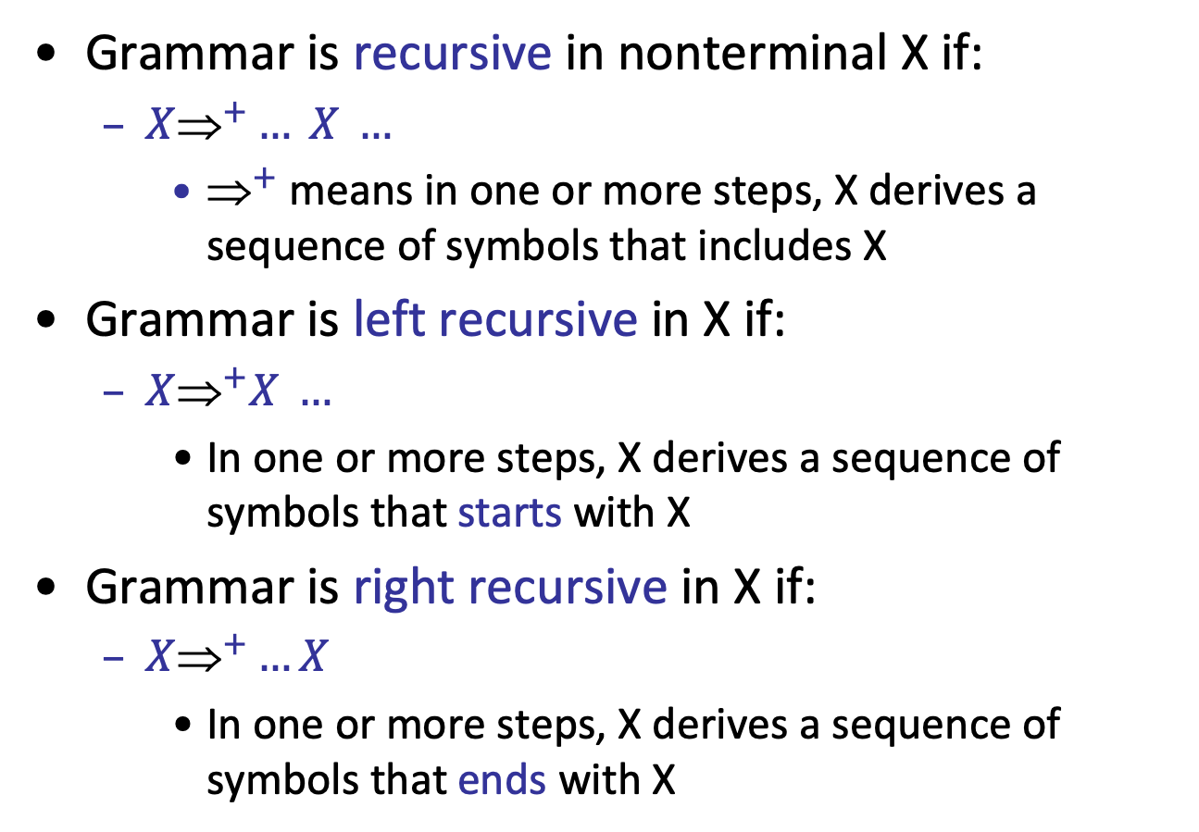
Recursion
Grammar is recursive in nonterminal X if:
$X{\text{⇒}}^{+}… X …$
${\text{}}^{+}$ means in one or more steps, X derives a sequence of symbols that includes X
Grammar is left recursive in X if:
$X{\text{⇒}}^{+}X …$
In one or more steps, X derives a sequence of symbols that starts with X
Grammar is right recursive in X if:
$X{\text{⇒}}^{+}…X$
In one or more steps, X derives a sequence of symbols that ends with X

Slide 8
Fix Associativity
Left and right recursive in non-terminals E and T
E → E - E E → T
T → T / T T → F
F → id F → ( E )
Express operator associativity:
For left associativity use left recursion
For right associativity use right recursion
Unambiguous grammar
E → E - T E → T
T → T / F T → F
F → id F → ( E )

Slide 9
Dangling else ambiguity
Original Grammar (ambiguous)
Stmt → if Expr then Stmt else Stmt
Stmt → if Expr then Stmt
Stmt → Other
if E₁ then if E₂ then E₃ else E₄
else matches the closest
unmatched then
if
if
E₁
if
E₄
E₁
if
E₂
E₃
E₂
E₃
E₄

Slide 10
Dangling else ambiguity
Original Grammar (ambiguous)
Stmt → if Expr then Stmt else Stmt
Stmt → if Expr then Stmt
Stmt → Other
Unambiguous grammar
Stmt → MatchedStmt /*all then are matched*/
Stmt → UnmatchedStmt /*some then are unmatched*/
MatchedStmt → if Expr then MatchedStmt else MatchedStmt
MatchedStmt → Other
UnmatchedStmt → if Expr then Stmt
UnmatchedStmt → if Expr then MatchedStmt else UnmatchedStmt
else matches the closest
unmatched then

Slide 11
Dangling else ambiguity
Check unambiguous dangling-else grammar with the following inputs:
if Expr then if Expr then Other else Other
if Expr then if Expr then Other else Other else Other
if Expr then if Expr then Other else if Expr then Other else Other

Slide 12
Precedence and Associativity Declaration
Impossible to automatically convert an ambiguous grammar to an unambiguous one
Used with care, ambiguity can simplify the grammar
Sometimes allow more natural definitions
We need disambiguation mechanisms

Slide 13
Precedence and Associativity Declaration
Instead of re-writing the grammar
Use the more natural (ambiguous) grammar
Along with disambiguation declarations
Most tools allow precedence and associativity declaration to disambiguate grammars

Slide 14
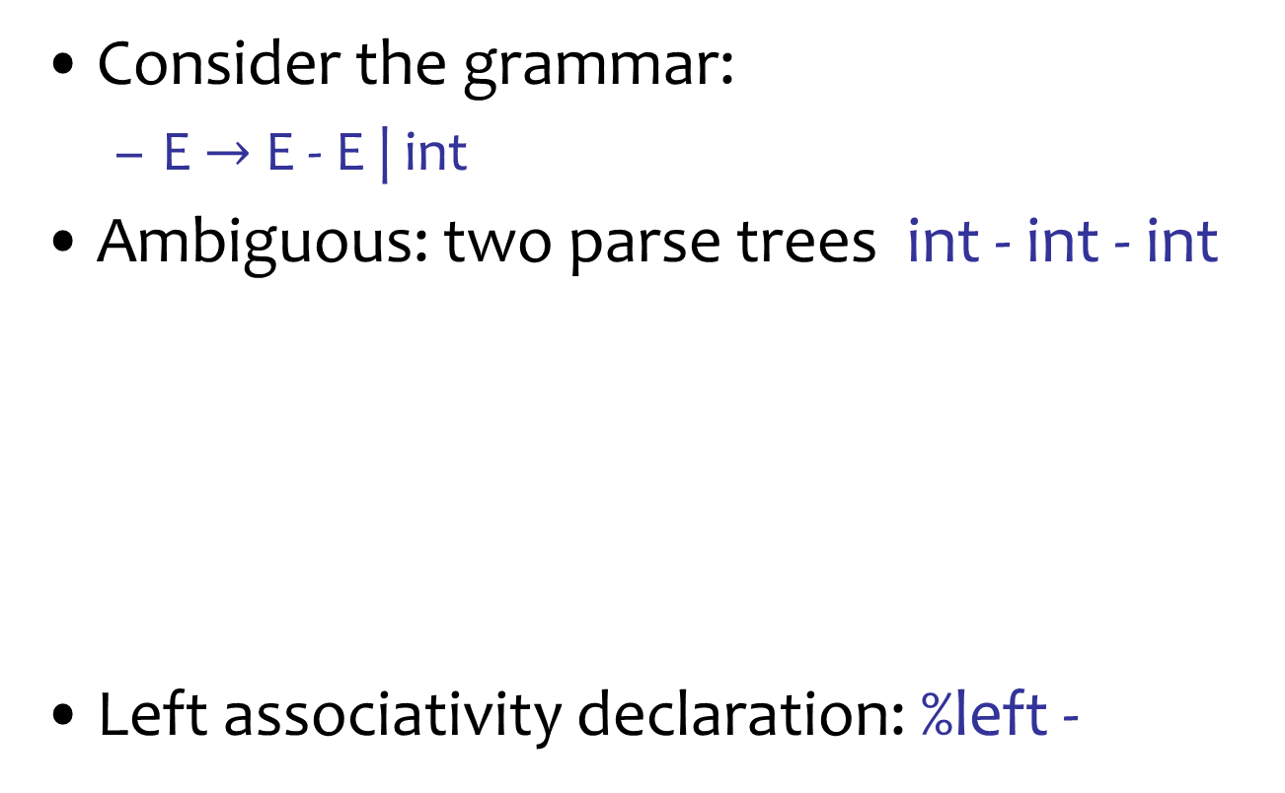
Associativity Declaration
Consider the grammar:
E $→$ E - E | int
Ambiguous: two parse trees int - int - int
Left associativity declaration: %left -
E
E
E
-
E
E
-
E
E
-
E
int
int
E
-
E
int
int
int
int

Slide 15
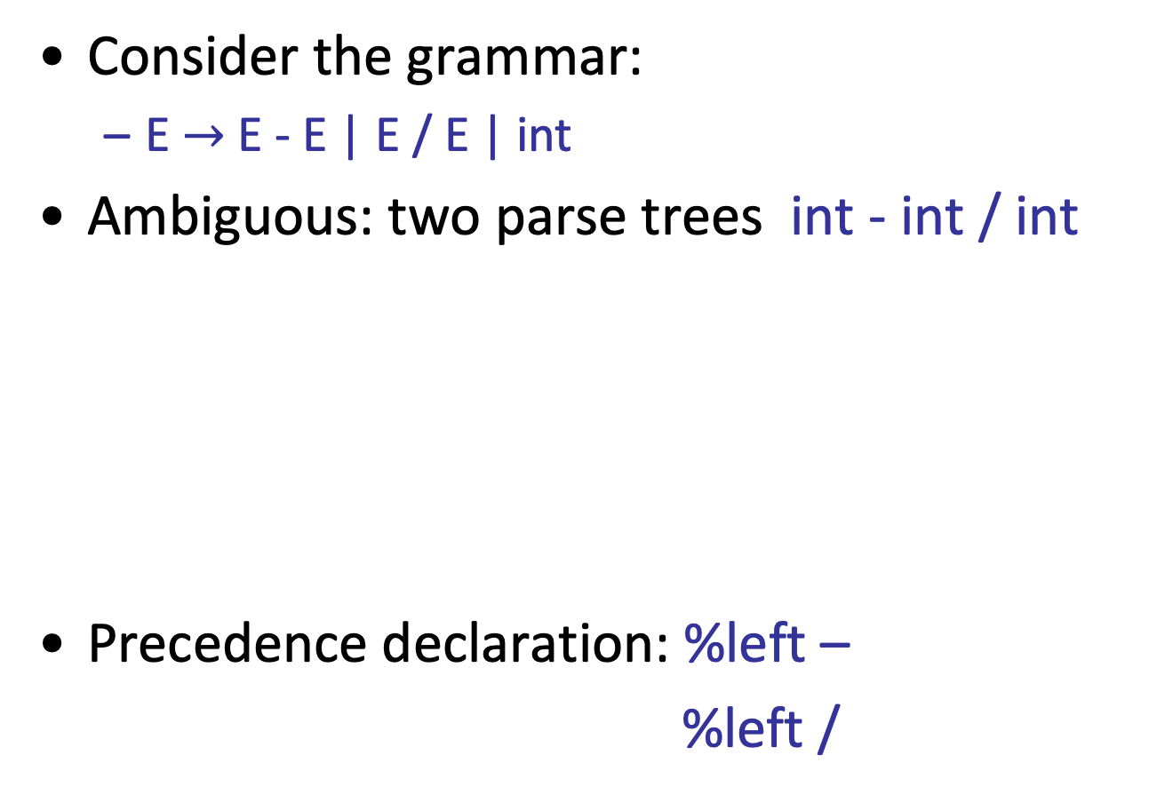
Precedence Declaration
Consider the grammar:
E $→$ E - E | E / E | int
Ambiguous: two parse trees int - int / int
Precedence declaration: %left –
%left /
E
E
E
/
E
E
-
E
E
-
E
int
int
E
/
E
int
int
int
int

Slide 16
Other Ambiguous Grammars
R → R ‘|’ R
| R R
| R ‘*’
| ‘(‘ R ‘)’
| a
| b
Consider the grammar
What does this grammar generate?
What is the parse tree for a|b*a
Is this grammar ambiguous?

Slide 17
Ambiguity
E
Original ambiguous grammar:
E → E + E E → E * E
E → ( E ) E → - E
E → id
Unambiguous grammar:
E → E + T T → T * F
E → T T → F
F → ( E ) F → - E
F → id
Input: id + id * id
E
+
T
T
T
*
F
F
id
F
id
id
Warning! Is this unambiguous?
Check derivations for – id + id
Compare with F → - F

Slide 18
Dangling else ambiguity
Original Grammar (ambiguous)
Stmt → if Expr then Stmt else Stmt
Stmt → if Expr then Stmt
Stmt → Other
Modified Grammar (unambiguous?)
Stmt → if Expr then Stmt
Stmt → MatchedStmt
MatchedStmt → if Expr then MatchedStmt else Stmt
MatchedStmt → Other

Slide 19
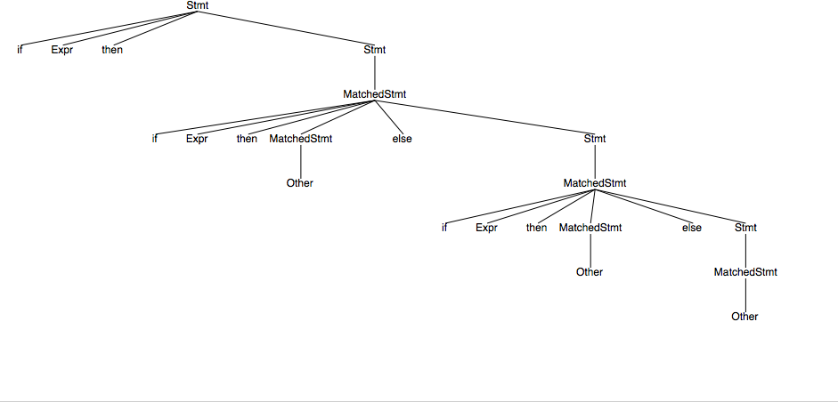
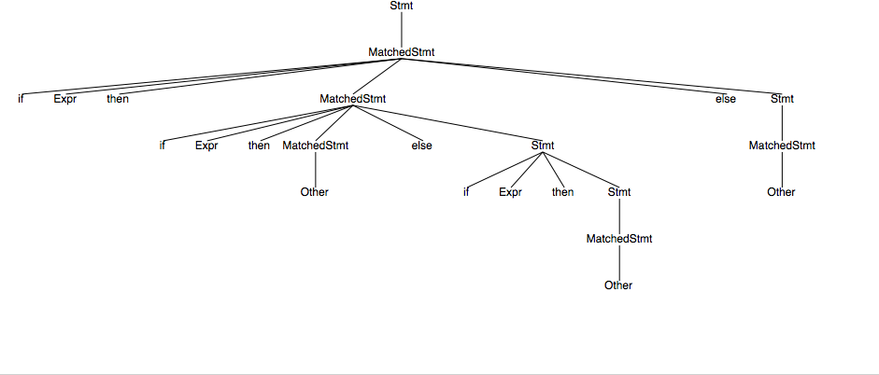

Slide 20
Dangling else ambiguity
Modified Grammar (check for ambiguity)
Stmt → MatchedStmt
Stmt → UnmatchedStmt
MatchedStmt → if Expr then MatchedStmt else MatchedStmt
MatchedStmt → Other
UnmatchedStmt → if Expr then Stmt
UnmatchedStmt → if Expr then MatchedStmt else UnmatchedStmt

