Slide 1
Why you should (not) take a Compilers course (with Anoop)
IN1: Supplemental
CMPT 379: Compilers
Instructor: Anoop Sarkar
anoopsarkar.github.io/compilers-class

Slide 2
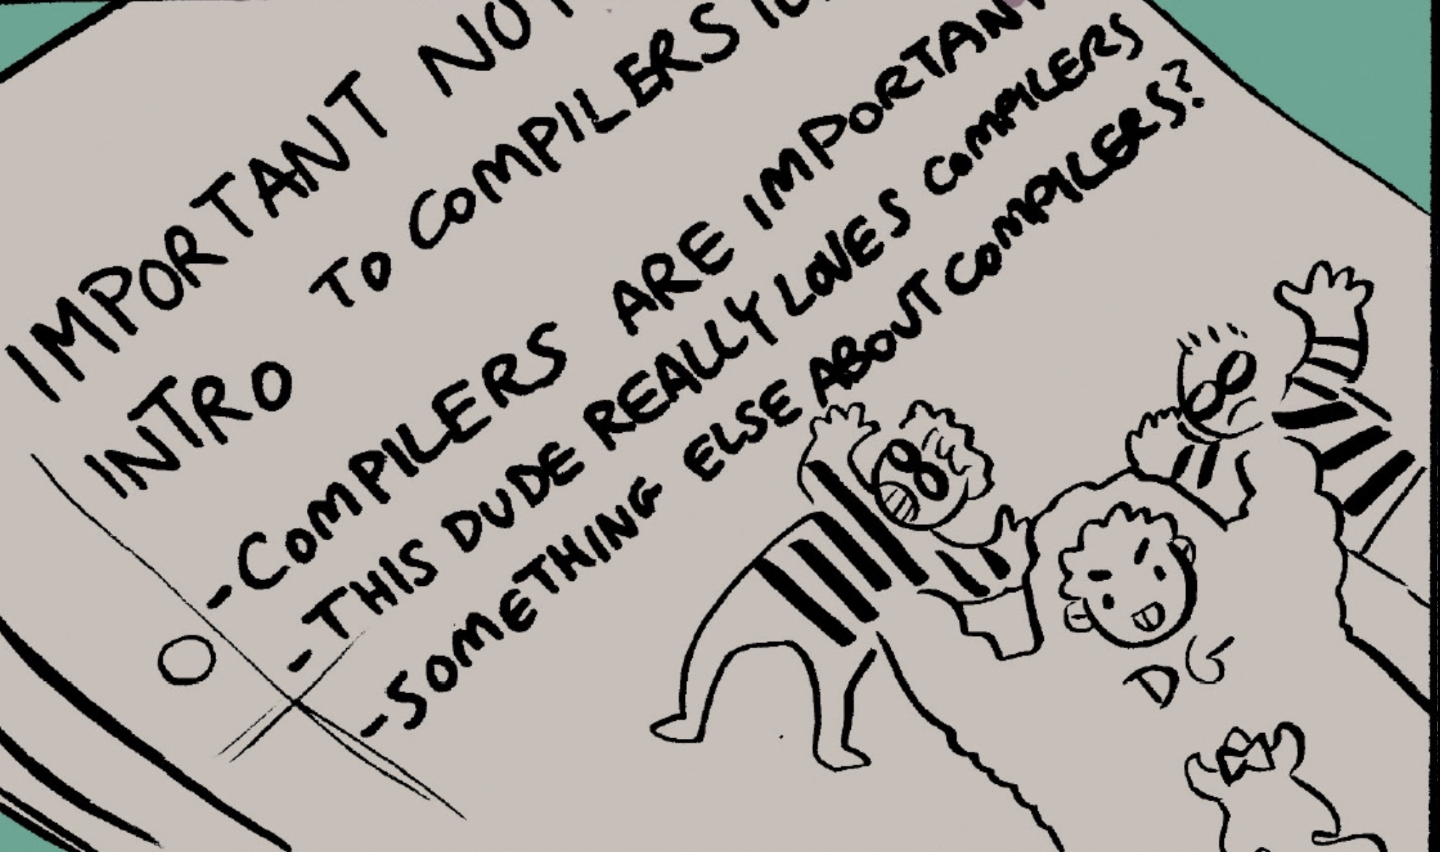

Slide 3
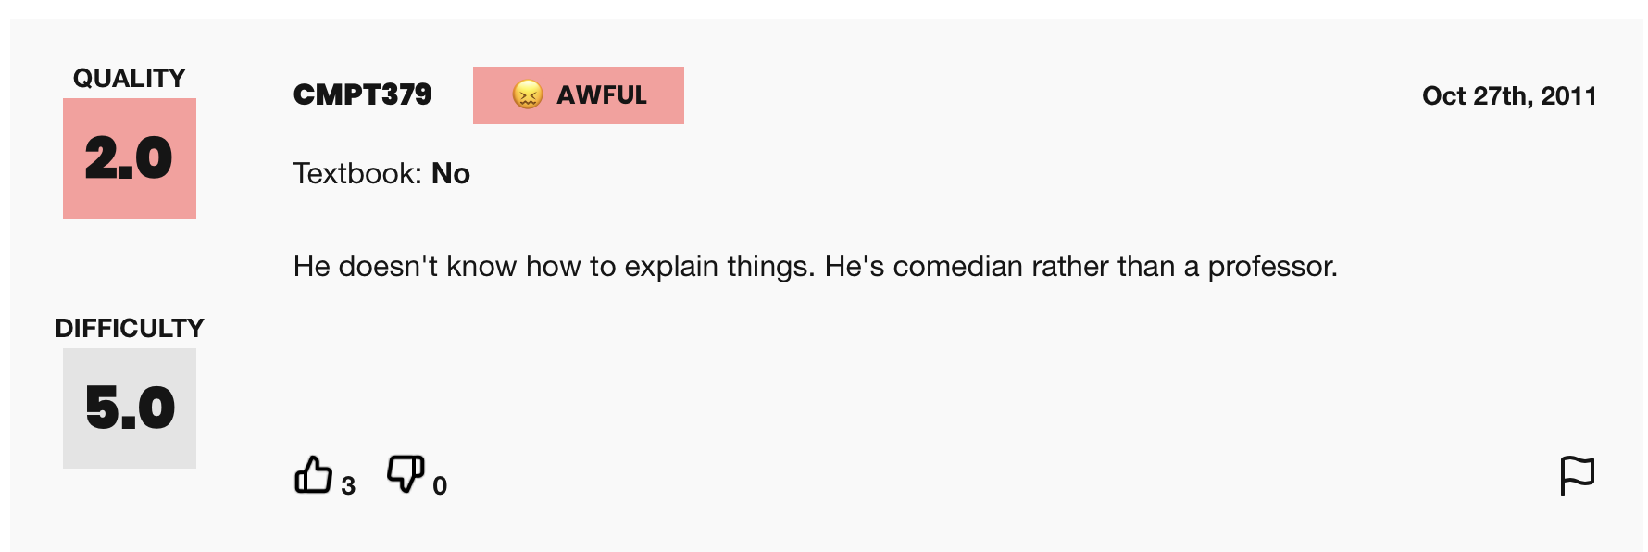
Rate my Professor

Slide 4
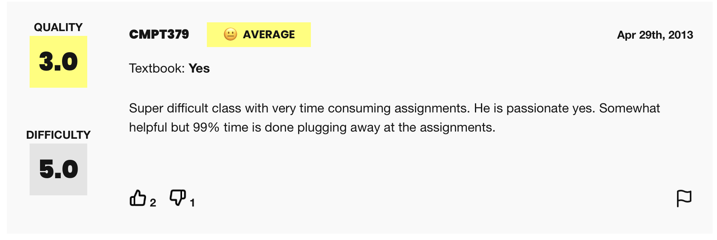
Rate my Professor

Slide 5
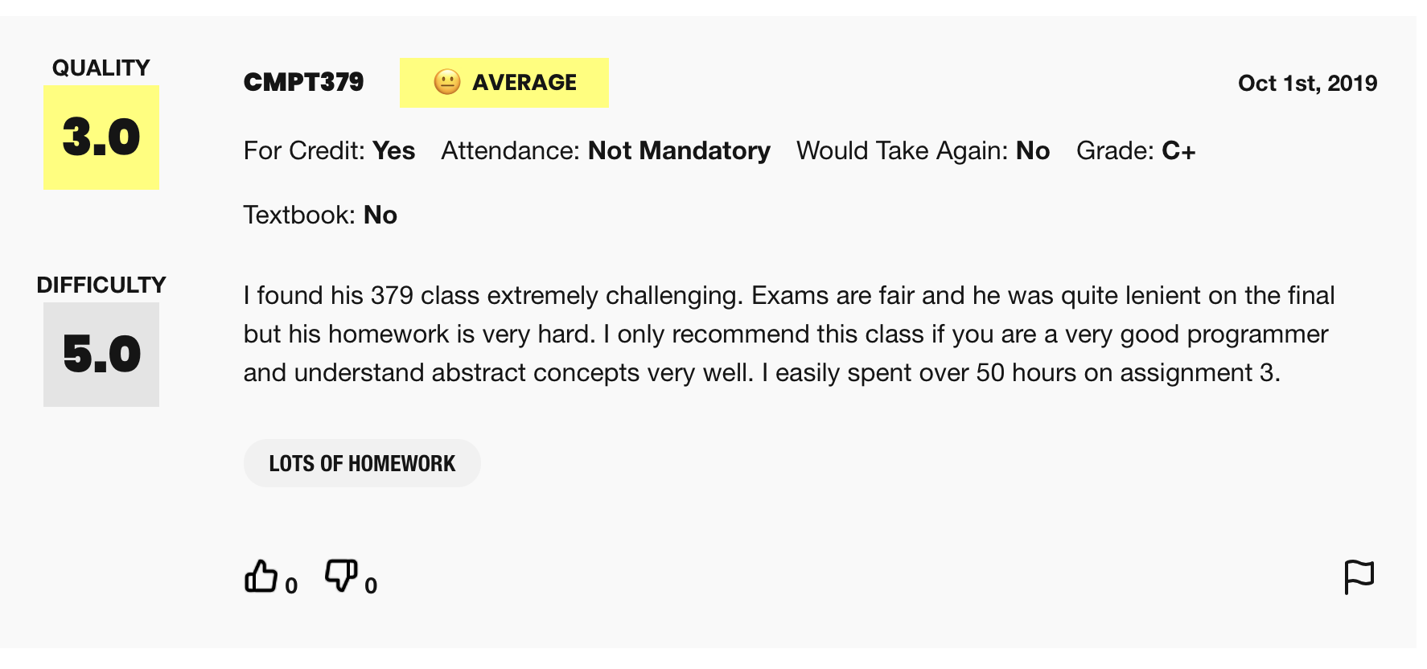
Rate my Professor

Slide 6
Discord

Slide 7
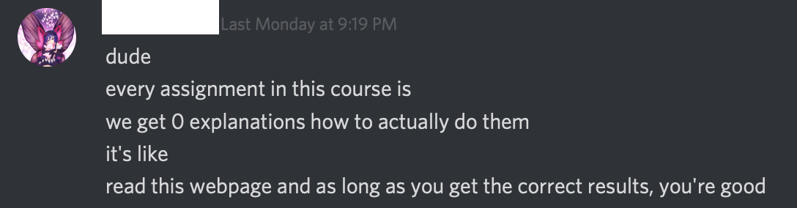
Discord

Slide 8
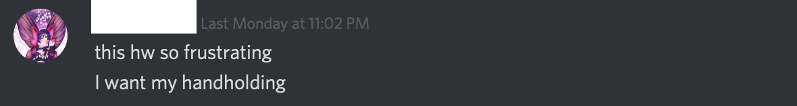
Discord

Slide 9

Don’t take this course if you are this guy:

