Slide 1
Linear Scan Register Allocation
OPT3: Linear Scan Algo
CMPT 379: Compilers
Instructor: Anoop Sarkar
anoopsarkar.github.io/compilers-class

Slide 2
Live Ranges and Live Intervals
The live range for a variable is the set of program points at which that variable is live.
The live interval for a variable is the smallest subrange of the IR code containing all a variable's live ranges.
A property of the IR code, not CFG.
Less precise than live ranges, but simpler to work with

Slide 3
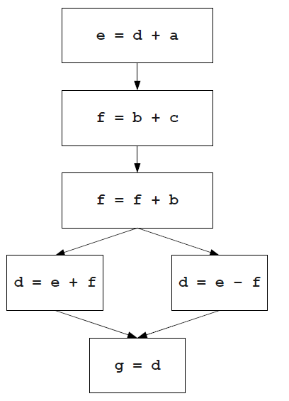
Live Intervals
{a,b,c,d}
e = d + a
{b,c,e}
f = b + c
{b,c,e}
f = f + b
{b,e,f}
if e==0 goto _L0
d = e + f
{b,e,f}
goto _L1
{e,f}
_L0: d = e - f
{e,f}
{e,f}
_L1: g = d
{d}
{d}
{d}
{g}

Slide 4
Live Intervals
a
{a,b,c,d}
e = d + a
{b,c,e}
f = b + c
{b,c,e}
f = f + b
{b,e,f}
if e==0 goto _L0
d = e + f
{b,e,f}
goto _L1
{e,f}
_L0: d = e - f
{e,f}
{e,f}
_L1: g = d
{d}
{d}
{d}
{g}

Slide 5
Live Intervals
a
b
{a,b,c,d}
e = d + a
{b,c,e}
f = b + c
{b,c,e}
f = f + b
{b,e,f}
if e==0 goto _L0
d = e + f
{b,e,f}
goto _L1
{e,f}
_L0: d = e - f
{e,f}
{e,f}
_L1: g = d
{d}
{d}
{d}
{g}

Slide 6
Live Intervals
a
b
c
{a,b,c,d}
e = d + a
{b,c,e}
f = b + c
{b,c,e}
f = f + b
{b,e,f}
if e==0 goto _L0
d = e + f
{b,e,f}
goto _L1
{e,f}
_L0: d = e - f
{e,f}
{e,f}
_L1: g = d
{d}
{d}
{d}
{g}

Slide 7
Live Intervals
a
b
c
d
{a,b,c,d}
e = d + a
{b,c,e}
f = b + c
{b,c,e}
f = f + b
{b,e,f}
if e==0 goto _L0
d = e + f
{b,e,f}
goto _L1
{e,f}
_L0: d = e - f
{e,f}
{e,f}
_L1: g = d
{d}
{d}
{d}
{g}

Slide 8
Live Intervals
a
b
c
d
{a,b,c,d}
e = d + a
{b,c,e}
f = b + c
{b,c,e}
f = f + b
{b,e,f}
if e==0 goto _L0
d = e + f
{b,e,f}
goto _L1
{e,f}
_L0: d = e - f
{e,f}
{e,f}
_L1: g = d
{d}
{d}
{d}
{g}

Slide 9
Live Intervals
a
b
c
d
e
{a,b,c,d}
e = d + a
{b,c,e}
f = b + c
{b,c,e}
f = f + b
{b,e,f}
if e==0 goto _L0
d = e + f
{b,e,f}
goto _L1
{e,f}
_L0: d = e - f
{e,f}
{e,f}
_L1: g = d
{d}
{d}
{d}
{g}

Slide 10
Live Intervals
a
b
c
d
e
f
{a,b,c,d}
e = d + a
{b,c,e}
f = b + c
{b,c,e}
f = f + b
{b,e,f}
if e==0 goto _L0
d = e + f
{b,e,f}
goto _L1
{e,f}
_L0: d = e - f
{e,f}
{e,f}
_L1: g = d
{d}
{d}
{d}
{g}

Slide 11
Live Intervals
a
b
c
d
e
f
g
{a,b,c,d}
e = d + a
{b,c,e}
f = b + c
{b,c,e}
f = f + b
{b,e,f}
if e==0 goto _L0
d = e + f
{b,e,f}
goto _L1
{e,f}
_L0: d = e - f
{e,f}
{e,f}
_L1: g = d
{d}
{d}
{d}
{g}

Slide 12
Register Allocation with Live Intervals
a
b
c
d
e
f
g
Given the live intervals for all the variables in the program, we can allocate registers using a simple greedy algorithm.
Idea: Track which registers are free at each point.
When a live interval begins, give that variable a free register.
When a live interval ends, the register is once again free.

Slide 13
Register Allocation with Live Intervals
a
b
c
d
e
f
g
r1
r2
r3
r4

Slide 14
Register Allocation with Live Intervals
a
b
c
d
e
f
g
r1
r2
r3
r4

Slide 15
Register Allocation with Live Intervals
a
b
c
d
e
f
g
r1
r2
r3
r4

Slide 16
Register Allocation with Live Intervals
a
b
c
d
e
f
g
r1
r2
r3
r4

Slide 17
Register Allocation with Live Intervals
a
b
c
d
e
f
g
r1
r2
r3
r4

Slide 18
Register Allocation with Live Intervals
a
b
c
d
e
f
g
r1
r2
r3
r4

Slide 19
Register Allocation with Live Intervals
a
b
c
d
e
f
g
r1
r2
r3
r4

Slide 20
Register Allocation with Live Intervals
a
b
c
d
e
f
g
r1
r2
r3
r4

Slide 21
Register Allocation with Live Intervals
a
b
c
d
e
f
g
r1
r2
r3
r4

Slide 22
Register Allocation with Live Intervals
a
b
c
d
e
f
g
r1
r2
r3
r4

Slide 23
Register Allocation with Live Intervals
a
b
c
d
e
f
g
r1
r2
r3
r4

Slide 24
Register Allocation with Live Intervals
a
b
c
d
e
f
g
r1
r2
r3
r4

Slide 25
Linear Scan Register Allocation
If a register cannot be found for a variable v, we may need to spill a variable.
This algorithm is called linear scan register allocation
Requires more up-front work to compute live intervals

Slide 26
Linear Scan Register Allocation
Pros:
Very efficient
Works well in many cases
Allocation needs one pass, the code can be generated simultaneously
Used in JIT compilers like Java HotSpot
Cons:
Produces less efficient code compared to the graph coloring approach

Slide 27
Summary
Register allocation is a “must have” in compilers, because:
Intermediate code uses too many temporaries
It makes a big difference in performance
The liveness at each location can be used for register allocation
Register allocation as heuristic graph coloring uses live ranges
The basis for the technique used in GCC
Linear scan register allocation uses live intervals
Often used in JIT compilers due to efficiency

