Slide 1
Lexical Analysis
LEX4: Regexps as Automata
CMPT 379: Compilers
Instructor: Anoop Sarkar
anoopsarkar.github.io/compilers-class

Slide 2
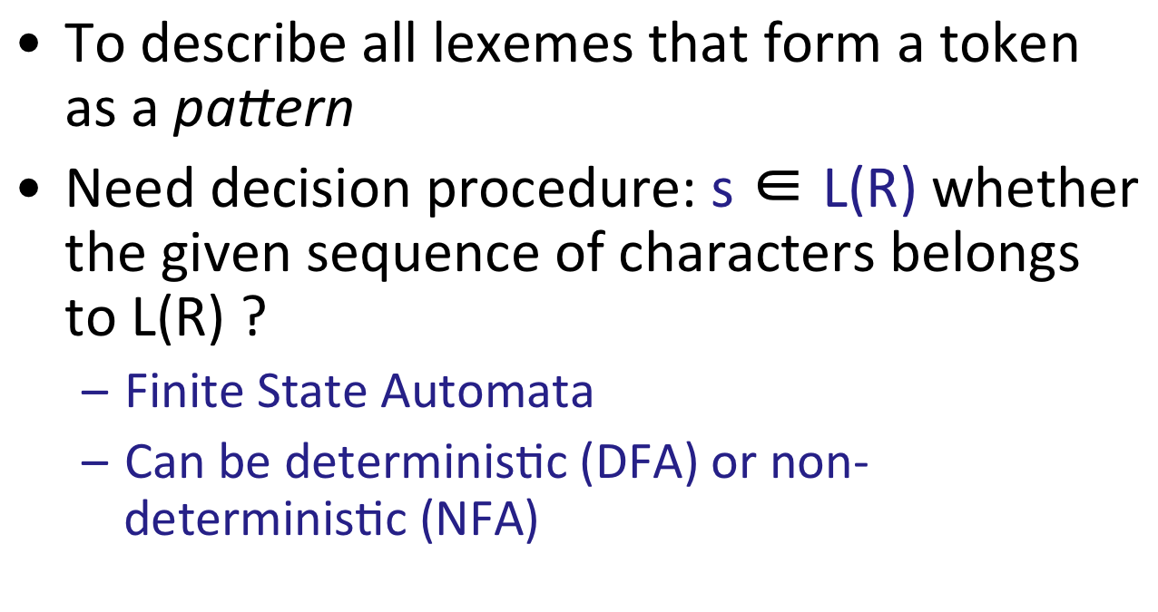
Regular Expressions

Slide 3
Finite State Automata
An alphabet ∑ of input symbols
A finite set of states S
One start state q₀
zero or more final (accepting) states F
A transition function:
δ: S x Σ ⇒ S
Example: δ(1, a) = 2
a
1
2

Slide 4
FA: Example
A finite automaton that accepts only ‘1’
state
input
1
A
1
A
B
1
Accept
B
A
0
Reject
Language of a FA: set of accepted strings
A
1 0
B
1 0
Reject

Slide 5
FA: Example
A finite automaton accepting any number of 1’s followed by a single 0
1
0
A
B

Slide 6
FA: Example
What regular expression does this automaton accept?
1
1
0
A
0
B
0
C
1
A: start state
C: final state
Answer: (0|1)*00

Slide 7
FA simulation
1
1
0
A
0
B
0
C
1
state
input
A
00100
Input string: 00100
B
00100
C
00100
A
00100
B
00100
C
00100
Accept

Slide 8
ε-move
Another kind of transition: ε-moves
ε
A
B
state
input
A
x₁ x₂ x₃
B
x₁ x₂ x₃

Slide 9
Deterministic Finite Automata (DFA)
One transition per input per state
No ε-moves
a
2
1
Invalid
a
3

Slide 10
Nondeterministic Finite State Automata (NFA)
Can have multiple transitions for one input in a given state
Can have ε-moves
a
2
1
a
3
a
ε
2
1
ε
3
a

Slide 11
Nondeterministic Finite State Automata (NFA)
A DFA takes only one path through the state graph (per input)
NFA can choose!
An NFA accepts if some choices lead to a final state
a
b
c
1
2
3
4
a
a
ε

Slide 12
Nondeterministic Finite State Automata (NFA)
An NFA can get into multiple states
1
state
input
0
0
{A}
100
A
B
C
{A}
100
0
{A,B}
100
{A,B,C}
100

Slide 13
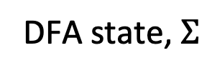
Nondeterministic to Deterministic
The Subset Construction converts an NFA into a DFA
1
DFA state, $Σ$
DFA state
0
0
A
B
C
{A}, 0
{A, B}
0
{A}, 1
{A}
1
{A, B}, 0
{A, B, C}
{A,B}
{A, B}, 1
{A}
1
1
0
{A}
{A, B, C}, 0
{A, B, C}
0
{A,B,C}
{A, B, C}, 1
{A}
0

Slide 14
Nondeterministic to Deterministic
1
{A,B}
1
1
0
{A}
0
{A,B,C}
0
1
1
0
X
0
Y
0
Z
1

Slide 15
NFAs vs DFAs
NFAs and DFAs recognize the same set of languages
Regular expressions
DFAs are faster to execute
There are no choices to consider
DFAs are usually smaller than NFAs
But in a worst case analysis, DFAs can be larger than NFAs
Exponentially larger

