Slide 1
Compiler Contest
Summer 2016

Slide 2
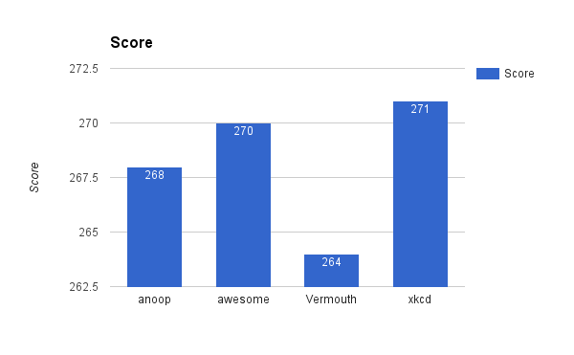
Overall Score (all test cases)

Slide 3
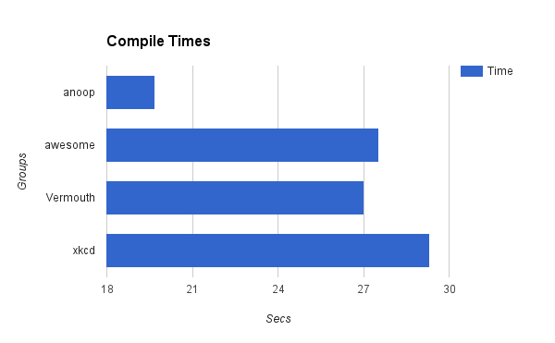
Compile Times

Slide 4
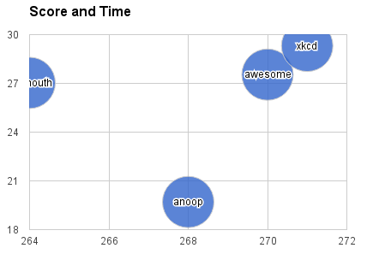
Score and Time

