Slide 1
Lexical Analysis
LEX1: Intro to Regexps
CMPT 379: Compilers
Instructor: Anoop Sarkar
anoopsarkar.github.io/compilers-class

Slide 2
Lexical Analysis
Also called lexing or scanning, take input program string and convert into tokens
Example
T_DOUBLE
(“double”)
T_IDENT
(“f”)
T_OP
(“=”)
T_IDENT
(“sqrt”)
double f = sqrt(-1);
T_LPAREN
(“(”)
T_OP
(“-”)
T_INTCONSTANT
(“1”)
T_RPAREN
(“)”)
T_SEP
(“;”)

Slide 3
Token Attributes
Some tokens have attributes:
T_IDENT (“sqrt”)
T_INTCONSTANT (“1”)
Other tokens do not:
T_WHILE
Source code location for error reports
A token is defined using a pattern.
The pattern for identifiers: a sequence of one or more letters, digits and underscores which starts with a letter or underscore.
T_IDENT
(“sqrt”)
Token
Lexeme

Slide 4
Lexical errors
The lexer does not check for syntax errors!
What if user omits spaces: doublef=sqrt(-1);
No lexical error!
Single token is produced: T_IDENT(“doublef”)
Not two tokens: T_DOUBLE, T_IDENT(“f”)
Typically few lexical error types
Illegal chars
Unclosed string constants
Comments that are not terminated correctly

Slide 5
Lexical errors
Lexical analysis should not disambiguate tokens
e.g. unary operator − (minus) versus binary operator − (minus)
Use the same token T_MINUS for both
It’s the job of the parser to disambiguate based on the context
Q: Using the same token definitions as before, provide the sequence of token(s) that will be produced for input double(-1)

Slide 6
Ad-hoc Lexer

Slide 7
Implementing Lexers: Loop and switch scanners
Big nested switch/case statements
Lots of getc()/ungetc() calls
Buffering and streams; Sentinels for push-backs
Can be error-prone
Changing or adding a keyword is problematic
Read source of an ad-hoc lexer: LexTokenInternal in clang

Slide 8
Implementing Lexers: Loop and switch scanners
Does the implementation exactly capture the language specification?
How can we show correctness?
Key idea: separate the definition of tokens from the implementation
Problem: we need to reason about patterns and how they can be used to define tokens (recognize strings).

Slide 9
Specifying Patterns using Regular Expressions

Slide 10
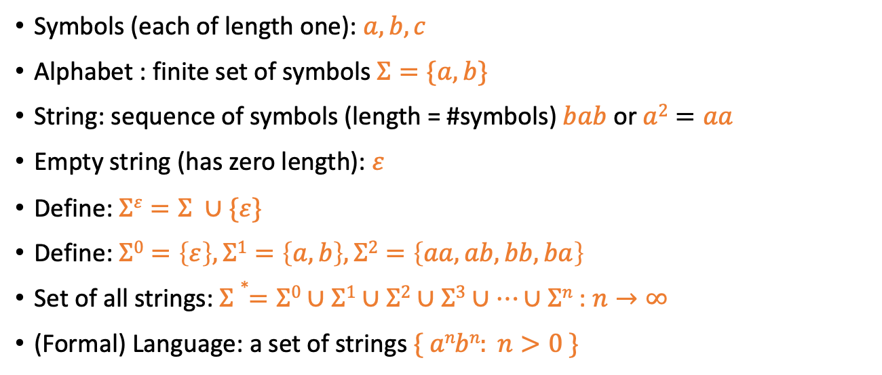
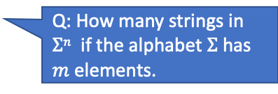
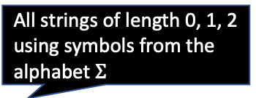
Formal Languages: Recap
Symbols (each of length one): $a, b, c$
Alphabet : finite set of symbols $Σ=\{a,b\}$
String: sequence of symbols (length = #symbols) $bab$ or $a2=aa$
Empty string (has zero length): $ε$
Define: $Σε=Σ ∪\{ε\}$
Define: $Σ0=\left\{ε\right\},Σ1=\left\{a,b\right\},Σ2=\left\{aa,ab,bb,ba\right\}$
Set of all strings: $Σ∗=Σ0∪Σ1∪Σ2∪Σ3∪…∪Σn$ : $n→∞$
(Formal) Language: a set of strings $\{ anbn: n>0 \}$
All strings of length 0, 1, 2 using symbols from the alphabet $Σ$
Q: How many strings in $Σn$ if the alphabet $Σ$has $m$ elements.

Slide 11
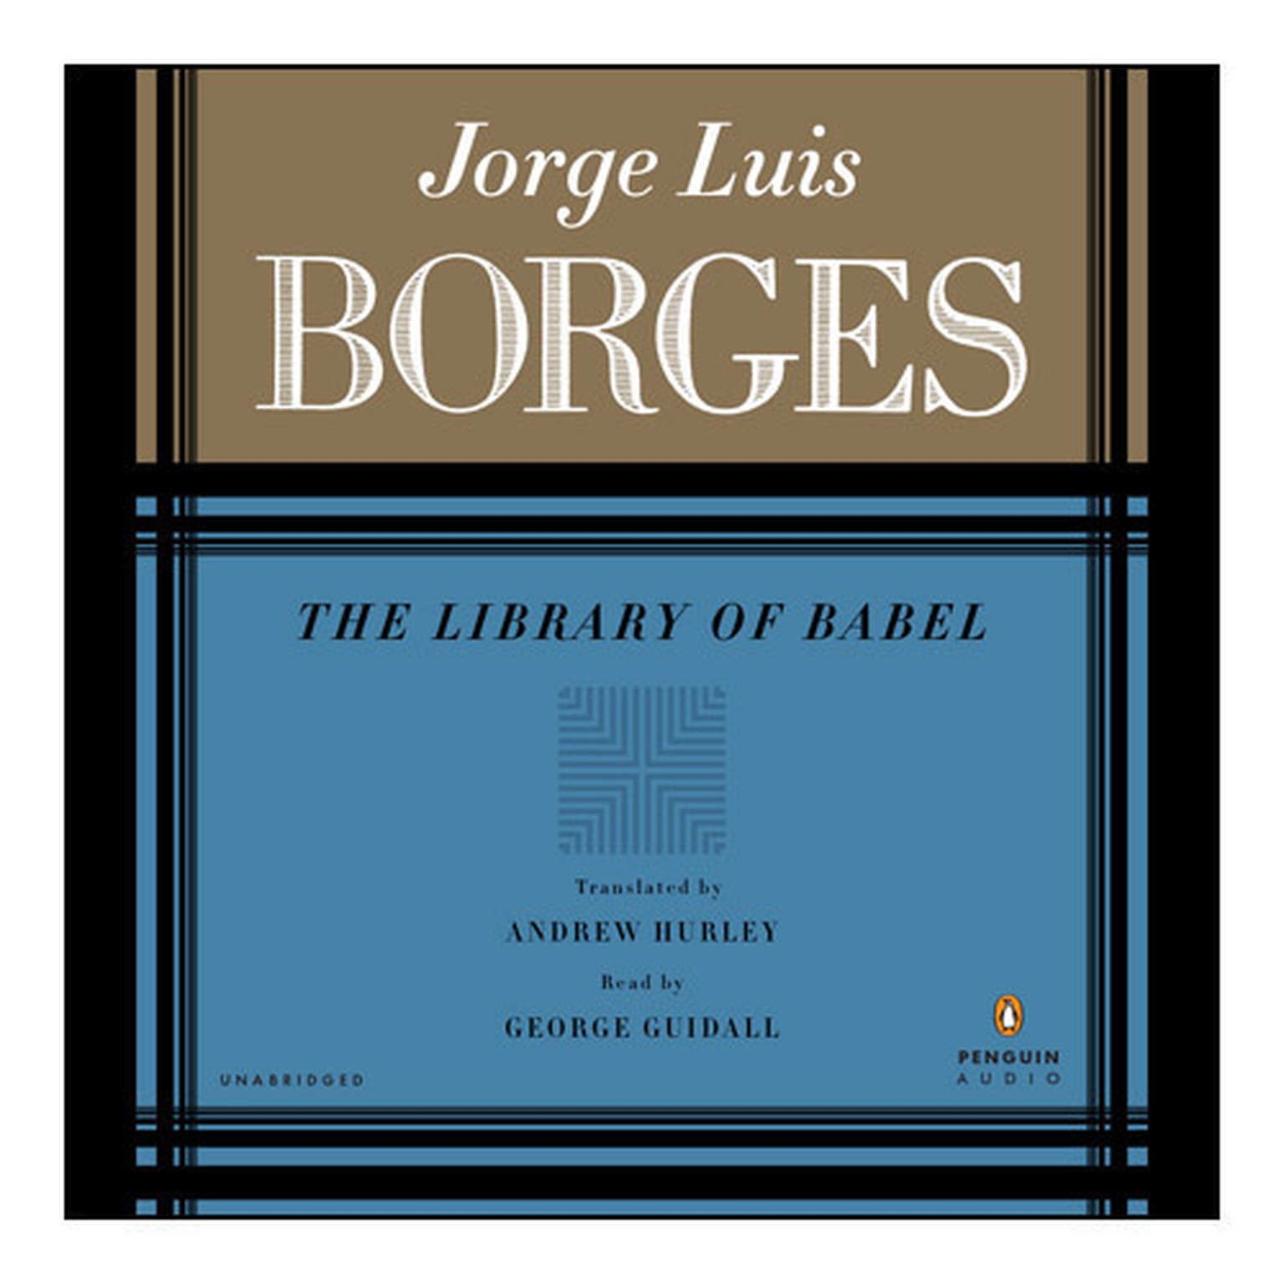
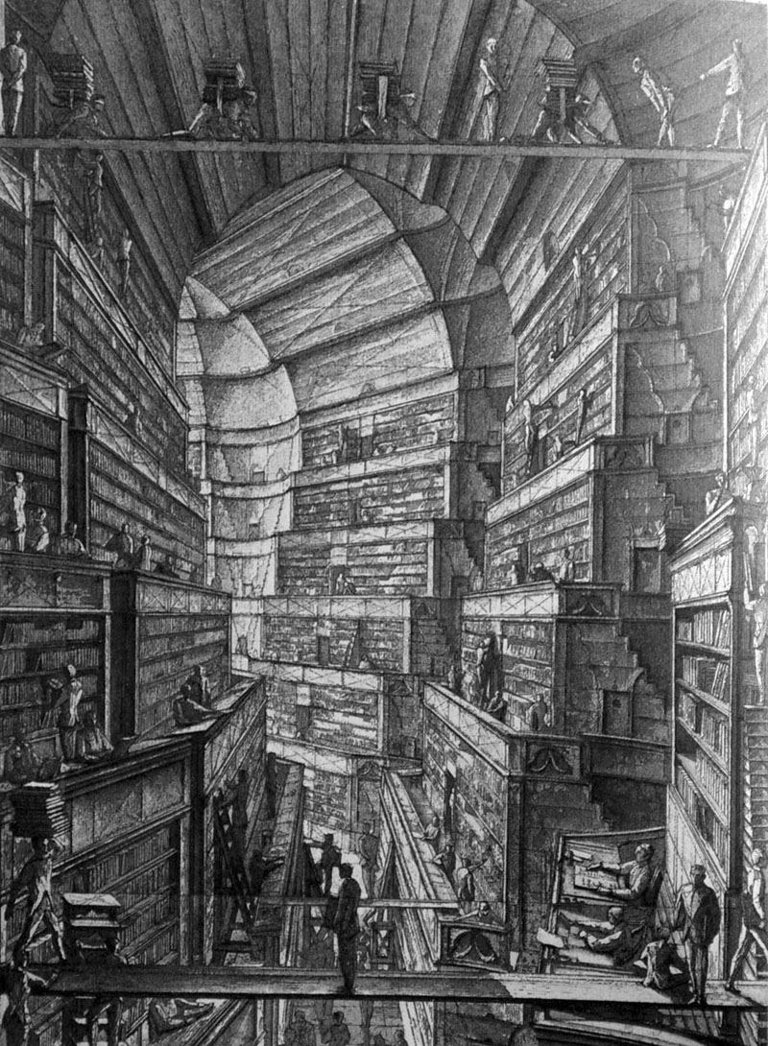

The Library of Babel: Visualizing $Σ∗$

Slide 12
Regular Languages
Recursively defining the set of all regular languages:
1. The empty set and $\{a\}$ for all $a$ in $$ are regular languages
2. If $L1$ and $L2$ and $L$ are regular languages, then:
(concatenation)
(union)
(Kleene closure)
are also regular languages
3. There are no other regular languages

Slide 13
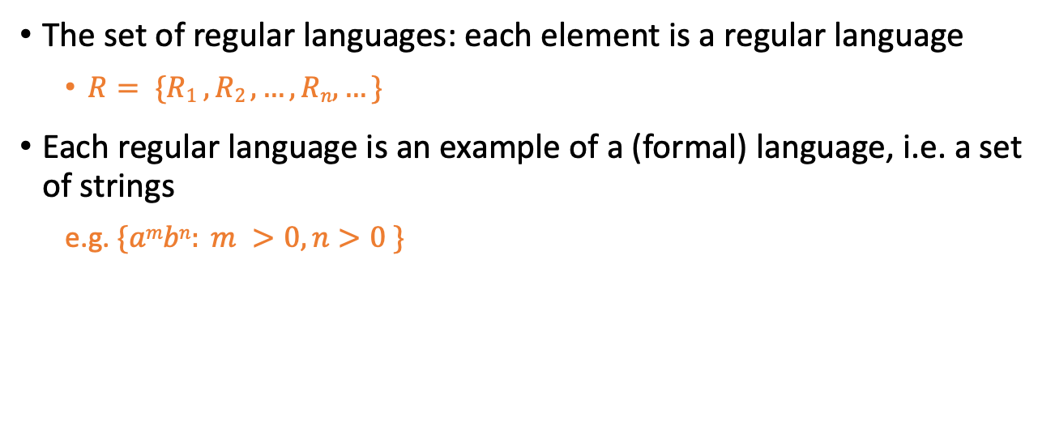
Regular Languages
The set of regular languages: each element is a regular language
$R= \{R1 , R2 , …, Rn,…\}$
Each regular language is an example of a (formal) language, i.e. a set of strings
e.g. $\{ambn: m >0, n>0 \}$

Slide 14
Formal Grammars
A formal grammar is a concise description of a formal language using a specialized syntax
For example, a regular expression is a concise description of a regular language
(a|b)*abb is the set of all strings over the alphabet {a, b} which end in abb
We will use regular expressions (regexps) in order to define tokens in our compiler,
e.g. Python integers are defined as the pattern [+-]?([1-9][0-9]*|0)
any number from 1 to 9
zero or more numbers from 0 to 9

Slide 15
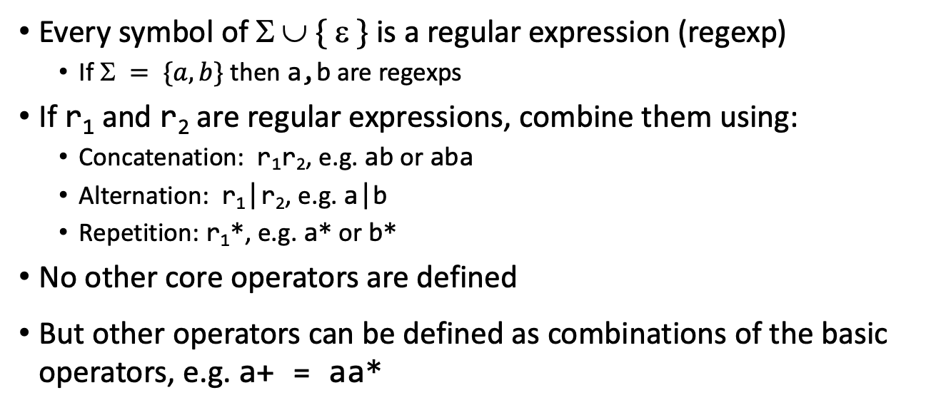
Regular Expressions: Definition
Every symbol of $  \{  \}$is a regular expression (regexp)
If $ = \{a,b\}$ then a,b are regexps
If r₁ and r₂ are regular expressions, combine them using:
Concatenation: r₁r₂, e.g. ab or aba
Alternation: r₁|r₂, e.g. a|b
Repetition: r₁*, e.g. a* or b*
No other core operators are defined
But other operators can be defined as combinations of the basic operators, e.g. a+ = aa*

Slide 16
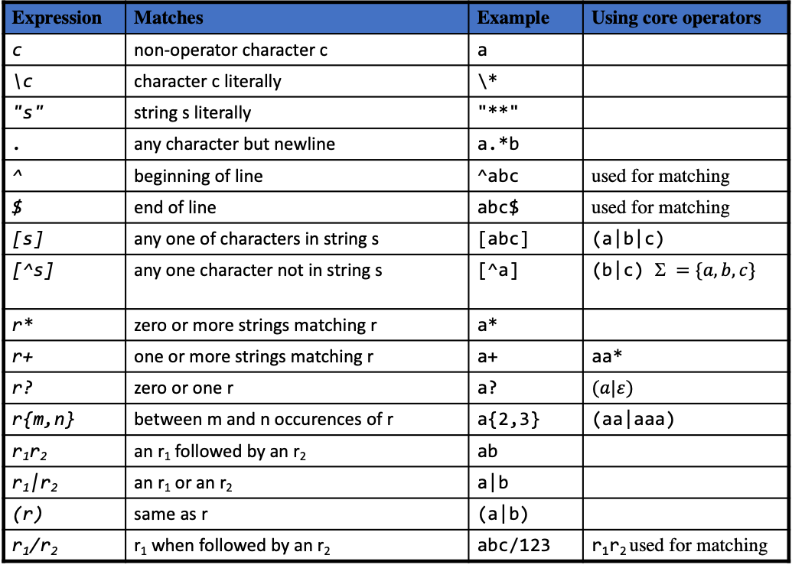
Lex regular expressions
Expression | Matches | Example | Using core operators
c | non-operator character c | a
\c | character c literally | \*
"s" | string s literally | "**"
. | any character but newline | a.*b
^ | beginning of line | ^abc | used for matching
$ | end of line | abc$ | used for matching
[s] | any one of characters in string s | [abc] | (a|b|c)
[^s] | any one character not in string s | [^a] | (b|c) $ =\{a,b,c\}$
r* | zero or more strings matching r | a*
r+ | one or more strings matching r | a+ | aa*
r? | zero or one r | a? | $$(a|ε)$$
r{m,n} | between m and n occurences of r | a{2,3} | (aa|aaa)
r₁r₂ | an r₁ followed by an r₂ | ab
r₁|r₂ | an r₁ or an r₂ | a|b
(r) | same as r | (a|b)
r₁/r₂ | r₁ when followed by an r₂ | abc/123 | r₁r₂ used for matching

Slide 17
Limitations(?) of Regular Expressions
Regexps can be used only if the language definition is sane
Should not permit crazy long-distance effects (e.g. Fortran)
DO 5 I = 1,5
T_DO T_INT(5) T_ID(I) T_EQ …
DO 5 I = 1.5
T_ID(DO 5 I) T_EQ T_FLOATCONST(1.5)

