Slide 1
Lexical Analysis
LEX1: Intro to Regexps
CMPT 379: Compilers
Instructor: Anoop Sarkar
anoopsarkar.github.io/compilers-class

Slide 2
Lexical Analysis
Also called lexing or scanning, take input program string and convert into tokens
Example
T_DOUBLE
(“double”)
T_IDENT
(“f”)
T_OP
(“=”)
T_IDENT
(“sqrt”)
double f = sqrt(-1);
T_LPAREN
(“(”)
T_OP
(“-”)
T_INTCONSTANT
(“1”)
T_RPAREN
(“)”)
T_SEP
(“;”)

Slide 3
Token Attributes
Some tokens have attributes:
T_IDENT (“sqrt”)
T_INTCONSTANT (“1”)
Other tokens do not:
T_WHILE
Source code location for error reports
A token is defined using a pattern.
The pattern for identifiers: a sequence of one or more letters, numbers and underscores which starts with a letter or underscore.
T_IDENT
(“sqrt”)
Token
Lexeme

Slide 4
Lexical errors
The lexer does not check for syntax errors!
What if user omits spaces: doublef=sqrt(-1);
No lexical error!
Single token is produced: T_IDENT(“doublef”)
Not two tokens: T_DOUBLE, T_IDENT(“f”)
Typically few lexical error types
Illegal chars
Unclosed string constants
Comments that are not terminated correctly
Q: What token(s) will be produced for input double(-1)

Slide 5
Lexical errors
Lexical analysis should not disambiguate tokens
e.g. unary operator − (minus) versus binary operator − (minus)
Use the same token T_MINUS for both
It’s the job of the parser to disambiguate based on the context
Regexps can be used only if the language definition is sane
Should not permit crazy long-distance effects (e.g. Fortran)
DO 5 I = 1,5
T_DO T_INT(5) T_ID(I) T_EQ …
DO 5 I = 1.5
T_ID(DO 5 I) T_EQ T_FLOATCONST(1.5)

Slide 6
Ad-hoc Lexer

Slide 7
Implementing Lexers: Loop and switch scanners
Big nested switch/case statements
Lots of getc()/ungetc() calls
Buffering and streams; Sentinels for push-backs
Can be error-prone
Changing or adding a keyword is problematic
Read source of an ad-hoc lexer: LexTokenInternal in clang

Slide 8
Implementing Lexers: Loop and switch scanners
Another problem: does the implementation exactly capture the language specification?
How can we show correctness?
Key idea: separate the definition of tokens from the implementation
Problem: we need to reason about patterns and how they can be used to define tokens (recognize strings).

Slide 9
Specifying Patterns using Regular Expressions

Slide 10
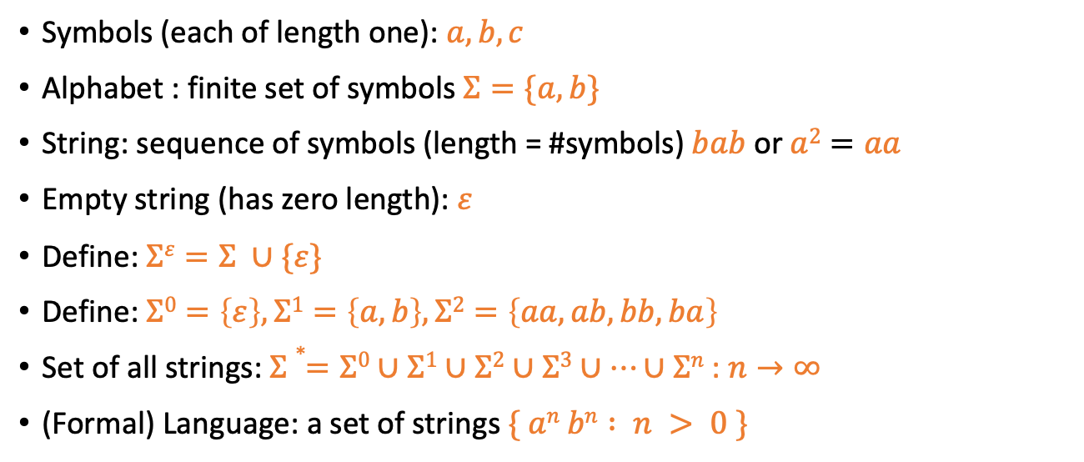
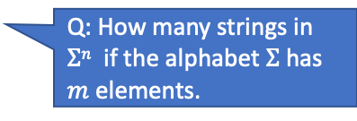
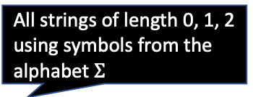
Formal Languages: Recap
Symbols (each of length one): $a, b, c$
Alphabet : finite set of symbols $Σ=\{a,b\}$
String: sequence of symbols (length = #symbols) $bab$ or $a2=aa$
Empty string (has zero length): $ε$
Define: $Σε=Σ ∪\{ε\}$
Define: $Σ0=\left\{ε\right\},Σ1=\left\{a,b\right\},Σ2=\left\{aa,ab,bb,ba\right\}$
Set of all strings: $Σ∗=Σ0∪Σ1∪Σ2∪Σ3∪…∪Σn$ : $n→∞$
(Formal) Language: a set of strings $\{ an bn : n > 0 \}$
All strings of length 0, 1, 2 using symbols from the alphabet $Σ$
Q: How many strings in $Σn$ if the alphabet $Σ$has $m$ elements.

Slide 11
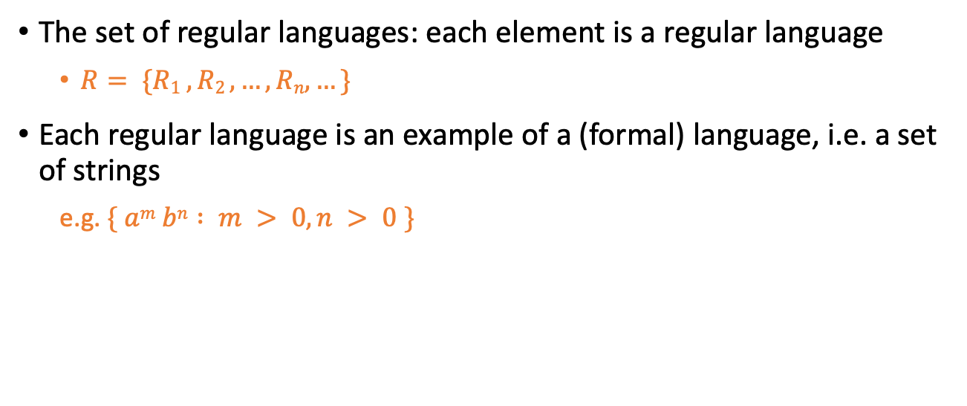
Regular Languages
The set of regular languages: each element is a regular language
$R= \{R1 , R2 , …, Rn,…\}$
Each regular language is an example of a (formal) language, i.e. a set of strings
e.g. $\{ am bn : m > 0, n > 0 \}$

Slide 12
Regular Languages
Recursively defining the set of all regular languages:
1. The empty set and $\{a\}$ for all $a$ in $$ are regular languages
2. If $L1$ and $L2$ and $L$ are regular languages, then:
(concatenation)
(union)
(Kleene closure)
are also regular languages
3. There are no other regular languages

Slide 13
Formal Grammars
A formal grammar is a concise description of a formal language using a specialized syntax
For example, a regular expression is a concise description of a regular language
(a|b)*abb is the set of all strings over the alphabet {a, b} which end in abb
We will use regular expressions (regexps) in order to define tokens in our compiler,
e.g. integers can be defined as the pattern [1-9][0-9]*
any number from 1 to 9
zero or more numbers from 0 to 9

Slide 14
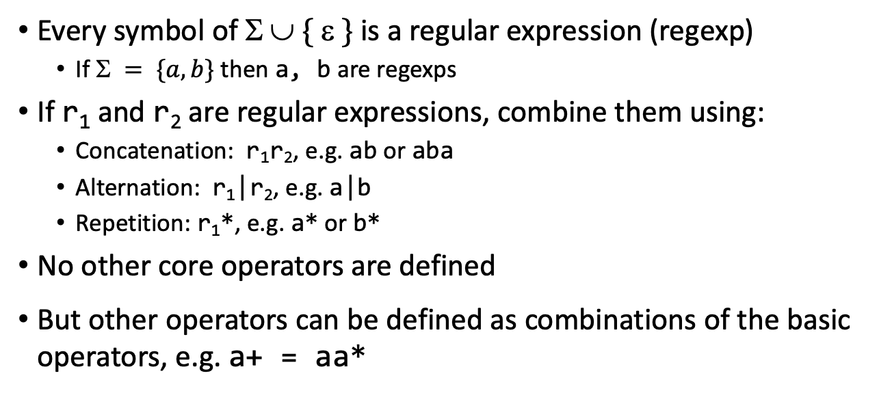
Regular Expressions: Definition
Every symbol of $  \{  \}$is a regular expression (regexp)
If $ = \{a,b\}$ then a, b are regexps
If r₁ and r₂ are regular expressions, combine them using:
Concatenation: r₁r₂, e.g. ab or aba
Alternation: r₁|r₂, e.g. a|b
Repetition: r₁*, e.g. a* or b*
No other core operators are defined
But other operators can be defined as combinations of the basic operators, e.g. a+ = aa*

Slide 15
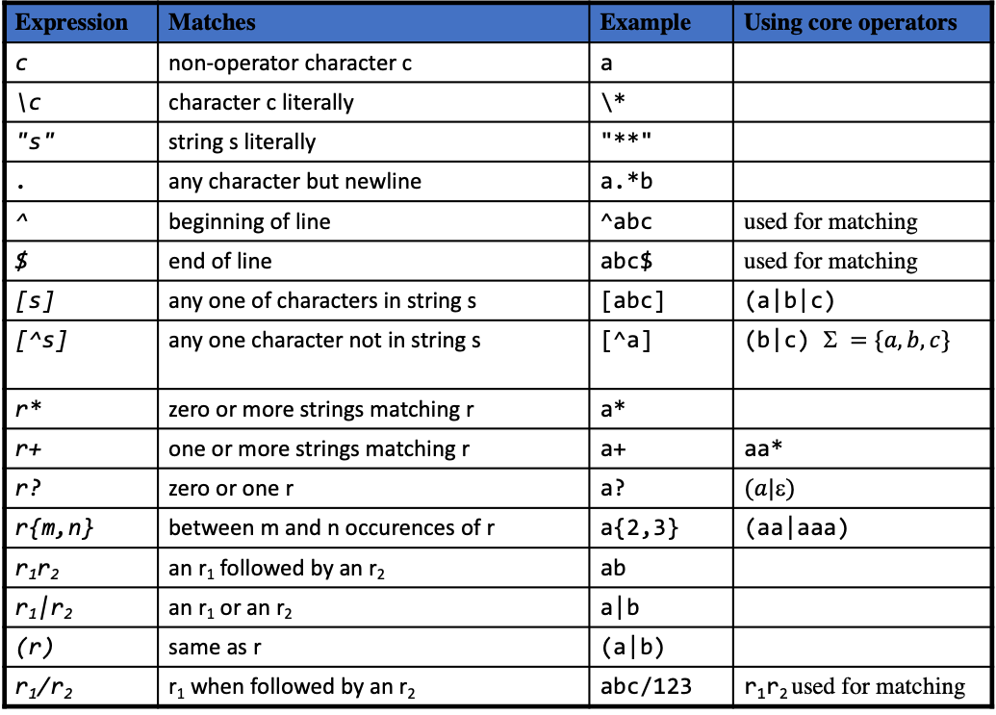
Lex regular expressions
Expression | Matches | Example | Using core operators
c | non-operator character c | a
\c | character c literally | \*
"s" | string s literally | "**"
. | any character but newline | a.*b
^ | beginning of line | ^abc | used for matching
$ | end of line | abc$ | used for matching
[s] | any one of characters in string s | [abc] | (a|b|c)
[^s] | any one character not in string s | [^a] | (b|c) $ =\{a,b,c\}$
r* | zero or more strings matching r | a*
r+ | one or more strings matching r | a+ | aa*
r? | zero or one r | a? | $$(a|)$$
r{m,n} | between m and n occurences of r | a{2,3} | (aa|aaa)
r₁r₂ | an r₁ followed by an r₂ | ab
r₁|r₂ | an r₁ or an r₂ | a|b
(r) | same as r | (a|b)
r₁/r₂ | r₁ when followed by an r₂ | abc/123 | r₁r₂ used for matching

