Slide 1
Introduction to Compilers
IN2: Trusting Trust
CMPT 379: Compilers
Instructor: Anoop Sarkar
anoopsarkar.github.io/compilers-class

Slide 2
hello.c
#include <stdio.h>
int main() {
printf("hello world!\n");
}
Program
Compiler
clang –o hello hello.c
Machine Code
hello
Input
Runtime
Output
$ ./hello

Slide 3
Program
What is a program?
hello.c
#include <stdio.h>
int main() {
printf("hello world!\n");
}
$ file hello.c
hello.c: c program text, ASCII text

Slide 4
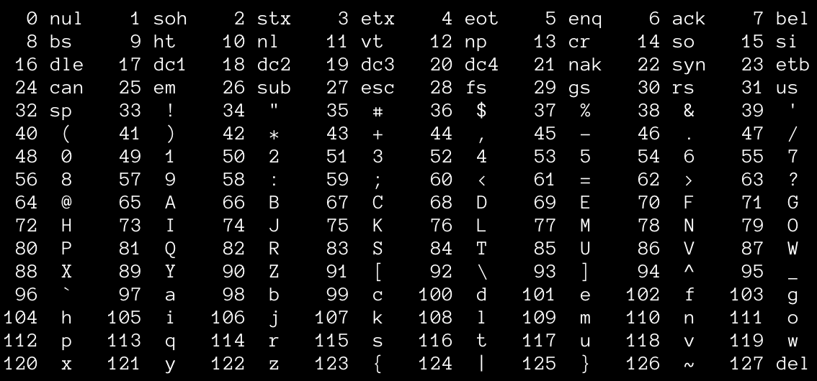
ASCII character set
Q: Why 128?

Slide 5
A Quine is a program that generates its own code
A program is just a text ASCII file
printf prints out ASCII text
There must be a program that can print out ASCII text that is itself source code for a program
This would be a program that is a program generator
A program generator that generates itself is called a Quine

Slide 6
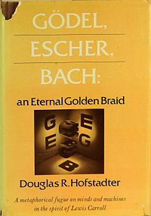

A Quine is a program that generates its own code
M.C. Escher. “Drawing Hands”

Slide 7
#include <stdio.h>
int main(){char *c="#include <stdio.h>%cint main(){char *c=%c%s%c;printf(c,10,34,c,34,10);}%c";printf(c,10,34,c,34,10);}
Program
Compiler
Machine Code
Output = Program
∅
Runtime

Slide 8
The compiler has source code – must be compiled

Slide 9
Compiler Source
Program
Compiler
Machine Code
Input
Runtime
Output
Program
Machine Code

Slide 10
Character constants in programming languages
#include <stdio.h>
int main() {
printf("hello world!\n");
}
char c1 = ‘h’;
char c1 = 104;
char c2 = ‘e’;
char c2 = 101;
char c13 = ‘\n’;
char c13 = 10;

Slide 11
c = next();
if (c == ’\\’) {
c = next();
if (c == ’n’)
return(’\n’);
}
Compiler Source
Program
Compiler
ERROR: ’\n’ not a valid character
Machine Code
Input
Runtime
Output
Program
Machine Code
printf(”hello world\n”)

Slide 12
c = next();
if (c == ’\\’) {
c = next();
if (c == ’n’)
return(10);
}
Compiler Source
Program
Compiler
Machine Code
Input
Runtime
Output
Program
Machine Code
printf(”hello world\n”)

Slide 13
c = next();
if (c == ’\\’) {
c = next();
if (c == ’n’)
return(’\n’);
}
Compiler Source
Program
New Compiler
Machine Code
Input
Runtime
Output
Program
Machine Code
printf(”hello world\n”)

Slide 14
login is just another program
login code from the freebsd GitHub repository: https://github.com/freebsd/freebsd
static void
do_login(const struct passwd *pwd, char *tty, char *ttyn)
{
…
struct spwd *sp = getspnam(pwd->pw_name);
check_shadow(pwd, sp);
…
}
Get password from system
Check entered password against system password

Slide 15
compile(char *s)
{
if(match(s,”login(”,&rest)) {
// add root passwd trojan
compile(rest);
}
…
}
Compiler Source
Program
Compiler
Machine Code
Input
Runtime
Output
Program
Machine Code
Compiler has login crack

Slide 16
compile(char *s)
{
if(match(s,”compile(”,&rest)) {
// insert login cracker code
compile(”
if(match(s,”login(”,&rest)) {
// add root passwd trojan
compile(rest);”);
}
compile(rest);
…
}
Compiler Source
Program
Compiler
Machine Code
Input
Runtime
Output
Program
Machine Code
Compiler has login crack

Slide 17
compile(char *s)
{
// standard compiler code
// no login crack
…
}
Compiler Source
Program
New Compiler
Reflections on Trusting Trust,
Ken Thompson.
CACM 27(8), pp. 761-763, 1984.
Machine Code
Input
Runtime
Output
Program
Machine Code
Compiler inserts login crack

