Slide 1
Lexical Analysis
LEX3: Regexps are Trees
CMPT 379: Compilers
Instructor: Anoop Sarkar
anoopsarkar.github.io/compilers-class

Slide 2
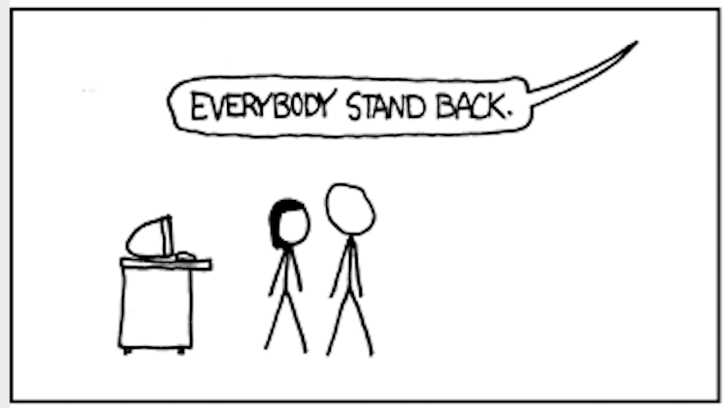
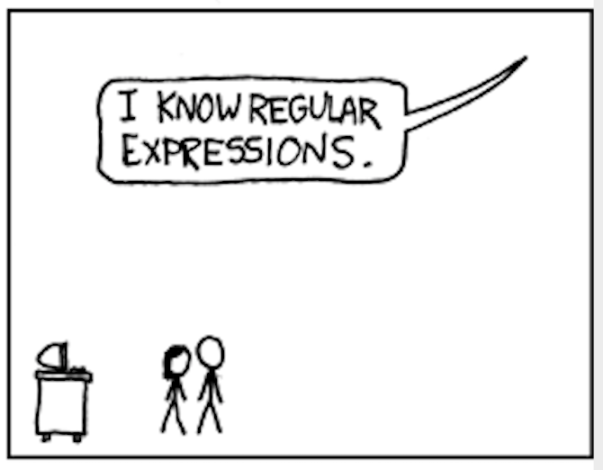
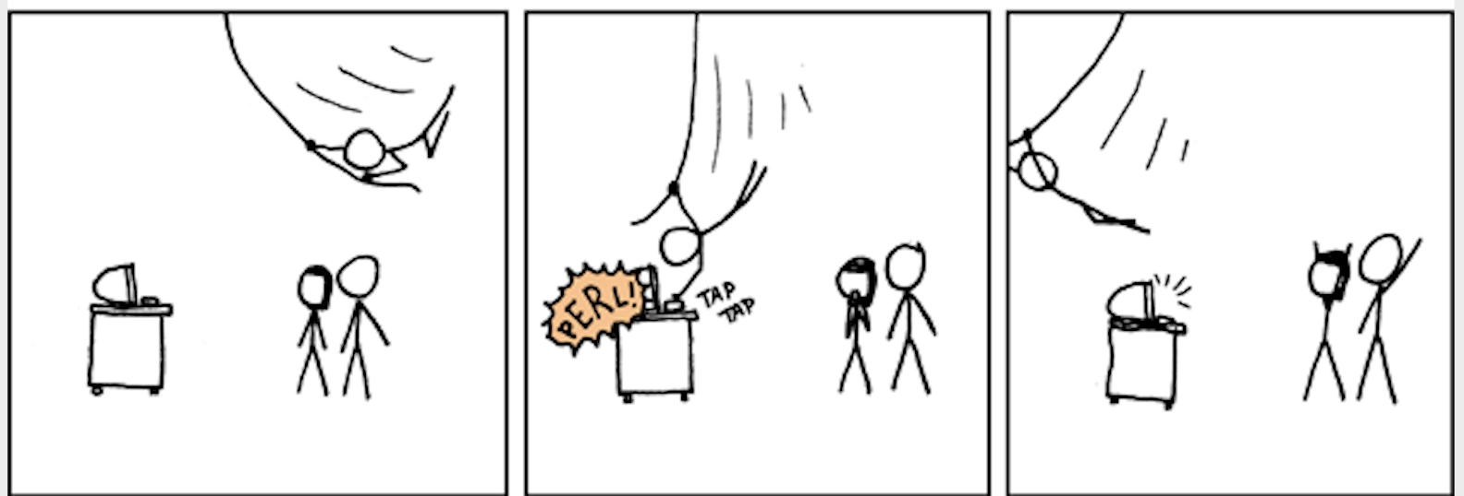
Nope! You don’t know regexps (yet)!
xkcd.com/208

Slide 3
Regular Expressions are Trees

Slide 4
Regular Expressions are ambiguous
Q: How many possible trees for regexp ab*|c*
(((ac)|b)c)
Regexp operator precedence rules
Grouping using parentheses ()
Unary operator *
Binary operator for concatenation
Binary operator for alternation |
(a((c|b)c))
ac|bc
(a(c|(bc)))
Q: Find the smallest set of strings that can find the above operator precedence rules for the regexp ac|bc.
((a(c|b))c)
Hint: Compare the matching on input strings between the original regexp ac|bc and the 5 unambiguous regexps.
((ac)|(bc))

Slide 5
Regular expressions are trees
Q: Provide the unambiguous bracketed tree for regexp ab*|c* using the precedence and associativity rules
|
*
⋅
Both alternation and concatenation are commutative, so we use left associativity to get a unique tree.
*
⋅
c
⋅
⋅
a
b
a
c
b
c
a
ac|bc
a**
abc
((ac)|(bc))
((a*)*)
((ab)c)

Slide 6
Equivalence of Regular Expressions

Slide 7
Equivalence of Regexps
(0(10)*1)|(01)* == (01)* ?
(R|S)|T == R|(S|T)
R|(S|T) == R|S|T
(RS)T == R(ST)
(R|S) == (S|R)
R*R* == (R*)*
(R*)* == R*
R* == RR*| ε
R** == R*
(R|S)T = (RT|ST)
R(S|T) == RS | RT
(R|S)* == (R*S*)*
(R*S*)* == (R*S)*R*
(R*S)*R* == (R*|S*)*
RR* == R*R
(RS)*R == R(SR)*
R == R|R
R|R = Rε

Slide 8
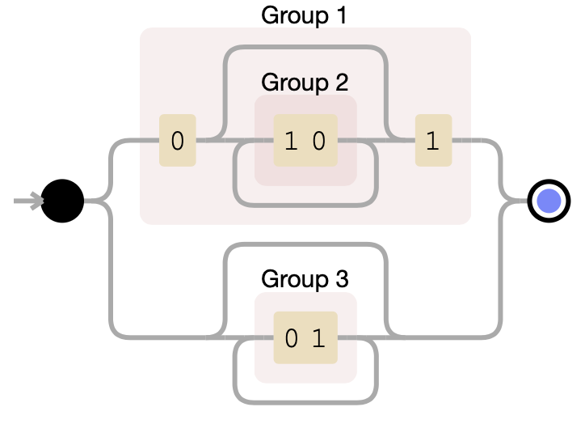
Equivalence of Regexps
debuggex.com
(0(10)*1)|(01)* == (01)* ?

Slide 9
Equivalence of Regexps
Q: Show that 1(0|(01)*) is equivalent to 10|(10)*1
(0(10)*1)|(01)*
(01(01)*)|(01)*
(01(01)*)|(01)*
((01)(01)*)|(01)*
((01)(01)*)|(01)*
(01)+|(01)*
(01)+|(01)*
(01)*
(RS)*R == R(SR)*
RS == (RS)
R+ == RR*
R+|R* == (RR*)|R* == R*

