Slide 1
LR Parsing
LR1: Shift-Reduce Parsing
CMPT 379: Compilers
Instructor: Anoop Sarkar
anoopsarkar.github.io/compilers-class

Slide 2
Top-Down vs. Bottom Up
Grammar:
S → A B
A → c | ε
B → cbB | ca
Input String: ccbca
Top-Down/leftmost |  | Bottom-Up/rightmost
S ⇒ AB ⇒ cB ⇒ ccbB ⇒ ccbca | S→AB A→c B→cbB B→ca | ccbca ⇐ Acbca ⇐ AcbB ⇐ AB ⇐ S | A→c B→ca B→cbB S→AB

Slide 3
Bottom-Up parsing
Bottom-up parsing reduces a string to the start symbol by inverting the derivation
E → T + E
E → T
T → id
T → id * T
T → ( E )
id * id + id
id * T + id
T + id
T + T
T + E
E
T → id
T → id * T
T → id
E → T
E → T + E
This is a rightmost derivation!

Slide 4
Bottom-up parse tree construction
Q: Write down the right sequence of shift-reduce actions and draw the parse tree for input id*(id*id)
A shift-reduce parser traces a rightmost derivation in reverse
E → T + E
E → T
T → id
T → id * T
T → ( E )
id * id + id
id * T + id
T + id
T + T
T + E
E
E
T
E
T
T
id
*
id
+
id
Parse tree

Slide 5
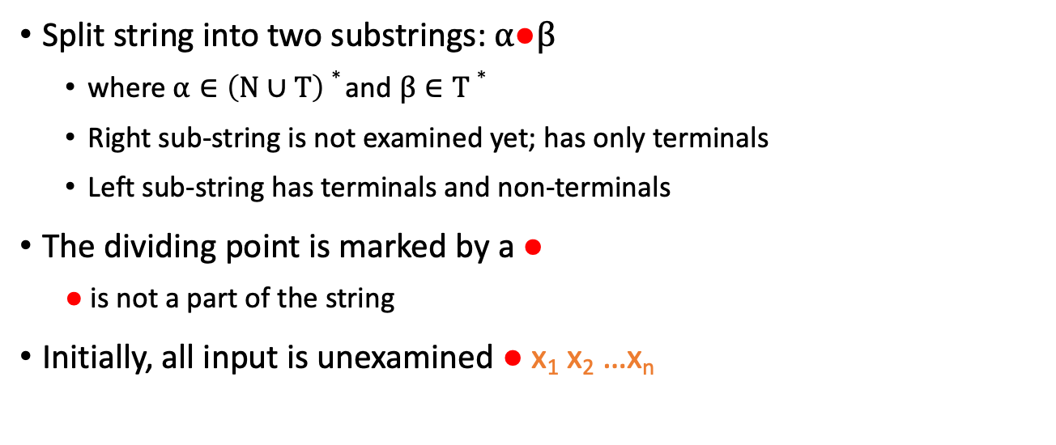
Notation
Split string into two substrings: $α●β$
where $α∈\left(N∪T\right)∗$ and $β∈T∗$
Right sub-string is not examined yet; has only terminals
Left sub-string has terminals and non-terminals
The dividing point is marked by a $●$
$●$ is not a part of the string
Initially, all input is unexamined ● x₁ x₂ …x_{n}

Slide 6
Shift-Reduce Parsing
Shift-reduce parsing uses only two kinds of actions:
Shift: Move ● one place to the right
Shift a terminal to the left string
ABC ● xyz ⇒ ABCx ● yz
Reduce: Apply a CFG rule to the string left of the ●
If A → xy is a production, then reduce
Cbxy ● ijk ⇒ CbA ● ijk

Slide 7
Shift-Reduce Parsing
E → T + E
E → T
T → id
T → id * T
T → ( E )
● id * id + id
id ● * id + id
id * ● id + id
id * id ● + id
id * T ● + id
T ● + id
T + ● id
T + id ●
T + T ●
T + E ●
E ●
Shift
Shift
Shift
Reduce T → id
Reduce T → id * T
Shift
Shift
Reduce T → id
Reduce E → T
Reduce E → T + E

Slide 8
Shift-Reduce Parsing
E → T + E
E → T
T → id
T → id * T
T → ( E )
● id * id + id
id ● * id + id
id * ● id + id
id * id ● + id
id * T ● + id
T ● + id
T + ● id
T + id ●
T + T ●
T + E ●
E ●
E
T
E
T
T
id
*
id
+
id

Slide 9
Stack
Left part of the string is implemented by a stack
Top of the stack is left of the ●
Shift pushes a terminal on the stack
Reduce
Pops 0 or more symbols off of the stack (rhs of one rule from the CFG)
Pushes a non-terminal on the stack (lhs of one rule from the CFG)

Slide 10
Conflicts
In a given state, more than one action (shift/reduce) may lead to different valid parse
If it is legal to either shift or reduce: shift-reduce conflict
Can be fixed (precedence and associativity declaration)
If it is legal to reduce by two different rules: reduce-reduce conflict
There is ambiguity in the grammar
Might be fixed by additional lookahead

Slide 11
When to shift/reduce?
E → T + E
E → T
T → id
T → id * T
T → ( E )
Consider step id ● * id + id
Shift action: id *● id +id
Reduce action: reduce by T→id giving T●*id +id
It causes fatal error:
No way to reduce to the start symbol E
Reduce is possible, but it is not a valid action
Q: For the same input id*id+id find another shift/reduce choice in the derivation where a shift over reduce leads to id*E which cannot be reduced further.

Slide 12
Viable Prefix and Handle
Intuition: reduce only if we can eventually reach the start symbol
Assume a rightmost derivation
S ⇒ * 𝜶X𝜷 ⇒ 𝜶w𝜷
Then 𝜶w is a viable prefix of 𝜶w𝜷
A handle w is valid if we can reduce w to X
We only reduce a handle
A handle always appears on top of the stack, never inside
reduction

Slide 13
Bottom-up Shift-Reduce Parsing Algorithms
LR(k) parsing:
L: scan input Left-to-right
R: produce Rightmost derivation
k: tokens of lookahead (k=1 is sufficient)
LR(0): zero tokens of lookahead
SLR: Simple LR, similar to LR(0), but uses Follow sets
LALR(k)
These algorithms work with left- or right-recursive grammars

Slide 14
Recognizing a Viable Prefix
LR parsing algorithms are based on recognizing viable prefixes
We can identify viable prefixes only for a subset of CFGs
Adding lookahead helps: (0) or (1) or (k) symbols of lookahead
For this subset of CFGs, LR parsing is a deterministic linear-time algorithm.

Slide 15
Hierarchy of grammars
All CFGs
Unambiguous CFGs
LR(k) CFGs
LALR(k) CFGs
SLR(k) CFGs
LR(0) CFGs

