Slide 1
Context-Free Grammars
CFG1: Intro to CFGs
CMPT 379: Compilers
Instructor: Anoop Sarkar
anoopsarkar.github.io/compilers-class

Slide 2
Parsing
token
source program
Lexical Analyzer
Parser
parse tree
Later Stages
next()
String of characters
flex: yylex()
Lexical Errors
Syntax Errors

Slide 3
Parsing
Not all string of tokens are valid programs
Parser distinguishes between valid and invalid programs
We need
A language for describing valid string of tokens
A method for distinguishing valid from invalid programs

Slide 4
Context-free Grammars (CFGs)
Programming languages have recursive structure
An EXP is …
Context Free Grammars are natural notation for the recursive structures
if EXP then
EXP
else
EXP
while EXP do
EXP
end

Slide 5
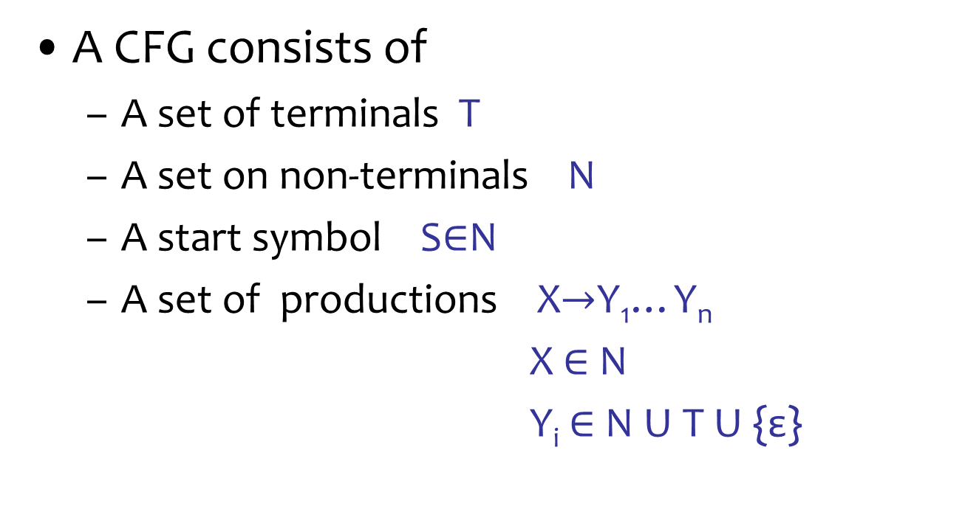
Context-free Grammars (CFGs)
A CFG consists of
A set of terminals T
A set on non-terminals N
A start symbol S$∈$N
A set of productions X$→$Y₁…Y_{n}
X$∈$N
Y_{i} $∈$ N U T U {ε}

Slide 6

Context-free Grammars (CFGs)
{$(^{i})^{i} | i≥0$ }
S $→$ ( S )
S $→$ ε
Productions:
N = {S}
T = { ( , ) }

Slide 7
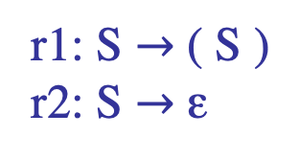
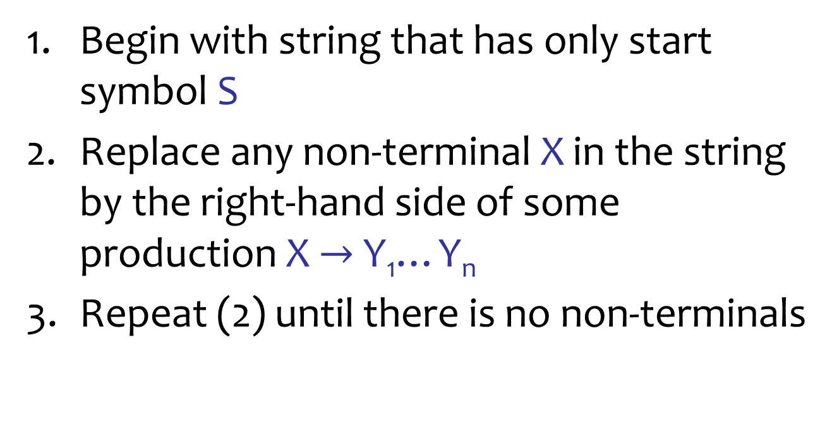
Context-free Grammars (CFGs)
Begin with string that has only start symbol S
Replace any non-terminal X in the string by the right-hand side of some production X $→$ Y₁…Y_{n}
Repeat (2) until there is no non-terminals
r1: S $→$ ( S )
r2: S $→$ ε
S ⇒^{r1}
( S ) ⇒^{r1}
( ( S ) ) ⇒^{r2}
( ( ) )

Slide 8
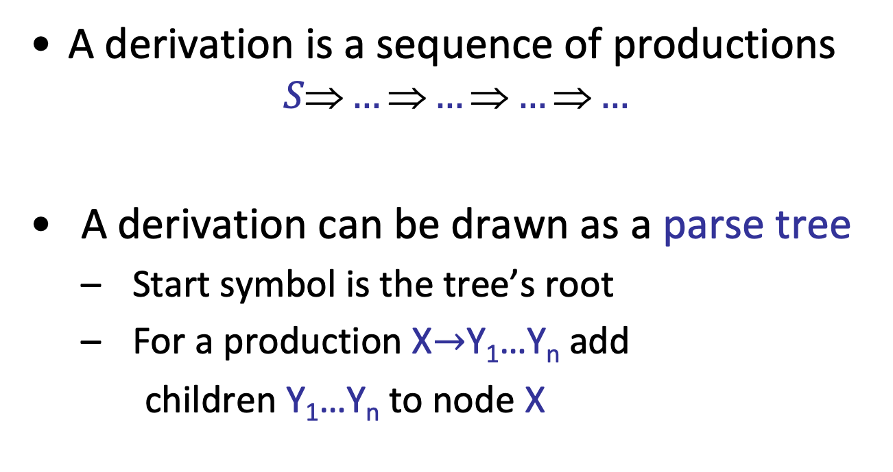
Derivation and Parse Tree
A derivation is a sequence of productions
$$S\text{⇒}…\text{⇒}…\text{⇒}…\text{⇒}…$$
A derivation can be drawn as a parse tree
Start symbol is the tree’s root
For a production X$→$Y₁…Y_{n} add
children Y₁…Y_{n} to node X
X
Y₁
…
Y_{n}

Slide 9
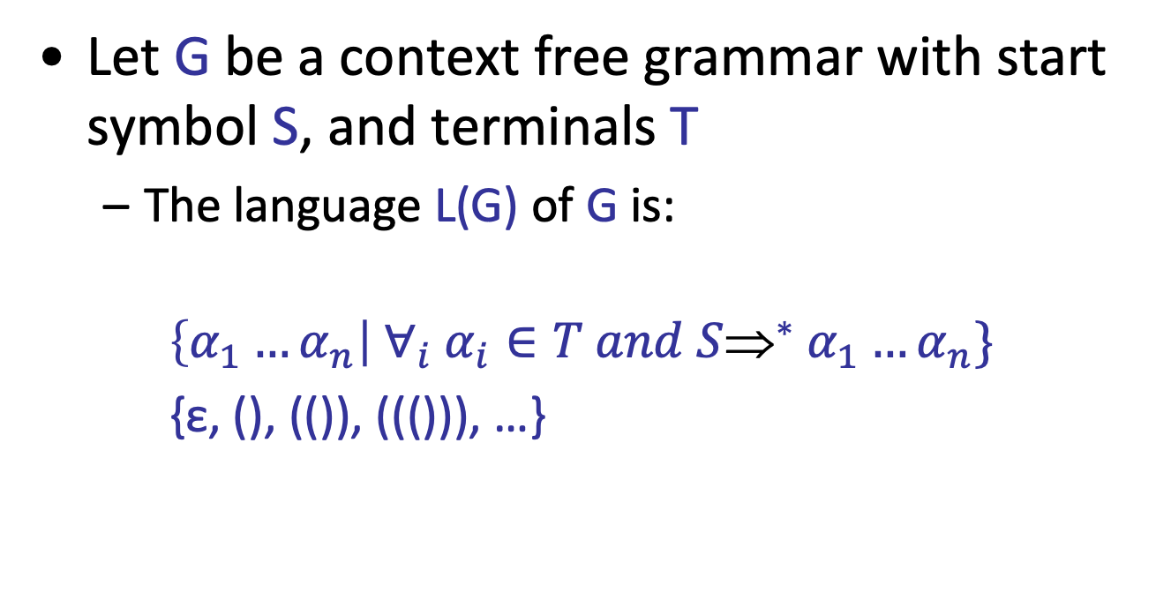
Language of CFGs
Let G be a context free grammar with start symbol S, and terminals T
The language L(G) of G is:
$$\left\{α_{1}…α_{n}\right| ∀_{i} α_{i}∈T and S{\text{⇒}}^{∗} α_{1}…α_{n}\}$$
{ε, (), (()), ((())), …}

Slide 10
Arithmetic Expressions
E → E + E
E → E * E
E → ( E )
E → - E
E → id

Slide 11
Derivation for id + id * id
Leaves nodes: terminals
Interior nodes:
non-terminals
E → E + E
E → E * E
E → ( E )
E → - E
E → id
E ⇒ E + E
⇒ id + E
⇒ id + E * E
⇒ id + id * E
⇒ id + id * id
E
E
+
E
id
E
*
E
Notation: E ⇒* id + id * id
id
id

Slide 12
Leftmost derivation for id + id * id
E → E + E
E → E * E
E → ( E )
E → - E
E → id
E ⇒ E * E
⇒ E + E * E
⇒ id + E * E
⇒ id + id * E
⇒ id + id * id
E
E
*
E
E
+
E
id
Parse tree gives a
meaning to the string
(id+id)*id vs id+(id*id)
id
id

Slide 13
Rightmost derivation for id + id * id
E → E + E
E → E * E
E → ( E )
E → - E
E → id
E ⇒ E * E
⇒ E * id
⇒ E + E * id
⇒ E + id * id
⇒ id + id * id
E
E
*
E
E
+
E
id
id
id

Slide 14
Rightmost vs. Leftmost Derivation
Note that rightmost and leftmost derivations have the same parse tree
Every parse tree has a rightmost and a leftmost derivation
Important in resolving ambiguity

Slide 15
Writing a CFG for a PL
First write (or read) a reference grammar of what you want to be valid programs
For now, we only worry about the structure, so the reference grammar might choose to over-generate in certain cases (e.g. bool x = 20; )
Convert the reference grammar to a CFG

Slide 16
Arithmetic Expressions
E → E + E { $$ = $1 + $3 }
E → E * E { $$ = $1 * $3 }
E → ( E ) { $$ = $2 }
E → - E { $$ = -1 * $2 }
E → id { $$ = $1 }
25
E
5
E
*
E
5
2
E
+
3
E
id(5)
id(2)
id(3)

Slide 17
CFG Notation
Normal CFG notation
E → E * E
E → E + E
Backus Naur notation
E ::= E * E | E + E
(an or-list of right hand sides)
Also:
E = E “*” E | E “+” E

