Slide 1
Lexical Analysis
LEX2: Regular Expressions
CMPT 379: Compilers
Instructor: Anoop Sarkar
anoopsarkar.github.io/compilers-class

Slide 2
Regular Languages
The set of regular languages: each element is a regular language
R= {R₁ , R₂ , …, R_{n},…}
Each regular language is an example of a (formal) language, i.e. a set of strings
R₁ = {a}, R₂ = {a, aa, aaa, ...}, R₃ = {b},
R₄ = {ba, ab}, R₅ = {ε, b, bb, bbb, …}, …

Slide 3
Regular Expressions: Definition
Meaning function L maps syntax to semantics
L(r) = Meaning of regexp r (a regular language)
a* = {ε, a, aa, aaa, …}
𝜖 = ‘’
c = c
A|B = A ⋃ B
AB = ab | a ∈ A and b ∈ B
A² = xy | x ∈ A and y ∈ A
A* = A⁰ ⋃ A¹ ⋃ A² ⋃ A³ ...

Slide 4
Regular Expressions: Definition
Meaning function L maps syntax to semantics
L(r) = Meaning of regexp r (a regular language)
L(a*) = {ε, a, aa, aaa, …}
L(𝜖) = {‘’}
L(c) = {c}
L(A|B) = L(A) ⋃ L(B)
L(AB) = { ab | a ∈ L(A) and b ∈ L(B) }
L(A²) = { xy | x ∈ L(A) and y ∈ L(A) }
L(A*) = L(A⁰) ⋃ L(A¹) ⋃ L(A²) ⋃ L(A³) ...

Slide 5
Regular Expressions
Why use meaning function?
Make clear what is syntax and what is semantics
Allow us to consider notation as a separate issue

Slide 6
Regular Expressions
Why use meaning function?
Make clear what is syntax and what is semantics
Allow us to consider notation as a separate issue
Identifier:
Sequence of letters r₁
Sequence of letters and digits r₂

Slide 7
Integer: a non-empty sequence of digits

Slide 8
Integer: a non-empty sequence of digits
(0|1|2|3|4|5|6|7|8|9)

Slide 9
Integer: a non-empty sequence of digits
digit =
(0|1|2|3|4|5|6|7|8|9)

Slide 10
Integer: a non-empty sequence of digits
digit =
(0|1|2|3|4|5|6|7|8|9)
{digit}*
Notes:
Most tools have facility for naming expressions.

Slide 11
Integer: a non-empty sequence of digits
digit =
(0|1|2|3|4|5|6|7|8|9)
{digit}{digit}*
Notes:
Most tools have facility for naming expressions.

Slide 12
Integer: a non-empty sequence of digits
digit =
(0|1|2|3|4|5|6|7|8|9)
{digit}{digit}*
{digit}+
Notes:
Most tools have facility for naming expressions.

Slide 13
Identifier: sequence of letters or digits, starting with a letter
Notes:
Let’s see a more sophisticated example. We want to see that how we can recognize Identifiers using regular expressions.

Slide 14
Identifier: sequence of letters or digits, starting with a letter
digit =
(0|1|2|3|4|5|6|7|8|9)
Notes:
Let’s see a more sophisticated example. We want to see that how we can recognize Identifiers using regular expressions.

Slide 15
Identifier: sequence of letters or digits, starting with a letter
digit =
(0|1|2|3|4|5|6|7|8|9)
letter =
(a|b|c|…|z|A|B|…|Z)
Notes:
Let’s see a more sophisticated example. We want to see that how we can recognize Identifiers using regular expressions.

Slide 16
Identifier: sequence of letters or digits, starting with a letter
digit =
(0|1|2|3|4|5|6|7|8|9)
letter =
(a|b|c|…|z|A|B|…|Z)
[a-z]
Notes:
Let’s see a more sophisticated example. We want to see that how we can recognize Identifiers using regular expressions.

Slide 17
Identifier: sequence of letters or digits, starting with a letter
digit =
(0|1|2|3|4|5|6|7|8|9)
letter =
(a|b|c|…|z|A|B|…|Z)
[a-zA-Z]
Notes:
Let’s see a more sophisticated example. We want to see that how we can recognize Identifiers using regular expressions.

Slide 18
Identifier: sequence of letters or digits, starting with a letter
digit =
[0-9]
letter =
[a-zA-Z]
Notes:
Let’s see a more sophisticated example. We want to see that how we can recognize Identifiers using regular expressions.

Slide 19
Identifier: sequence of letters or digits, starting with a letter
digit =
[0-9]
letter =
[a-zA-Z]
{letter}
Notes:
Let’s see a more sophisticated example. We want to see that how we can recognize Identifiers using regular expressions.

Slide 20
Identifier: sequence of letters or digits, starting with a letter
digit =
[0-9]
letter =
[a-zA-Z]
{letter}({letter}|{digit})*
Notes:
Let’s see a more sophisticated example. We want to see that how we can recognize Identifiers using regular expressions.

Slide 21
Whitespace: a non-empty sequence of blanks, newlines and tabs
Notes:
Let’s see a more sophisticated example. We want to see that how we can recognize Identifiers using regular expressions.

Slide 22
Whitespace: a non-empty sequence of blanks, newlines and tabs
" "
Notes:
Let’s see a more sophisticated example. We want to see that how we can recognize Identifiers using regular expressions.

Slide 23
Whitespace: a non-empty sequence of blanks, newlines and tabs
" "|"\t"
Notes:
Let’s see a more sophisticated example. We want to see that how we can recognize Identifiers using regular expressions.

Slide 24
Whitespace: a non-empty sequence of blanks, newlines and tabs
" "|"\t"|"\n"
Notes:
Let’s see a more sophisticated example. We want to see that how we can recognize Identifiers using regular expressions.

Slide 25
Whitespace: a non-empty sequence of blanks, newlines and tabs
(" "|"\t"|"\n")+
Notes:
Then we wrap the whole union in a paranthesis and put a plus on it and that’ gives us what we need. We have to have a naming for characters which does not have a nice print representation. Not only these characters, there are some chars which have worse representation or does not have any represention at all but still they might embed somewhere in the input program file.

Slide 26
Definition of Numbers
digit = [0-9]
digits = [0-9]+
opt_frac = ("."{digits})?
opt_exp = (E(\+|\-)?{digits})?
num = {digits}{opt_frac}{opt_exp}
Notes:
Then we wrap the whole union in a paranthesis and put a plus on it and that’ gives us what we need. We have to have a naming for characters which does not have a nice print representation. Not only these characters, there are some chars which have worse representation or does not have any represention at all but still they might embed somewhere in the input program file.

Slide 27
Definition of Numbers
digit = [0-9]
digits = [0-9]+
opt_frac = ("."{digits})?
opt_exp = (E(\+|\-)?{digits})?
num = {digits}{opt_frac}{opt_exp}
345 , 345.04 , 2.14+e7
Notes:
Then we wrap the whole union in a paranthesis and put a plus on it and that’ gives us what we need. We have to have a naming for characters which does not have a nice print representation. Not only these characters, there are some chars which have worse representation or does not have any represention at all but still they might embed somewhere in the input program file.

Slide 28
Lex regular expressions
Expression | Matches | Example | Using core operators
c | non-operator character c | a
\c | character c literally | \*
"s" | string s literally | "**"
. | any character but newline | a.*b
^ | beginning of line | ^abc | used for matching
$ | end of line | abc$ | used for matching
[s] | any one of characters in string s | [abc] | (a|b|c)
[^s] | any one character not in string s | [^a] | (b|c) where  = {a,b,c}
r* | zero or more strings matching r | a*
r+ | one or more strings matching r | a+ | aa*
r? | zero or one r | a? | (a|ε)
r{m,n} | between m and n occurences of r | a{2,3} | (aa|aaa)
r₁r₂ | an r₁ followed by an r₂ | ab
r₁|r₂ | an r₁ or an r₂ | a|b
(r) | same as r | (a|b)
r₁/r₂ | r₁ when followed by an r₂ | abc/123 | used for matching

Slide 29
Regular Expressions for Lexical Analysis

Slide 30
Write a regexp for the lexemes of each token class
Integer = digit+
Identifier = letter(letter|digit)+
Lparen = ‘(‘
. . .
Construct R, matching all lexemes for all tokens.
R = Integer | identifier | . . .
= R₁ | R₂ | R₃ | …

Slide 31
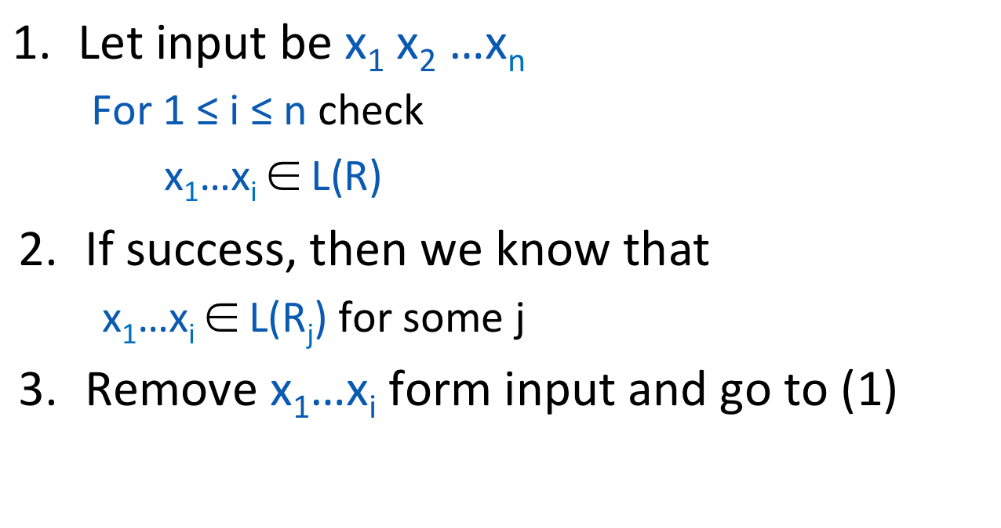
Lexical Analyzer
R = R₁ | R₂ | . . . | R_{n}

Slide 32
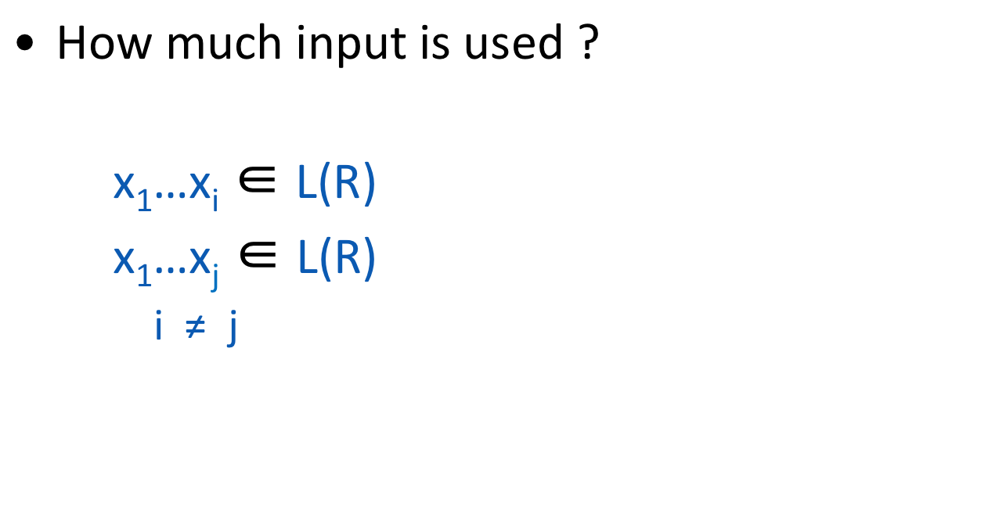
Lexical Analyzer
x₁ x₂ x₃ x₄ x₅ x₆ x₇ . . .
==
T_ASSIGN
T_EQ
Maximal Munch
max(i, j)

Slide 33
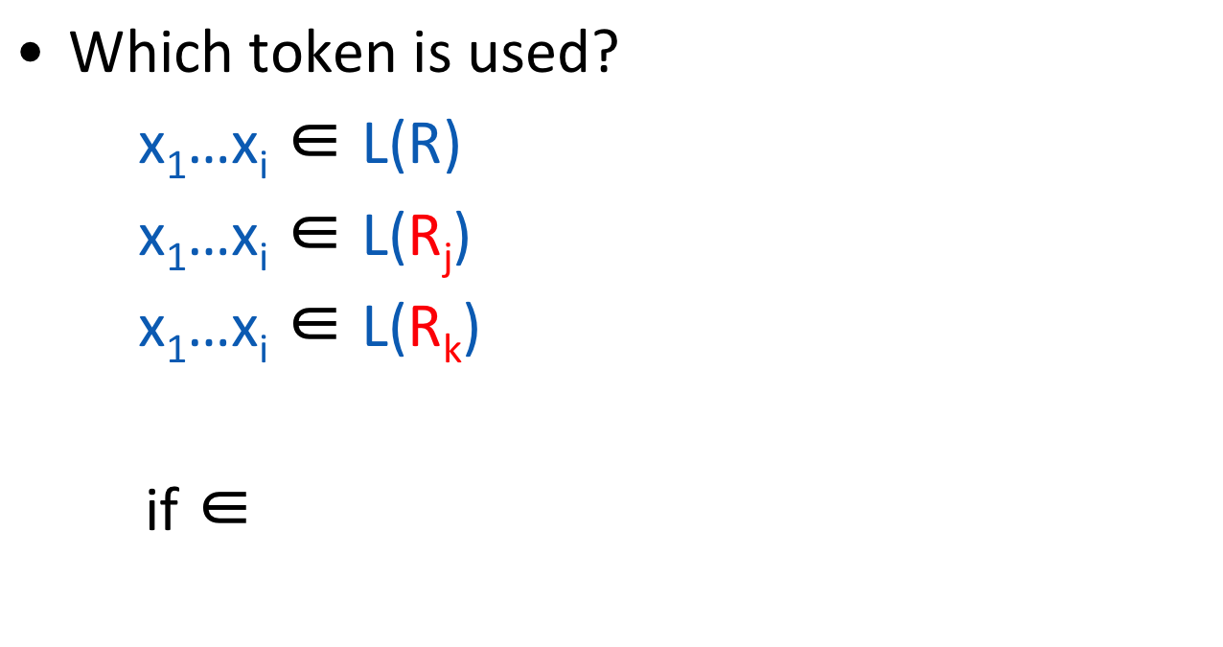
Lexical Analyzer
Choose the one listed first!
R = R₁ | R₂ | . . . | R_{n}
IF = if
identifier = letter(letter|digit)*
L(IF)
L(Identifier)
This situation arises when if is followed by Lparen e.g. if(

Slide 34
Lexical Analyzer
What if no rule matches?
x₁…x_{i} ∉ L(R)
Error = all strings not in specification
Put it last in priority

Slide 35
Regexps in Lexical Analysis
Regular expressions are a concise notation for string patterns
Use in lexical analysis requires small extensions
Resolve ambiguities
Handle errors
A good algorithm for lexical analysis will:
Require only single pass over the input
Few operations per character (lookup table)

