Slide 1
Lexical Analysis
LEX7: NFA to DFA Complexity
CMPT 379: Compilers
Instructor: Anoop Sarkar
anoopsarkar.github.io/compilers-class

Slide 2
NFA to DFA
converting NFA to DFA
Complexity:
For FSAs, we measure complexity in terms of initial cost (creating the automaton) and per string cost
Let r be the length of the regexp and n be the length of the input string
NFA, Initial cost: O(r); Per string: O(rn)
DFA, Initial cost: O(r²s); Per string: O(n)
DFA, common case, s = r, but worst case s = 2^{r}

Slide 3
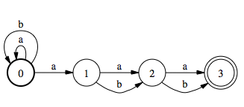
NFA to DFA
A regexp of size r can become a 2^{r} state DFA, an exponential increase in complexity
Try the subset construction on NFA built for the regexp A*aA^{n-1} where A is the regexp (a|b)
(a|b)*a(a|b)(a|b)

Slide 4
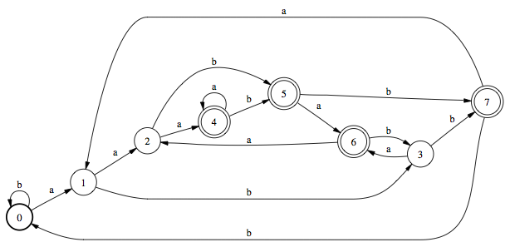
NFA to DFA

Slide 5
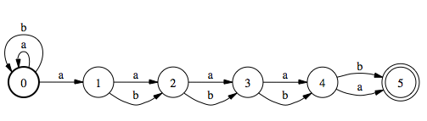
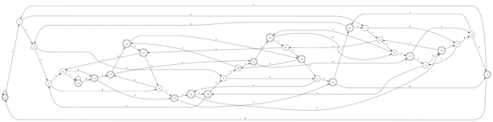
NFA to DFA
(a|b)*a(a|b)(a|b)(a|b)(a|b)
2⁵ = 32 states

Slide 6
NFA vs. DFA in the wild
Engine Type | Programs
DFA | awk (most versions), egrep (most versions), flex, lex, MySQL, Procmail
Traditional NFA | GNU Emacs, Java, grep (most versions), less, more, .NET languages, PCRE library, Perl, PHP (pcre routines), Python, Ruby, sed (most versions), vi
POSIX NFA | mawk, MKS utilities, GNU Emacs (when requested)
Hybrid NFA/DFA | GNU awk, GNU grep/egrep, Tcl

Slide 7
Extensions to Regular Expressions
Most modern regexp implementations provide extensions:
matching groups; \1 refers to the string matched by the first grouping (), \2 to the second match, etc.,
e.g. ([a-z]+)\1 which matches abab where \1=ab
match and replace operations,
e.g. s/([a-z]+)/\1\1/g which changes ab into abab where \1=ab
These extensions are no longer “regular”. In fact, extended regexp matching is NP-hard
Extended regular expressions (including POSIX and Perl) are called REGEX to distinguish from regexp (which are regular)
In order to capture these difficult cases, the algorithms used even for simple regexp matching run in time exponential in the length of the input

Slide 8
NFA to DFA
A regexp of size r can become a 2^{r} state DFA, an exponential increase in complexity
Try the subset construction on NFA built for the regexp A*aA^{n-1} where A is the regexp (a|b)
Note that the NFA for regexp of size r will have O(r) states
Minimization can reduce the number of states
But minimization requires determinization

