Slide 1
Lexical Analysis
LEX9: Implementing DFAs
CMPT 379: Compilers
Instructor: Anoop Sarkar
anoopsarkar.github.io/compilers-class

Slide 2
Building a Lexical Analyzer
Token ⇒ Pattern
Pattern ⇒ Regular Expression
Regular Expression ⇒ NFA
NFA ⇒ DFA
DFA ⇒ Table-driven implementation of DFA
Implement NFAs
Convert regexp to DFA

Slide 3
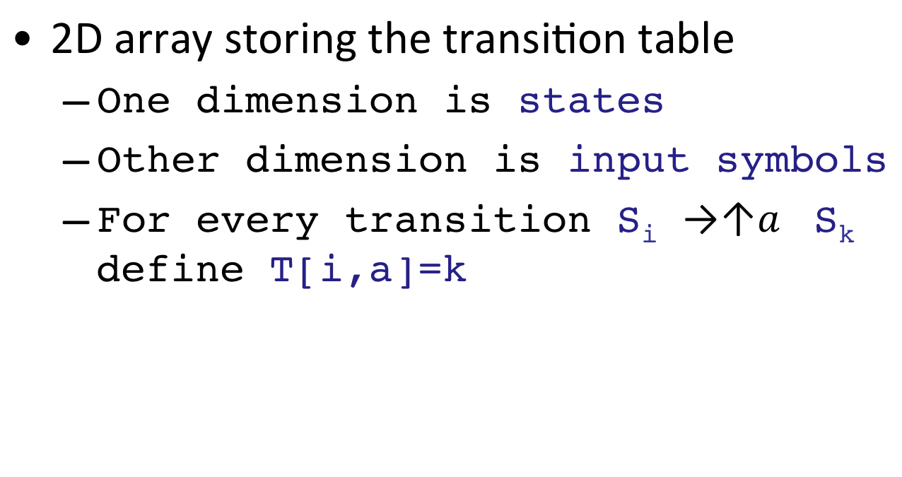
Implementing DFAs
2D array storing the transition table
One dimension is states
Other dimension is input symbols
For every transition S_{i} S_{k} define T[i,a]=k
a
Input symbols
k
i
states

Slide 4
Implementing DFAs
a
c
 | a | b | c | d
0
1
2
b
1
- | 1 | - | 2
0
a
c
1 | - | 1 | -
2
1 | 2 | 1 | -
d
b
i = 0
state = 0
while (input[i]) {
state = nextState(state, input[i])
i = i + 1
}
nextState(state, x) {
return A[state][x]
}

Slide 5
Implementing DFAs
2D array storing the transition table
Too many states and duplicates
Adjacency list
more space efficient but slower
Merge two ideas: array structures used for sparse tables like DFA transition tables

Slide 6
Implementing DFAs
 | a | b | c | d
0 | - | 1 | - | 2
1 | 1 | - | 1 | -
2 | 1 | 2 | 1 | -
 |  | - | 1 | - | 2
 |  |  |  | 1 | - | 1 | -
1 | 2 | 1 | -
1 | 2 | 1 | 1 | 1 | 2 | 1 | -
0 | 1 | 2 | 3 | 4 | 5 | 6 | 7
next
base
0 | 2
1 | 4
2 | 0
2 | 2 | 2 | 0 | 1 | 0 | 1 | -
check
nextState(2,a)=
next[0+0]
nextState(1,c)=
next[4+2]
nextState(0,c)=
next[2+2]

Slide 7
Implementing DFAs
 | a | b | c | d
0 | - | 1 | - | 2
1 | 1 | - | 1 | -
2 | 1 | 2 | 1 | -
 |  | - | 1 | - | 2
 |  |  |  | 1 | - | 1 | -
1 | 2 | 1 | -
1 | 2 | 1 | 1 | 1 | 2 | 1 | -
0 | 1 | 2 | 3 | 4 | 5 | 6 | 7
next
base
0 | 2
1 | 4
2 | 0
2 | 2 | 2 | 0 | 1 | 0 | 1 | -
check
nextState(s, x) :
L := base[s] + x
return next[L]
if check[L] == s

Slide 8
Implementing DFAs
 | a | b | c | d
0 | - | 1 | - | 2
1 | 1 | - | 1 | -
2 | 1 | 2 | 1 | -
 | - | 1 | - | 2
 |  |  | 1 | - | 1 | -
- | 2 | - | -
- | 2 | 1 | 1 | 2 | 1 | -
0 | 1 | 2 | 3 | 4 | 5 | 6
next
base
0 | 1
1 | 3
2 | 0
-
-
1
- | 2 | 0 | 1 | 0 | 1 | -
check
nextState(2,b)=
next[1]
nextState(s, x) :
L := base[s] + x
return next[L]
default
if check[L] == s
else return nextState(default[s], x)

Slide 9
Implementing DFAs
 | a | b | c | d
0 | - | 1 | - | 2
1 | 1 | - | 1 | -
2 | 1 | 2 | 1 | -
 | - | 1 | - | 2
 |  |  | 1 | - | 1 | -
- | 2 | - | -
- | 2 | 1 | 1 | 2 | 1 | -
0 | 1 | 2 | 3 | 4 | 5 | 6
next
base
0 | 1
1 | 3
2 | 0
-
-
1
- | 2 | 0 | 1 | 0 | 1 | -
check
nextState(s, x) :
L := base[s] + x
return next[L]
nextState(2,a)=
nextState(1,a)
= next[3]
default
if check[L] == s
else return nextState(default[s], x)

