Slide 1
Top-down Parsing
TD1: Recursive Descent
CMPT 379: Compilers
Instructor: Anoop Sarkar
anoopsarkar.github.io/compilers-class

Slide 2
Top-Down Parsing
1
The parse tree is constructed
From the top
From the left to right
Terminals are seen in the order of appearance in the token stream
t₂ t₅ t₆ t₈ t₉
t₂
3
t₉
4
7
t₅
t₆
t₈

Slide 3
Recursive Descent Parsing
Consider the grammar
E → T + E | T
T → int | int * T | ( E )
Token stream is int₅ * int₂
Start from top-level non-terminal E
Try the rules for E in order

Slide 4
Recursive Descent Parsing
Try E₀ → T₁ + E₂
Try T₁ → int
Token int matches!
but + does not match to input
Try T₁ → int * T₂
Tokens int and * match
Try T₃ → int
Token int matches
input is matched but tree should match + E₂
Try T₁ → ( E₃ )
Token ( does not match
has exhausted the choices for T₁
backtrack to choices for E₀
E₀
E → T + E
E → T T → int
T → int * T
T → ( E )
Failure
T₁
+
E₂
int₅
*
T₃
Input:
int₅ * int₂
Failure
Failure

Slide 5
Recursive Descent Parsing
Try: E₀ → T₁
Try T₁ → int
Token int matches!
but no non-terminals left and
the input is not matched completely
Try T₁ → int * T₂
Tokens int , * match
Try T₂ → int
Token int matches!
Succeed! No non-terminal left in the tree,
input is totally matched
E₀
E → T + E
E → T T → int
T → int * T
T → ( E )
Failure
T₁
int₅
*
T₂
Input:
int₅ * int₂
int₂

Slide 6
Preliminaries
TOKEN: the type of all tokens
Special tokens INT, OPEN, CLOSE, PLUS, TIMES
The global next points to the next token in the input

Slide 7
Implementing Productions
Define boolean functions that check the token string for match of
A given token terminal
bool term(TOKEN tok) { return *next++ == tok; }
A given production of S (the n-th)
bool S_{n}() {…}
Any production of S
bool S() {…}
These functions advance next

Slide 8
Implementing Productions
E → T
E → T + E
For production E → T
bool E₁() { return T(); }
For production E → T + E
bool E₂() { return T() && term(PLUS) && E(); }
For all productions of E (with backtracking)
bool E() {
TOKEN *save = next;
return (next= save, E₁()) || (next= save, E₂()); }

Slide 9
Implementing Productions
For non-terminal T
bool T₁() { return terms(OPEN) && E() && term(CLOSE); }
bool T₂() { return terms(INT) && term(TIMES) && T(); }
bool T₃() { return terms(INT); }
bool T() {
TOKEN *save = next;
return (next= save, T₁())
|| (next= save, T₂())
|| (next= save, T₃()); }
E → T + E
E → T
T → ( E )
T → int * T T → int

Slide 10
Recursive Descent Parsing
To start the parser
Initialize next to point to the first token
Invoke E()
Note how this simulates our previous example
Easy to implement
But this does not always work …

Slide 11
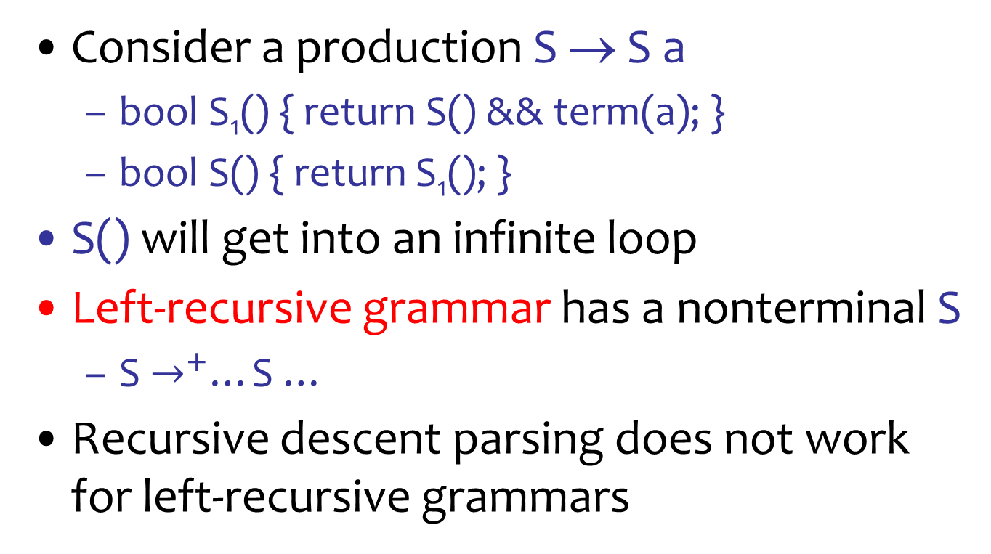
Left-Recursion in Recursive Descent Parsing
Consider a production S → S a
bool S₁() { return S() && term(a); }
bool S() { return S₁(); }
S() will get into an infinite loop
Left-recursive grammar has a nonterminal S
S $→^{+}$…S …
Recursive descent parsing does not work for left-recursive grammars

Slide 12
Elimination of Left Recursion
Consider the left recursive grammar
S → S a | b
S generates all strings starting with ‘b’ and followed by a number of ‘a’
Can rewrite using right-recursion
S → b S’
S’ → a S’ | ε

Slide 13
No Immediate Left Recursion
In general for immediate left recursion
S → S α₁ | …| S α_{n} | β₁ |…| β_{m}
All strings derived from S start with one of β₁, …, β_{m} and continue with several instances of α₁,…, α_{n}
Rewrite as
S → β₁ S’|…| β_{m} S’
S’ → α₁ S’ | …| α_{n} S’| ε

Slide 14
No Immediate Left Recursion
T
T*F
T*F*F
F*F*F
T : T * F
| F
F : a
| b
| c
T : F T’
T’ : * F T’
| ε
F : a
| b
| c
No left recursion
T
FT’
F*FT’
F*F*FT’
F*F*F

Slide 15
Remove General Left Recursion
S : A a
| b
A : A c
| S d
| ε
S : A a
| b
A : A c
| A a d
| b d
| ε
Ordering:
S, A

Slide 16
Immediate Left Recursion
S : A a
| b
A : A c
| A a d
| b d
| ε
S : A a
| b
A : b d A’
| A’
A’ : c A’
| a d A’
| ε
Remove Left Recursion

Slide 17
General Left Recursion
Input: grammar G with no cycles A -> A or empty rules A -> ε
Output: grammar with no left recursion
Arrange nonterminals in order A₁, A₂, A₃, …, A_{n}
for i = 1 to n {
for j = 1 to i-1 {
replace each rule A_{i} -> A_{j} α where A_{j} -> β₁ | … | β_{m} with
the rules A_{i} -> β₁ α | … | β_{m} α
}
remove immediate left recursion among A_{i} rules
}

Slide 18
Remove General Left Recursion
S : A a
| b
A : A c
| S d
| B
B : B e
| A f
| S g
| h
Order: S, A, B
B : b d A' a g B'
| b d A' f B'
| b g B'
| h B'
B’ : A' a g B'
| A' f B'
| e B'
| ε
S : A a
| b
A : b d A'
| B A'
A’ : a d A'
| c A'
| ε

Slide 19
Summary of Recursive Descent
Simple and general parsing strategy
Left-recursion must be eliminated first
Most of the time manually (but it can be done automatically)
Backtracking is inefficient
In practice, backtracking is eliminated by restricting the grammar
Used in production compilers (e.g. gcc front-end)

Slide 20
How to compute: Does X ⇒* ε ?
The question `Does X ⇒* ε ?’ can be written as the predicate: nullable(X)
Nullable = {} (set containing nullable non-terminals)
Changed = True
While (changed):
changed = False
if X is not in Nullable:
if
1. X → ε is in the grammar, or
2. X → Y₁ … Y_{n} is in the grammar and Y_{i} is in Nullable for all i then
add X to Nullable; changed = True

