Slide 1
Context-Free Grammars
CFG1: Intro to CFGs
CMPT 379: Compilers
Instructor: Anoop Sarkar
anoopsarkar.github.io/compilers-class

Slide 2
Parsing
token
source program
Lexical Analyzer
Parser
parse tree
Later Stages
next()
String of characters
flex: yylex()
Lexical Errors
Syntax Errors

Slide 3
Parsing
Every possible token sequence is not a valid program
Parser distinguishes between valid and invalid programs
We need
A language for describing valid sequence of tokens
A method for distinguishing valid from invalid programs
Provide the program structure for a valid token sequence

Slide 4
Context-free Grammars (CFGs)
if EXP then
(_{if}
while EXP do
(_{while}
if EXP then
(_{if}
while EXP do
(_{while}
Programming languages have recursive structure
An EXP is …
Context Free Grammars are natural notation for the recursive structures we find in programming languages
Finite state automata cannot handle nested parentheses
EXP
end
if EXP then
EXP
else
EXP
while EXP do
EXP
end
)_{while}
else
EXP
)_{if}
end
)_{while}
else
EXP
)_{if}

Slide 5
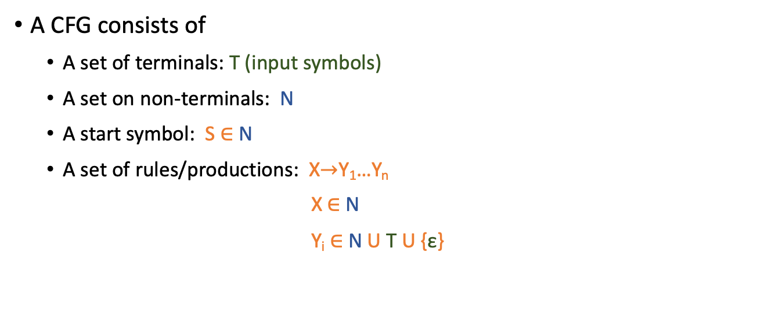
Context-free Grammars (CFGs)
A CFG consists of
A set of terminals: T (input symbols)
A set on non-terminals: N
A start symbol: S $∈$ N
A set of rules/productions: X$→$Y₁…Y_{n}
X$∈$N
Y_{i} $∈$ N U T U {ε}
Rule application:
Replace
LHS
with
RHS
LHS
RHS

Slide 6

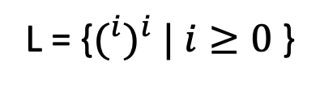
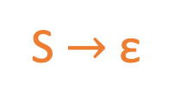
Context-free Grammars (CFGs)
Q: Modify this CFG to use the alphabet { ‘(‘, ‘)’, ‘{‘, ‘}’, ‘[‘, ‘]’ } where opening and closing parentheses must of the same type. So “({[()]})” is valid but “(}” is invalid.
L = {$(^{i})^{i} | i≥0$ }
Q: Does the string “()(())” belong to this language?
CFG Rules:
S $→$ ‘(‘ S ‘)’
N = {S}
Non-deterministic choice of S rule
S $→$ ε
T = { ‘(‘, ‘)’ }

Slide 7
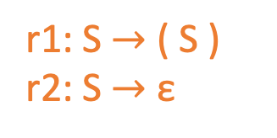

Context-free Grammars (CFGs)
Begin with string that has only start symbol S
Replace any non-terminal X in the string by the right-hand side of some production X $→$ Y₁…Y_{n}
Repeat (2) until there is no non-terminals
r1: S $→$ ( S )
r2: S $→$ ε
S ⇒^{r1}
( S ) ⇒^{r1}
( ( S ) ) ⇒^{r2}
( ( ) )
Non-deterministic choice of S rule

Slide 8
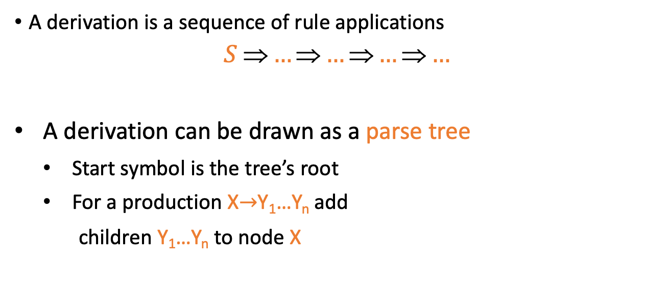
Derivation and Parse Tree
A derivation is a sequence of rule applications
$$S \text{⇒}…\text{⇒}…\text{⇒}…\text{⇒}…$$
A derivation can be drawn as a parse tree
Start symbol is the tree’s root
For a production X$→$Y₁…Y_{n} add
children Y₁…Y_{n} to node X
X
Y₁
…
Y_{n}

Slide 9
Derivation and Parse Tree
S ⇒^{r1} ( S )
⇒^{r1} ( ( S ) )
⇒^{r2} ( ( ) )
S
(
S
)
(
S
)
Closure of ⇒
S ⇒* ( ( ) )
Q: Write down the derivation and parse tree for the input string “({[]})” using your grammar for question on slide 6
ε

Slide 10
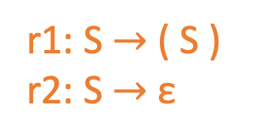

Language of CFGs
Let G be a context free grammar with start symbol S, and terminals T
The language L(G) of G is:
$$\left\{α_{1}…α_{n}\right| ∀_{i} α_{i}∈T and S{\text{⇒}}^{∗} α_{1}…α_{n}\}$$
r1: S $→$ ( S )
r2: S $→$ ε
L(G) = {ε, (), (()), ((())), …}

Slide 11
Arithmetic Expressions
E → E + E
E → E * E
E → ( E )
E → - E
E → id

Slide 12
Derivation for id + id * id
Leaf nodes: terminals
Interior nodes: non-terminals
E → E + E
E → E * E
E → ( E )
E → - E
E → id
E ⇒ E + E
⇒ id + E
⇒ id + E * E
⇒ id + id * E
⇒ id + id * id
E
E
+
E
id
E
*
E
Notation: E ⇒* id + id * id
id
id

Slide 13
Leftmost derivation for id + id * id
Parse tree disambiguates operator precedence:
(id+id)*id vs id+(id*id)
E → E + E
E → E * E
E → ( E )
E → - E
E → id
E ⇒ E * E
⇒ E + E * E
⇒ id + E * E
⇒ id + id * E
⇒ id + id * id
E
E
*
E
E
+
E
id
id
id

Slide 14
Rightmost derivation for id + id * id
E → E + E
E → E * E
E → ( E )
E → - E
E → id
E ⇒ E * E
⇒ E * id
⇒ E + E * id
⇒ E + id * id
⇒ id + id * id
E
E
*
E
E
+
E
id
id
id
Q: Write down the rightmost derivation for same grammar and input to get the parse tree in slide 12

Slide 15
Rightmost vs. Leftmost Derivation
Rightmost and leftmost derivations have the same parse tree
Every parse tree has a rightmost derivation
And every parse tree has an equivalent leftmost derivation
Leftmost / Rightmost derivations are important in resolving ambiguity

Slide 16
Writing a CFG for a programming language
First write (or read) a reference grammar of what you want to be valid programs
For now, we only worry about the structure, so the reference grammar might choose to over-generate in certain cases
e.g. bool x = 20;
Convert the reference grammar to a CFG
Use actions for each CFG rule to produce the output

Slide 17
Actions in a CFG: Arithmetic Expressions
E → E + E { $$ = $1 + $3 }
E → E * E { $$ = $1 * $3 }
E → ( E ) { $$ = $2 }
E → - E { $$ = -1 * $2 }
E → id { $$ = $1 }
25
E
5
E
*
E
5
2
E
+
3
E
id(5)
id(2)
id(3)
Q: Draw the parse tree and calculate the output value using the above CFG & actions for -(2+3)

Slide 18
CFG Notation
Normal CFG notation
E → E * E
E → E + E
Backus Naur notation
E : E * E | E + E ;
(an or-list of right-hand sides)
Also:
E = E “*” E | E “+” E .

