Slide 1
Introduction to Compilers
IN3: What is a Compiler
CMPT 379: Compilers
Instructor: Anoop Sarkar
anoopsarkar.github.io/compilers-class

Slide 2
Static
Input
Assembly Language
Executable Binary
Program
Compiler
Assembler
Runtime
Output
Input
Program
Interpreter
Dynamic
Output

Slide 3
Static
Input
Assembly Language
Executable Binary
Program
Compiler
Assembler
Runtime
Output
Input
Bytecode
Virtual Machine
Program
Compiler
Static/Dynamic
Output

Slide 4
Compilers
Analysis of the source (front-end)
Synthesis of the target (back-end)
The translation from source code to executable
Requirements from a Compiler are:
Support high-level programming languages
Good error messages
Speed of compilation
Produce fast executables with small footprint

Slide 5
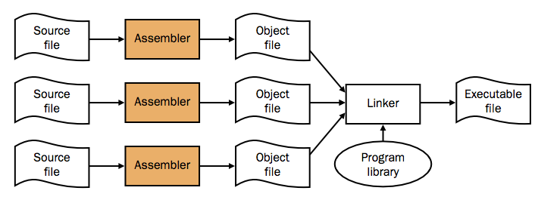
The UNIX toolchain
dylib.zip demo

Slide 6
Bootstrapping a Compiler
Machine code at the beginning
Make a simple subset of the language, write a compiler for it
Use that subset for the rest of the language definition
Bootstrap from a simpler language
Interpreters: write it in a lower level language,
e.g. Python interpreter is written in C
Cross compilation
generate ARM executables with compiler running on x86

Slide 7
Modern challenges
Instruction Parallelism
Out of order execution; branch prediction
Parallel algorithms:
New programming languages for grid computing, multi-core computers
Memory hierarchy: register, cache, memory
New architectures: GPUs, quantum computers, DNA computers
Hardware synthesis (extreme inner loop optimization)

