Slide 1
Introduction to Compilers
IN3: What is a Compiler
CMPT 379: Compilers
Instructor: Anoop Sarkar
anoopsarkar.github.io/compilers-class

Slide 2
Program
Compiler
Machine Code
Input
Runtime
Output

Slide 3
Compilers
Analysis of the source (front-end)
Synthesis of the target (back-end)
The translation from user intention into intended meaning
The requirements from a Compiler and a Programming Language are:
Ease of use (high-level programming)
Speed

Slide 4
Cousins of the compiler
“Smart” editors for structured languages
static checkers; pretty printers
Structured or semi-structured data
Trees as data: s-expressions; XML
query languages for databases: SQL
Interpreters (for PLs like lisp or scheme)
Scripting languages: perl, python, tcl/tk
Special scripting languages for applications
“Little” languages: awk, eqn, troff, TeX
Compiling to Bytecode (virtual machines)

Slide 5
Program
Program
Compiler
Input
Interpreter
Output
Machine Code
Dynamic
Input
Runtime
Output
Static

Slide 6
Program
Translator
Bytecode
Input
Virtual Machine
Output
Static/Dynamic

Slide 7
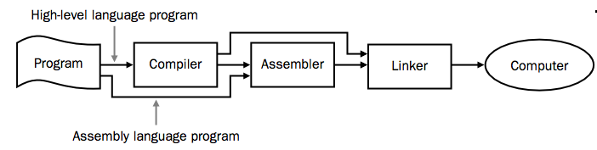

Slide 8
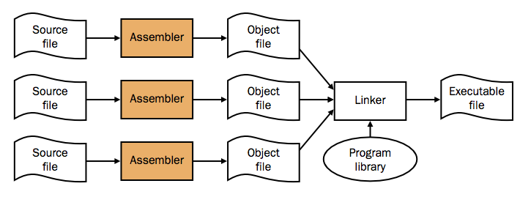
The UNIX toolchain as, ar, ranlib, ld, …

Slide 9
Bootstrapping a Compiler
Machine code at the beginning
Make a simple subset of the language, write a compiler for it
Use that subset for the rest of the language definition
Bootstrap from a simpler language
Interpreters
Cross compilation

Slide 10
Modern challenges
Instruction Parallelism
Out of order execution; branch prediction
Parallel algorithms:
Grid computing, multi-core computers
Memory hierarchy: register, cache, memory
Binary translation, e.g. x86 to VLIW
New computer architectures: GPUs, quantum
Hardware synthesis / Compiled simulations

