Slide 1
package a
package a
package b
package b
package c

Slide 2
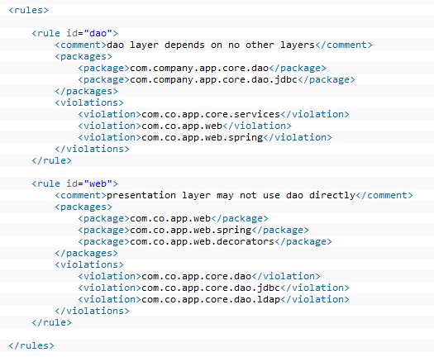
Presentation Layer
controllers
package a
Business Layer
services
package b
Integration Layer
daos
package c

Slide 3
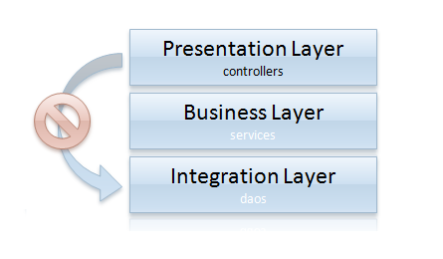
Presentation Layer
controllers
Business Layer
services
Integration Layer
daos

Slide 4
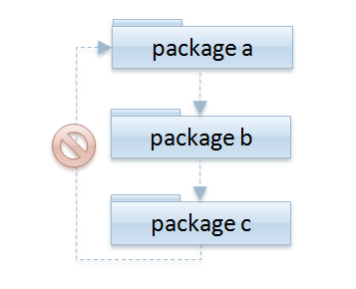

Slide 5
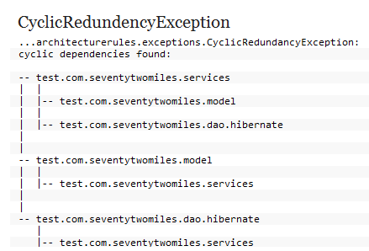


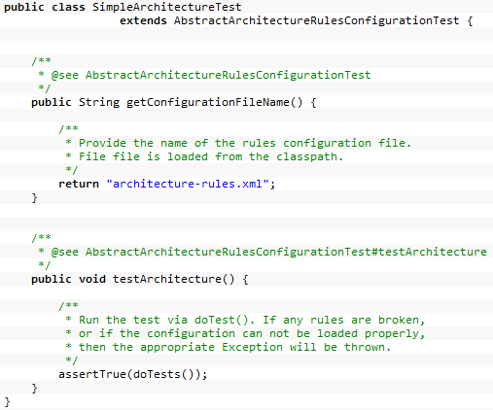

Slide 6
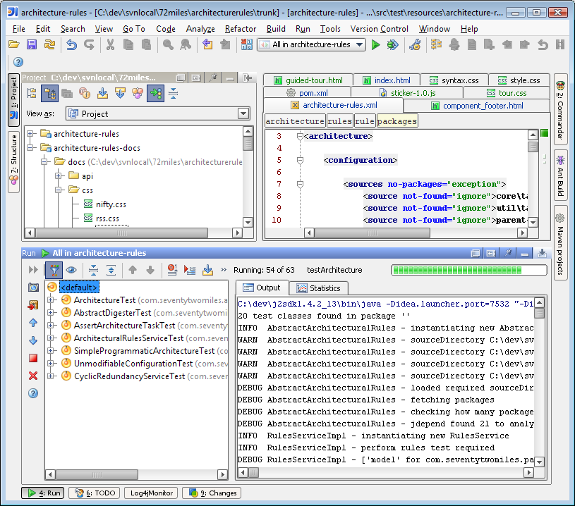

Slide 7








Slide 8


Slide 9
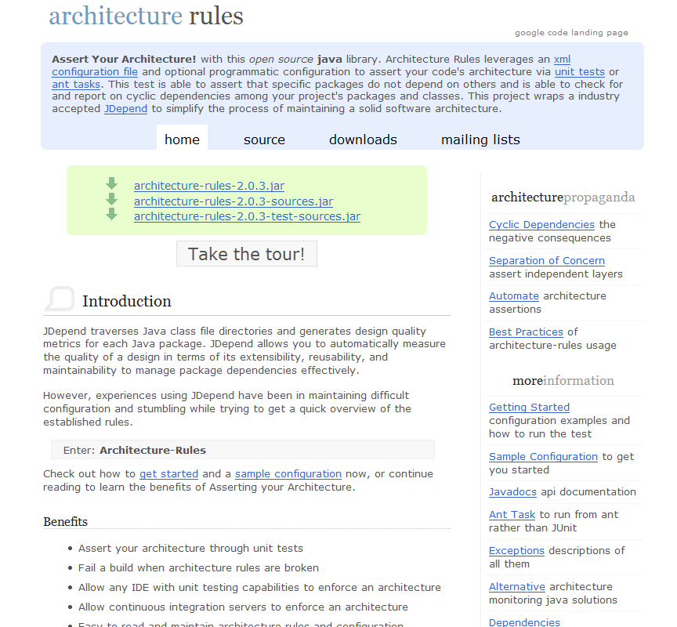
Donate
$
Support this project
Donate
$
Support this project

