Slide 1
MCU TNC Summer Break Update
David Cain, Kobe Keopraseuth, and Kaleb Leon

Slide 2
TNC Hardware Driver Code

Slide 3
Hardware Drivers
Driver code has been developed to generate and receive AFSK bitstreams
The code is structured to be easily imported into an ST project
(Code is mostly hosted in .h/.c files)
TNC switches between a TX and RX mode, setting hardware as needed per current mode
External interrupts drive a frequency counting method to track zero crossing and measuring period length
Timer interrupts are used to fill a period buffer and keep many measurements of frequencies
Code is thoroughly commented and organized

Slide 4
Mode | Timer Settings |  |  | External Interrupt settings
Transmission (TX) | Timer 2: | Pre-scaler | 9-1 (10MHz) | External Interrupt 0 | Not used, disabled in mode change
 |  | Reload Count | 100
 |  | Timer Purpose | DAC uses this period reload to increment through sine array
 | Timer 3: | Pre-scaler | 90-1 (1MHz)
 |  | Reload Count | 833
 |  | Timer Purpose | Interrupt progresses DAC through bitstream values
Receiving (RX) | Timer 2: | Pre-scaler | 9-1 (10MHz) | External Interrupt 0 | Used to detect zero crossing
 |  | Reload Count | 10000 |  | Triggers at rising edge only
 |  | Timer Purpose | Timer is used to measure wave period duration
 | Timer 3: | Pre-scaler | 90-1 (1MHz)
 |  | Reload Count | 209
 |  | Timer Purpose | Interrupt loads values into period buffer

Slide 5
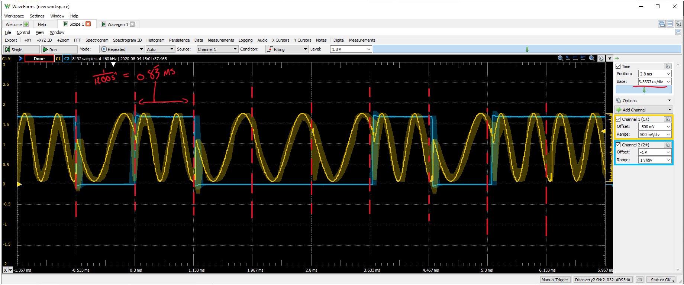
TNC Output waveform

Slide 6
TNC Live Counting Input Frequencies

Slide 7
TNC AFSK Signal Input Amp Circuit

Slide 8
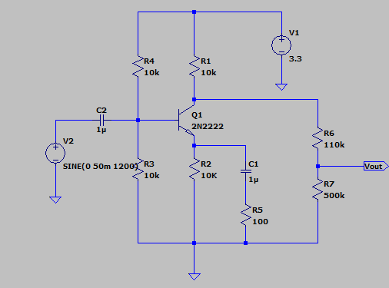
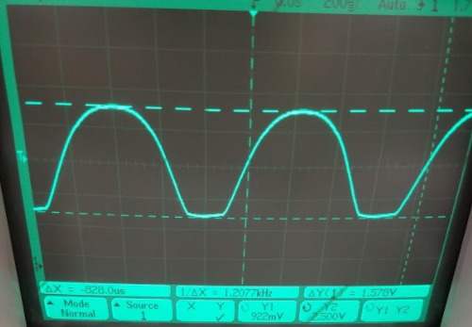
TNC AFSK Input Amplifying Circuit
With the consideration of a 50mV input signal, the TNC needs an amplifying circuit to trigger the onboard interrupts
Simulated Amplifying Circuit
Measured Amplifying Circuit Output Waveform

Slide 9
Questions
Input waveform from radio
KISS Software to generate packets
Final presentation goals

