Slide 1
CSY3025 Artificial Intelligence Techniques
Support Vector Machines

Slide 2
https://colab.research.google.com/github/ageron/handson-ml2/blob/master/05_support_vector_machines.ipynb
https://ocw.mit.edu/courses/electrical-engineering-and-computer-science/6-034-artificial-intelligence-fall-2010/lecture-videos/lecture-16-learning-support-vector-machines/

Slide 3
Support Vector Machine
A Support Vector Machine (SVM) is a very powerful and versatile Machine Learning model, capable of performing linear or nonlinear classification, regression, and even outlier detection.
SVMs are particularly well suited for classification of complex but small- or medium-sized datasets.

Slide 4
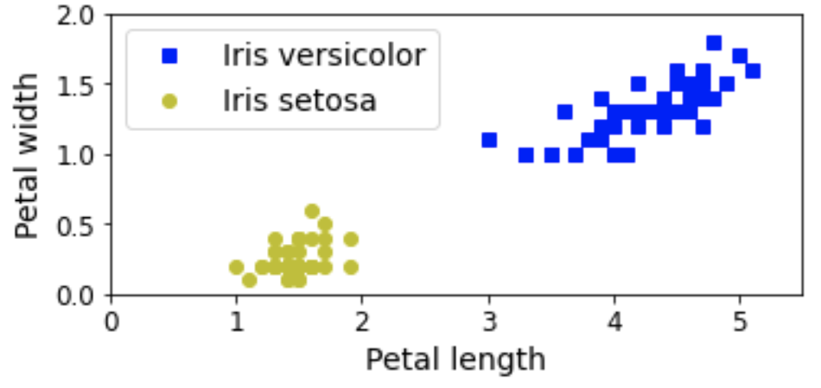
Support Vector Machine

Slide 5
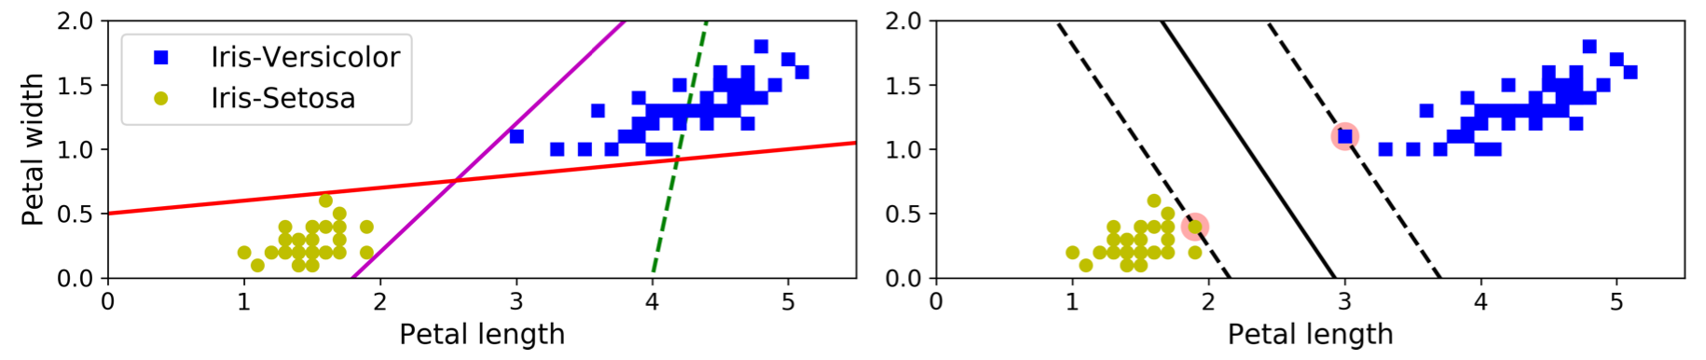
Linear SVM Classification
Solid lines OK but decision boundaries very close to instances that these models will probably not perform as well on new instances.
SVM classifier fitting the widest possible street (represented by the parallel dashed lines) between the classes. This is called large margin classification.
Decision boundary is fully determined (or “supported”) by the instances located on the edge of the street. These instances are called the support vectors (circled)

Slide 6
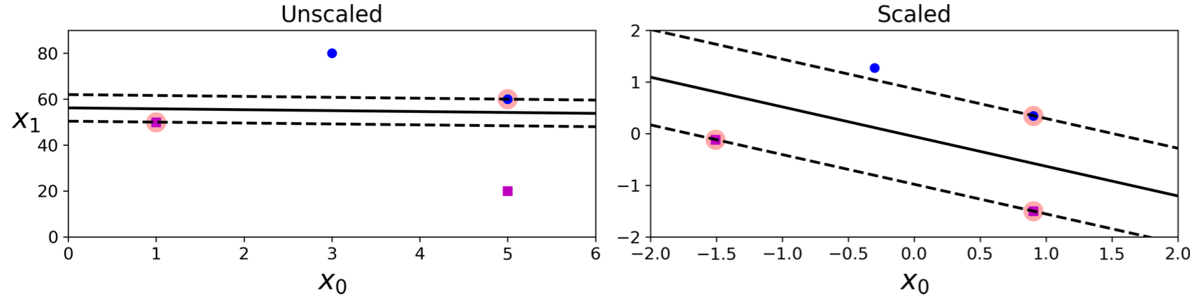
Linear SVM Classification
SVMs are sensitive to the feature scales
on the left plot, the vertical scale is much larger than the horizontal scale, so the widest possible street is close to horizontal.
After feature scaling (e.g., using Scikit-Learn’s StandardScaler), the decision boundary looks much better (on the right plot).

Slide 7
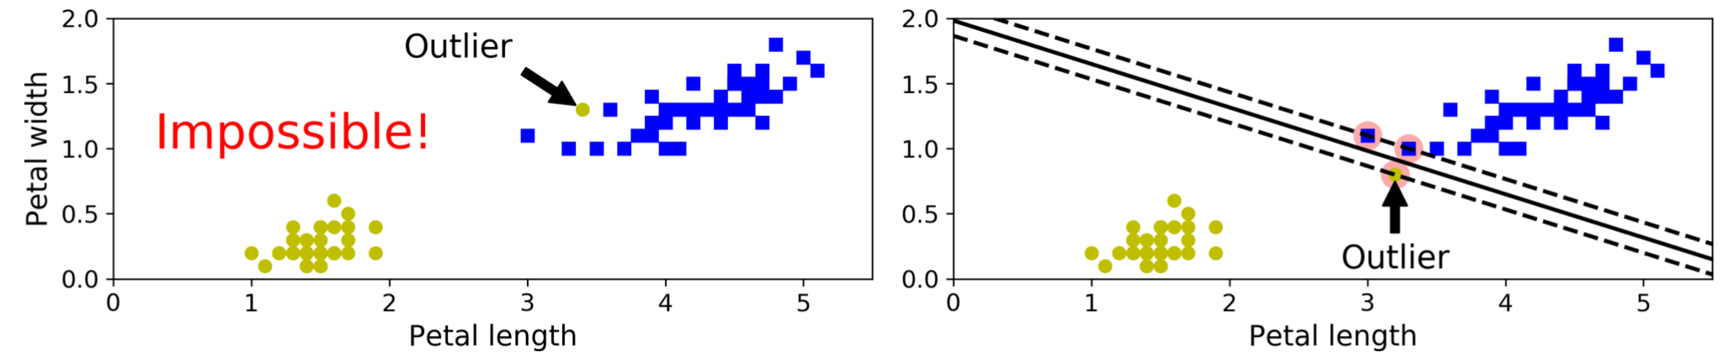
Hard Margin Classification
If we strictly impose that all instances be off the street and on the right side, this is called hard margin classification.
Two main issues :
it only works if the data is linearly separable
it is quite sensitive to outliers.

Slide 8
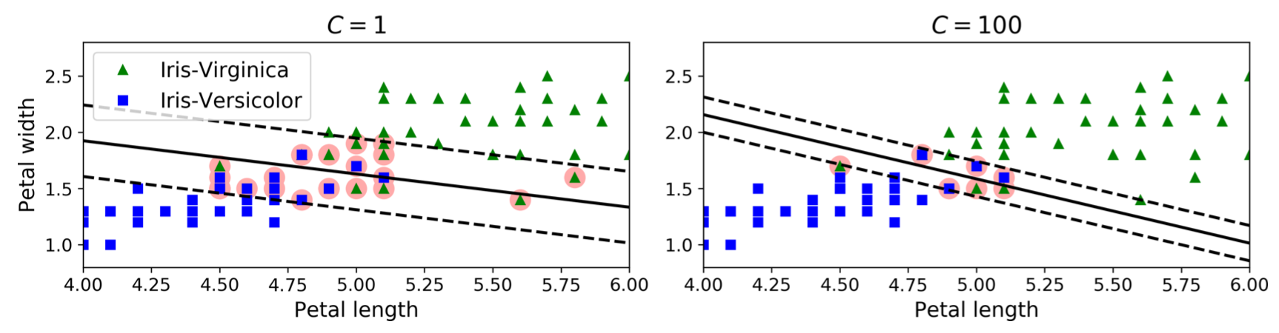
Soft Margin Classification
To avoid these issues it is preferable to use a more flexible model.
The objective is to find a good balance between keeping the street as large as possible and limiting the margin violations. This is called soft margin classification.
In Scikit-Learn’s SVM classes, you can control this balance using the C hyperparameter: a smaller C value leads to a wider street but more margin violations.

Slide 9
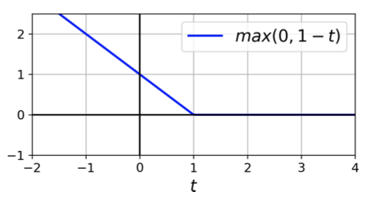
LinearSVC
import numpy as np
from sklearn import datasets
from sklearn.pipeline import Pipeline
from sklearn.preprocessing import StandardScaler
from sklearn.svm import LinearSVC
iris = datasets.load_iris()
X = iris["data"][:, (2, 3)] # petal length, petal width
y = (iris["target"] == 2).astype(np.float64) # Iris-Virginica
svm_clf = Pipeline([
("scaler", StandardScaler()),
("linear_svc", LinearSVC(C=1, loss="hinge")),
])
svm_clf.fit(X, y)
>>> svm_clf.predict([[5.5, 1.7]])
array([1.])
Hinge loss

Slide 10
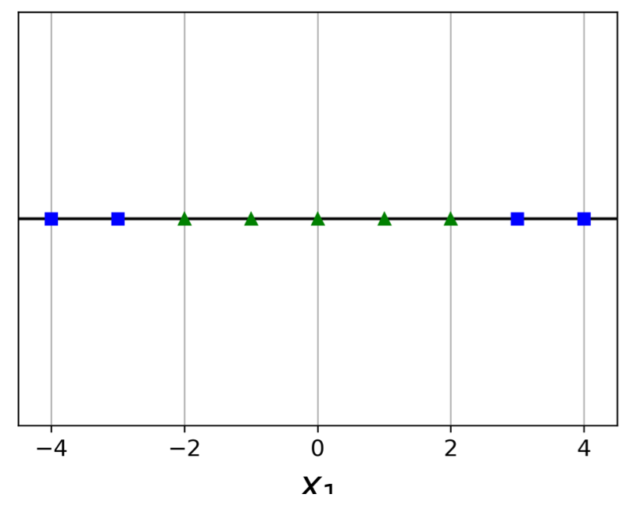
Nonlinear SVM Classification

Slide 11
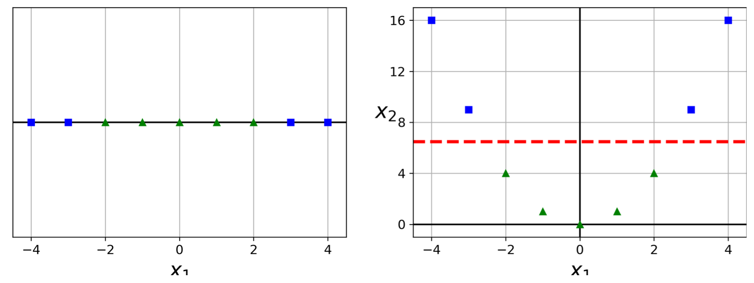
Nonlinear SVM Classification
One approach to handling nonlinear datasets is to add more features, such as polynomial features; in some cases this can result in a linearly separable dataset.

Slide 12
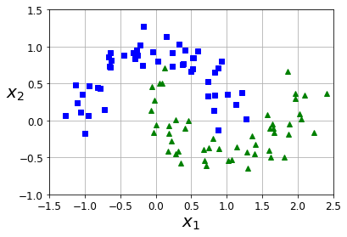
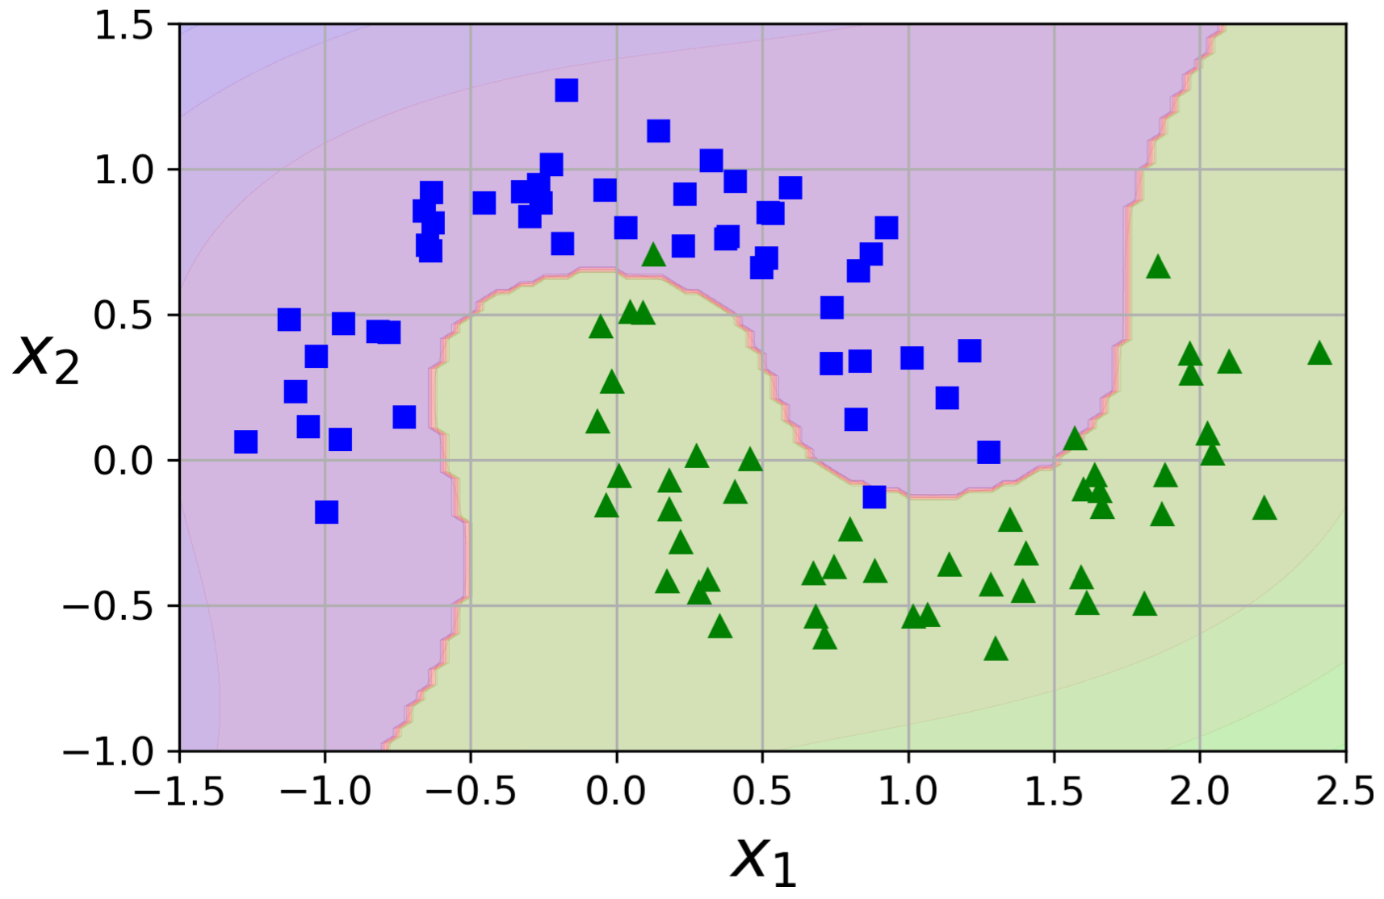
Nonlinear SVM Classification
Create a Pipeline containing a PolynomialFeatures transformer.
polynomial_svm_clf = Pipeline([
("poly_features", PolynomialFeatures(degree=3)),
("scaler", StandardScaler()),
("svm_clf", LinearSVC(C=10, loss="hinge"))
])
sklearn.datasets.make_moons. Make two interleaving half circles. A simple toy dataset to visualize clustering and classification algorithms.

Slide 13
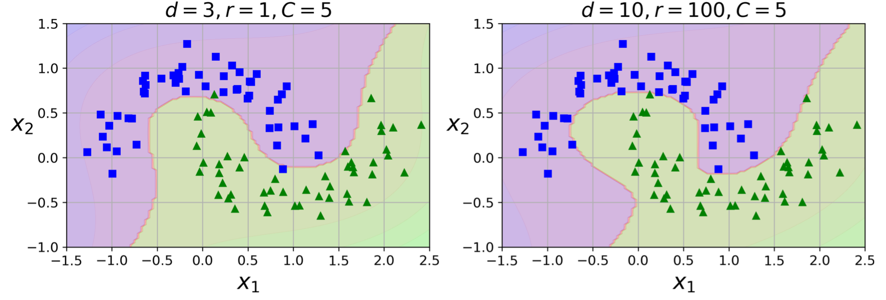
Nonlinear SVM Classification
poly_kernel_svm_clf = Pipeline([
("scaler", StandardScaler()),
("svm_clf", SVC(kernel="poly", degree=3, coef0=1, C=5))
#("svm_clf", SVC(kernel="poly", degree=10, coef0=100, C=5))
])
poly_kernel_svm_clf.fit(X, y)

Slide 14
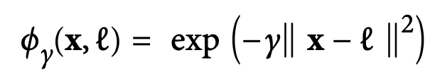
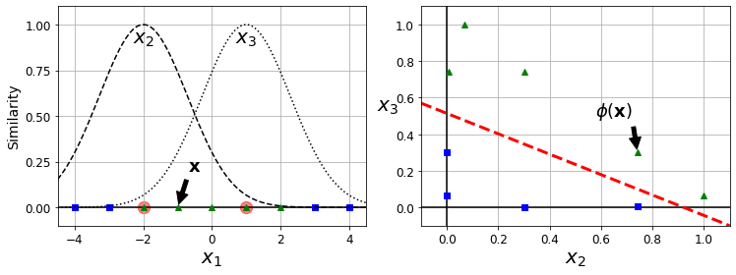
Adding Similarity Features - Gaussian RBF Kernel
Another technique is to add features computed using a similarity function that measures how much each instance resembles a particular landmark.
add two landmarks to it at x1 = –2 and x1 = 1 with the similarity function to be the Gaussian Radial Basis Function (RBF) with γ = 0.3
x2 = exp (–0.3 × 12) ≈ 0.74 and x3 = exp (–0.3 × 22) ≈ 0.30

Slide 15
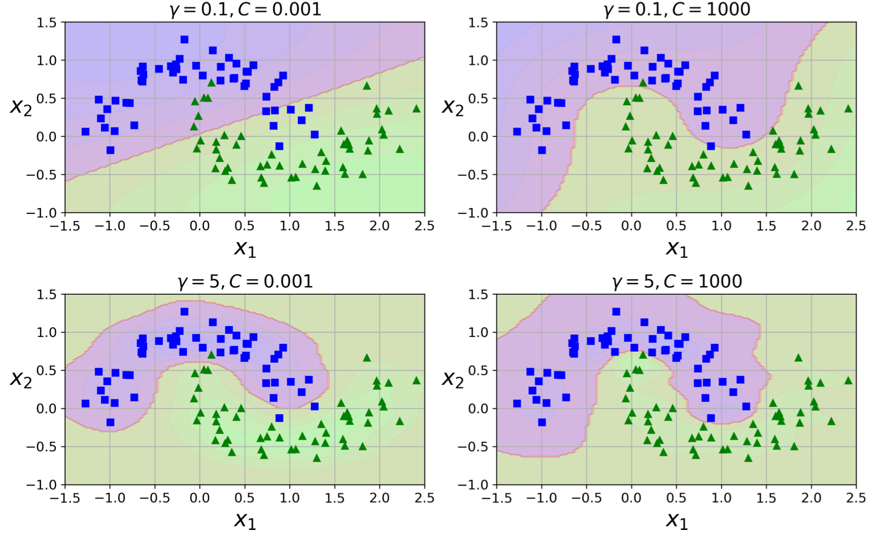
Adding Similarity Features - Gaussian RBF Kernel
…
("svm_clf", SVC(kernel="rbf", gamma=5, C=0.001))
…

Slide 16
sklearn.svm.SVC
kernel{‘linear’, ‘poly’, ‘rbf’, ‘sigmoid’, ‘precomputed’}, default=’rbf’

