Slide 1
MVC-Pattern

Slide 2
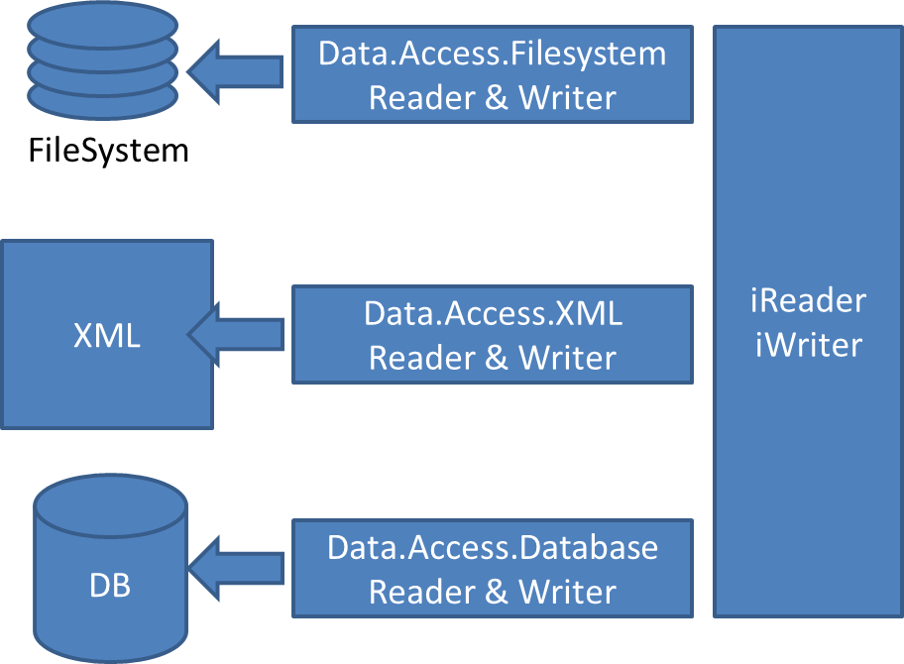
Data.Access
Main Form
Data Changed Events
Read, Write, Change
Data.
Datasource
Data.Access
AccessController
Save, Load

Slide 3
Data.Access
VIEW
Main Form
Data Changed Events
Read, Write, Change
CONTROLLER
Data.
Datasource
Data.Access
AccessController
Save, Load
MODEL

Slide 4
Add
Del
ShowInExplorer
Drag‘n‘Drop
Projects
ProjectFolders
Content
Detail View
Add
Del
ShowInExplorer
ZIP/Export
Add
Del
ShowInExplorer
Drag‘n‘Drop
Status Bar

Slide 5
Filesystem Structure and Classes Representation
Project: IProject, IContentFolder
FileSystem Structure
(PRJ) – Project Name
EMAIL
Documentation
Bin
Driver
Pictures
File1.png
File2.png
File.txt
FileB.doc
ProjectFolder: IProjectFolder, IContentFolder, IContent,
SubFolder: IContentFolder, IContent
SubFile: IContent
IProject
String Projectname
IContentFolder
ListOf<IContent> Contents
IProjectFolder
String Name
Project ParentProject
IContent
String DisplayName
String Description
IContentFolder ParentFolder

