Slide 1
MVC-Pattern

Slide 2
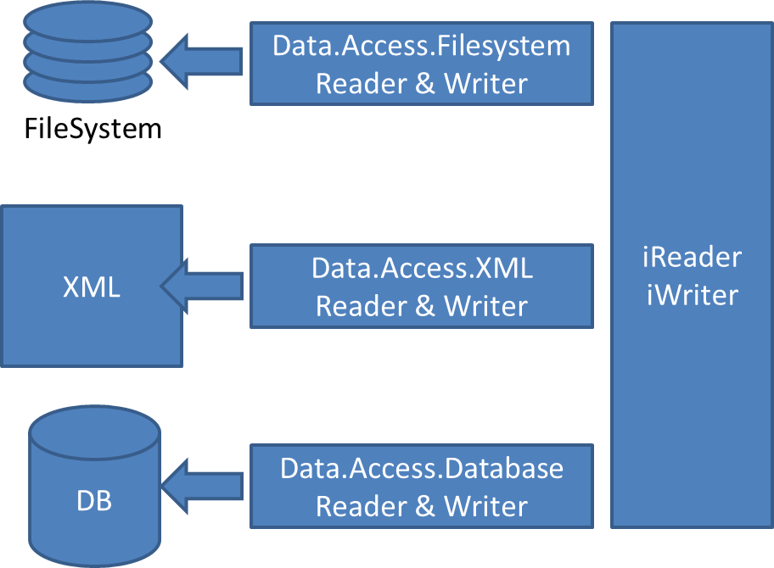
Data.Access
Main Form
Data Changed Events
Read, Write, Change
Data.
Datasource
Data.Access
AccessController
Save, Load

Slide 3
Data.Access
VIEW
Main Form
Data Changed Events
Read, Write, Change
CONTROLLER
Data.
Datasource
Data.Access
AccessController
Save, Load
MODEL

