Slide 1
Problem 2 Tests
1155

Slide 2
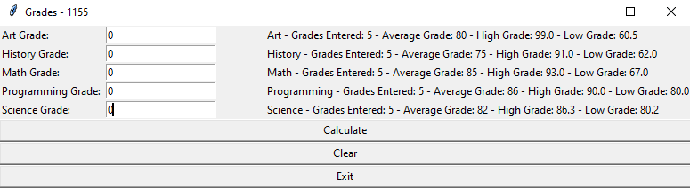
Test 1
Screen displays output with: class name - # of grades - averages – highs - and lows

Slide 3
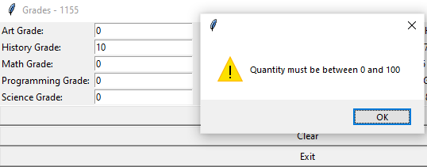
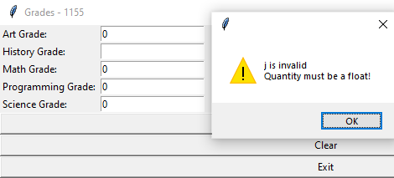
Test 2
Does not allow any values outside the range
Does not allow invalid inputs

Slide 4
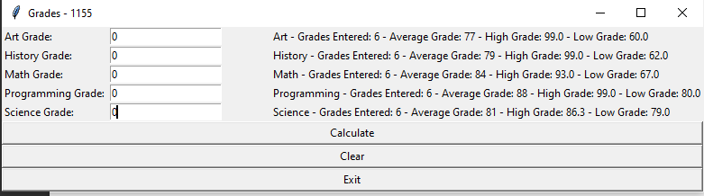
Test 3
All values are shown to the right of the input

