Slide 1
Project 1 Tests
1155

Slide 2
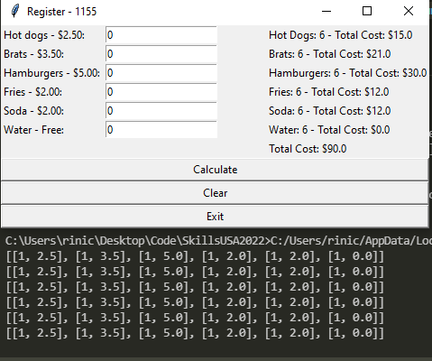
Test 1
Register displays total
Command line shows each order

Slide 3
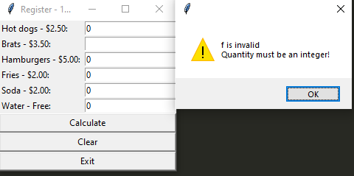
Test 2
Attempting to buy “f” brats
My code rejects that input and pops up this error

Slide 4
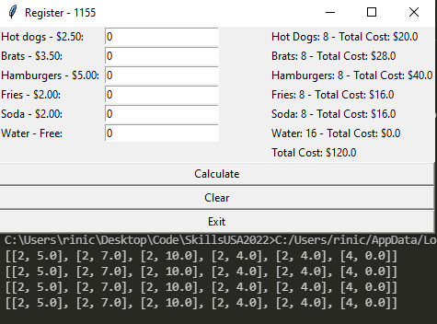
Test 3
Console again shows each order
Totals are displayed on the register

Slide 5
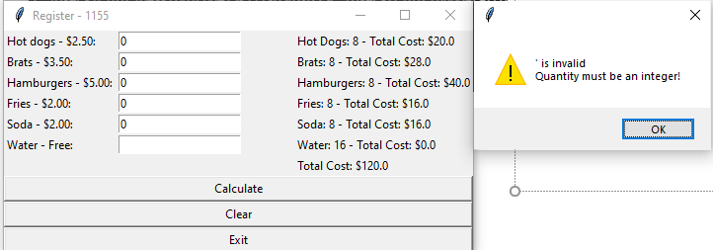
Test 4
Program once again denies invalid characters
It also displays the invalid character warning

Slide 6
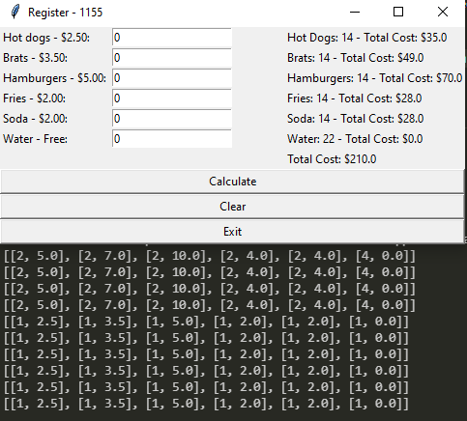
Test 5
Register displays total
Command line shows individual orders

