Slide 1
Developing Data Products Week 3 Project
Marcel Fratz
8/1/2021

Slide 2
Introduction
In this project is the goal to create a web page presentation using R Markdown that features a plot created with Plotly.
2/4

Slide 3
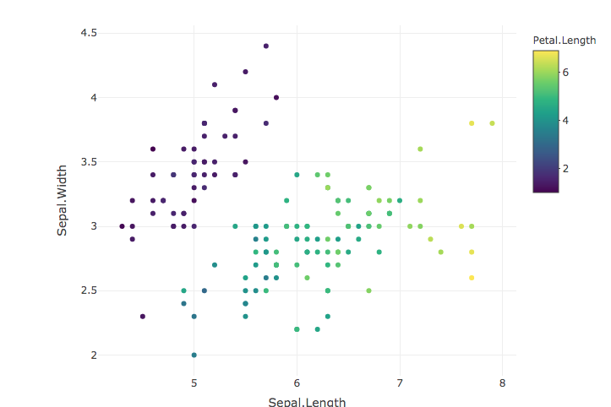
Code in R & Plot
# Loading dataset
data("iris")
library(plotly)
plot_ly(iris, x = ~Sepal.Length, y = ~Sepal.Width, type = "scatter", mode = "markers", color = ~Petal.Length)
3/4

Slide 4
Thanks for the attention
Marcel Fratz
8/1/2021

