Slide 1
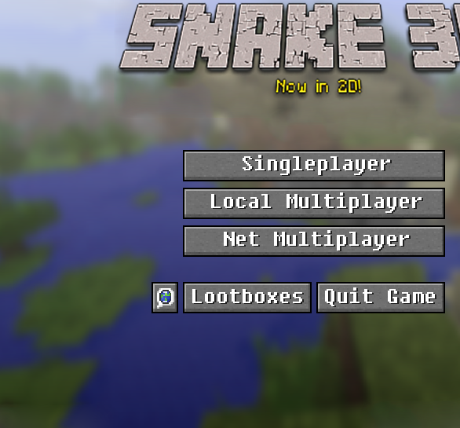
Snake
A Comrades Tale

Slide 2

Lootboxes

Slide 3

Roles
Zachary Handshoe: Snake, snake movement, collectable, local multiplayer, and bass boosting.
Zach Oritz: Skins, lootboxes, implementing music, animated background, game modes.
Chris McLain: Maps, game modes, mode selection, timing.
Rewrote entire GameStage because Chris is easily set off.

Slide 4
Lootboxes

Slide 5
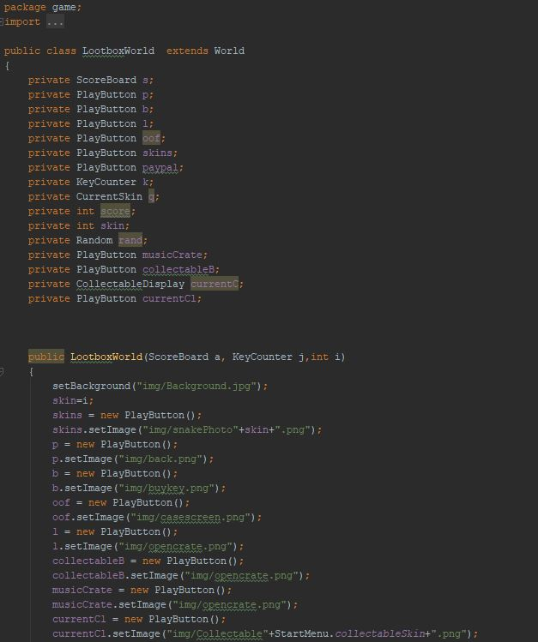
Interesting Code

Slide 6
Lootboxes

Slide 7
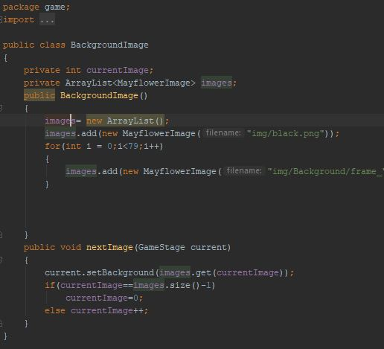
Interesting Code Two

Slide 8
Lootboxes

