Slide 1
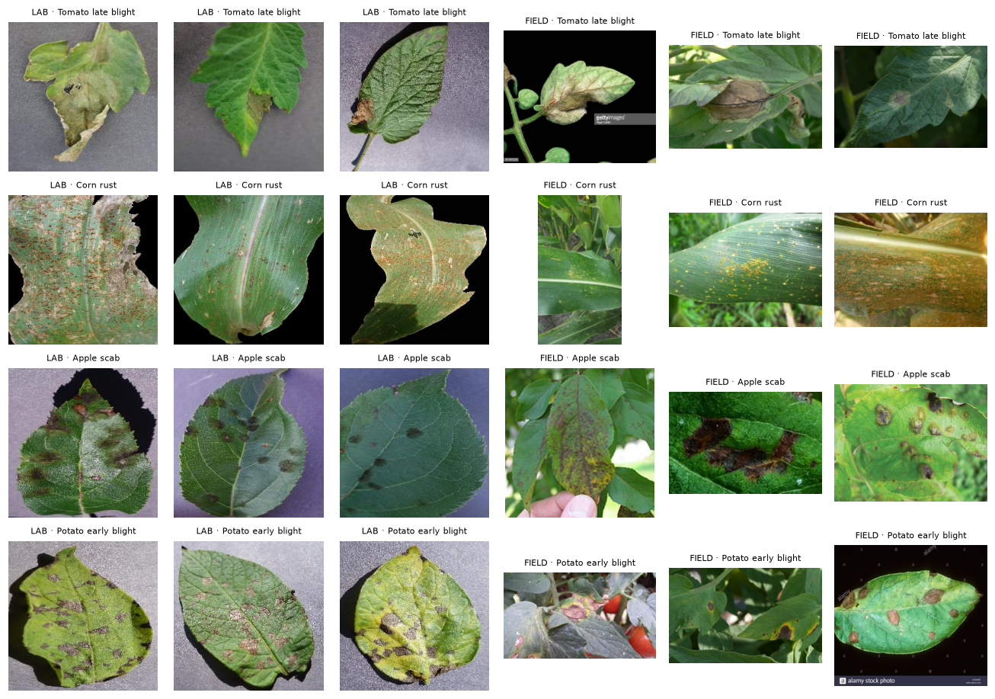
Lab to Field
Crop disease detection that works on real farm photos, not just lab images
Edge AI and Robotics: Data Center Vision · Group Project 1 (Modules 1–5)
Mehul Khanna
Notes:
Introduce the project in one line: plant-disease AI gets about 99% on lab photos but fails on real farm photos. We measured that failure honestly, fixed part of it, and made the model say 'not sure' when it doesn't know.

Slide 2
Models that ace the lab fail in the field
99%
~30%
accuracy on lab photos (PlantVillage)
on real field photos in published studies
Lab photo: one leaf on a plain board. Field photo: many leaves, soil, shadows, blur
This change of data is called domain shift
India: few extension officers per farmer and weak rural internet, so the app must be offline, small and honest
Notes:
Published: Mohanty 2016, 99.35% to 31.4% on web images; Xiang 2026, ResNet-50 99.73% to 32.05% while still ~80% confident. Left three columns are lab photos, right three are field photos of the same disease.

Slide 3
Our approach: one step per course module
Understand
Baseline
Transfer
Augment
Train better
Ship
M1: task = image classification; audit the data
M2, M3: CNN from scratch, shapes and parameters
M2, M3: pretrained models, probe vs fine-tune
M4: controlled ablation, background replacement
M5: optimizers, losses, activations, calibration
Grad-CAM, ONNX FP16, Streamlit app
The rule behind every decision
Train on lab photos (PlantVillage). Choose every setting on field validation photos. Report the PlantDoc field test only once, with 95% confidence intervals. 28 shared classes, so chance is 3.6%.
Notes:
Each notebook covers one step: 01 problem and data, 02 CNN from scratch, 03 transfer learning, 04 augmentation, 05 training choices, 06 explain and export. The test set is the final exam, never used to choose anything.

Slide 4
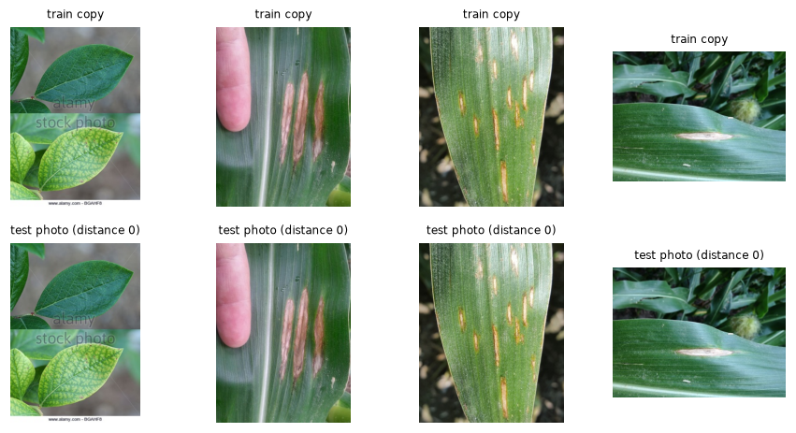
Making the test honest before training anything
37 leaves
15 images
46% vs 6%
were in both the official train and test split. Removed: we split by leaf
duplicated between PlantDoc train and test. Found by image fingerprint (pHash)
disease guessed from background corners only: lab vs field. A shortcut
Data leakage inflates the score: the model has already seen the test leaf
Corner test: lab backgrounds predict the label, field backgrounds don't
So a 99% lab score partly rewards cheating
Notes:
Two leaks fixed: same-leaf photos across splits, and duplicate web images. The corner test used a random forest on four 8x8 corner patches only; chance is 3.6%.

Slide 5
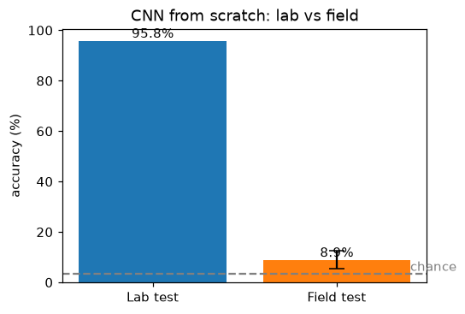
CNN from scratch: 95.8% in the lab, 8.9% in the field
Input
Block 1
Block 2
Block 3
Block 4
Pool + Linear
3×224×224
32×112×112
64×56×56
128×28×28
256×14×14
256 → 28
Each block: Conv 3×3 → BatchNorm → ReLU → MaxPool. 396,092 parameters, counted by hand and checked against PyTorch.
Learns the lab almost perfectly
Barely above chance on field photos
Still 78% confident: confidently wrong (calibration error 0.69)
Notes:
Conv parameters = k·k·Cin·Cout, BatchNorm = 2·C, Linear = in·out + out. ReLU, pooling and dropout have none. The red flag is the confidence: 78% while being right 9% of the time.

Slide 6
Pretrained features help; real field photos help most
Pretraining lifts field accuracy from 9% to 25–32%
Best lab score is not the best field score (EfficientNet)
Fine-tuning adds ~3 points but more overconfidence
Frozen DINOv2 (self-supervised) transfers best: 46%
~2,000 real field photos take MobileNetV3 to 64%
Notes:
Linear probe trains only the last layer; fine-tuning trains everything with a small learning rate. Our ResNet-50 (32.2%) and DINOv2 (46.2%) match published numbers (32.05% and ~41-43%). MobileNetV3 is deployed because it is phone-sized: 5.5M parameters, depthwise separable convolutions.

Slide 7
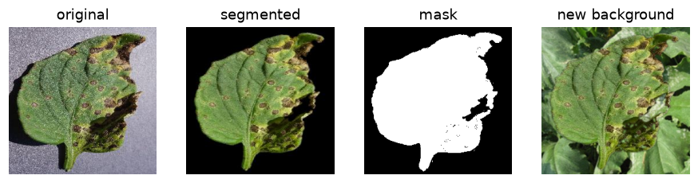
Targeted augmentation beats generic augmentation
Background replacement: cut out the leaf, paste it on a new background, so the background can no longer predict the label.
One change per run, everything else fixed (an ablation)
Background replacement: about +13 points over none
RandAugment does not help: it doesn't target the real gap
Winner chosen on validation, never on test
Notes:
On field validation bg_field narrowly won (28.9 vs 27.7) while bg_synthetic was better on test (39.0 vs 31.4). We followed validation anyway; the disagreement shows how noisy small field sets are.

Slide 8
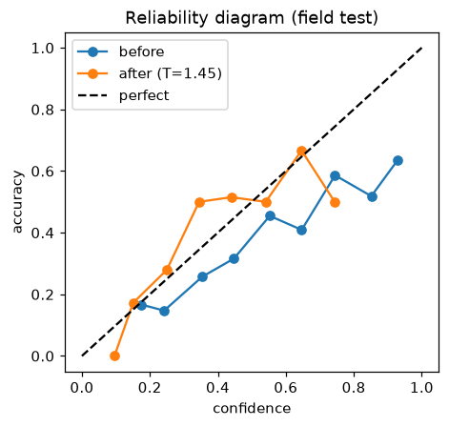
Training choices: label smoothing makes the model honest
Experiment (Module 5) | Field val | Field test | Calibration error
AdamW, cross-entropy | 28.9% | 31.4% | 0.44
SGD + momentum | 27.7% | 33.5% | 0.37
AdamW + label smoothing | 29.4% | 36.4% | 0.16
AdamW + focal loss | 24.3% | 29.7% | 0.37
Scratch CNN: ReLU / SiLU / GELU | 7–9% | 9–10% | ~0.67
Calibration error (ECE): gap between stated confidence and real accuracy
Label smoothing: target 0.9 instead of 1, so less overconfidence
Activations change ~1 point; the data problem matters far more
Notes:
AdamW and SGD are within noise; AdamW kept. Focal loss did not help because classes were already capped at 500 photos. The reliability diagram compares confidence with accuracy; the diagonal is perfect calibration.

Slide 9
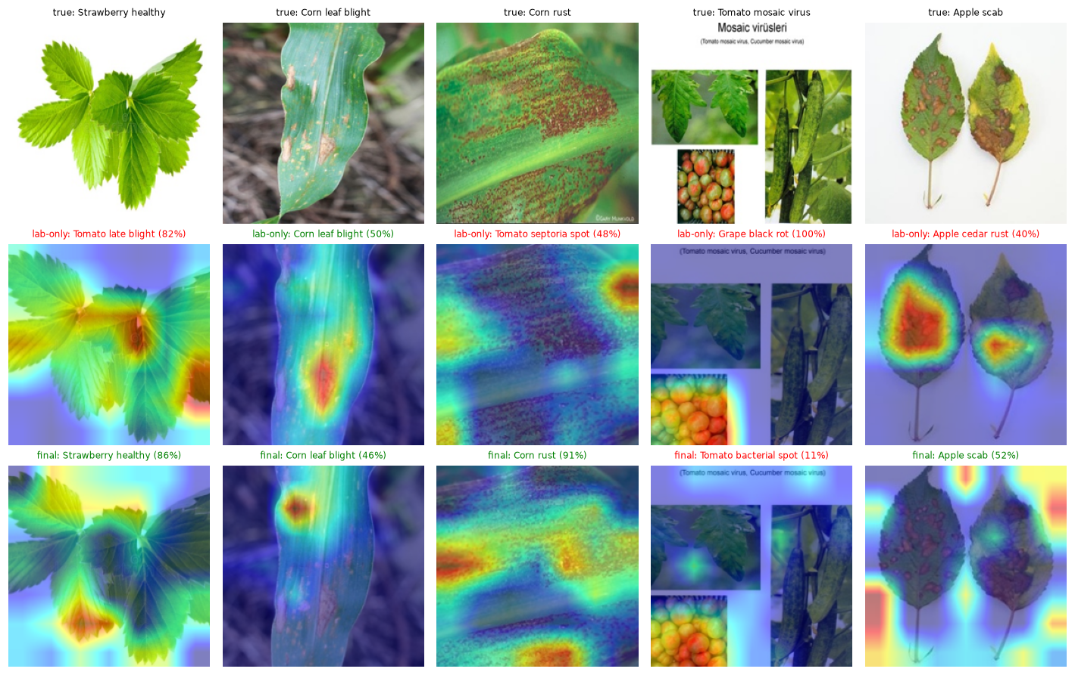
Final model: 64% in the field, and it knows when it's unsure
64.4%
0.09
field test accuracy (95% CI 58–70%)
calibration error, down from 0.69
77.8%
8.5 MB
accuracy on the 71% of photos it answers
FP16 model, runs offline on a CPU
MobileNetV3 · lab + field photos · background replacement · label smoothing · says “not sure” below 54% confidence
Notes:
Grad-CAM shows where the model looked: middle row is the lab-only model, bottom row the final model. The final model gets 4 of 5 right and looks at lesions more often, but sometimes still at background. The collage image gets 11% confidence, so the app would say not sure.

Slide 10
From notebook to app
Photo
Preprocess
ONNX FP16
Calibrate
Answer
sample, upload or camera
resize 255, crop 224, normalise
MobileNetV3, 8.5 MB
logits ÷ temperature, softmax
top-3, or “not sure”
Format | Size | Field accuracy
FP32 | 16.9 MB | 64.4%
FP16 (shipped) | 8.5 MB | 64.4%
INT8 | 4.7 MB | 60.6%
ONNX export matches PyTorch (difference 2×10⁻⁶)
INT8 loses 3.8 points on MobileNetV3, so FP16 ships
Live app: lab-to-field.streamlit.app
Code and notebooks: github.com/MrMehulkhanna/lab-to-field
Notes:
The app never needs PyTorch for prediction. Abstain threshold 0.54 and temperature were set on validation data. INT8 would need quantization-aware training (Module 7).

Slide 11
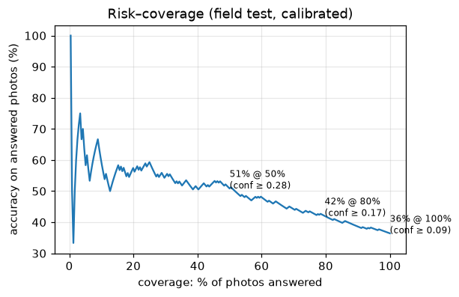
What we learned
Lab accuracy lies: always test in the field
Remove leakage and shortcuts before trusting a number
A model that knows when it's unsure is more useful
Next: Punjab field photos (wheat, rice, cotton), DINOv2 distillation, INT8 with quantization-aware training, leaf segmentation, Android app
Notes:
End with the three lessons and the next steps for Group Project 2. Then take questions.

