Slide 1
Introduction to E-BOX AETS
Diploma thesis: E-BOX AETS
Vojtěch Míček
23.3.2026

Slide 2
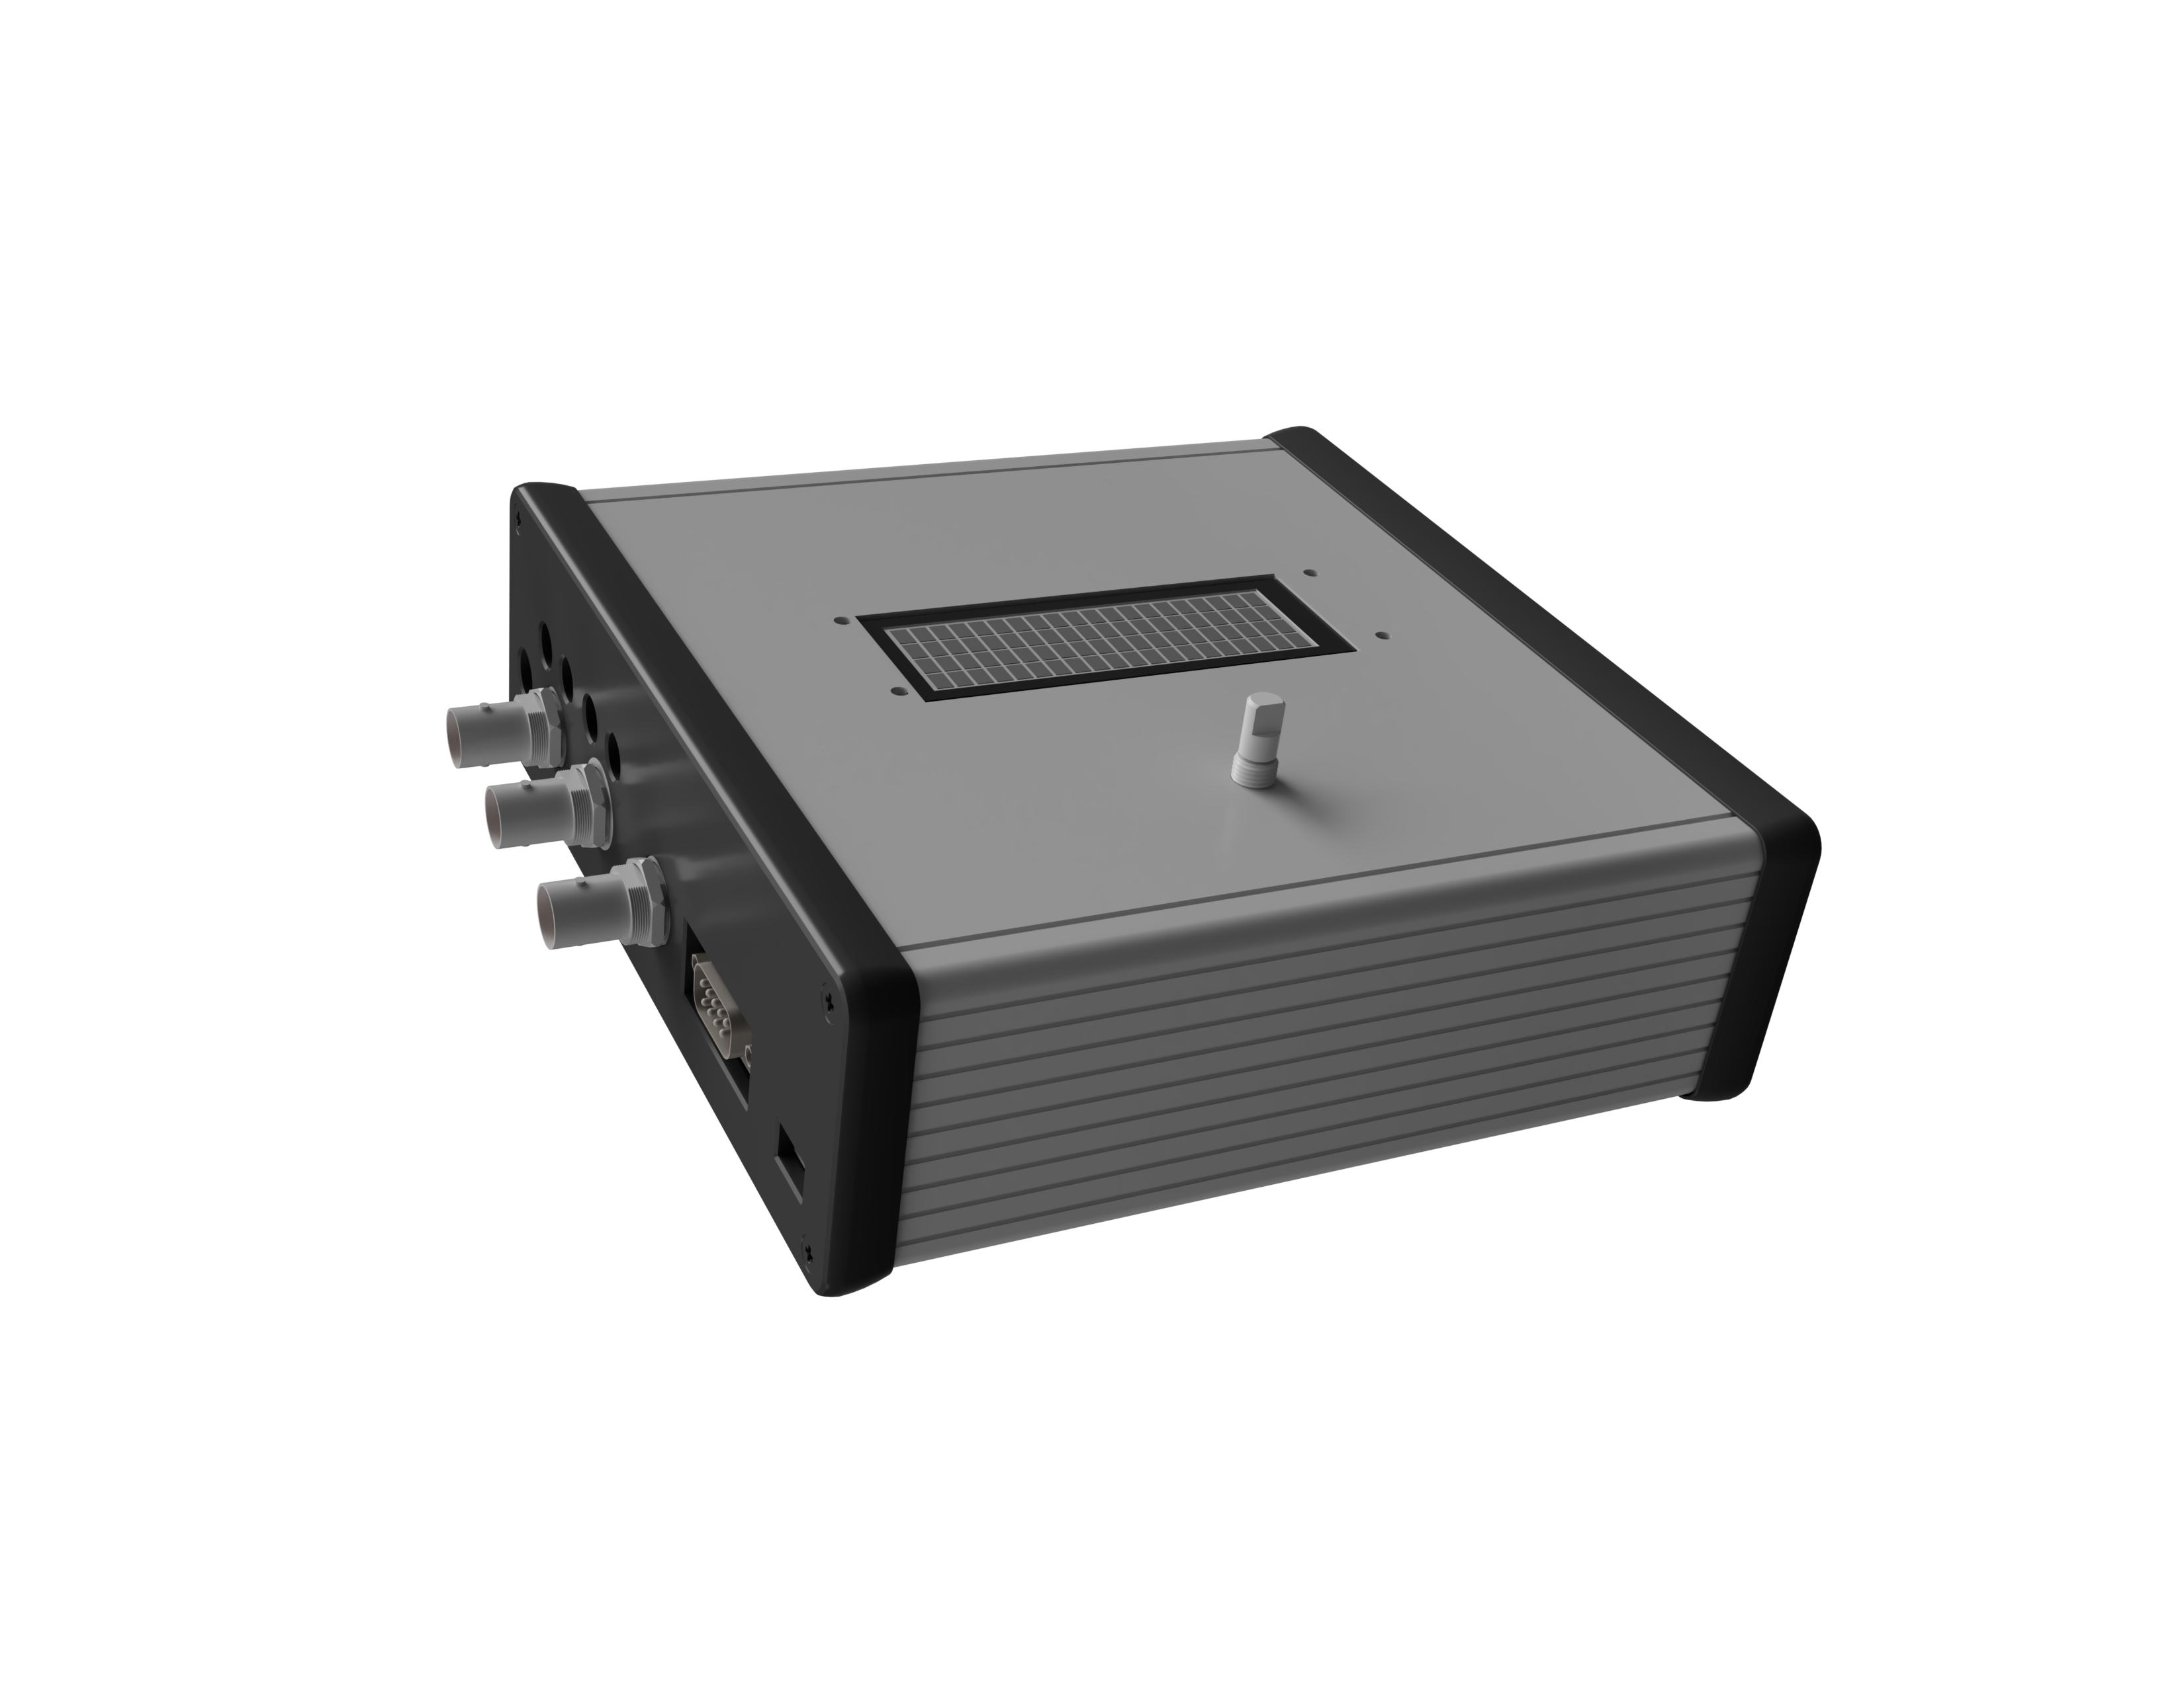
Basic description of the system
Diploma thesis: E-box aets
AETS Automated Electrical Testing System
Laboratory equipment for electrical testing of automotive components
Combines relay and MOSFET branches, local UI and PC control
Designed for faster, repeatable, safer and easier testing

Slide 3
Why was the device developed?
Diploma thesis: E-box aets
Need in practice
What it does
Typical usage
Acceleration of repetitive electrical tests
Universal platform across EE Teams
Reproducibility of test sequences.
Switching of tested branches
Basic internal supervision of test progress
Communication with host PC with option to remotely control the device
ON/OFF tests
Switching sequences
Fast switching for INRUSH current testing
Long-term cyclic tests

Slide 4
Brief description of how the system works
Diploma thesis: E-box aets
PC/LabVIEW Manual setup
MCU logic & sequence control
Relays MOSFETs
DUT
Measurement devices
Relays
Low contact resistance (~15mΩ), suitable for normal ON/OFF sequences and long-term cycles
MOSFETs
Bidirectional structure, short pulses, and monitoring of transient signals.
Additional functions
Advanced UI, Trigger, Relay cycle counter & current monitoring, External MOSFET control

Slide 5
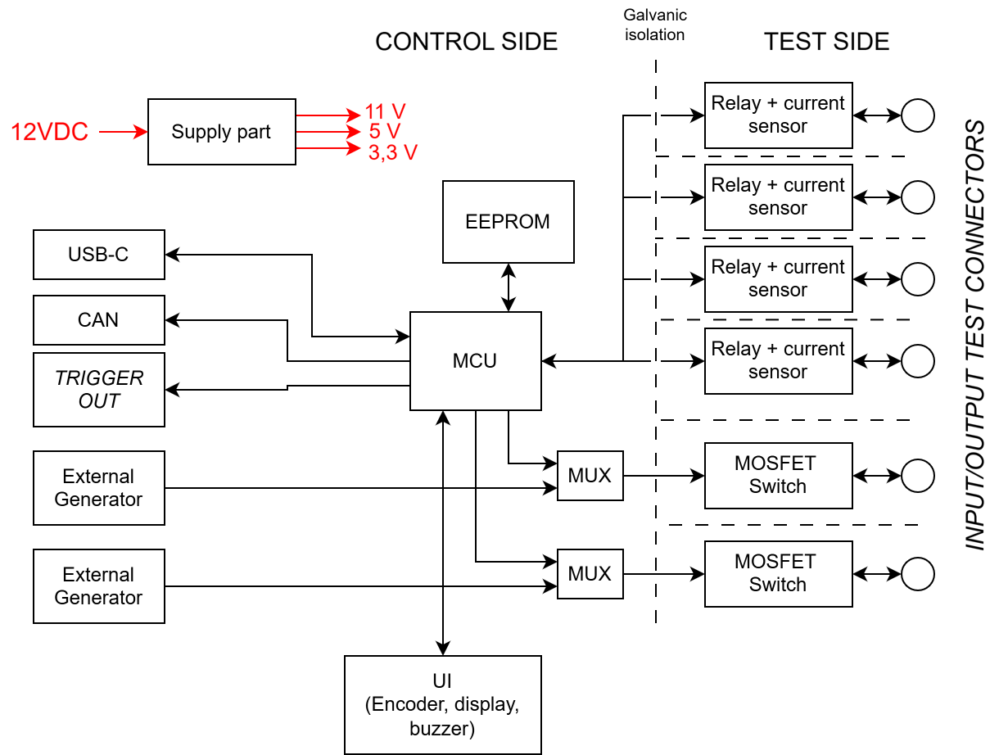
Brief description of how the system works
Diploma thesis: E-box aets

Slide 6
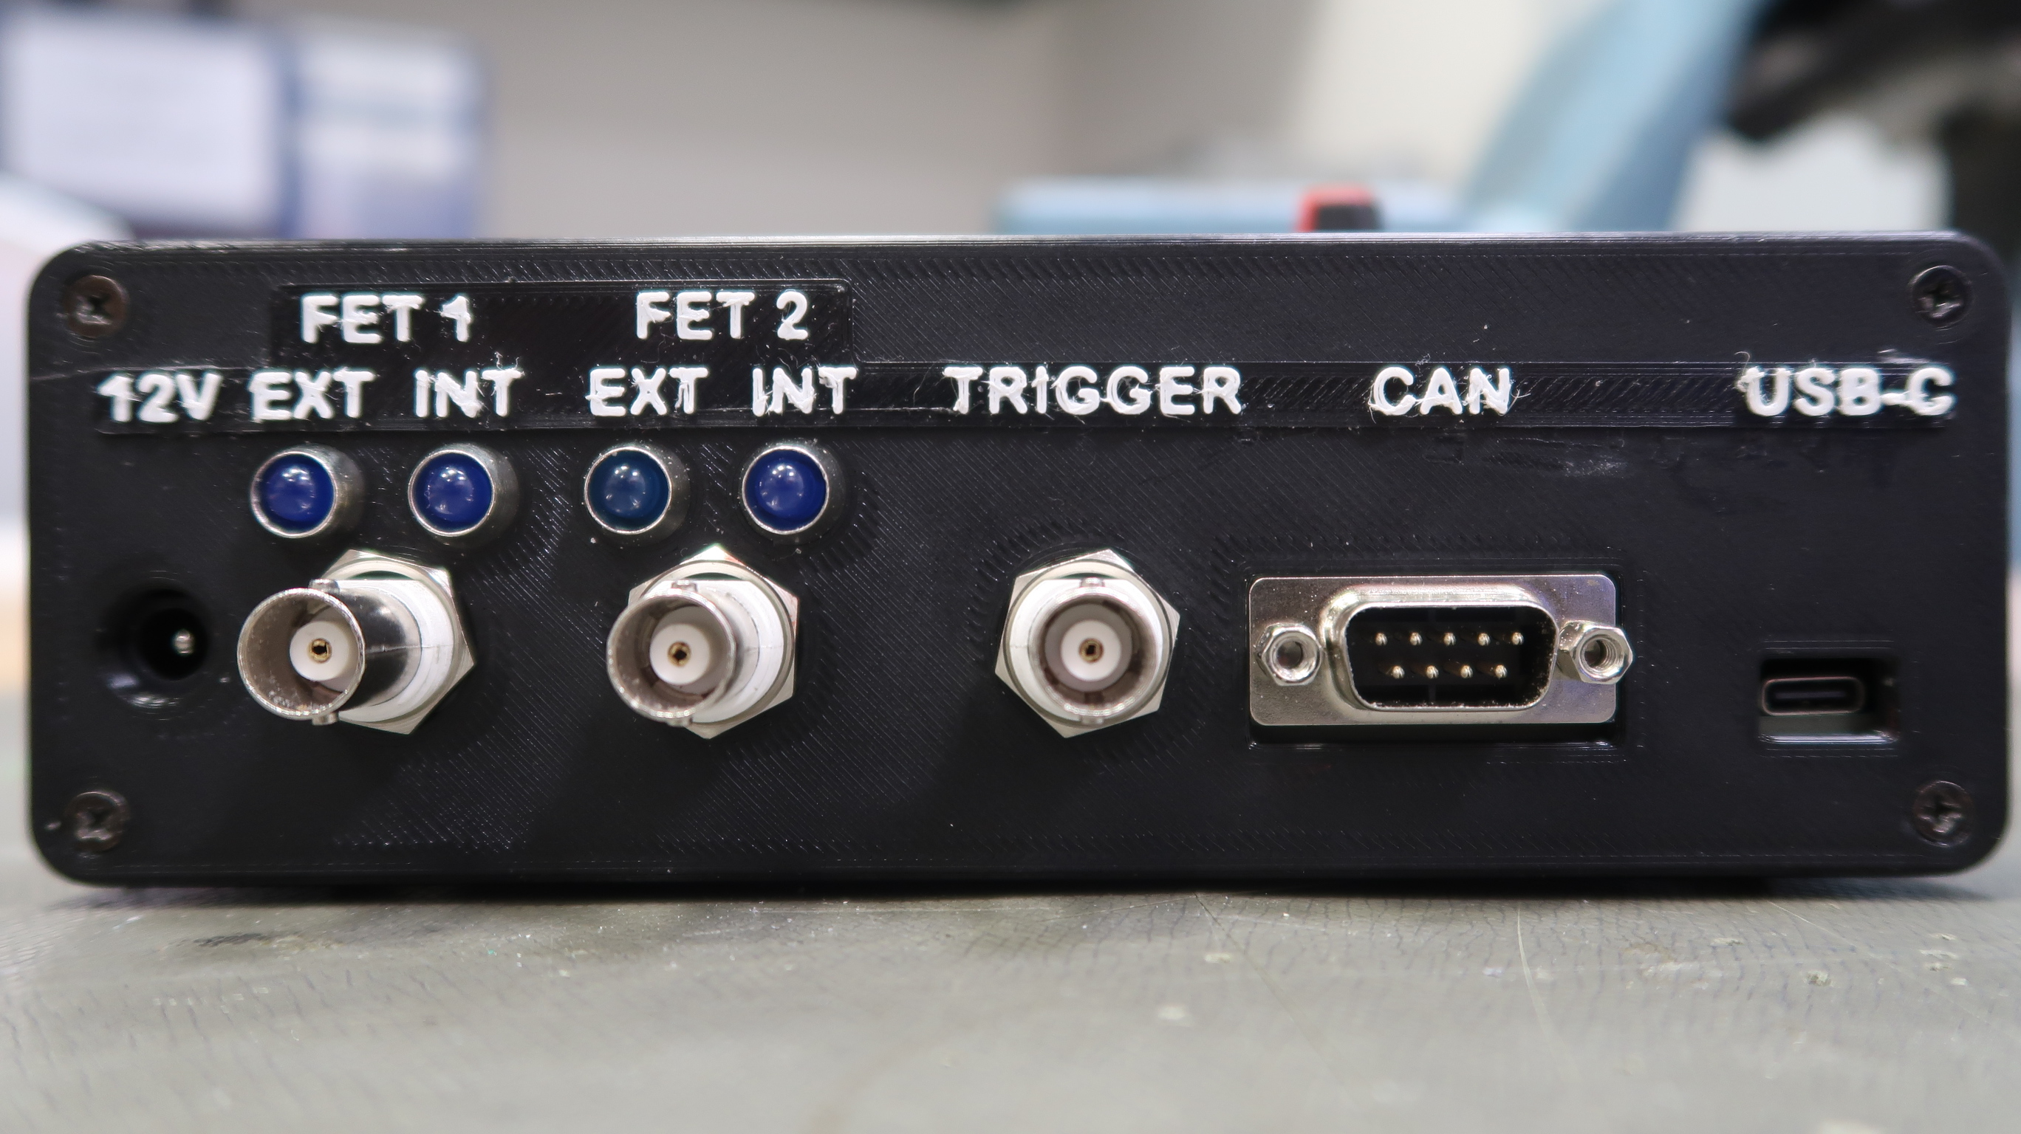
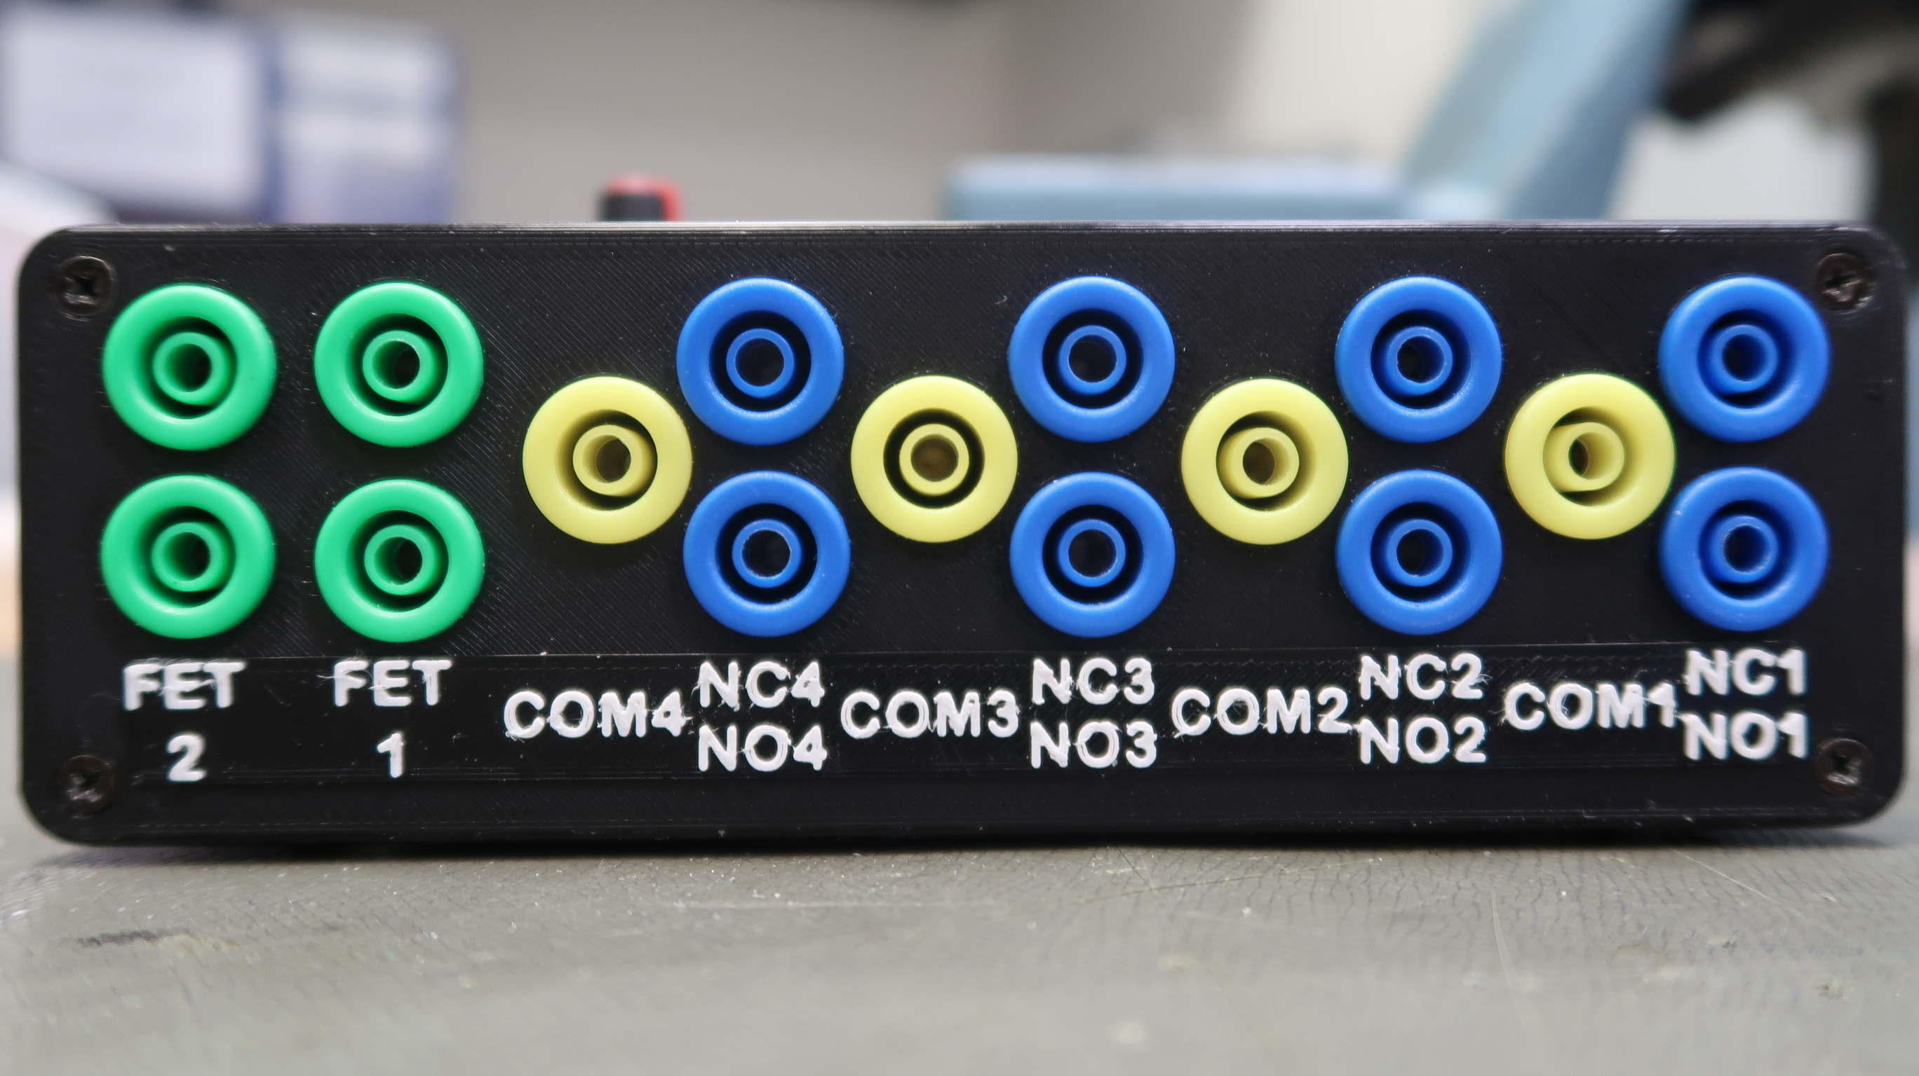
Connectors and interfaces
Diploma thesis: E-box aets
Control Connectors
12 V DC power supply jack
2x BNC input for external control of MOSFETs
BNC TRIGGER output for synchronization
DSUB-9 CAN OUTPUT for extended communication
USB for connection to a PC and remote control
Test Connectors
4 Relay Branches
2 MOSFET switch pairs

Slide 7
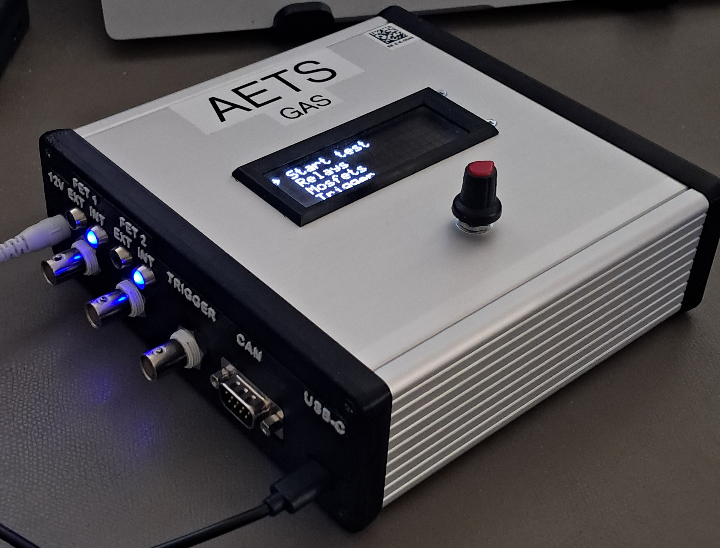
Complete Assembly
Diploma thesis: E-box aets

Slide 8
System configuration
Diploma thesis: E-box aets
Relays
Channel enable, turn-on time, turn-off time, number of cycles, and internal current control limits.
MOSFETs
Channel enable, turn-on time, turn-off time, internal or external control selection, and number of cycles.
System options
Trigger, communication and data storage in profiles.
Select control mode
Configure channels and timing
Run test
Monitor test progress
Evaluate test results

Slide 9
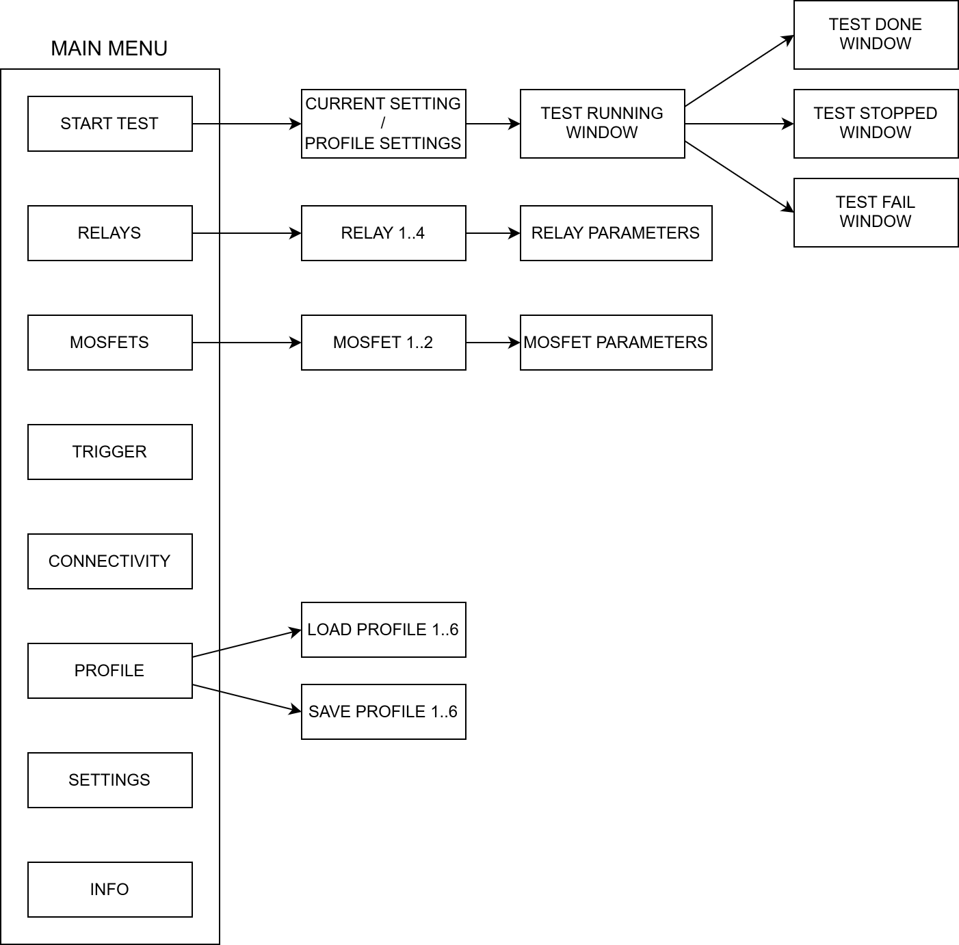
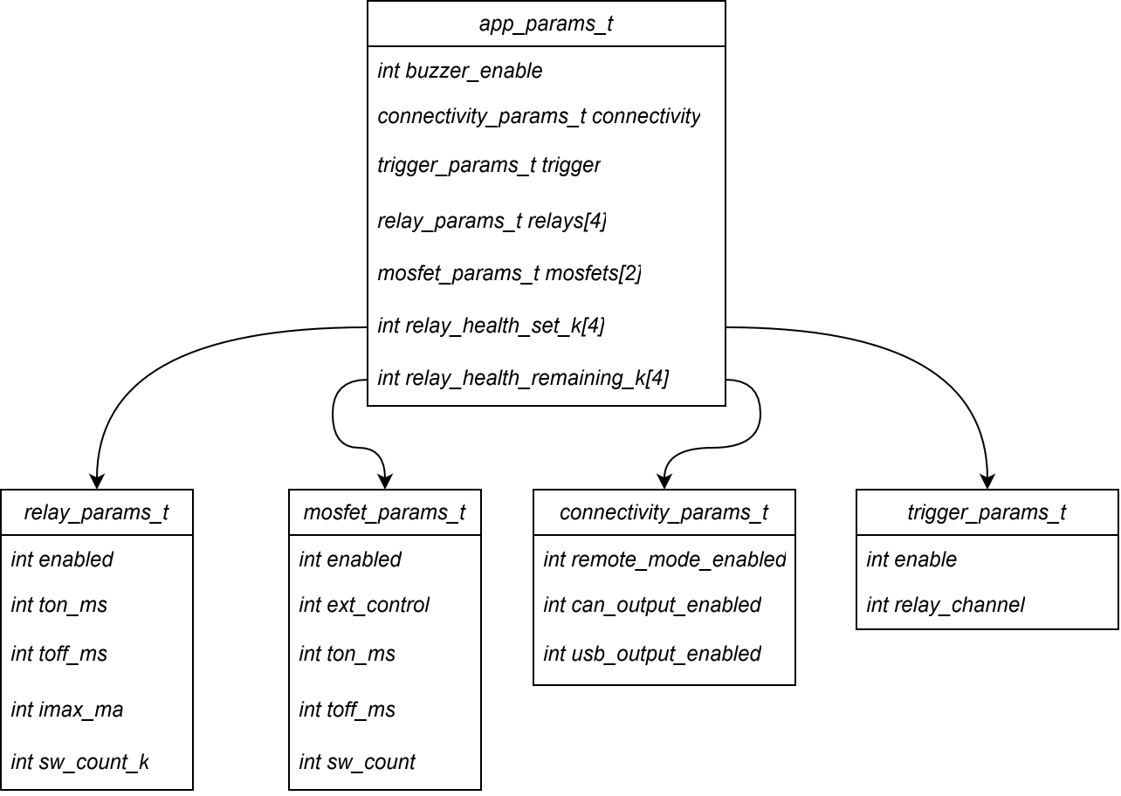
System configuration
Diploma thesis: E-box aets

Slide 10
Basic navigation and modes
Diploma thesis: E-box aets
MANUAL
Local operation via display and encoder. Suitable for quick function checks, servicing, and simple sequences.
REMOTE
Control from a PC via USB. Suitable for automation and integration into laboratory workflow.
TEST
Run sequence with supervision. In case of failure, the system will switch to a safe state and report the error.
The display shows the basic status of the device, function selection, and test progress.
The encoder is used to navigate the menu, change parameters, and confirm selections.
The system can be controlled remotely using commands and telemetry/status information can be obtained.
Important operating data is stored in EEPROM and is retained in the event of a brownout.

Slide 11
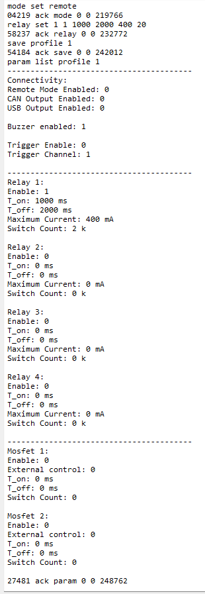
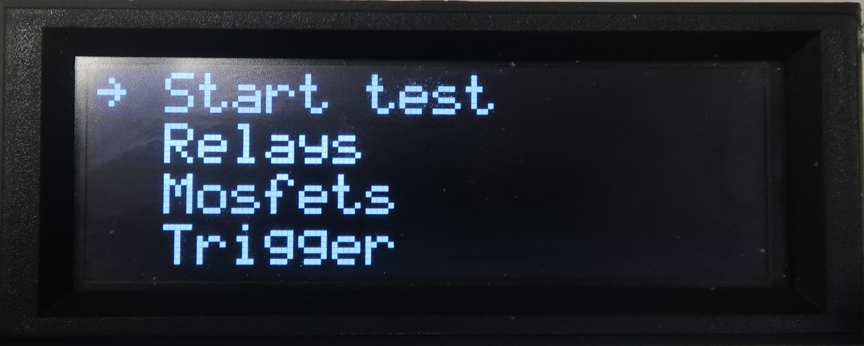
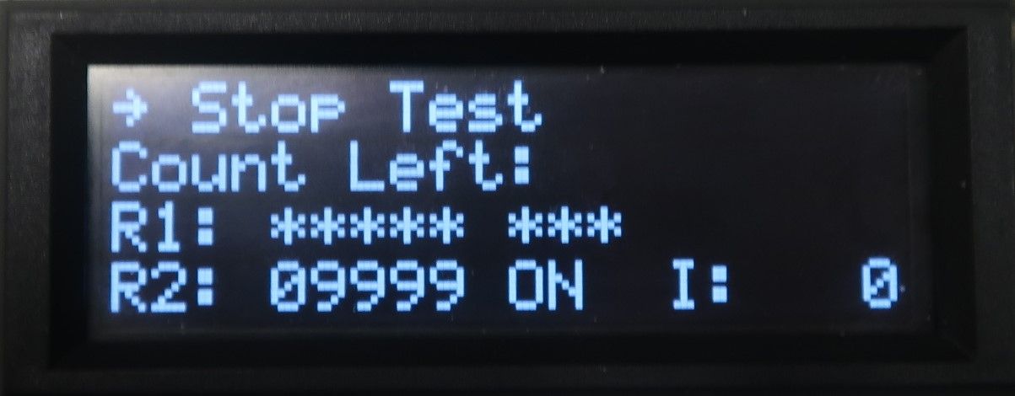
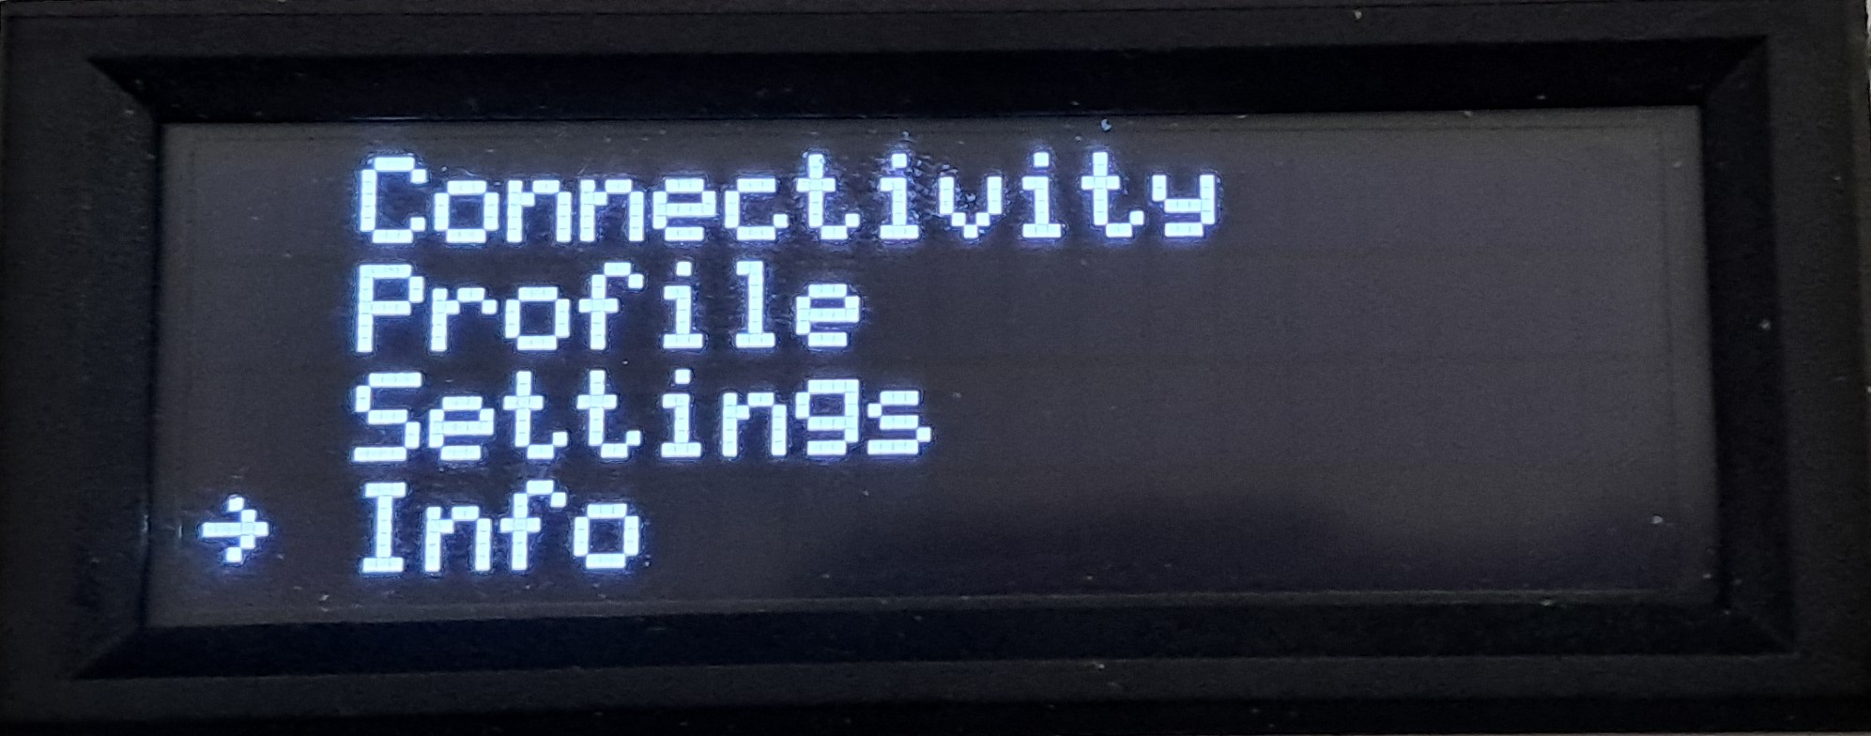
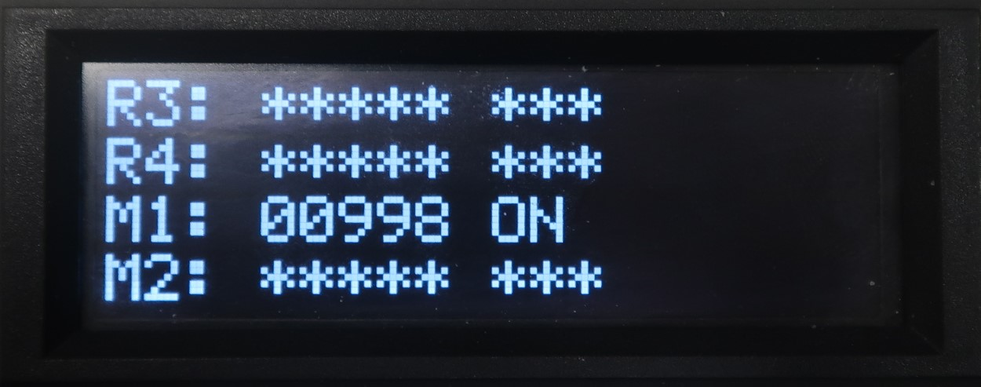
Basic navigation and modes
Diploma thesis: E-box aets
MANUAL
REMOTE
TEST

Slide 12
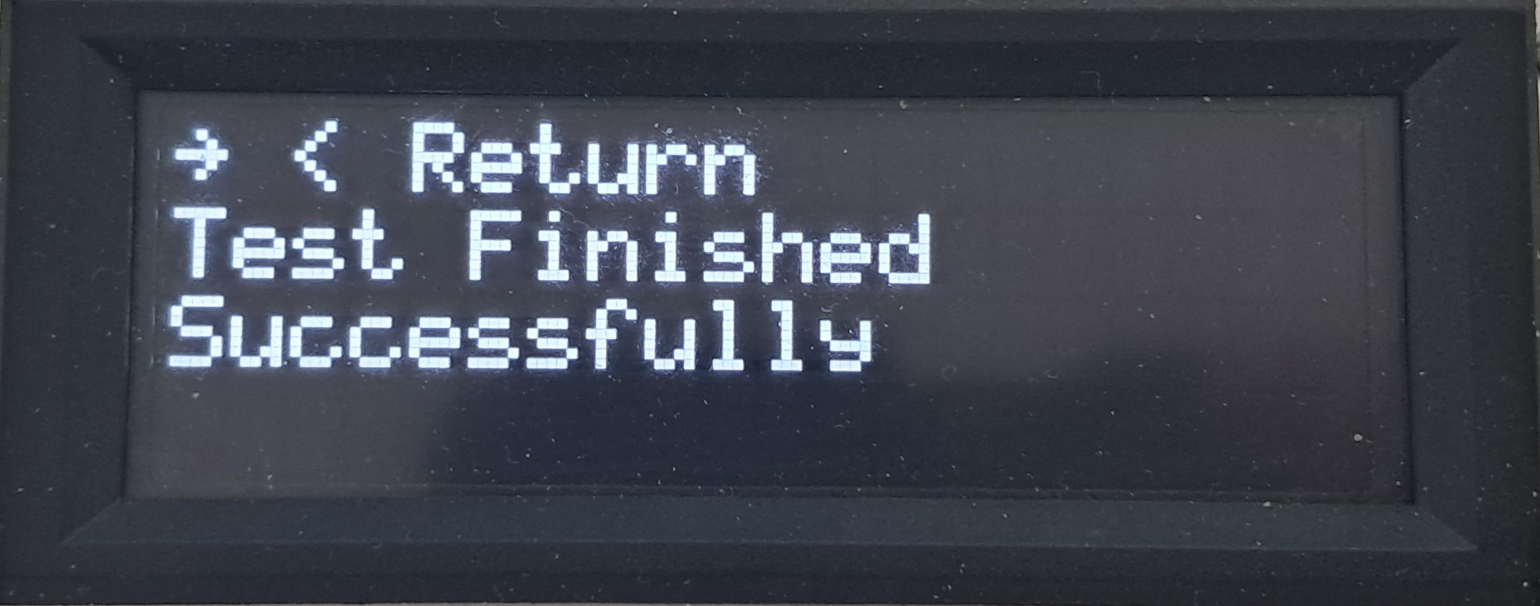
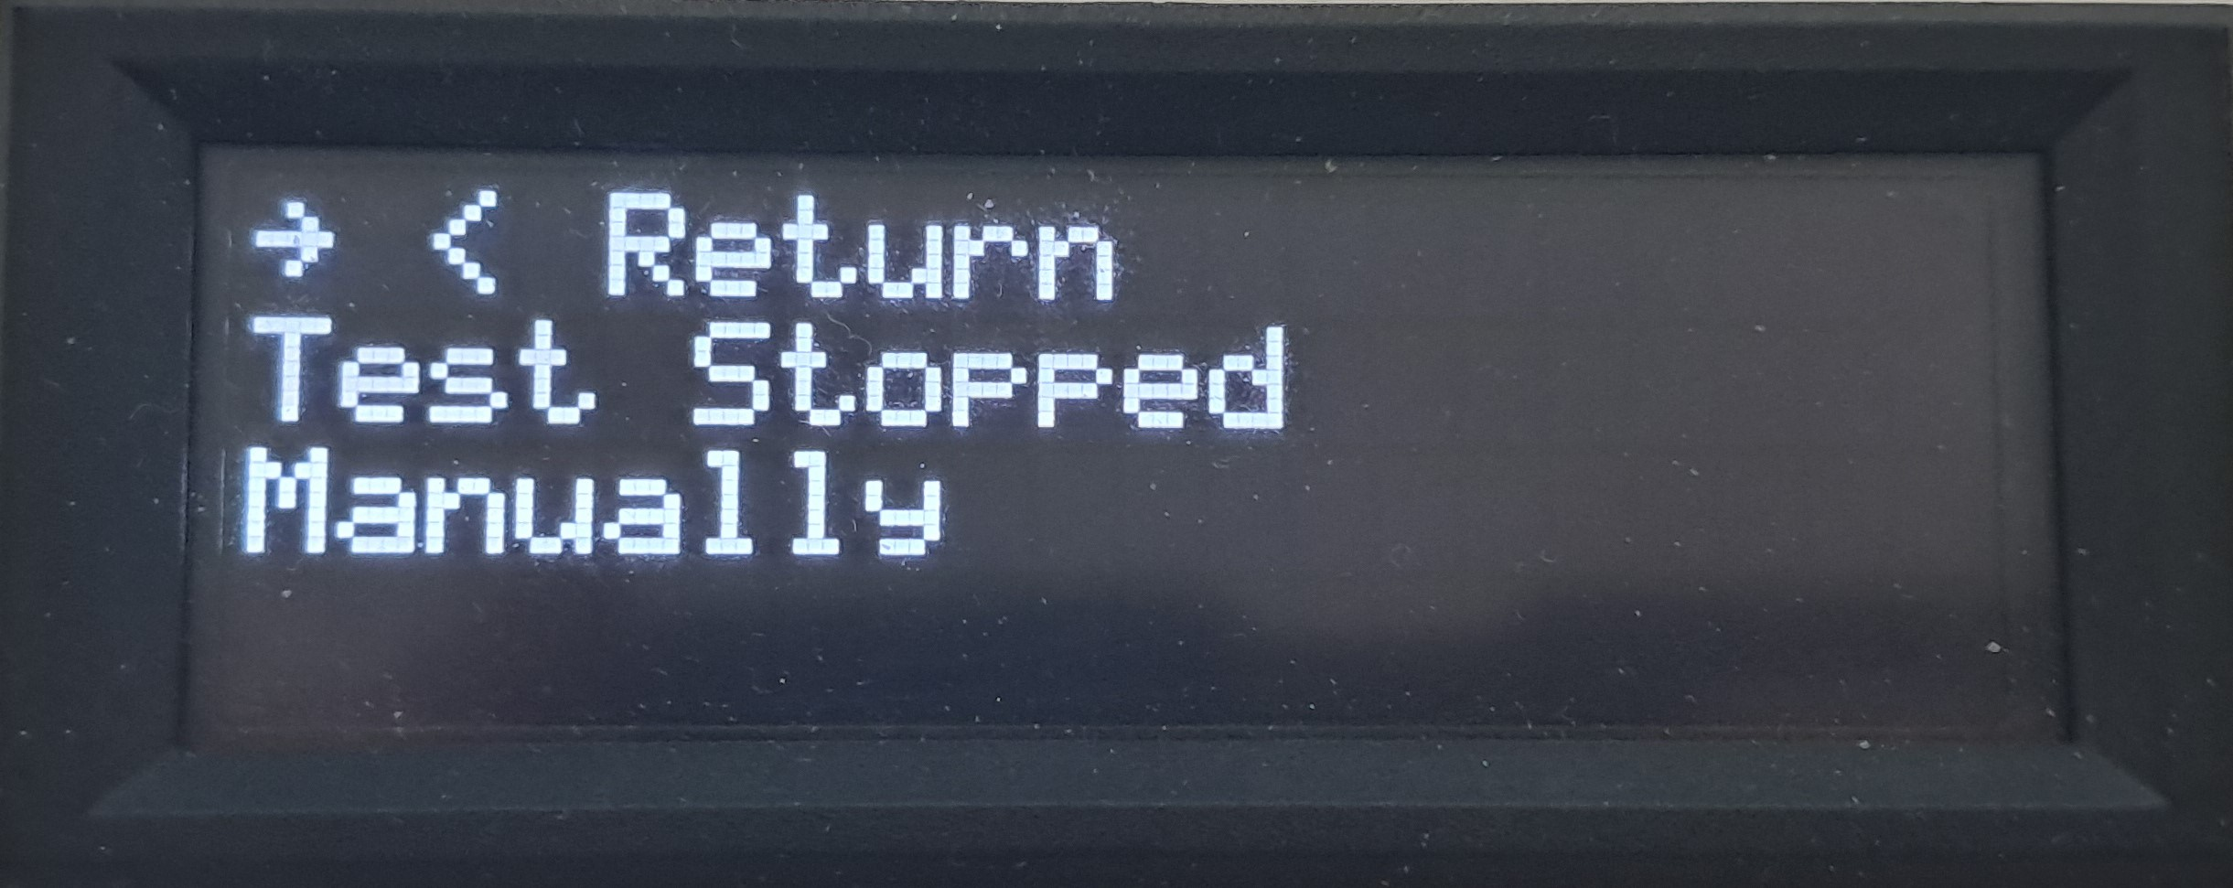
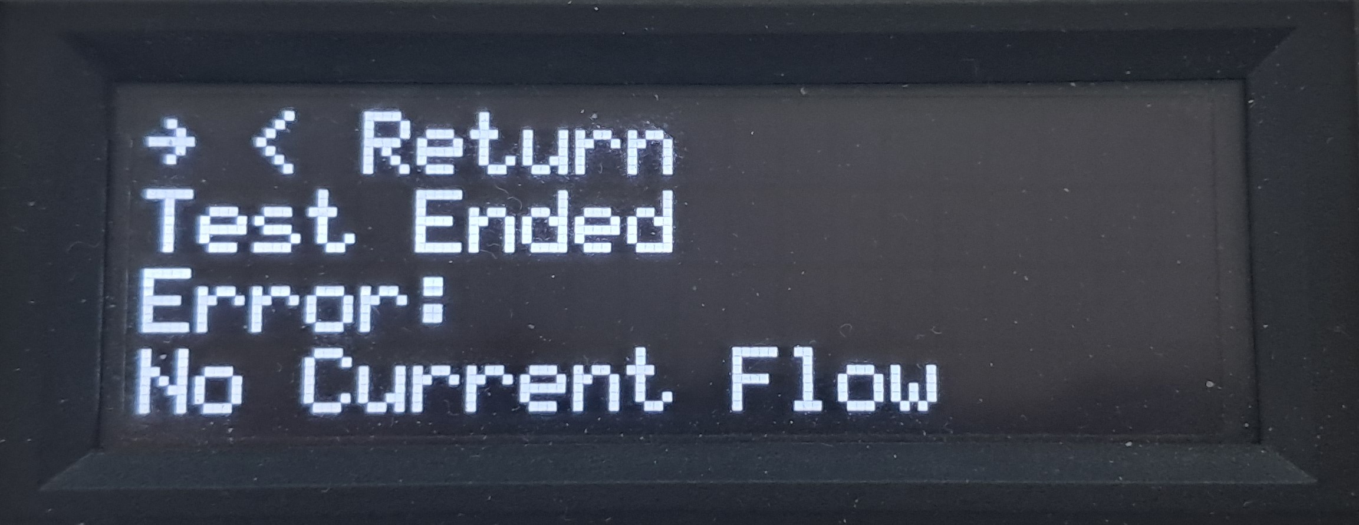
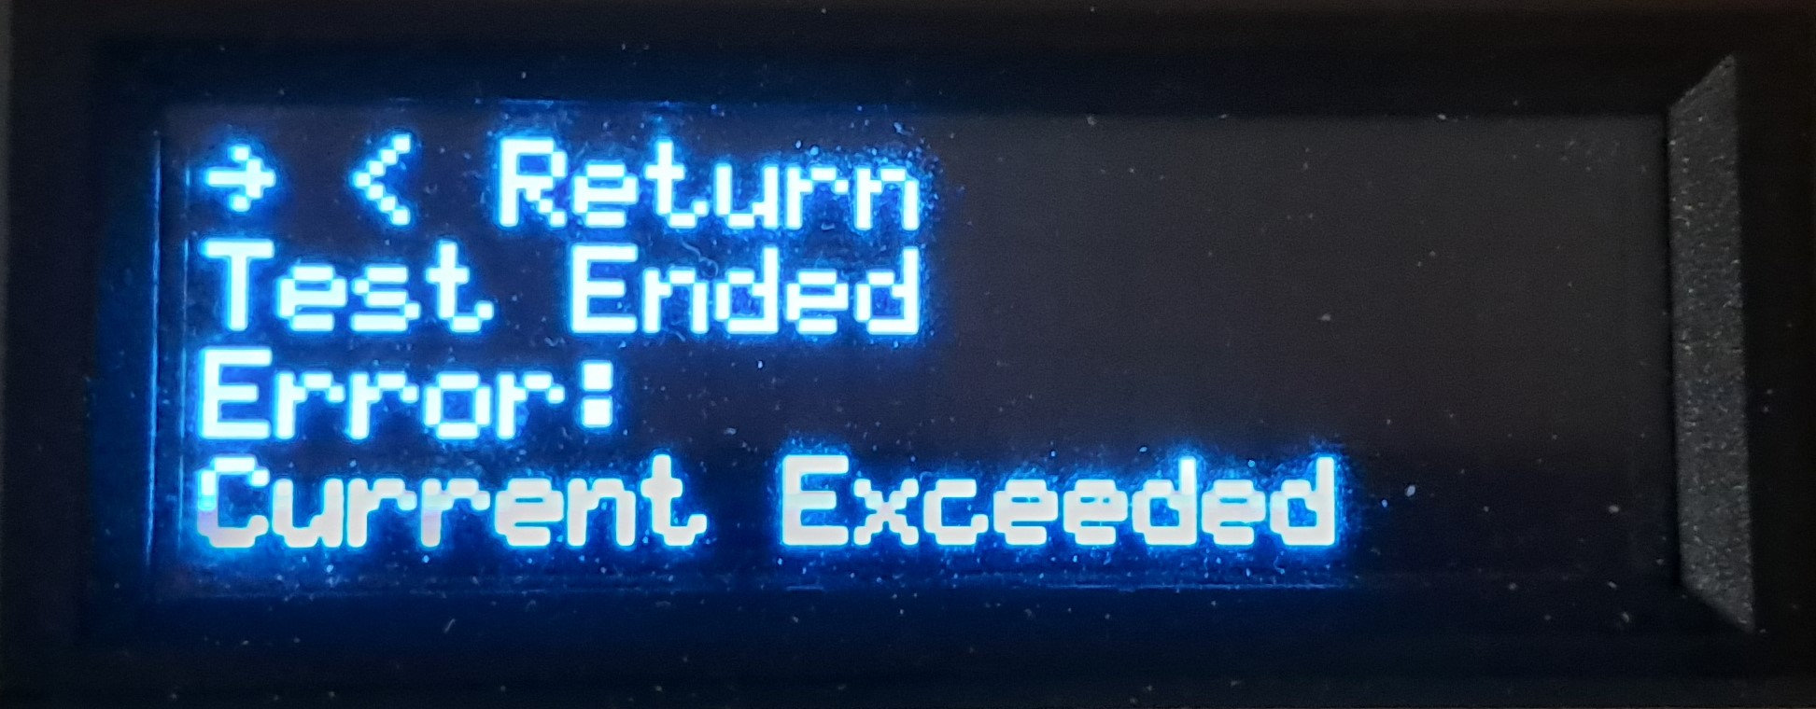
Post-test screens
Diploma thesis: E-box aets
DONE
STOPPED
FAULT

Slide 13
First time using remote mode
Diploma thesis: E-box aets
Connect to device via USB-C
Setup serial port in terminal
Connect to the device in terminal
Type ‘gh’ into the terminal
Continue onward based on help instruction
How to setup serial port
Categories in help
Choose COM port (dynamic)
Baudrate: 9600
Databits: 8
Parity: None
Stopbits: One
HELP/INFO Commands
Remote-mode gating
Standard Response
Error Codes
Mode Control Commands
RELAY Commands
MOSFET & MUX Commands
TEST CONTROL Commands
PARAMETER SETTING Commands
PROFILE MANAGEMENT Commands
USB OUTPUT DESCRIPTION
CAN OUTPUT DESCRIPTION

Slide 14
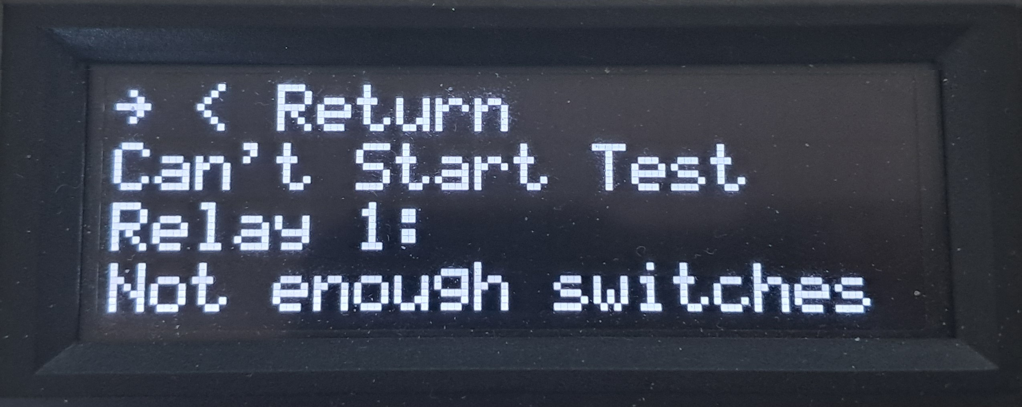
Relay cycle counter managment
Diploma thesis: E-box aets
Switch count value
The value of the number of switches was determined from datasheet and verified in test to be 3 million cycles.
Brownout event
If supply voltage of the device drops below a certain threshold, the device will stop all the current operations and save all important data to EEPROM. This includes relay cycles.
Prevention of excess relay use
If you set switch count higher, than the relay has remaining, this screen will appear to notify you.
You can’t start a test in this condition.

Slide 15
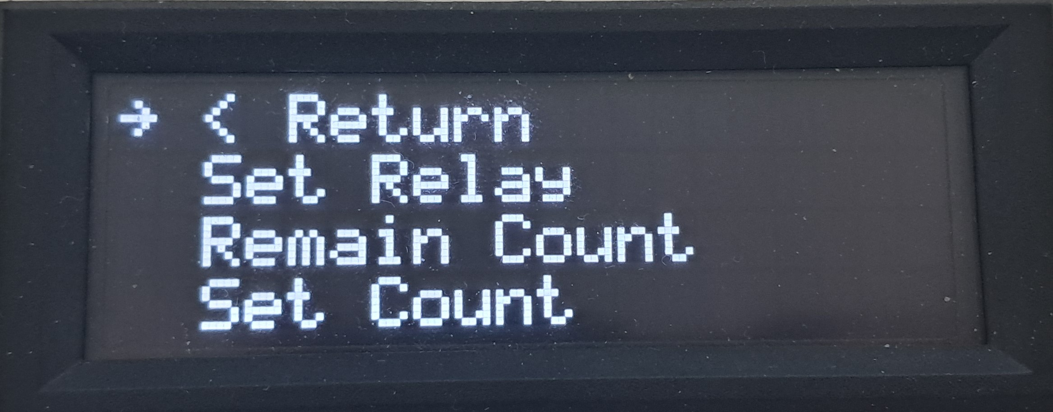
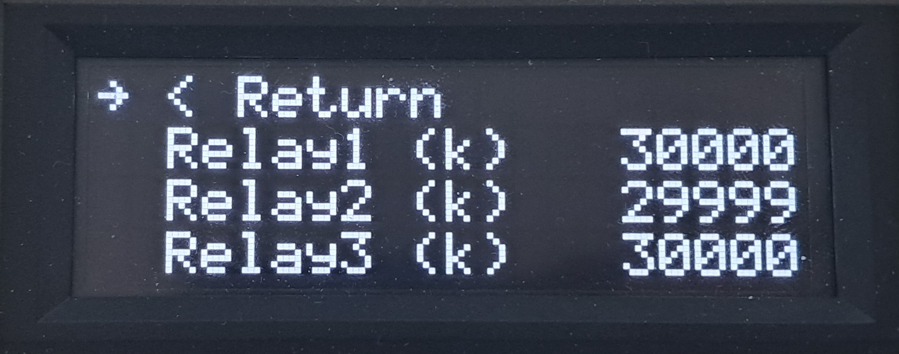
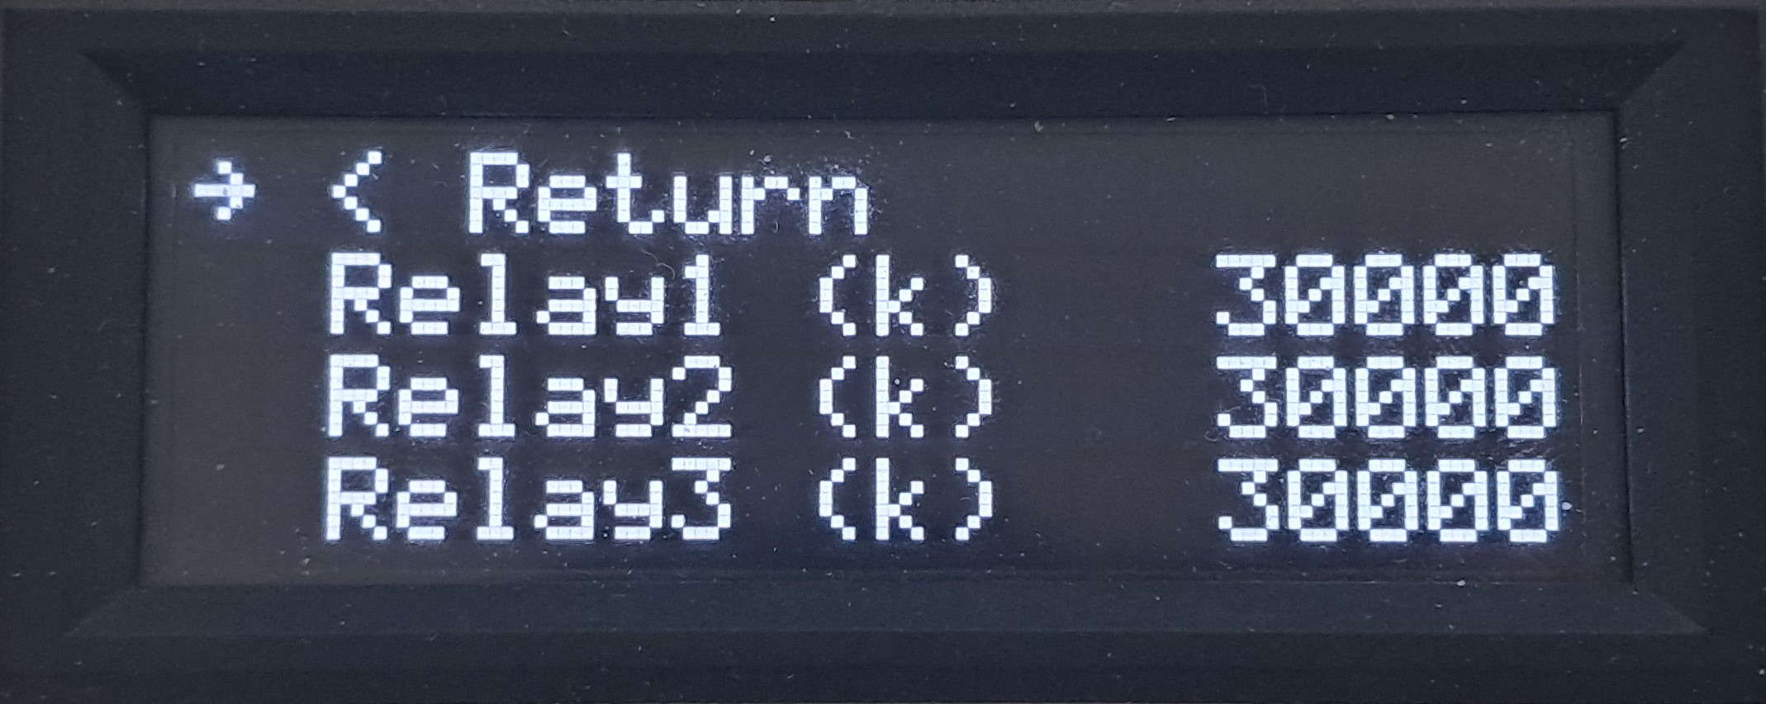
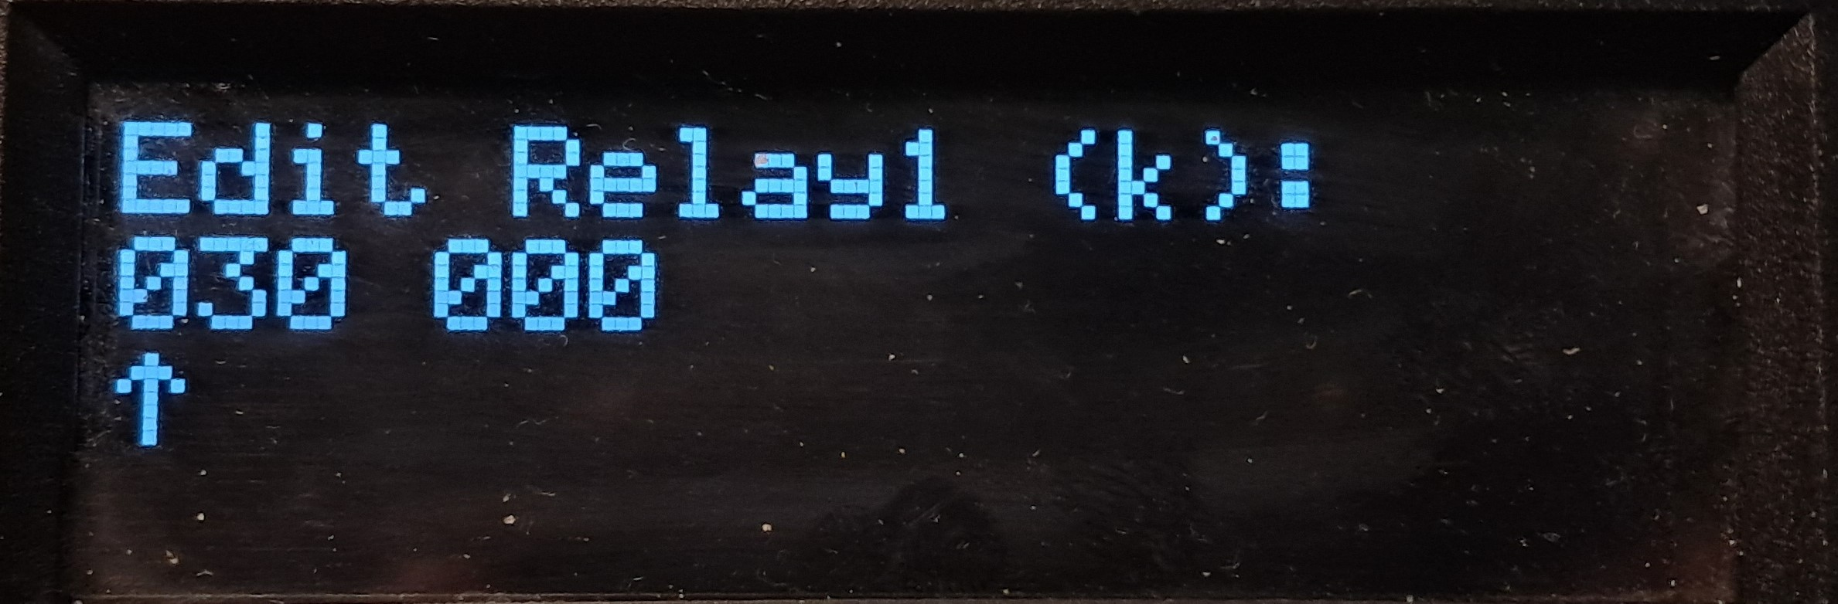
Reading/editing relay cycles
Diploma thesis: E-box aets
Remain Count
read only information
Relay menu screen
Set Count
read/write information
Value editor
Universal style for the device

Slide 16
Maximum values and performance
Diploma thesis: E-box aets
RELAYS
MOSFETS
Switching dynamics
4 channels
Continuous current per branch:
Min. current: 10 mA
Max. current: 2.5 A
Max. switching voltage: 60 VDC
2 pairs of back-to-back MOSFETs
Continuous current per pair:
Max. current: 5 A
Max. inrush current (<300 µs): 40 A
Max. switching voltage: 80 VDC
Relay typical response time: 7 ms
Relay typical release time: 3 ms
Relay bounce time: ~2 ms
MOSFET rise time:
min: 700 ns max: 1000 µs
MOSFET fall time:
min: 2 µs max: 4 µs

Slide 17
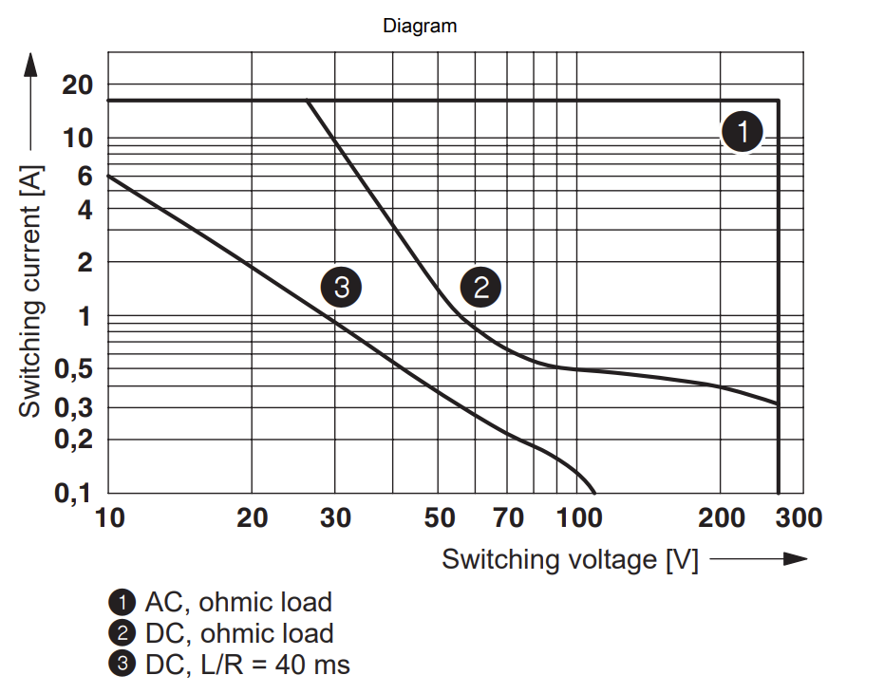
Relay voltage / ampere curve
Diploma thesis: E-box aets
Maximum current for commonly used voltage values (with reserve)*
Voltage [V] | Current [A]
6 | 10
12 | 10
18 | 10
24 | 8
32 | 5
48 | 1
60 | 0.6
*These are extremes. If you go above specified range of 0 - 2.5 A, you may damage the relay based on your load/time configuration.

Slide 18
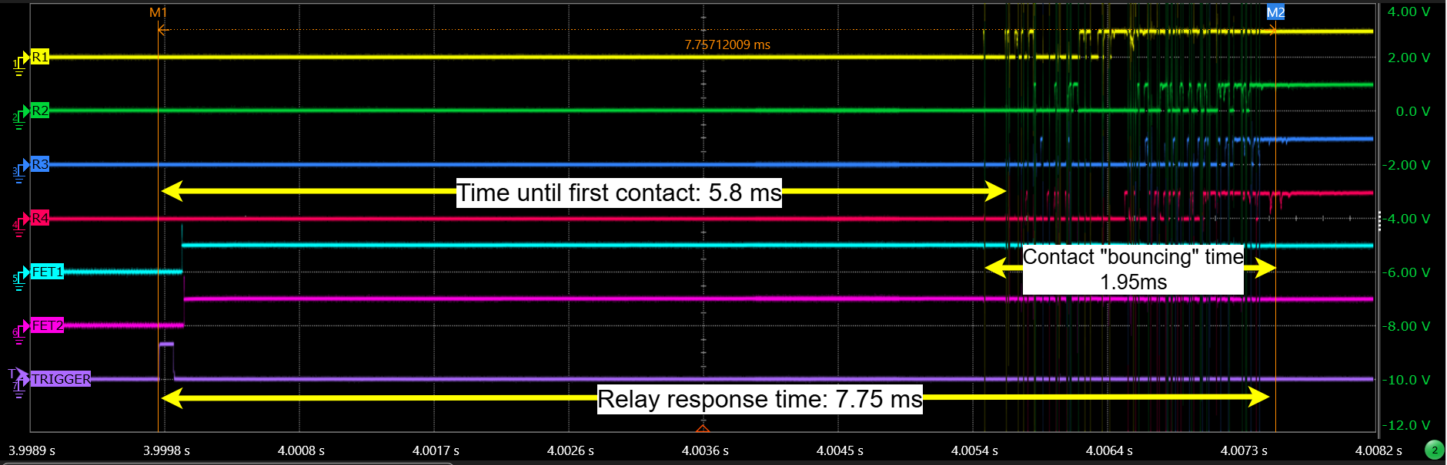
Relay response time test
Diploma thesis: E-box aets

Slide 19
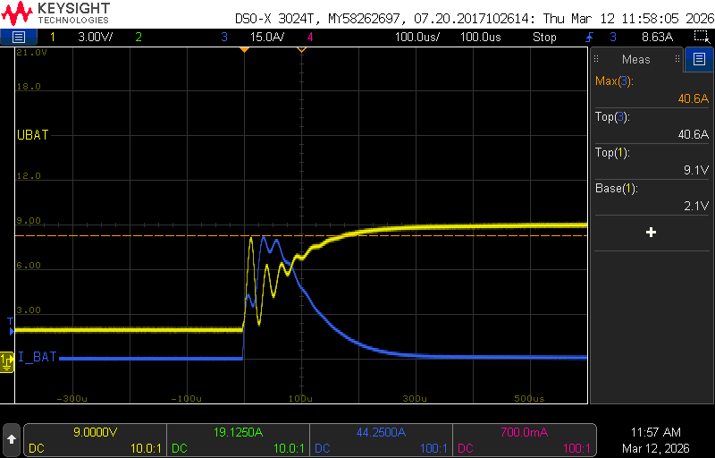
MOSFET inrush current test – peak current test
Diploma thesis: E-box aets

Slide 20
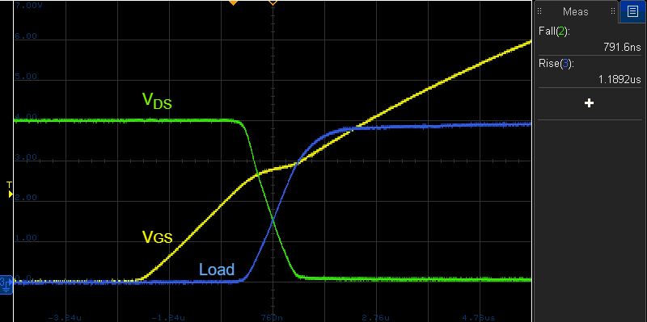
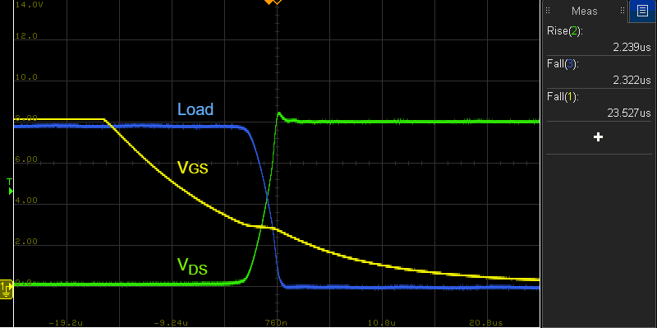
MOSFET inrush current test – rise & fall time
Diploma thesis: E-box aets
Rise time
Fall time

Slide 21
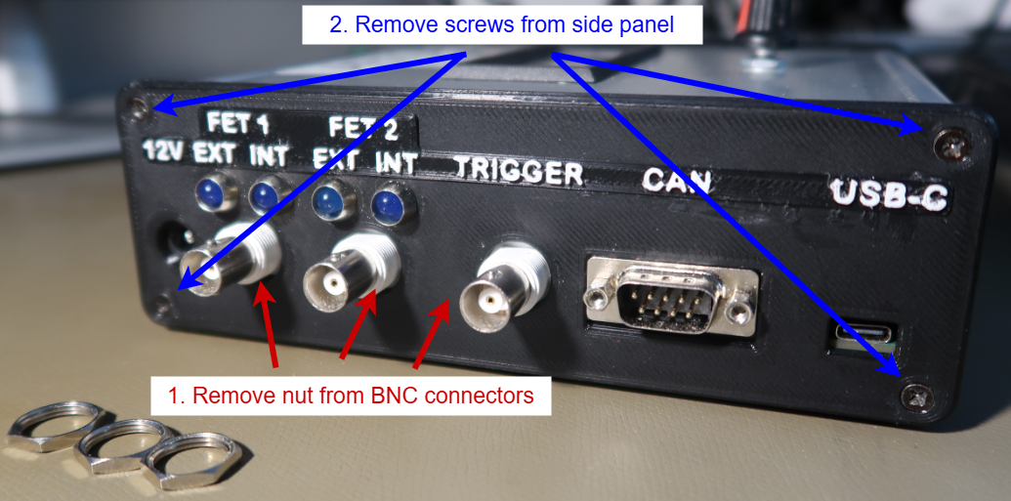
Device disassembly & service
Diploma thesis: E-box aets

Slide 22
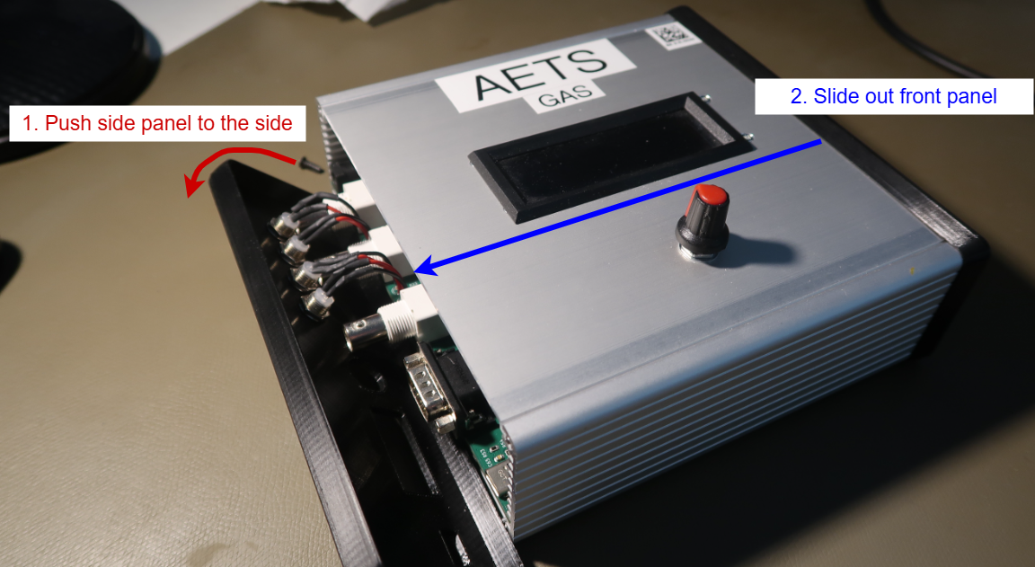
Device disassembly & service
Diploma thesis: E-box aets

Slide 23
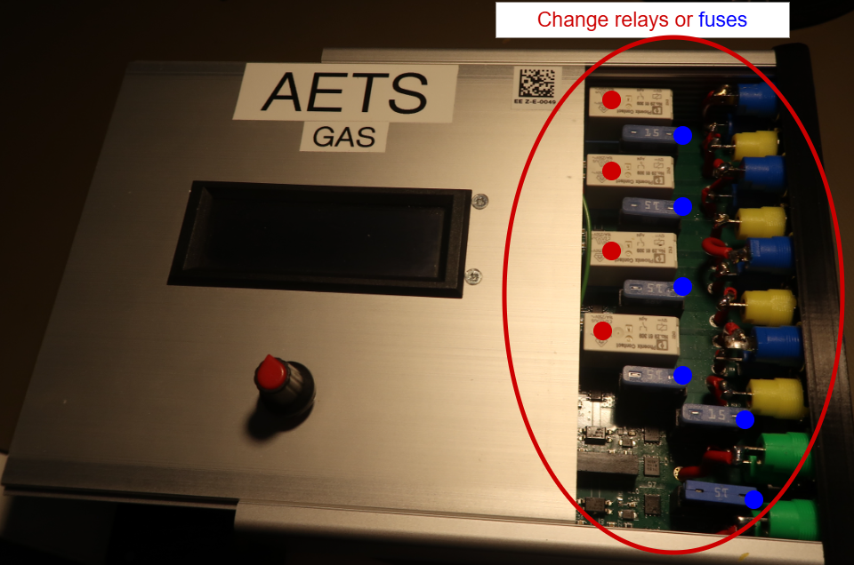
Device disassembly & service
Diploma thesis: E-box aets

Slide 24
How can the system make work easier for test engineers?
Diploma thesis: E-box aets
Faster repetition of test sequences without manual switching
Integration of multiple switching options into a single device
Ability to control the test locally or remotely from a PC depending on the type of task
Easier synchronization with an oscilloscope or generator via trigger/BNC inputs
Storage of operating data and basic diagnostics of error states
Suitable basis for further expansion of test scenario automation in the laboratory
Conclusion
AETS is a practical laboratory platform that combines:
robust switching
fast MOSFET actions
local and remote control
simple measurement synchronization
Goal: to simplify and speed up electrical component testing.

Slide 25
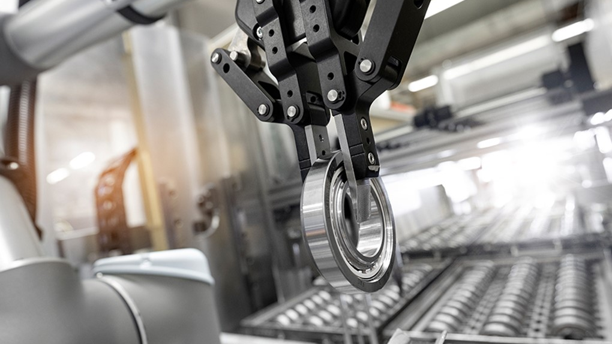
THANK YOU

