Slide 1

Video Games
By the Super Mario Bros Michael Mahoney and Nathan Shepherd

Slide 2
Video game Timeline
1972 Atari released pong
1983 Nintendo NES
1994 Sony Playstation
2001 Microsoft Xbox
2006 Nintendo Wii

Slide 3


Slide 4


Slide 5


Slide 6

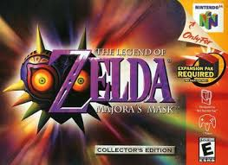

Slide 7

September 17, 2013

Slide 8
Questions
Are there any interesting trends that have shaped games and sales over the years?
Can any variables predict whether a game will be a success or not?
Is there a way to determine the best possible genre for a certain geographic area?
What kind of trends can we find in the customer buying habits?

Slide 9
Hypothesis
Null: Success of the game can not be predicted (Sales)
Alternative: We accurately predict the success of a game
Null: We can not segment sales by geographic area
Alternate: We can segment sales by geographic area

Slide 10
Problem Statement and Background
Video games relatively new compared to TV, radio
Still unexplored
There is no industry standard for the success of a game
Companies could use this data to observe research and market trends to
Optimize sales in certain areas
Predict genre success

Slide 11


Data
Data set from Kaggle
Combined web scrapes
VGChartz
Metacritic

Slide 12
Data and Preprocessing
Incomplete data caused 60% of the data to be dropped
Total observations we are using is 7191
Critic score and User score were not on the same scale
Convert User score to a 100 point scale by multiplying user score by 10

Slide 13
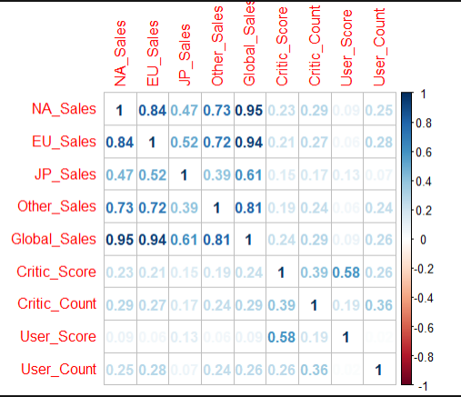
Exploratory Analysis

Slide 14
Predicting Global Success
Predicting using North American (NA) Sales
Critic Score
Platform
SVM Model
Gamma = 0.1
Cost = 1
NA Sales | 0 | 1
0 | 2017 | 46
1 | 3 | 1

Slide 15
Predicting Global Success
Predicting using European (EU) Sales
Critic Score
Platform
SVM Model
Gamma = 0.1
Cost = 1
EU Sales | 0 | 1
0 | 2110 | 19
1 | 0 | 28

Slide 16
Predicting Global Success
Predicting using Japan (JP) Sales
Critic Score
Platform
SVM Model
Gamma = 0.1
Cost = 1
JP Sales | 0 | 1
0 | 2109 | 35
1 | 1 | 12

Slide 17
Predicting Global Success
Predicting using Other (????) Sales
Critic Score
Platform
SVM Model
Gamma = 0.1
Cost = 1
Other Sales | 0 | 1
0 | 2107 | 16
1 | 3 | 31

Slide 18
Predicting NA Sales
Critic Score
Platform
SVM Model
Gamma = 0.1
Cost = 1
Predicting NA Sales | 0 | 1
0 | 2110 | 47
1 | 0 | 0

Slide 19
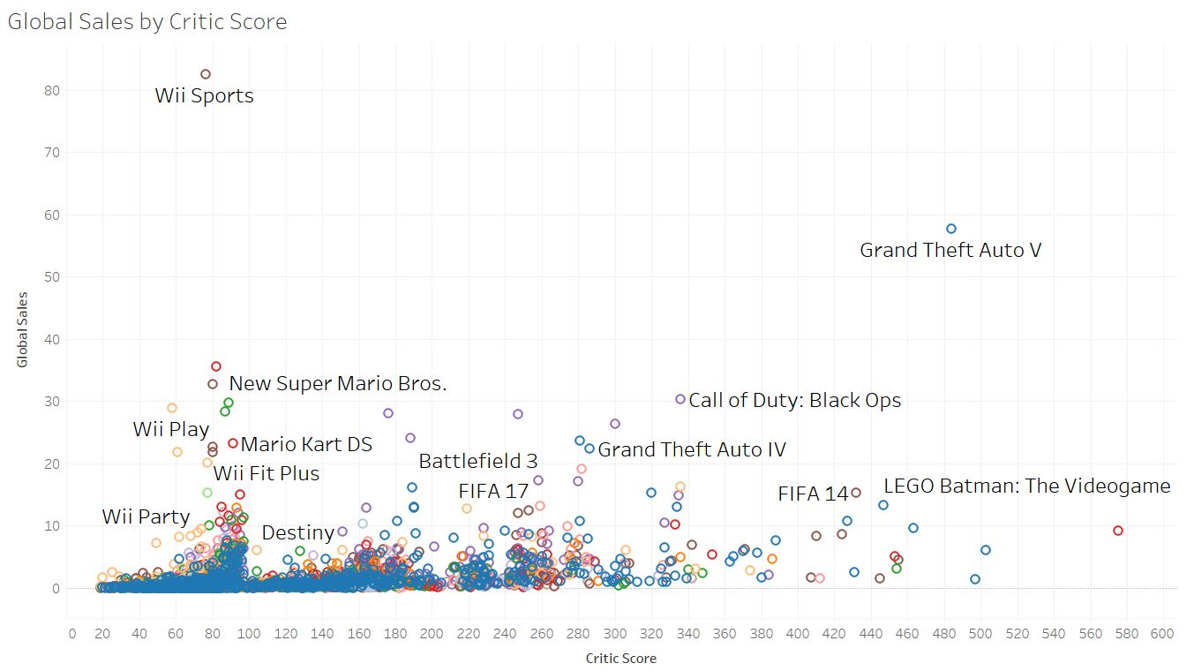

Slide 20
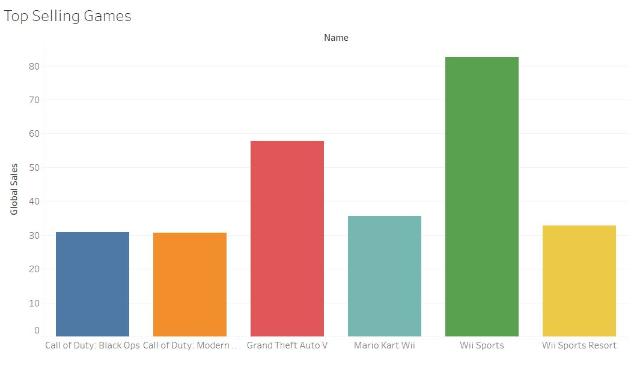

Slide 21
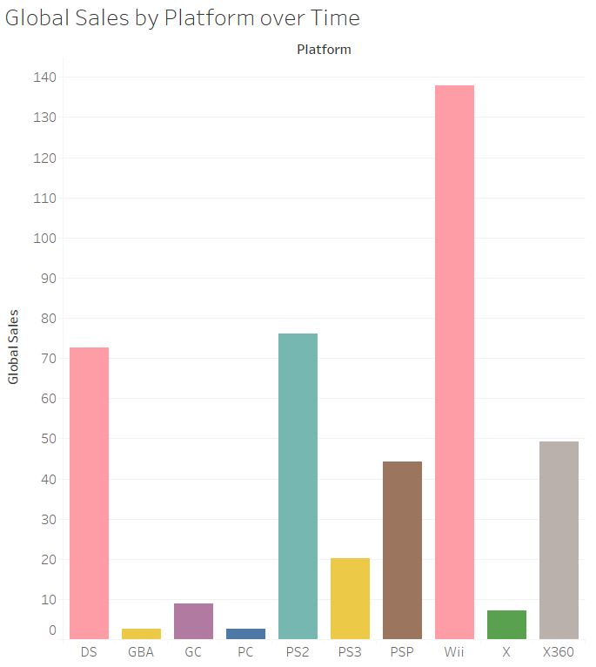
2006

Slide 22
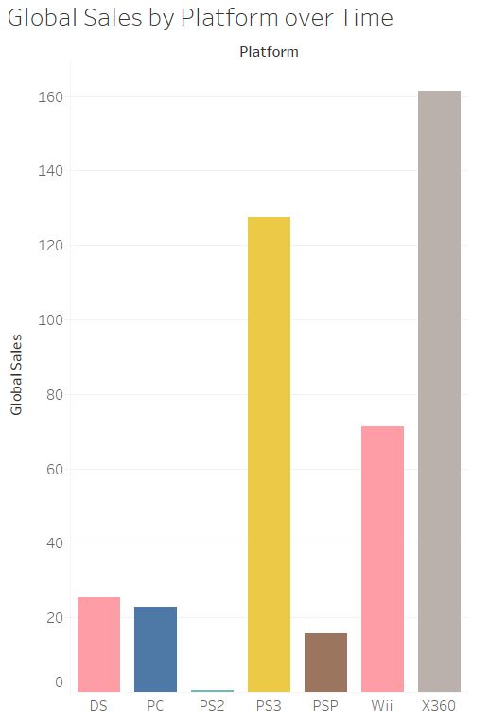
2010

Slide 23
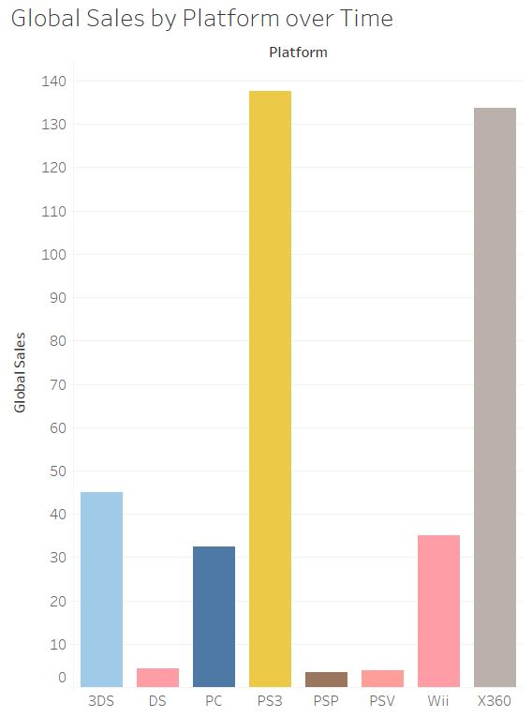
2011

Slide 24
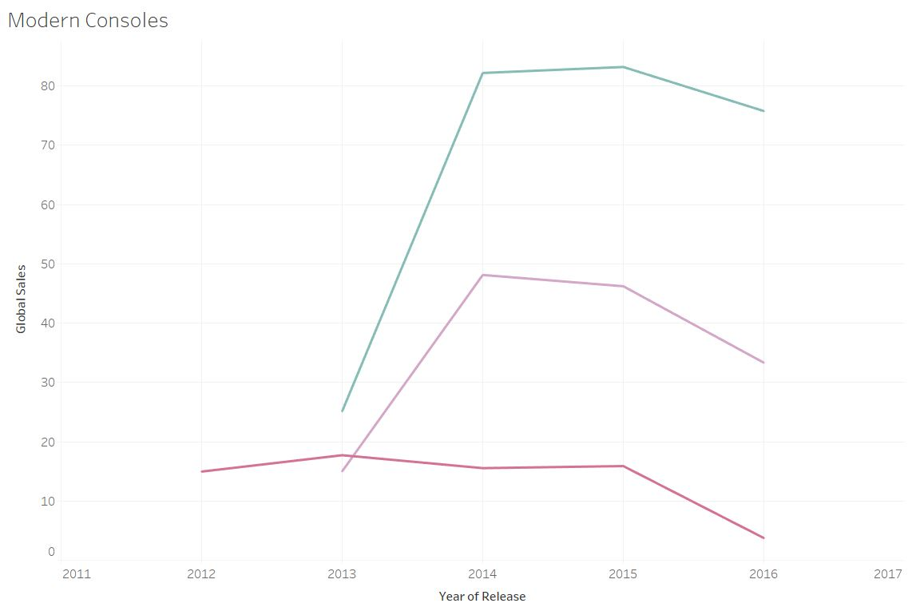


Slide 25
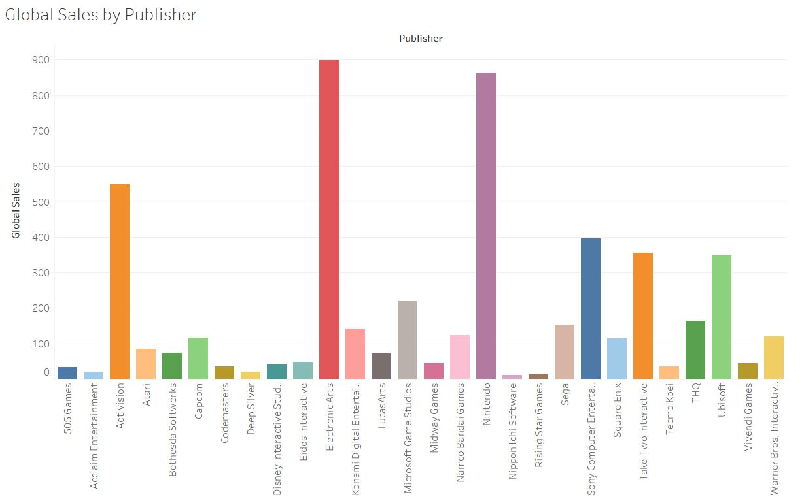

Slide 26
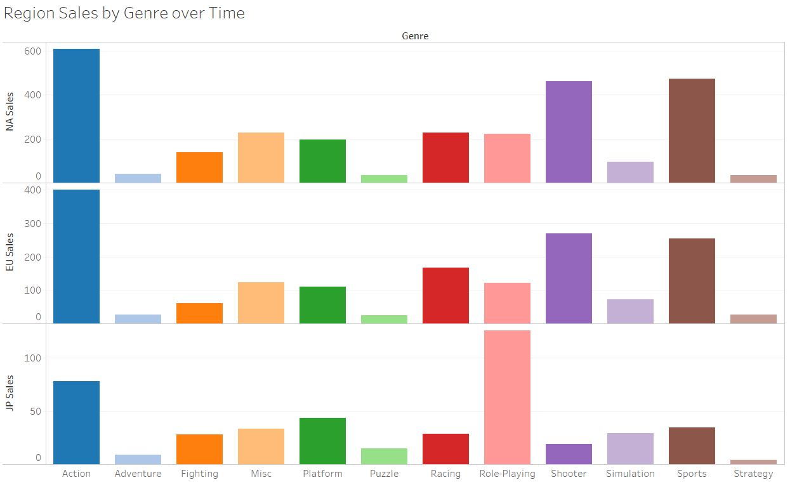

Slide 27
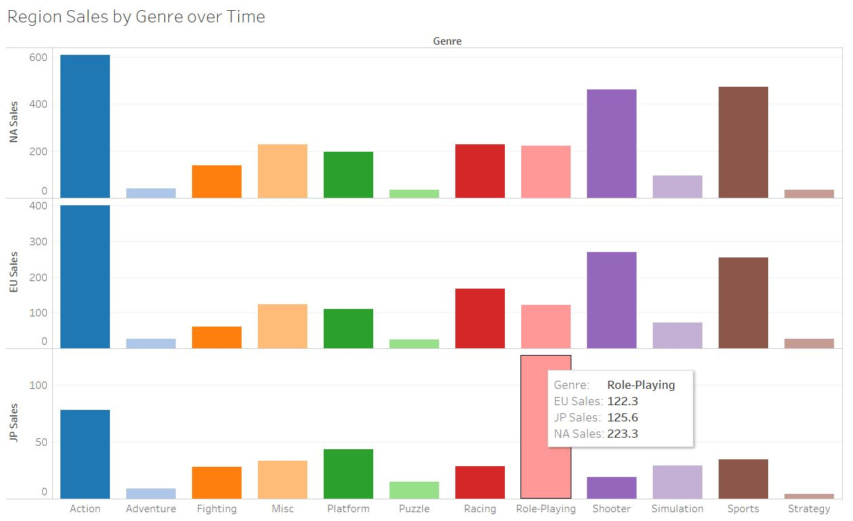

Slide 28
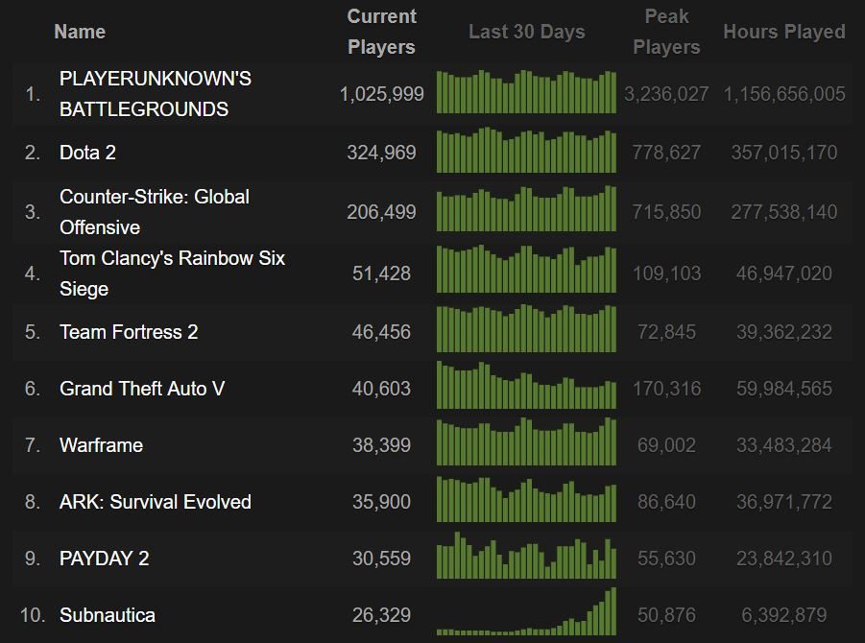

Slide 29
Dataset Problems
Only includes what publishers want us to know
Omissions including the very popular Nintendo 64
Variables that should have been included
Rate of sale by month
Bundle
Multiplayer
Franchise

Slide 30
Words of Wisdom
“If you assume any rate of improvement at all, the games will become indistinguishable from reality.”

Slide 31
???????????? ???????????? ???????????? ???????????? ???????????? ???????????? ???????????? ???????????? ???????????? ???????????? ???????????? ???????????? ???????????? ???????????? ???????????? ???????????? ???????????? ???????????? ???????????? ???????????? QUESTIONS ???????????? ???????????? ???????????? ???????????? ???????????? ???????????? ???????????? ???????????? ???????????? ???????????? ???????????? ???????????? ???????????? ???????????? ???????????? ???????????? ???????????? ???????????? ???????????? ???????????? ???????????? ???????????? ???????????? ???????????? ???????????? ????????????

Slide 32
References and Cites
Kendall Gillies. (2017). Video Game Sales and Ratings [Data File]. Retrieved from https://www.kaggle.com/kendallgillies/video-game-sales-and-ratings
Methodology. (n.d.). Retrieved January 15, 2018, from http://www.vgchartz.com/methodology.php
Metacritic. (2018, January 8). Retrieved January 15, 2018, from https://en.wikipedia.org/wiki/Metacritic
VG Chartz. (2017, December 29). Retrieved January 215 2018, from https://en.wikipedia.org/wiki/VG_Chartz

Slide 33
References and Cites Cont.
http://www.history.com/topics/history-of-video-games
https://www.atari.com/history/1972-1984-0
https://www.nintendo.com/corp/history.jsp
http://www.computinghistory.org.uk/det/4032/Sony-Playstation/
https://www.digitaltrends.com/gaming/the-history-of-the-xbox/
http://www.businessinsider.com/pidgeys-law-bill-aims-to-force-removal-of-pokestops-in-pokemon-go-2016-8
http://www.guinnessworldrecords.com/news/2013/10/confirmed-grand-theft-auto-breaks-six-sales-world-records-51900

