Slide 1
Introduction
CCP6224
Object-oriented Analysis and Design

Slide 2
Course Learning Outcomes
 |  | Domain | Level
CLO1 | Explain object-oriented analysis and design concepts | Cognitive | 2
CLO2 | Apply proper object oriented techniques to analyse and design software | Cognitive | 3
CLO3 | Solve object oriented design problems by employing design patterns | Cognitive | 3

Slide 3
Lecture outcomes
At the end of this lecture you should be able to
  Recall the concepts of object-oriented programming
  Identify and use fundamental object-oriented terms and how they relate to coding
  Differentiate between styles of programming languages
  Understand the differences and similarities between OO programming languages

Slide 4

What do you remember
about OOPDS?

Slide 5
Object orientation
Is a programming paradigm (style) found in modern programming languages
  Procedural paradigm:
    Software is organized around the notion of procedures/functions
    Works as long as the data is simple
    The program is typically modeled with a data flow diagram
  Object oriented paradigm:
    Revolves around objects and what can they do and how they can perform certain tasks.
    The objects are instances of classes, which are data abstractions and contain procedural abstractions that operate on the objects themselves or other objects
    A running OO program can be seen as a collection of objects collaborating to perform a given task

Slide 6
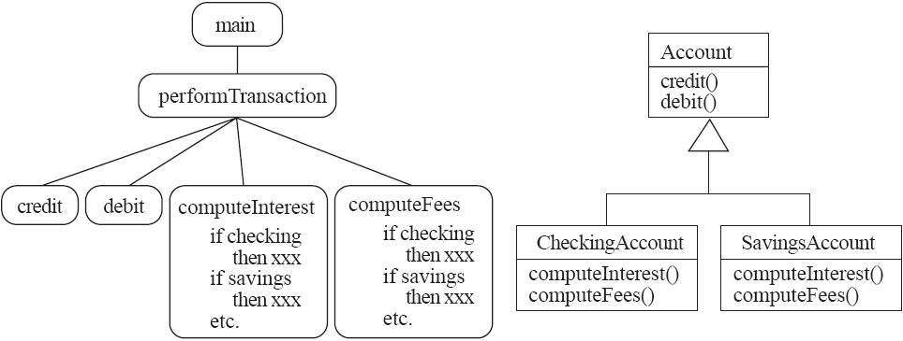

Slide 7
What is an object?
A chunk of structured data in a running software system
  Has properties that represents its current state
  Has behaviour which represents how it acts and reacts
May simulate/mirror the behaviour of an object in the real world
What are examples of objects?

Slide 8
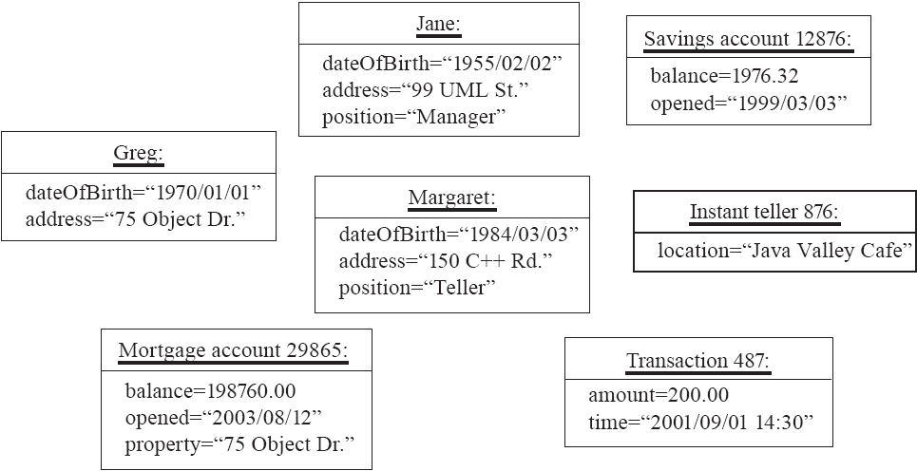

Slide 9
What are classes?
A unit of abstraction in an object oriented (OO) program
Classes represents similar objects which are required in the program and its instances
In program code, a class is a kind of software module
  Describes its instances’ structure (properties)
  Contains methods to implement their behaviour
What is the difference between class and instance? Examples?

Slide 10
OO class naming convention
The compiler won’t care, but humans who read your program will:
  Use capital letters for classes
  E.g. BankAccount not bankAccount
  Use singular nouns
        E.g. Student not Students
  Use the right level of generality
        E.g. Municipality, not City
  Make sure the name has only one meaning
  E.g. ‘bus’ has several meanings

Slide 11
Object variables
Variables defined inside a class corresponding to data present in each instance are called instance variables (also called fields or member variables)
  Identifies the state of an object’s instance
  Used to represent attributes and/or associations
    E.g. name, dateOfBirth, supervisor, coursesTaken
A class variable is a value is shared by all instances of a class (Also called a static variable)
  If one instance sets the value of a class variable, then all the other instances see the same changed value.
  Class variables are useful for:
    Default or ‘constant’ values (e.g. PI)
    Shared incremental values
  Caution: do not over-use class variables because it defeats OO approach of variable responsibility

Slide 12
Object methods
Method
  A procedural abstraction used to implement the behaviour of a class – a ‘function’
  Several different classes can have methods with the same name
    They implement the same abstract operation in ways suitable to each class
    Using a common method name makes it easy to remember which function to call in different objects to achieve the same desired output
      E.g. calculating area in a rectangle is done differently from a circle but each class may have the similarly named method ‘calculateArea’

Slide 13
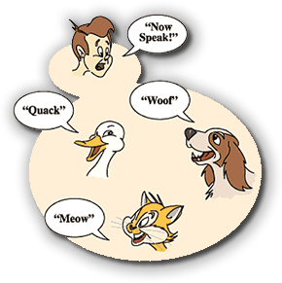
Polymorphism
A property of object oriented software by which an operation may be performed in different ways in different classes.
  Requires that there be multiple methods of the same name
  The choice of which one to execute depends on the object that is in a variable
  Reduces the need for programmers to code many if-else or switch statements
What were the conditions required to
show methods with polymorphism
using C++?

Slide 14
Inheritance hierarchies
Superclasses
  Contain features common to a set of subclasses
  Sometimes called parent class
Subclasses
  Inherits from superclasses but contains features unique to the subclass (specialized)
  Sometimes called child class
Inheritance hierarchies
  Show the relationships among superclasses and subclasses
  A triangle shows a generalization
Inheritance
  The implicit possession by all subclasses of features defined in its superclasses

Slide 15
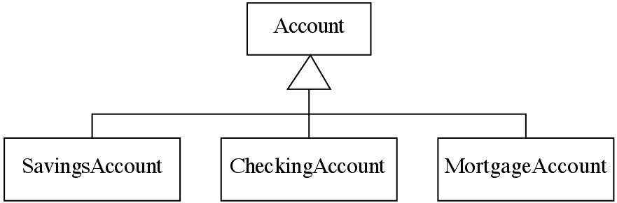
Always check generalizations to ensure they obey the
is-a rule, e.g.:
  “A checking account is a (type of) account”
  “A student is a person”

Slide 16
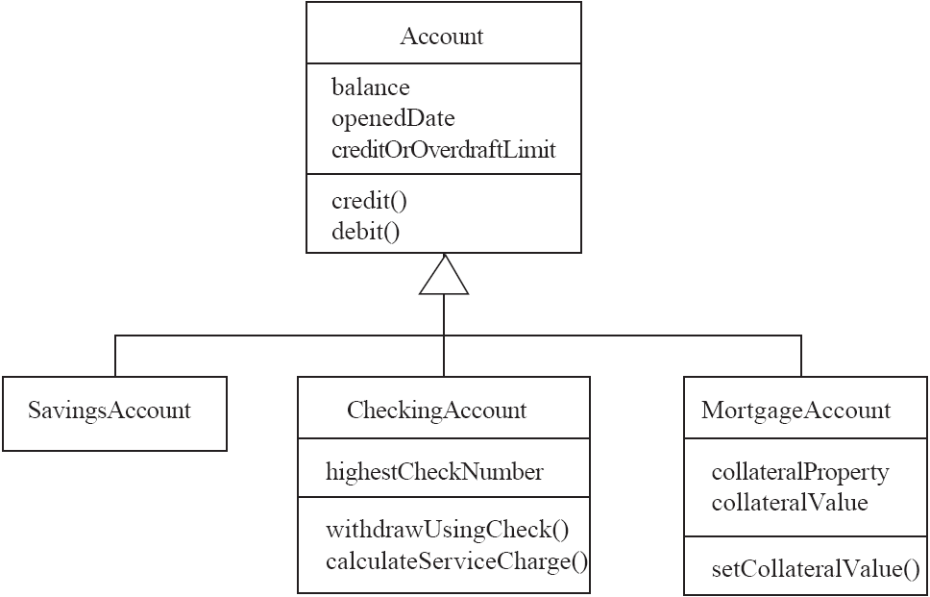
Make sure inherited features make sense in subclasses

Slide 17
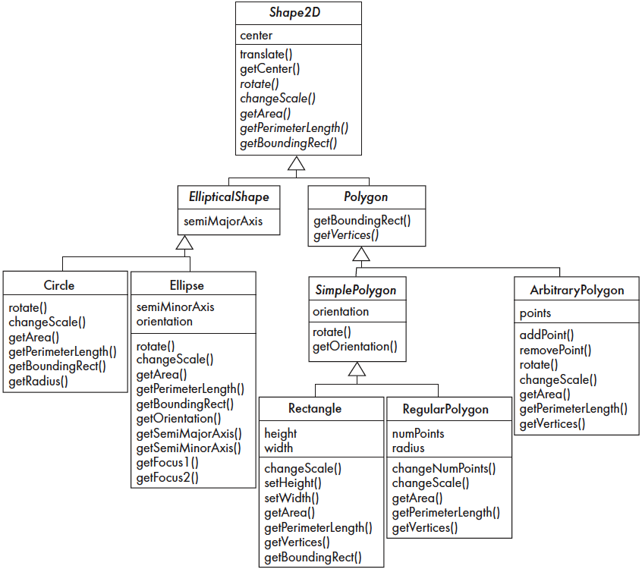

Slide 18
Abstract classes
Abstract classes (AC) are usually the highest in the inheritance hierarchy
ACs have no implementation and their operations are abstract (method declarations without definitions)
Because of this
    No instances can be created
    The opposite of an abstract class is a concrete class
Classes that inherit from ACs MUST override ALL methods from the AC.
If a superclass has an abstract operation, then its subclasses at some level must have a concrete method for the operation
  Subclasses must have or inherit concrete methods for all operations
  Leaf classes (final) must be concrete

Slide 19
Overriding
Applies to methods that are inherited from a parent class.
A public method would normally be inherited, but with overriding the subclass contains a new version instead
  For restriction
    E.g. scale(x,y) would not work in Circle so the method is rewritten
  For extension
    E.g. SavingsAccount might charge an extra fee following every debit whilst other account types do not
  For optimization
    E.g. The getPerimeterLength method in Circle is much simpler than the one in Ellipse

Slide 20
What about overloading??

Slide 21
Access control
Applies to all content in a class
  public
    Any class can access
  protected
    Only code in the package, or subclasses can access
  (blank)
    Only code in the package can access
  private
    Only code written in the class can access
    Inheritance still occurs!

Slide 22
Concepts that define OO
The following are necessary for a system or language to be OO
Identity
  Each object is distinct from each other object, and can be referred to
  Two objects are distinct even if they have the same data
Classes
  The code is organized using classes, each of which describes a set of objects
Inheritance
  The mechanism where features in a hierarchy inherit from superclasses to subclasses
Polymorphism
  The mechanism by which several methods can have the same name and implement the same abstract operation.

Slide 23
Other key concepts
Abstraction
  Object → something in the world
  Class → objects
  Superclass → subclasses
  Operation → methods
  Attributes and associations → instance variables
Modularity
  Code can be constructed entirely of classes
Encapsulation
  Details can be hidden in classes
  This gives rise to information hiding:
    Programmers do not need to know all the details of a class

Slide 24
Java backstory
The first object oriented programming language was Simula-67
  designed to allow programmers to write simulation programs
In the early 1980’s, Smalltalk was developed at Xerox PARC
  New syntax, large open-source library of reusable code, bytecode, platform independence, garbage collection.
Late 1980’s, C++ was developed by B. Stroustrup,
  Recognized the advantages of OO but also recognized that there were tremendous numbers of C programmers
In 1991, engineers at Sun Microsystems started a project to design a language that could be used in consumer ‘smart devices’: Oak
  When the Internet gained popularity, Sun saw an opportunity to exploit the technology.
  The new language, renamed Java, was formally presented in 1995 at the SunWorld ’95 conference.

Slide 25
Why Java?
Java is an OO programming language which is:
  simple (C,C++ syntax, single inheritance, auto-garbage-collection)
  reliable (strong typing, no pointer-arithmetic, exception handling)
  platform-independent (compiles to virtual machine)
  Inherently multithreaded - you can create multithreaded programs (very useful for GUI or network apps)
  Well documented libraries (called packages in Java)
  Hardware support (Android mobile platform, media platform)
Any OO language could be used for this course (e.g. C++, C#, Ruby, PHP, etc) but Java is chosen because majority of its syntax follows what you already have learnt from C++

Slide 26
WORM
Write Once, Run Many
Java Programs compile to a Java Byte Code binary.
All Java Virtual Machines (Windows JVM, Solaris JVM) understand Java Byte Code
Therefore, Java is relatively platform independent

Slide 27
Using Java
To run Java, you need the Java Runtime Environment (JRE)
  Specific for each platform
  Executes compiled binaries in a virtualized environment
To code in Java, you need the Java Development Kit (JDK)
  Each JDK is specific for each platform.
  Compiles Java code into byte code (binaries) for the target platform.

Slide 28
Similarities between C++ and Java
Most OO concepts are carried over from C++ - the syntax is just possibly different
Basic programming concepts remain the same - control structures (loops, case, if-else etc), operators (relational, mathematical, set, logical, bitwise)
Variables from C++ work similarly in Java (but their scope and capacity maybe different)
Arrays work the same but has alternative declaration style
Similar method of writing functions (return type, name + parameters)
Naming styles are the same – CaSe SeNsItIvE too!

Slide 29
Differences between C++ / Java
C++ | Java
Has preprocessor statements (include, define) | No preprocessor (no #includes ….)
Has enum | No enums but has named constraints
Can have standalone functions | All functions MUST belong to a class
Has global functions and data | No global functions or data
Can have multiple inheritance | No multiple inheritance
Inherits legacy goto commands | No goto but still supports break and continue
Operator overloading is allowed | No operator overloading
No garbage collection | Automatic garbage collection
Automatic type conversion | No automatic type conversion
Has pointers | NO pointers
Different size variables / platform | Similar sized variables / platform
No boolean (uses integer) | True boolean variable
8-bit char | 16-bit char

Slide 30
Java programming quirks
Language evolution and deprecated features:
  Java is constantly evolving, so some features are ‘deprecated’ at every release
  But the same thing is true of most other languages
Efficiency can be a concern in some object oriented systems
  Java can be less efficient than other languages
    VM-based
    Dynamic binding

Slide 31
Java program types
There are two major types of Java programs
  Java applications
    Standalone applications
    This can be command-line based (no/basic text interface, just plain text on screen) or Graphical User Interface based (using WIMP)
  Java applets
    ‘mini’ programs that are small and run inside a web browser and rely on support from browser features
    no longer supported or recommended
    replaced with webstart applications (not covered in TCP2201)
TCP2201 will only focus on Java applications since modern browsers have deprecated support for NPAPI plugins (which applets require to run)

Slide 32
Why not C#?
Proprietary language that runs optimally on Windows – possible to run on other platforms but requires work
C# gets a bad reputation from its dirty little cousin VB
Proprietary compilers are closed source for majority of the versions but available for free
Exposure to more languages to prepare you for FYP/real world
You might not understand C++ that well so its better to start with a new language that tries to fix some of C++’s problems
Opportunity to be certified as JCP or MCP – C++ has no certifications
Why not stick with C++?

Slide 33
Revision!
What you need to do before the next class:
  Quick revision on C++ for the basic concepts
  Java programming will be covered fairly quickly so your fundamentals should be strong enough
  Basics will NOT be covered again (e.g. no more explaining what if-else is and what it does)

Slide 34
Requirements to pass a subject
Achieve at least 40% for formative (coursework) assessment, and
Achieve at least 40% for summative (final exam) assessment, and
Achieve at least 40% overall mark (coursework + final exam).

