Slide 1
The economics of health care systems
Distributive justice in practice
Hero image
Homer G. Phillips Hospital, the Ville
Copy from:
en.wikipedia.org/wiki/Homer_G._Phillips_Hospital
(infobox photograph, Wikimedia Commons)
Delete this box after inserting
Mohammed Abba-Aji
Lecturer in Public Health and Society
PUBHLTHSOC 1000 · Foundations in Public Health
Washington University in St. Louis · 27 October 2026
WashU Bursky Public Health
Notes:
Good morning. Two weeks ago we stood at the corner of 63105 and 63106 and asked why eighteen years of life separate Clayton from north St. Louis city. Last week Professor Irfan and Andwele Jolly took you into the structures that produce that gap. Today we go to the money. Every structure we have discussed in this module runs on a budget, and every budget is a set of choices about who gets what.
I want to start with one of those choices, made about four miles from this room.

Slide 2
Homer G. Phillips Hospital, the Ville, 1937 to 1979
Photograph of Homer G. Phillips Hospital
Copy from one of:
en.wikipedia.org/wiki/Homer_G._Phillips_Hospital (Wikimedia Commons image, free licence)
mohistory.org/collections, search "Homer G. Phillips Hospital" (Missouri Historical Society, 1930s to 1970s photographs)
Delete this box after inserting
Opened 1937 as the public hospital for Black St. Louisans; closed by the city in 1979; senior apartments since 2003. O’Connor C., Climbing the Ladder, Chasing the Dream, University of Missouri Press, 2021.
WashU Bursky Public Health
Notes:
This is Homer G. Phillips Hospital in the Ville. It opened in 1937 as the public hospital for Black St. Louisans, and for a generation it trained a large share of the Black physicians and nurses in the United States. In the 1970s the city said it could no longer afford two municipal hospitals. One had to close. In 1979, over sustained protest from the neighbourhood, the city closed this one. No hospital has been built in the Ville since. The building became senior apartments in 2003.
I am not going to tell you today whether the city was right. I am going to give you the tools to ask the questions the city had to answer, and the questions it avoided. How scarce was the money, really? What was the cost of keeping both open, and the cost of closing this one, and to whom? Which rule of fairness was the city using when it chose? Who was in the room when it chose?
That set of questions is health economics. The subtitle of today's session, distributive justice in practice, is the second half of each question: not only what is efficient, but what is fair, and fair by whose rule.

Slide 3
1. Choice under scarcity
2. Why health care breaks the market
3. Distributive justice in practice
4. You decide
WashU Bursky Public Health
Notes:
[target 0:04]
Three notes. Public Health Leadership Perspective II is due today; the prompts covered Dr Abdalla and Mr Jolly, and the TAs will take questions on Canvas. Thursday, Dr Patrick Aguilar from Olin comes to talk about the business of health, including private equity and the Walgreens buyout; read his piece in The Conversation before you come, because today sets up his argument. The required reading for today, Guinness and Wiseman, is twenty-one pages and no mathematics; if you did not read it, the first third of this hour is that reading, and the rest of the hour is why it matters.
[advance] Four parts. One: economics is the study of choice under scarcity, and health is no exception. Two: why health care breaks the ordinary market, and what every country does about it. Three: distributive justice in practice, which means the United States, Missouri, and the evidence on what coverage buys. Four: you make an allocation decision yourselves, and defend it.

Slide 4
By the end of today
Define scarcity, opportunity cost and the margin, and apply them to a public health decision
Explain why health care is not an ordinary market, and name the failures
Distinguish efficiency from equity, and horizontal from vertical equity
Compare the four ways countries pay for care
Defend an allocation decision using an explicit rule of justice
Then ask the second question
WashU Bursky Public Health
Notes:
[target 0:06]
[read briskly] By the end of today you should be able to define scarcity, opportunity cost and the margin and apply them to a public health decision; explain why health care is not an ordinary market and name the failures; distinguish efficiency from equity and horizontal from vertical equity; compare the four ways countries pay for care; and defend an allocation decision using an explicit rule of justice. The last one is the exam skill. The others are what make it possible.
One habit to carry out of here: whenever someone tells you a programme works, ask the second question. Compared with what, and at what cost? Whenever someone tells you who a programme serves, ask who it does not serve, and who decided. Health economics is the discipline of the second question.

Slide 5
1. Choice under scarcity
2. Why health care breaks the market
3. Distributive justice in practice
4. You decide
WashU Bursky Public Health
Notes:
[hold two seconds; no words needed beyond "Part one."]

Slide 6
What economics is
The study of how societies use scarce resources that have alternative uses
Scarcity, choice, alternatives. Money is only the unit we count in
Scarcity means wants exceed means, everywhere, always
Every yes is also a no
WashU Bursky Public Health
Notes:
Your reading opens with a definition most of you will find narrower than you expected. Economics is not the study of money. It is the study of how people and societies choose to use resources that are scarce, when those resources have alternative uses. Three words do the work: scarcity, choice, alternatives. Money is only the unit we count in.
Scarcity does not mean poverty. The United States spent 5.3 trillion dollars on health care in 2024 and still rations care; we will see how in part three. Scarcity means that wants exceed means, everywhere, always, so that every yes is also a no. A hospital that opens a new cardiac unit has decided not to open something else. A health department that funds a screening campaign has decided not to fund the community health workers. The decision is made whether or not anyone says it aloud.

Slide 7
Opportunity cost
The cost of anything is the value of the best alternative you gave up
Not the price tag. The next best thing you did not do
1979: the budget line was visible; the cost to the Ville was not
“and the money would otherwise have gone to …”
WashU Bursky Public Health
Notes:
Which brings us to the single most important idea in this lecture, and I would say in the whole of economics: opportunity cost. The cost of anything is the value of the best alternative you gave up to get it. Not the price tag. The next best thing you did not do.
Take the Homer G. Phillips decision. The city's accountants could tell you the budget line for running two hospitals. The opportunity cost was different for each option and for each group of people. Keeping both open meant something else in the city budget went unfunded. Closing Phillips meant the Ville lost its emergency department, its training pipeline for Black clinicians, and a large employer, and those costs fell on one neighbourhood. An economist's first job in that room is to make every opportunity cost visible, including the ones that do not appear in the accounts.
[pause] When you write your Leadership Perspectives, or later your policy memos, test every recommendation with this sentence: "and the money would otherwise have gone to." If you cannot finish the sentence, you have not costed the decision.

Slide 8
Thinking at the margin
Rarely “is this programme good?”
Is one more unit of it worth one more unit of cost?
The first thousand doses save many lives; the ten-thousandth saves fewer
Would the next billion dollars do more in Medicaid dental coverage or in lead pipe replacement?
WashU Bursky Public Health
Notes:
[target 0:11]
The second tool is the margin. Economists rarely ask whether a programme is good. They ask whether one more unit of it is worth one more unit of cost. The first thousand doses of a vaccine in an outbreak save many lives. The ten-thousandth dose, given to someone already low-risk, saves fewer. The question is never "vaccines, yes or no." It is "at what point does the next dollar do more good somewhere else?"
This is why the public debate about health care is so often beside the point. "Should we spend more on health?" is not an economic question. "Would the next billion dollars do more in Medicaid dental coverage or in lead pipe replacement?" is. The margin is where decisions actually live.

Slide 9
Positive and normative
Positive, what is: Medicaid expansion reduced uninsured emergency visits in Missouri
Normative, what ought to be: Missouri should expand Medicaid
Economics is good at the first and has no special authority on the second
Watch me change hats
WashU Bursky Public Health
Notes:
One distinction from the reading that you will need in part three. A positive statement describes what is: Medicaid expansion reduced uninsured emergency visits in Missouri. A normative statement says what ought to be: Missouri should expand Medicaid. Economics is good at the first and has no special authority on the second. When an economist tells you a policy is efficient, that is positive. When they tell you it is therefore the right policy, they have changed hats without telling you. Today I will change hats several times, and I will try to say so each time.

Slide 10
Health and health care are different goods
Nobody wakes up wanting a colonoscopy
Health care is demanded only for the health it produces: derived demand
Grossman, 1972: a stock of health that depreciates, and that we invest in
The larger input is the conditions of life (8 October)
Grossman M. On the concept of health capital and the demand for health. Journal of Political Economy 1972;80:223–255.
WashU Bursky Public Health
Notes:
Now the move that makes this health economics and not economics in general. People do not want health care. They want health. Nobody wakes up wanting a colonoscopy. Health care is demanded only because, and only to the extent that, it produces health. Economists call this derived demand, and Michael Grossman formalised it in 1972: each of us holds a stock of health that depreciates with age, and we invest in it through care, diet, time, and the conditions we live in.
Hold this against what we did on 8 October. If health care produces only part of health, and the conditions of life produce the larger part, then a health economics that studies only hospitals and drugs is studying the smaller input. Your reading makes this point in its map of the field: the first box is "what influences health, other than health care." The field knows this. Practice often forgets it.

Slide 11
Efficiency, two kinds
Technical: the same output with fewer resources
Allocative: the mix of outputs that society values most
Every operating theatre full, and a diabetic without a podiatrist
WashU Bursky Public Health
Notes:
[target 0:15]
Two words you will hear argued over for the rest of your careers. Efficiency first. Technical efficiency means producing a given output with the fewest resources: the same number of vaccinations with fewer nurse-hours. Allocative efficiency is harder: it means producing the mix of outputs that society values most. A health system can be technically efficient, running every operating theatre at capacity, and allocatively inefficient, because it is performing procedures nobody needed while diabetics lose their feet for want of a podiatrist. The United States, as we will see, is a world leader in the second kind of failure.

Slide 12
Equity, two kinds
Horizontal: equal treatment of equals
Vertical: unequal treatment of unequals
The inverse care law is horizontal inequity, in the direction of wealth
Efficiency asks how much health. Equity asks who got it
Tudor Hart J. The inverse care law. Lancet 1971;297:405–412.
WashU Bursky Public Health
Notes:
Equity second. Horizontal equity: equal treatment of equals. Two people with the same need should get the same care, regardless of income, race or postcode. Vertical equity: unequal treatment of unequals. People with greater need should get more. Both sound obvious. Both are violated constantly. Tudor Hart's inverse care law, which you met two weeks ago, is a description of horizontal inequity: equal need, unequal care, in the direction of wealth.
Here is the first return of the second question. Efficiency asks whether we got the most health for the money. Equity asks who got it. A system can score well on one and badly on the other, and most real decisions trade one against the other. Economics can measure the trade. It cannot tell you where to stand. That is normative, and it is yours.

Slide 13
1. Choice under scarcity
2. Why health care breaks the market
3. Distributive justice in practice
4. You decide
WashU Bursky Public Health
Notes:
[hold; "Part two."]

Slide 14
The market, and when it works
Buyers reveal value, sellers reveal cost, the price settles between them
Conditions: many buyers and sellers, good information, no spillovers, goods that can be withheld
Groceries, roughly
Health care fails every one. Arrow, 1963
Arrow KJ. Uncertainty and the welfare economics of medical care. American Economic Review 1963;53:941–973.
WashU Bursky Public Health
Notes:
A market is a mechanism for allocating scarce things without anyone being in charge. Buyers reveal what they value by what they will pay; sellers reveal what it costs by what they will accept; the price settles where the two meet. Under certain conditions, and this is the result the whole of market economics rests on, that price allocates resources efficiently. The conditions matter: many buyers and sellers, good information on both sides, no spillovers onto third parties, and goods that can be withheld from people who do not pay.
Groceries roughly meet those conditions. Health care fails every one of them. This was Kenneth Arrow's argument in 1963, and it remains the founding paper of the field.

Slide 15
Arrow 1963: five ways health care is different
Uncertainty: you cannot budget for a cancer the way you budget for rent
Information asymmetry: the person telling you that you need it is the person paid to do it
Externalities: my vaccination protects you
Public goods: clean air, surveillance, an emergency system
Barriers to entry: licences, certificates of need, patents
A patent is a legal monopoly: 84,000 dollars for a course of sofosbuvir, 2013
WashU Bursky Public Health
Notes:
[target 0:21]
[walk the five, one example each]
Uncertainty. You do not know when you will need care, or how much, or whether it will work. You cannot budget for a cancer the way you budget for rent. That uncertainty is why insurance exists at all, and insurance brings its own failures, which we come to in a moment.
Information asymmetry. The seller knows more than the buyer. You cannot shop for an appendectomy the way you shop for a car, because you do not know whether you need one, and the person telling you is the person who will be paid to do it. Economists call this the agency problem, and in its worst form supplier-induced demand: more care because there is more capacity to provide it, not more need.
Externalities. My vaccination protects you. My untreated tuberculosis endangers you. The market prices only what the buyer gains, so it under-produces vaccination and under-treats infection. This is the economic case for public health as a public function, and it is the case the founders of the field made in 1854 as well as 1963.
Public goods. Clean air, disease surveillance, a functioning emergency system. Once they exist nobody can be excluded, so nobody will voluntarily pay, so the market does not supply them. Governments do, or nobody does.
Barriers to entry. We license physicians, restrict hospital construction, patent drugs. Each has a reason. Each also hands sellers market power. The patent on a drug is a legally created monopoly, which is why a course of a new hepatitis C treatment was priced at 84,000 dollars when it launched, and why the price fell when competitors arrived.

Slide 16
Insurance: the fix that needs fixing
Risk pooling: many pay a little in advance so the few who fall ill are covered
Adverse selection: the sick join, the healthy wait, the pool collapses
Moral hazard: once insured, people use more care
RAND: cost-sharing cut needed care as readily as waste
Newhouse JP and the Insurance Experiment Group. Free for All? Lessons from the RAND Health Insurance Experiment. Harvard University Press, 1993.
WashU Bursky Public Health
Notes:
Insurance is society's answer to uncertainty: many people pay a little in advance so that the few who fall ill are covered. Risk pooling. It is the logic of every health system in the world, including ours, and it fails in two predictable ways.
Adverse selection. If joining is voluntary, the sick join and the healthy wait, premiums rise, more healthy people leave, and the pool collapses. Every country that uses insurance either compels membership or subsidises it heavily, and the Affordable Care Act's individual mandate was this logic made law.
Moral hazard. Once insured, you use more care, some of it care you would not have bought at full price. The RAND Health Insurance Experiment in the 1970s randomised families to different levels of cost-sharing and found that people facing higher out-of-pocket costs used less care. The catch, which matters for part three: they used less of the care that worked and less of the care that did not, in roughly equal measure, and the poorest hypertensive participants were measurably worse off. Cost-sharing is a blunt instrument. It cuts need as readily as waste.

Slide 17
Four ways to pay
Beveridge: taxes, public providers (United Kingdom, Spain)
Bismarck: compulsory social insurance (Germany, France, Japan)
National health insurance: one public payer, private providers (Canada, Taiwan)
Out-of-pocket: pay when ill
The United States runs all four at once
Reid TR. The Healing of America. Penguin, 2009.
WashU Bursky Public Health
Notes:
[target 0:26]
Because the market fails, every rich country intervenes. The question is how, and the answers sort into four models. Beveridge: tax-funded, government-provided, as in the United Kingdom and Spain. Bismarck: compulsory social insurance through employers and non-profit funds, as in Germany, France and Japan. National health insurance: private providers paid by a single public insurer, as in Canada and Taiwan. And out-of-pocket: you pay when you are ill, which is the default in much of the world and the model for the uninsured everywhere.
The United States runs all four at once. Veterans get Beveridge. Working-age people with employer insurance get something like Bismarck. People over 65 get national health insurance called Medicare. People without coverage get out-of-pocket, which in practice means delay, debt, and the emergency room. Which model you live under depends on your age, your employer, your state, and your income. Four systems, then, and the gaps between them are where people fall.

Slide 18
Who pays, and when
Prepayment: taxes and premiums, paid while well
Point of use: deductibles, copays and uninsured bills, paid while ill
The point-of-use share predicts who goes without care, and who goes into debt
WashU Bursky Public Health
Notes:
One more distinction, and then the evidence. Prepayment against payment at the point of use. Taxes and premiums are prepayment: you pay while well. Deductibles, copays and uninsured bills are payment at the point of use: you pay while ill. The share of a system that runs on point-of-use payment predicts, better than almost anything else, who goes without care and who goes into debt. Keep that in mind when we reach the medical debt figures.

Slide 19
Two questions
Have you ever decided not to see a doctor because of what it might cost?
Have you ever not known what a visit would cost until after it happened?
WashU Bursky Public Health
Notes:
[target 0:29]
[quick show of hands, thirty seconds each]
Hands up if you have ever decided not to see a doctor because of what it might cost. [count roughly] Hands up if you have ever not known what a medical visit would cost until after it happened. [count] That second one is Arrow's information asymmetry in this room. The first is point-of-use payment doing exactly what RAND predicted, to people who are, on the whole, healthy and insured. Now scale it to people who are neither.

Slide 20
1. Choice under scarcity
2. Why health care breaks the market
3. Distributive justice in practice
4. You decide
WashU Bursky Public Health
Notes:
[hold; "Part three, and now the evidence."]

Slide 21
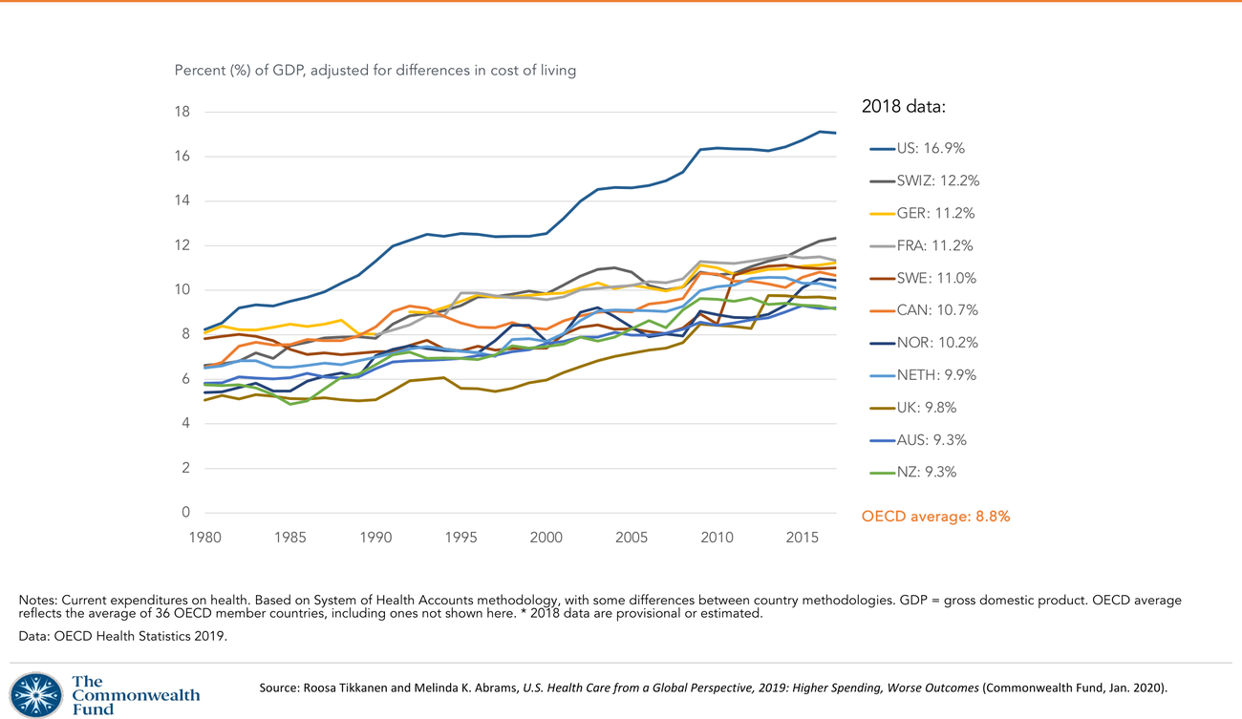
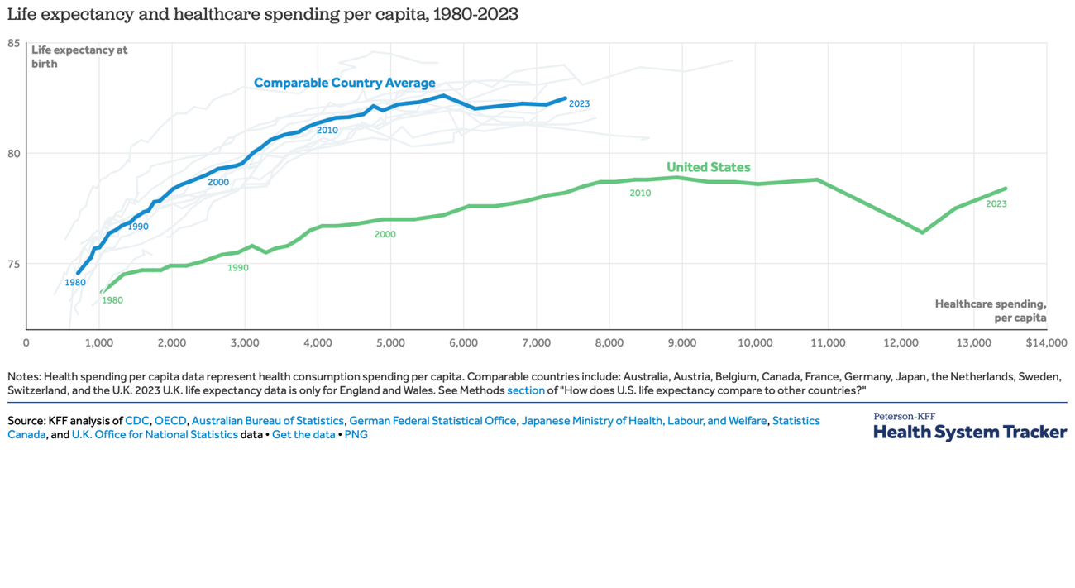
The United States, 2024
5.3 trillion dollars · 15,474 dollars per person · 18 percent of GDP · 43 percent public money
Left: Commonwealth Fund, OECD Health Statistics 2019. Right: Peterson-KFF Health System Tracker, 1980–2023. Figures: CMS National Health Expenditure Accounts, 2024 data, released January 2026.
WashU Bursky Public Health
Notes:
[the two charts from 8 October reappear; let the room recognise them]
You have seen these. Spending as a share of the economy; life expectancy against spending per person. I bring them back with the newest numbers, released by the Centers for Medicare and Medicaid Services in January. In 2024 the United States spent 5.3 trillion dollars on health care, 15,474 dollars for every person, 18 percent of everything the economy produced. Spending grew faster than the economy for the second year running. Public programmes paid 43 percent of it, so the idea that this is a private system is only partly true: nearly half the money is tax money.
And we know from two weeks ago what that bought: life expectancy below every comparable country, maternal mortality several times the peer rate, and a gap between Black and white Americans that fifteen years of medical progress did not close. In economic language, this is allocative inefficiency on a national scale. We are technically very good at producing health care. We are producing the wrong amount of the wrong things for the wrong people.

Slide 22
Why? The second question
Americans see doctors less often and spend fewer nights in hospital than Germans or the French
Anderson, Hussey and Petrosyan, Health Affairs, 2003 and again in 2019
“It’s the prices, stupid”
Thursday: who sets the prices, and who owns the sellers
Anderson GF, Hussey P, Petrosyan V. It’s still the prices, stupid. Health Affairs 2019;38:87–95.
WashU Bursky Public Health
Notes:
[target 0:33]
Why does the United States spend so much more? For years the comfortable answer was that Americans use more care. The data say otherwise: Americans see doctors less often and spend fewer nights in hospital than Germans or the French. In 2003 Gerard Anderson and colleagues published a paper in Health Affairs with a title that has become the field's shorthand: "It's the prices, stupid." They revisited it in 2019 and the answer had not changed. The same drug, the same scan, the same appendectomy costs more here because the sellers can charge more, and the buyers, fragmented across four systems, cannot push back.
That is Arrow's barriers to entry and information asymmetry, operating at the scale of a 5-trillion-dollar economy. It is also exactly what Dr Aguilar will take up on Thursday, because the question of who sets prices is the question of who owns the hospital, the pharmacy, and the physician practice, and the answer is increasingly a private equity fund. The Anderson paper is in your recommended reading for Thursday. Read it; it is short and it will reorganise how you read every health story in the news.

Slide 23
Who is outside
About 8 percent uninsured in 2025, roughly 27 million people; up about 800,000 in a year
CBO: 10 million more uninsured over the decade from the 2025 Medicaid changes
KFF, 2022: 41 percent of adults, about 100 million people, carry medical or dental debt
56 percent of Black adults, 50 percent of Hispanic adults, 37 percent of white adults
Medical debt is the quiet rationing mechanism, and nobody voted for it
National Center for Health Statistics, National Health Interview Survey, 2025. Congressional Budget Office, 2025. KFF Health Care Debt Survey, 2022: kff.org/report-section/kff-health-care-debt-survey-main-findings
WashU Bursky Public Health
Notes:
Now the distribution. About 8 percent of Americans had no health insurance in 2025, roughly 27 million people, and the number rose by about 800,000 in a year, 300,000 of them children. The low point was 2023. The Congressional Budget Office estimates that the Medicaid changes enacted in 2025 could add 10 million to the uninsured over the coming decade. I am giving you these as positive statements; what you make of them is normative, and we will argue it in the working groups.
Being insured does not mean being protected. In 2022 KFF estimated that about 41 percent of American adults, around 100 million people, carried debt from medical or dental bills. The rate was 56 percent among Black adults, 50 percent among Hispanic adults, 37 percent among white adults, and 57 percent among households earning under 40,000 dollars. This is point-of-use payment, Slide 18, landing on exactly the people vertical equity says should pay least. Medical debt is the American health system's rationing mechanism. It is quiet, it is regressive, and nobody voted for it.

Slide 24
What coverage buys: Oregon, 2008
A lottery: 90,000 applicants, about 10,000 places. A randomised trial by accident of budget
Depression down about 9 percentage points
Catastrophic out-of-pocket spending: 5.5 percent of households to 1 percent
No significant change in blood pressure or cholesterol within two years
Emergency department use up about 40 percent
Finkelstein A, et al. Quarterly Journal of Economics 2012;127:1057–1106. Baicker K, et al. New England Journal of Medicine 2013;368:1713–1722. Taubman SL, et al. Science 2014;343:263–268.
WashU Bursky Public Health
Notes:
[target 0:37]
Does coverage change health? Here is the cleanest evidence we have. In 2008 Oregon had money to add about 10,000 low-income adults to Medicaid and 90,000 applicants, so it ran a lottery. A lottery is a randomised trial, and Amy Finkelstein, Katherine Baicker and colleagues followed the winners and losers.
After two years, coverage cut the probability of screening positive for depression by about nine percentage points. It nearly eliminated catastrophic out-of-pocket spending, from 5.5 percent of households to 1 percent. It increased use of preventive care and diagnosis of diabetes. It did not produce a statistically significant improvement in blood pressure, cholesterol or measured cardiovascular risk within those two years. And it raised emergency department use by about 40 percent, which was not what the programme's champions had predicted.
[pause] Read that result both ways, because both sides of the Medicaid debate quote it. Coverage is financial protection and mental health first; measured physical health moves slowly and the study was short. The second question applies here too: compared with what? Compared with no coverage, the Oregon winners were protected from ruin and less depressed. Whether that is worth the cost is a normative judgement, and it is the one Missouri voters faced.

Slide 25
Missouri, 2020 to 2025
August 2020: Amendment 2 passes with 53 percent
October 2021: enrolment opens, after the state Supreme Court orders it
2019 to 2024: uninsured emergency and inpatient visits fall; Medicaid visits rise; uncompensated care falls
Hospital closures slow (McBride, WashU School of Public Health, 2025)
McBride T, et al. Medicaid expansion reduced uncompensated care costs and may have prevented hospital closures. WashU School of Public Health policy brief, October 2025. Optional map: en.wikipedia.org/wiki/2020_Missouri_Amendment_2
WashU Bursky Public Health
Notes:
In August 2020 Missourians passed Amendment 2 to expand Medicaid, with 53 percent of the vote. The legislature declined to fund it; the state Supreme Court ordered implementation; enrolment opened in October 2021. By early 2022 the expansion group had about 58,000 enrolled with a long backlog, and the St. Louis region was among the fastest to apply.
A policy brief from this School, led by Timothy McBride and published last October, looked at hospital data from 2019 to 2024. Uninsured emergency and inpatient visits fell; visits by Medicaid enrollees rose; uncompensated care costs fell. Before expansion, Missouri had lost ten to twelve hospitals; in the years after, the closures slowed. McBride is careful to say expansion is one factor among several, and so should you be. But the mechanism is exactly the one we have built today: prepayment replaced point-of-use payment for a few hundred thousand people, and the costs that had been falling on them and on safety-net hospitals moved to the pooled budget.

Slide 26
Every system rations.
The question is by what rule.
WashU Bursky Public Health
Notes:
[target 0:40]
Here is the sentence I most want you to leave with. Every health system rations. Scarcity guarantees it. The only choices are the rule and the visibility. The United Kingdom rations partly by queue and partly by an explicit rule: NICE will generally recommend a treatment if it costs under about 20,000 to 30,000 pounds per quality-adjusted life year gained, and will say so in public. The United States rations by price, by insurance status, by what your plan covers, and by medical debt, and almost none of it is written down. One of these rules can be debated in a legislature. The other is argued with a billing department.

Slide 27
Rules of justice
Utilitarian: maximise total health, whoever gets it
Egalitarian: equalise access, or outcomes
Prioritarian: benefits to the worst-off count for more (Rawls)
Libertarian: the fairness of the exchange, not the pattern of the outcome
Capabilities: the real freedom to live a life one has reason to value (Sen)
Distributional cost-effectiveness analysis puts the trade-off on the table
Cookson R, et al. Using cost-effectiveness analysis to address health equity concerns. Value in Health 2017;20:206–212. Cullinan J, Lorgelly P. Social Science & Medicine 2025;372:117997.
WashU Bursky Public Health
Notes:
So what rule? Philosophers have offered several, and each gives a different answer to the working-group problem you are about to face.
Utilitarian: maximise total health. Spend each dollar where it buys the most quality-adjusted life years, whoever gets them. This is what cost-effectiveness analysis does by default.
Egalitarian: equalise. The same access, or the same outcomes, for everyone.
Prioritarian, or Rawlsian: benefits to the worst-off count for more. Rawls asked what rules you would choose if you did not know which position in society you would occupy.
Libertarian: health care is a good like any other; justice is in the fairness of the exchange, not the pattern of the outcome. This is the only rule under which the American arrangement is not a failure, which is worth noticing.
Capabilities, from Amartya Sen: the aim is not health as such but the real freedom to live a life one has reason to value, and health is one of its conditions.
Health economics has started to build the trade-offs into its methods. Distributional cost-effectiveness analysis, developed by Richard Cookson and colleagues at York, scores each option on total health gained and on how that gain is spread across income or race, and lets a decision-maker state how much total health they would give up for a fairer distribution. Cullinan and Lorgelly's review in your recommended reading surveys this and the equity measures around it. The point for you today is simpler: the rule is a choice, the choice is normative, and an honest analyst names the rule before giving the answer.
[second question, landed] "Who gets it" has a second question: by what rule, and who chose the rule.

Slide 28
1. Choice under scarcity
2. Why health care breaks the market
3. Distributive justice in practice
4. You decide
WashU Bursky Public Health
Notes:
[hold; "Part four. Your turn."]

Slide 29
One budget, four options
Missouri DHSS. 10 million dollars a year for three years. New money. Choose one
A. Adult dental coverage in Medicaid, statewide
B. Community health workers for hypertension and diabetes, 63106 and 63113
C. Lung cancer screening campaign for current and former smokers, statewide
D. Raise Medicaid payment rates to physicians by 20 percent
Name the rule. Then finish the sentence: “and the opportunity cost is …”
Five minutes. Two groups per Learning Community.
WashU Bursky Public Health
Notes:
[target 0:44]
[brief on screen; countdown timer ready]
You are the Missouri Department of Health and Senior Services. You have 10 million dollars a year for the next three years, and it is new money, so there is no programme to protect. Four options, each costing the full 10 million. You may choose one.
A. Add adult dental coverage to Medicaid statewide. Reaches many people; modest health gain per person; large financial protection; some of the gain goes to people who could have paid.
B. A community health worker programme in north St. Louis city and county, targeting hypertension and diabetes in the 63106 and 63113 zip codes. Reaches fewer people; larger gain per person; concentrated on the worst-off; evidence of effect is good but local.
C. A statewide lung cancer screening campaign for current and former smokers. Reaches a mixed population; the evidence base is strong; the largest absolute number of life-years saved of the four; the benefit skews towards people already connected to care.
D. Raise Medicaid payment rates to physicians by 20 percent. Reaches nobody directly; the evidence says more physicians accept Medicaid patients when rates rise, improving access across the state; the health gain is diffuse and slow to measure.
Your task, five minutes: choose one option; name the rule of justice you used, in one of the words from the previous slide; and finish this sentence out loud when you report: "and the opportunity cost is." [start the timer; walk the room]

Slide 30
“… and the opportunity cost is”
WashU Bursky Public Health
Notes:
[target 0:50]
[three groups, ninety seconds each; push on the second question every time]
[A group that chooses C will usually say "most lives saved." Ask: and who are they? If they say "smokers," ask who in Missouri smokes most, and whether a screening campaign reaches them. They have just discovered that a utilitarian rule can be regressive in practice.]
[A group that chooses B will say "the worst-off." Ask: how many people did you not reach in Kansas City, in the Bootheel? They have discovered that a prioritarian rule has a horizontal equity cost.]
[A group that chooses D will have thought hardest. Ask: how long before a patient feels it, and how will you know it worked? They have discovered the time-lag problem from 8 October, and the measurement problem.]
[If a group refuses to choose and asks for more money, say: the legislature said no. Choose. Refusing to choose is choosing the status quo, and the status quo has an opportunity cost too.]
The purpose is not the right answer. There is no right answer on the slide; there is a defensible one, and the defence is the rule plus the cost. That sentence is the whole of this lecture, and it is what the final will ask you to do with a problem you have not seen.

Slide 31
Back to the Ville
Show the scarcity
Show the opportunity cost, for each group
Name the rule
Say who chose it
WashU Bursky Public Health
Notes:
[target 0:53]
Return to 1979. The city said one hospital had to close. In the language we now have, it made a scarcity claim. It never published the opportunity cost of each option, by neighbourhood. It did not name the rule: was this technical efficiency, the cheaper building to run, or allocative, the location that served the most need? It did not ask the Ville which rule it would have chosen. And it never asked the second question: closing Phillips saved the city a budget line, and it cost north St. Louis an emergency department, a training pipeline, and one of its largest employers, costs that fell on one community for forty-seven years and counting.
I said I would not tell you whether the city was right. I will tell you that it did not show its work. That is the minimum health economics asks of any allocation: show the scarcity, show the opportunity cost for each group, name the rule, and say who chose it. A decision that cannot survive those four questions was made politically and costed afterwards.

Slide 32
Five things to take with you
Every yes is a no, and the cost falls unevenly
Health care is not a normal market; the question is how to intervene, not whether
Efficiency and equity are different scores. Economics measures the trade; you choose where to stand
Every system rations. Prefer the rule that can be argued in public
Name the rule before you give the answer. Then ask the second question
WashU Bursky Public Health
Notes:
[walk briskly]
One. Every yes is a no. Opportunity cost is the real cost, and it falls unevenly.
Two. Health care is not a normal market, and Arrow told us why in 1963. Every country intervenes; the question is how.
Three. Efficiency and equity are different scores, and most decisions trade one against the other. Economics measures the trade; you choose where to stand.
Four. Every system rations. The United States rations by price, coverage and debt, mostly out of sight. Prefer the rule that can be argued in public.
Five. Name the rule of justice before you give the answer. Then ask the second question.

Slide 33
Thursday
Dr Patrick Aguilar, Olin: the business of health
Read: Aguilar and Boumgarden, The Conversation, on the Walgreens buyout
Optional, and worth it: Anderson, “It’s still the prices, stupid”
Bring one question that uses a price, an opportunity cost, or a rule
WashU Bursky Public Health
Notes:
[target 0:56]
Thursday, Dr Patrick Aguilar: the business of health. Read Aguilar and Boumgarden in The Conversation on the Walgreens buyout, and if you read one optional piece this semester make it Anderson's "It's still the prices, stupid." Come with one question for him that uses today's vocabulary: ask him about a price, an opportunity cost, or a rule. Leadership Perspective II closes tonight on Canvas.

Slide 34
Questions
WashU Bursky Public Health
Notes:
[target 0:57]
The floor is yours. [If quiet, seed it: "Here is one. The NICE threshold is a number. Should the United States have one, and who should set it?" Or: "Missouri voters chose expansion by 53 to 47. Which rule of justice did the 47 percent use?"]

Slide 35
abba-aji@wustl.edu
Notes:
Office hours as usual. Thank you.

