Slide 1
When More Trauma Means Less Stress Sensitivity
Evidence for a Trauma Saturation Effect Among Violence-Exposed Populations in Nigeria
Mohammed Abba-Aji, MBBS, MPH, DrPH · Washington University in St. Louis
ISTSS 42nd Annual Meeting · San Antonio, TX · September 24, 2026
Notes:
Thank the chair. This talk asks whether trauma changes what everyday stress does to mental health, in the population Salma just described.

Slide 2
Continuing Medical Education Financial Disclosure
Amedco, our CME provider, asks that all individuals who have the ability to influence and/or control the content of this accredited activity disclose any/all relationships with ‎Ineligible Companies.
This information is disclosed to CME activity participants, and Amedco has procedures in place to resolve any apparent conflicts. In addition, presenters are asked to disclose when any discussion of unapproved use of pharmaceuticals and devices are being discussed.
In the past 24 months, I Mohammed Abba-Aji, have not had financial relationships with any ineligible companies.
Notes:
No financial relationships to disclose.

Slide 3
Nigeria's Crisis Landscape
Overlapping insecurity across all six geopolitical zones — not one war but many
  Northeast: Boko Haram / ISWAP insurgency — 350,000+ deaths, 2.2 million displaced in Borno
  Northwest: armed banditry and mass kidnappings (Sokoto)
  Middle Belt: farmer–herder conflict — ~60,000 lives (Benue)
  Southeast: separatist and political violence (Enugu); Niger Delta: cultist violence (Rivers)
Violence is layered on economic crisis: GDP per capita ~US$800 (from ~$3,100 in 2014); ~63% multidimensionally poor; food inflation reached ~41%
Notes:
When we talk about conflict-affected Nigeria, we are not talking about one war but multiple, overlapping forms of insecurity. In the northeast, Boko Haram and ISWAP. In the northwest, banditry and mass kidnappings. In the Middle Belt, farmer-herder conflict. In the southeast, separatist violence; in the Delta, cult groups. These events sit on top of a very difficult economy: income per person has fallen by two-thirds in a decade, roughly 133 million people are multidimensionally poor, and food inflation touched 40 percent. The population we study is exposed to violence and chronic economic stress at the same time.

Slide 4
Two Exposures, Two Intervention Logics
This population carries both traumatic events and grinding daily stressors — job loss, rent difficulty, food insecurity, family disruption
MaRVIN survey (previous talk): PTSD 18.5%, depression 21.0%, anxiety 20.7%; nearly 1 in 3 with at least one condition
System capacity cannot treat everyone: ~0.6 mental health workers per 100,000 (WHO recommends 5.0); ~250 psychiatrists for 200+ million; <10% receive care
Whether trauma and stressors simply add — or interact — decides who benefits from which intervention
Notes:
Two exposures run together here: the traumatic events, and the daily stressors of poverty and displacement. Salma showed the burden: nearly one in three adults with at least one condition. Against that, capacity: 0.6 mental health workers per hundred thousand people, one psychiatrist per 800,000 Nigerians, fewer than one in ten receiving care. Rationing is unavoidable, so the question of whether trauma and stress add or interact is not academic — it decides targeting.

Slide 5
Three Competing Accounts of Trauma and Daily Stress
Building-block model: trauma and stressors add independently (Miller & Rasmussen, 2010)
  Underlies most humanitarian programming — stress reduction assumed to help everyone equally
Stress sensitization: trauma amplifies reactivity to later stress (Hammen, 2005; McLaughlin et al., 2010)
  Predicts steepest stress–symptom gradients among the most trauma-exposed
Emerging third pattern — saturation: stress sensitivity diminishing at high exposure (Syrian and Burundian refugees: Hou et al., 2020; Scharpf et al., 2021)
  Never formally tested: shape of the interaction, multiple outcomes, African conflict setting
Notes:
The literature gives three incompatible answers. The building-block model says effects add, so every stressor removed helps everyone. Sensitization says trauma lowers the threshold at which stress triggers symptoms — gradients should be steepest among the most exposed. And a third pattern is emerging from refugee studies: diminishing sensitivity at high exposure. Nobody had formally tested the shape of this interaction, across outcomes, in an African conflict setting. That is this paper.

Slide 6
Study Aim and Hypotheses
Aim: test whether trauma exposure modifies the association between socioeconomic stressors and PTSD, depression, and anxiety
H1: trauma and stressors each predict all three outcomes
H2: significant trauma × stressor interactions emerge
H3: adults with extensive trauma show diminished stress sensitivity — saturation, not sensitization
Design principle: let the data reject saturation — model trauma continuously, test on both relative and absolute scales
Notes:
Three hypotheses. Both exposures predict outcomes; the interaction exists; and its direction is saturation, not sensitization. The design principle mattered as much as the hypotheses: the model had to be free to reject saturation, which drives the analytic choices you will see.

Slide 7
Design and Sample
MaRVIN population-based cross-sectional survey, May–October 2025, with AFENET and the Federal Ministry of Health and Social Welfare
Six states, one per geopolitical zone: five conflict-affected (Benue, Borno, Enugu, Rivers, Sokoto) + Ogun as non-conflict comparison
12 LGAs (urban + rural per state); 573 communities; households by systematic sampling; IDP camps included through the same procedures
1,729 adults completed the trauma inventory (of 1,774 interviewed); 37 who declined the trauma items treated as missing, not unexposed
Adjusted models: N=1,706 across 558 community clusters
Notes:
The sample Salma presented: six states, one per zone, with Ogun anchoring the low end of the trauma gradient. Of 1,774 interviewed, 1,729 completed the trauma inventory. The 37 who declined it are missing, not zeros — we verified the count against the item-level responses. Interviews were face-to-face, 45 to 60 minutes, tablet-based with range checks, private settings, referral information in hand.

Slide 8
Measures
Outcomes — instruments validated against SCID-5 psychiatrist interview in this population (paper 1):
  PCL-5, 20 items, past month; probable PTSD ≥ 38 (population-specific; AUC 0.71; α 0.92)
  PHQ-9, 9 items; depression ≥ 10 (AUC 0.70; α 0.88) · GAD-7, 7 items; anxiety ≥ 10 (α 0.86)
Trauma exposure: adapted Life Events Checklist, 12 event types, lifetime; summed 0–12
  Distribution: 28% none, 54% 1–2, 13% 3–4, 5.5% five or more
Daily stressors: 10-item Nigerian-specific count (0–10) — job loss, rent, eviction, family disruption, isolation; mean 2.05 (SD 1.65)
Covariates: age, gender, education, state
Notes:
Outcomes use the cut-points Jaimie validated, including the population-specific PCL-5 threshold of 38. Trauma is a count of twelve event types from an adapted Life Events Checklist. Stressors are a ten-item Nigerian-specific count — the everyday socioeconomic grind. Note the exposure distribution: over a quarter report nothing, a small tail reports five or more.

Slide 9
Analysis: Letting the Data Draw the Curve
Poisson regression → prevalence ratios; design-based variances (state strata, community PSUs, Taylor linearization)
Trauma entered continuously as a restricted cubic spline (knots 0, 2, 5)
  Smooth curve segments joined at knots — the data chooses the shape; categories would impose it
Focal test: trauma × stressor interaction (adjusted Wald test)
Both scales: per-stressor prevalence ratios AND absolute prevalence differences (margins), because targeting claims rest on absolute risk
Prespecified sensitivity: PCL-5≥33, PHQ-9≥15, GAD-7≥7; continuous scores; categorical specification; Stata 19.5
Notes:
Two analytic choices matter. First, trauma enters as a restricted cubic spline — smooth cubic segments joined at knots — so any flattening is estimated from the data rather than imposed by bins. The model was free to show sensitization, additivity, or saturation. Second, we read the interaction on both scales, because ratios can fade arithmetically when baseline risk is high; percentage points cannot. Everything prespecified, with sensitivity analyses on thresholds and continuous scores.

Slide 10
The Burden Gradient Comes First
Trauma shows the expected dose-response with every outcome
  Adjusted PTSD prevalence at zero stressors: 6.5% (no trauma) → 19.6% (three events) → 40.9% (five events)
Both exposures predict all three outcomes (H1 confirmed)
Stressor burden also rises with trauma exposure — which is exactly why the interaction needs adjusted, formal testing
The question is what happens to the stress gradient along this curve
Notes:
First, the main effect: trauma dominates the risk landscape, a six-fold prevalence gradient. That is not the news — it confirms hypothesis one and sets the stage. The news is what happens to the stressor effect as you move up this curve.

Slide 11
Per-Stressor Prevalence Ratio, by Trauma Exposure
Trauma | PTSD | Depression | Anxiety
0 events | 1.97 (1.53–2.54) | 1.83 (1.46–2.30) | 1.71 (1.35–2.17)
1–2 events | 1.26 (1.06–1.50) | 1.27 (1.11–1.45) | 1.15 (1.01–1.31)
3–4 events | 1.03 (0.87–1.21) | 0.95 (0.81–1.12) | 0.86 (0.75–0.99)
5+ events | 0.92 (0.83–1.03) | 0.99 (0.90–1.09) | 1.03 (0.95–1.13)
Interaction p | <0.0001 | <0.0001 | <0.0001
Notes:
The interaction. Read the red row: among adults with no trauma exposure, each additional stressor nearly doubles PTSD prevalence — ratio 1.97 — and depression and anxiety behave the same. Walk down any column and the effect fades monotonically to null at five or more events. All three interactions below 0.0001. This is the opposite of sensitization: the gradient is steepest where exposure is lowest. The adjusted spline models confirm it — p of 0.0027, 0.0001, 0.0027 — with the curve free to reject it.

Slide 12
Adjusted PTSD Prevalence Across the Stressor Range
Notes:
The same result as a picture. Each line is a trauma level. The red line — no trauma exposure — climbs from about 7 percent to 28 and keeps rising. Each step up the trauma curve rotates the line flatter. At five events the line is high, around 40 percent, and horizontal. The gradient belongs to the unexposed; the burden belongs to the exposed. Depression and anxiety fan out the same way.

Slide 13
The Absolute Scale Carries the Programming Point
Four additional stressors (0 → 4), change in adjusted prevalence:
  No trauma exposure — PTSD +21.8 points (95% CI 7.2–36.5); depression +24.1 (10.5–37.6); anxiety +17.8 (3.9–31.6)
  Five or more events — PTSD −2.5 (−18.3 to +13.4); depression +3.5 (−7.7 to +14.6); anxiety −4.0 (−15.1 to +7.1) — null in all three
At five events, prevalence sits near 40% at every stressor level — high and flat
The fading is not ratio arithmetic: it appears in percentage points too
Notes:
Why this matters for programming: the absolute scale. Four additional stressors add 22 points of PTSD prevalence among the unexposed, 24 of depression, 18 of anxiety. The same contrast among the heavily exposed adds nothing, against a baseline near 40 percent. A fading ratio can be arithmetic when baseline risk is high; a fading risk difference cannot.

Slide 14
Robustness
Adjusted spline interaction: PTSD p=0.0027; depression p=0.0001; anxiety p=0.0027
Alternative thresholds: PCL-5≥33 (p=0.0002), PHQ-9≥15 (p=0.0001), GAD-7≥7 (p<0.0001)
Continuous symptom scores — no cutoff at all: all p≤0.0001
Not a ceiling: the 5+ group sits at ~40% prevalence with a tight confidence interval, estimated over real stressor variation
Categorical and continuous specifications agree; adjusted and unadjusted agree
Notes:
Every route to an artifact is closed. Alternative cutoffs reproduce it. The continuous scores reproduce it with no threshold at all. The high-exposure group is far from any ceiling and its null is precise, not sparse. And the spline, free to reject the shape, chose it.

Slide 15
Interpretation: Differential Stress Sensitivity
The stress–symptom gradient is concentrated among adults with limited trauma exposure; among the heavily exposed, prevalence is high at every stressor level
Consistent with sensitization AND saturation operating at different exposure levels: sensitivity retained at 1–2 events, flattening at 3–4, complete by 5+
Candidate mechanisms: allostatic exhaustion (McEwen), hypocortisolism and blunted amygdala reactivity (Yehuda), emotional numbing, altered world assumptions
Cross-sectional data: this is a population pattern, not a demonstrated within-person mechanism
Notes:
We read this as trauma saturation — stated carefully. The population pattern: sensitivity concentrated among the least exposed, burden saturated among the most. Both classic theories may hold at different exposure levels: sensitivity is retained at one to two events and gone by five. Mechanistic candidates — allostatic exhaustion, hypocortisolism, numbing — are discussion, not demonstration; the data are cross-sectional.

Slide 16
Implications for Humanitarian Programming
One program for everyone serves neither group well
~4 in 5 adults have fewer than three event types and retain stress sensitivity:
  Stress management, livelihood support, Problem Management Plus, community psychosocial support (Rahman 2016; Jordans 2010)
The heavily exposed minority carries ~40% prevalence regardless of stressors:
  Trauma-focused therapies — Narrative Exposure Therapy (Robjant & Fazel 2010), culturally adapted CPT (Bass 2013)
Brief trauma-history screening at program entry could route scarce specialist capacity to where stress reduction cannot substitute for it
Notes:
The programming implication is stratification. For the four in five with limited exposure, stress-focused and livelihood interventions address something their symptoms demonstrably track. For the heavily exposed minority, the burden does not move with stressors — trauma-focused therapies are the treatments with evidence. A brief trauma-history screen at entry is cheap and routes specialist capacity where it is irreplaceable. Dr. Ojo will speak to how this enters Mental Health Act implementation.

Slide 17
Limitations
Cross-sectional: saturation names an association pattern, not a mechanism; selection and reverse causation cannot be excluded
Lifetime event recall set against current stressors
Sparse data above six events (~60 respondents): extreme-tail predictions unstable, reported only to five events
Screens, not diagnoses — though locally validated, and the pattern holds in continuous scores
Equal sampling weights; design-based clustering (state strata, community PSUs)
Notes:
Stated plainly. Cross-sectional, so no within-person claim. Recall of lifetime events against current stress. A thin extreme tail. Screens rather than diagnoses, though validated ones. The longitudinal test — does a new stressor move symptoms differently by trauma history — is the next study.

Slide 18
Conclusions
Trauma exposure modifies what everyday stress does: per-stressor PTSD risk falls from ×1.97 among the unexposed to null at five or more events, across all three outcomes, on both scales, in every sensitivity analysis
Simple dose-response assumptions — and universal psychosocial programming built on them — do not fit these data
Match the intervention to trauma history: stress-focused support where sensitivity is retained; trauma-focused therapy where exposure is extensive
Next: longitudinal designs to establish when saturation develops and whether it reverses with treatment
Notes:
To close: trauma changes what stress does. The gradient lives among the least exposed; the burden among the most. Programming should follow that structure. Thank you — and the field teams across six states, AFENET, the Federal Ministry, and my co-authors. I hand over to Dr. Ojo, who takes these findings to policy.

Slide 19
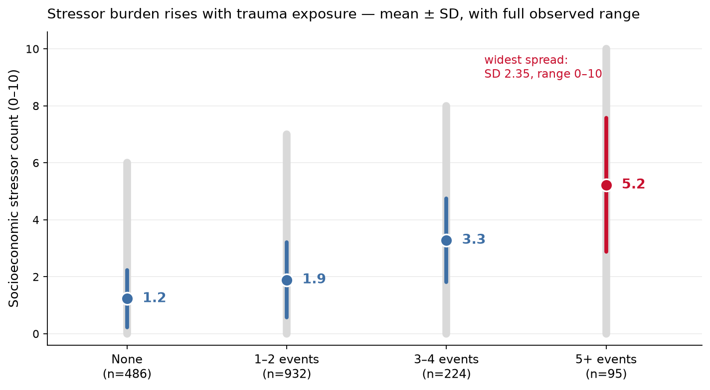
Backup: The Two Exposures Are Correlated — and the Null Is Not Range Restriction
Notes:
Backup for the artifact question. Two points in one figure. First, stressor burden rises with trauma — mean count quadruples from 1.2 to 5.2 across categories — which is exactly why the interaction needed formal, adjusted testing rather than eyeballing. Second, the gray bars are the full observed range and the colored whiskers are one SD: the five-plus group has the WIDEST stressor spread in the sample (SD 2.35, range 0 to 10). Its null stressor effect is estimated over more variation than any other group's — not a compressed range. Add the continuous-score results and the fading interaction survives every route to an artifact.

Slide 20
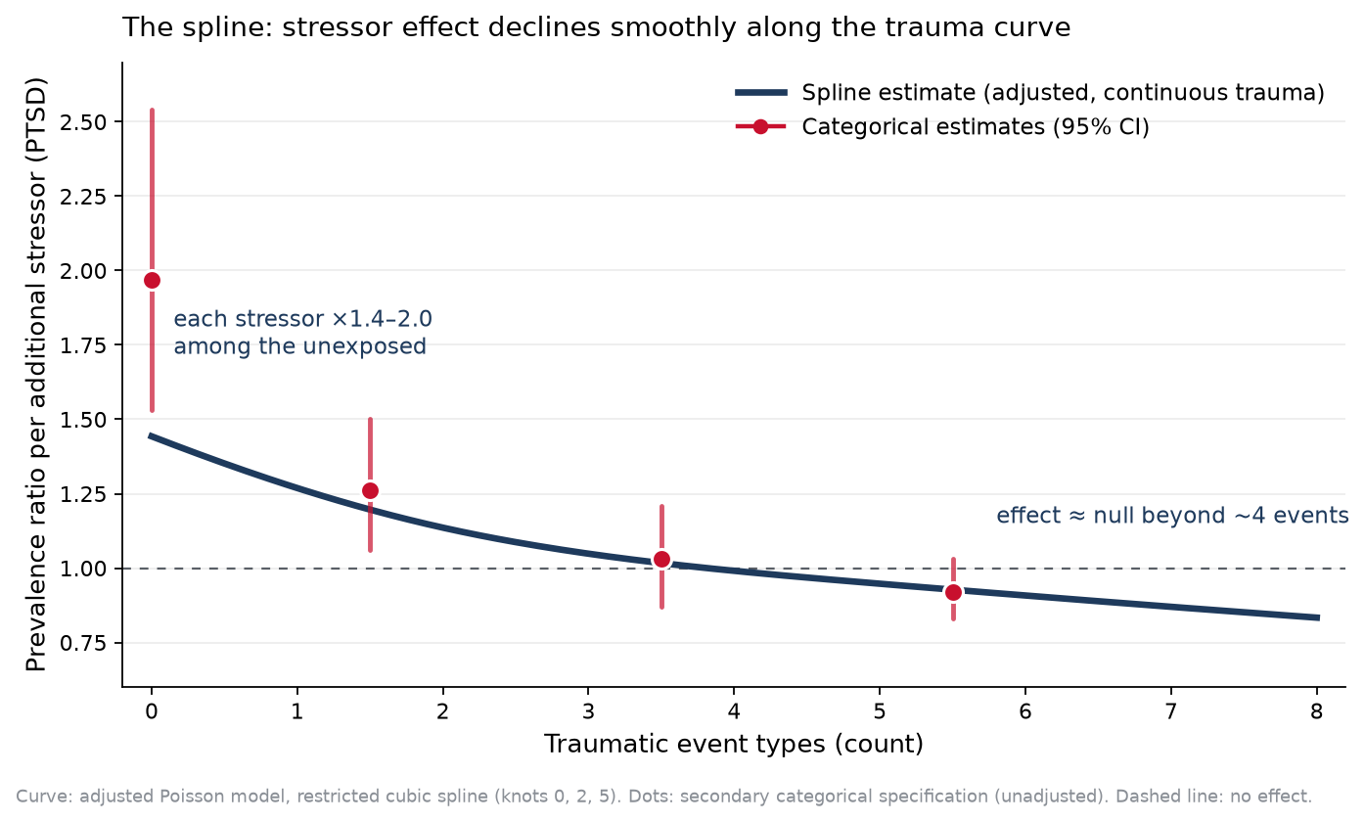
The Spline Itself: A Smoothly Declining Stressor Effect
Notes:
This is the spline, shown as what it estimates: the prevalence ratio per additional stressor, as a continuous function of the trauma count. The dark curve comes from the adjusted model with trauma as a restricted cubic spline, knots at 0, 2, and 5 — free to rise (sensitization), stay flat (additivity), or fall. It falls, smoothly and monotonically, crossing the null just past four events. The red dots are the secondary categorical specification with confidence intervals — the two approaches agree on the shape; the gap at zero reflects adjustment (the categorical estimates are unadjusted). No bins imposed this: the curve chose it.

