Slide 1
When More Trauma Means Less Stress Sensitivity
Evidence for a Trauma Saturation Effect Among Violence-Exposed Populations in Nigeria
Mohammed Abba-Aji, MBBS, MPH, DrPH · Washington University Bursky School of Public Health
ISTSS 42nd Annual Meeting · San Antonio, TX · September 24, 2026
Notes:
My paper uses the same survey and asks a different question. Dr. Abdalla showed that trauma and camp residence each raise the burden. I want to ask whether trauma changes what everyday stress does to people.

Slide 2
Continuing Medical Education Financial Disclosure
Amedco, our CME provider, asks that all individuals who have the ability to influence and/or control the content of this accredited activity disclose any/all relationships with ‎Ineligible Companies.
This information is disclosed to CME activity participants, and Amedco has procedures in place to resolve any apparent conflicts. In addition, presenters are asked to disclose when any discussion of unapproved use of pharmaceuticals and devices are being discussed.
In the past 24 months, I Mohammed Abba-Aji, have not had financial relationships with any ineligible companies.
Notes:
I have no financial relationships to disclose.

Slide 3
Background
INTRODUCTION
Violence-exposed Nigerians carry two loads: traumatic events and daily socioeconomic stressors
Most humanitarian programming assumes the two add, so stress reduction helps everyone equally
Whether they add or interact decides who benefits from which intervention
Three accounts in the literature predict different answers
Notes:
People in this population carry two kinds of load. One is the traumatic events: assault, armed attack, disaster. The other is the daily grind: losing a job, struggling to pay rent, family breakdown, isolation. Most humanitarian programming assumes the two simply add, so reducing stress helps everyone equally. Whether that is true decides who benefits from which intervention, and the literature offers three accounts that predict different answers.

Slide 4
Background: Building-Block Model
INTRODUCTION
Trauma and daily stressors raise symptoms independently
Stress reduction helps everyone equally
Symptoms
No trauma
Trauma
Daily stressors →
Miller & Rasmussen, 2010
Notes:
The first is the building-block model of Miller and Rasmussen. Trauma and daily stressors each add risk independently. Trauma raises the whole line; each stressor adds the same amount whoever you are. The implication is that stress reduction helps everyone equally.

Slide 5
Background: Stress Sensitization
INTRODUCTION
Symptoms
No trauma
Trauma
Trauma amplifies reactivity to later stress
Stress reduction would do the most good for the most exposed
Daily stressors →
Hammen, 2005; McLaughlin et al., 2010
Notes:
The second is stress sensitization, from Hammen and from McLaughlin's work on childhood adversity. Trauma lowers the threshold at which stress produces symptoms, so each added stressor does more harm among people with more trauma. If that is right, stress reduction does the most good for the most exposed.

Slide 6
Rationale: Saturation, Never Formally Tested
INTRODUCTION
Stress sensitivity diminishes at high trauma exposure
Never formally tested: the shape of the interaction, multiple outcomes, an African conflict setting
Symptoms
No trauma
Trauma
Daily stressors →
Hou et al., 2020; Scharpf et al., 2021
Notes:
The third is less developed. Studies of Syrian and Burundian refugees found that stress sensitivity diminished among the most exposed: their symptoms were high and stopped tracking current stress. Nobody had formally tested the shape of this interaction, across several outcomes, in an African conflict setting, in a population where exposure runs this high. That is the gap this paper addresses.

Slide 7
Objectives and Hypotheses
INTRODUCTION
AIM
Test whether trauma exposure modifies the association between socioeconomic stressors and PTSD, depression, and anxiety
HYPOTHESES
H1 Trauma × stressor interactions are significant, so the effects do not simply add
H2 Direction of H1: the interaction is negative; stress sensitivity diminishes with extensive trauma, which is saturation, not sensitization
Notes:
Our objective was to test whether trauma exposure modifies the association between socioeconomic stressors and PTSD, depression, and anxiety. We had two hypotheses. First, that the trauma-by-stressor interaction is real, meaning the two exposures do not simply add. Second, that the interaction is negative: stress sensitivity diminishes with extensive trauma, which is saturation, not sensitization.

Slide 8
Study Design, Setting, and Participants
METHODS
1,729
6
70
2025
adults completed the trauma inventory (of 1,774 interviewed)
states, one per zone: five conflict-affected plus Ogun
70 wards across 12 LGAs, IDP camps included
fieldwork, August to December, with AFENET and FMoHSW
Notes:
This is the survey you have just seen: a cross-sectional, population-based sample from six states, one per geopolitical zone, fielded between August and December 2025. Ogun matters here. It gives us people with little or no trauma exposure, which is where the stress gradient turns out to live.

Slide 9
Variables and Measurement
METHODS
OUTCOMES
Probable PTSD
PCL-5
Depression
PHQ-9
Anxiety
GAD-7
EXPOSURES
COVARIATES
Trauma exposure
Adapted Life Events Checklist; 12 types, lifetime
Daily stressors
10-item Nigerian-specific count, 0–10
Covariates
Age, gender, education, state
PCL-5 and PHQ-9 cut-offs from the validation study (paper 1); GAD-7 at the international ≥10, interpreted cautiously
Notes:
The outcomes are the same: PCL-5 at 38, PHQ-9 at 10, and GAD-7 at 10, read cautiously. Trauma is the count of twelve event types from the adapted Life Events Checklist. Daily stressors are a ten-item count developed for Nigeria, covering job loss, rent, eviction, family disruption, and isolation. All models adjust for age, gender, education, and state.

Slide 10
Bias
METHODS
Exposure misclassification: the 37 who declined the trauma items treated as missing, not unexposed; counts verified against item-level responses
Confounding: all models adjusted for age, gender, education, and state
Correlated exposures: stressor burden rises with trauma, so the interaction is tested formally with adjustment
Artifacts: ratio-scale compression, cut-off choice, and imposed functional form each addressed by a prespecified analysis
Notes:
We addressed bias on four fronts. The 37 people who declined the trauma items are treated as missing, not as unexposed, and we checked every count against the item-level answers. All models adjust for age, gender, education, and state. Stressor burden rises with trauma, so the interaction had to be tested formally, with adjustment. And each route to a statistical artifact, from ratio-scale compression to the choice of cut-off to an imposed functional form, has its own prespecified analysis.

Slide 11
Statistical Analysis: Spline Model
METHODS
Poisson regression → prevalence ratios; design-based variances (state strata, community PSUs, Taylor linearization)
Trauma entered continuously as a restricted cubic spline (knots 0, 2, 5)
  Smooth curve segments joined at knots — the data chooses the shape; categories would impose it
H1: trauma × stressor interaction, adjusted Wald test
H2: direction and shape of that same interaction across the trauma spline, on both scales
Notes:
Two analytic choices carry the argument. The first concerns how we enter trauma. In the dissertation version we grouped people into bins: none, one to two, three to four, five or more. A sceptic can reasonably say the bins produced the pattern. So here trauma enters as a continuous count through a restricted cubic spline, a set of smooth curve segments joined at chosen points, called knots, at zero, two, and five events. The spline lets the data choose the shape: a steepening, no change, or a flattening. We did not decide in advance which.

Slide 12
Statistical Analysis: Scales and Sensitivity
METHODS
Both scales: per-stressor prevalence ratios AND absolute differences in model-predicted prevalence (Stata margins: predictions at fixed trauma and stressor values, averaged over each participant's own covariates)
  Targeting claims rest on absolute risk
Prespecified sensitivity analyses:
  Alternative cut-offs: PCL-5 ≥ 33, PHQ-9 ≥ 15, GAD-7 ≥ 7
  Continuous scores
  Categorical specification of trauma
All analyses in Stata 19.5
Notes:
The second choice is to read the interaction on two scales. A ratio can shrink for purely arithmetic reasons when baseline risk is high, so we also report absolute differences in percentage points, which do not have that property. Claims about who should receive which intervention rest on absolute risk. We prespecified sensitivity analyses at other cut-points, on continuous symptom scores, and with the categorical version of trauma.

Slide 13
Participant Flow
RESULTS
1,774
adults interviewed across six states
45 excluded: 37 declined the trauma items; 8 missing outcome or sampling data
1,729
completed the trauma inventory and outcomes
23 excluded: missing covariate data
1,706
included in adjusted models (complete-case analysis)
Notes:
Of the 1,774 adults interviewed, 1,729 completed the trauma inventory and the outcome measures; 37 declined the trauma items and 8 lacked outcome or sampling data. Adjusted models include 1,706 people with complete covariates. This is a complete-case analysis.

Slide 14
Descriptive Data: Exposures
RESULTS
Trauma exposure
Adapted Life Events Checklist; 12 types, lifetime
Daily stressors
10-item Nigerian-specific count, 0–10
mean 2.05 (SD 1.65)
None
28%
0
10
1–2 events
54%
Items include
Job loss · rent · eviction · family disruption · isolation
3–4 events
13%
5+ events
5.5%
Covariates in all models: age, gender, education, state
Notes:
Just over a quarter of people reported no traumatic event, about half reported one or two, 13 percent three or four, and 5.5 percent five or more. The average person reported about two current stressors.

Slide 15
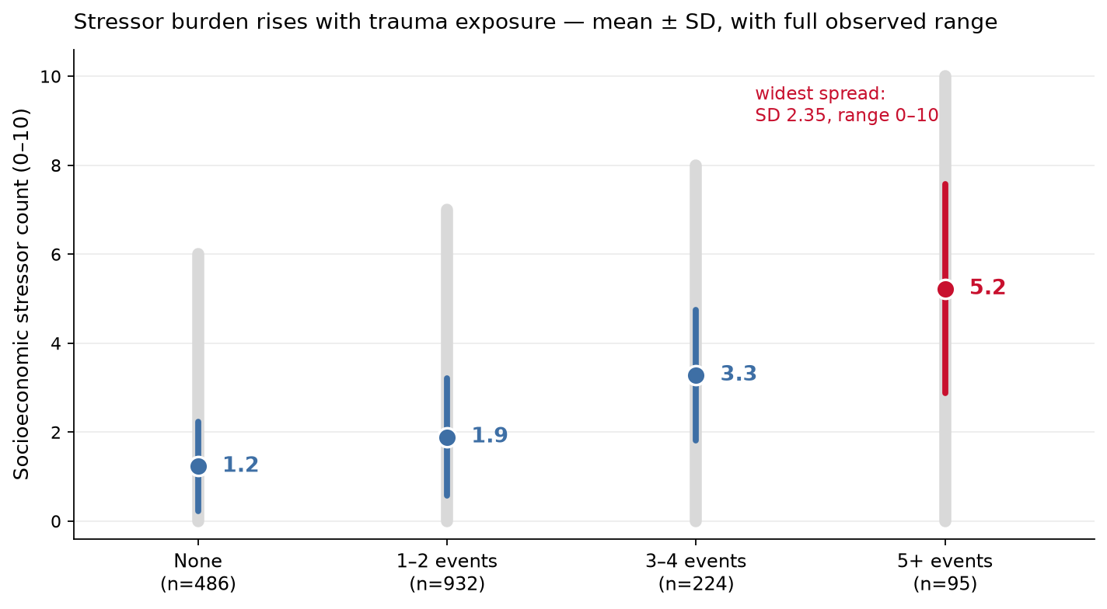
Descriptive Data: Stressors by Trauma Exposure
RESULTS
Notes:
The two exposures are correlated. Mean stressor burden rises from about one at no trauma to about five at five or more events, which is why the interaction needs formal, adjusted testing. Note also the spread: the five-plus group has the widest stressor range in the sample, from zero to ten, so any null in that group is estimated over real variation, not a compressed range.

Slide 16
Outcome Data: PTSD by Trauma
RESULTS
Model-predicted PTSD prevalence at zero stressors, standardized to sample covariates (Stata margins)
PTSD Prevalence Rises Sixfold With Trauma
Notes:
First, the main effect, so the interaction has context. At zero stressors, model-predicted PTSD prevalence rises from about 7 percent among people with no trauma to about 40 percent at five events. Trauma dominates the risk landscape. These are predicted prevalences from the Poisson model using Stata's margins: each person's probability is predicted at a fixed trauma and stressor level, keeping their own age, gender, education, and state, and the predictions are averaged. That standardizes the comparison to the same covariate mix. The gradient itself is expected. The question is what happens to the stress gradient along the way.

Slide 17
Main Results: Per-Stressor Prevalence Ratios
RESULTS
Prevalence ratio per additional daily stressor (95% CI), by lifetime trauma events
0 events
1–2 events
3–4 events
5+ events
Interaction p < 0.0001 for all three outcomes. A ratio of 1.0 means no added risk per stressor.
Notes:
This is the central result. Each marker is the prevalence ratio for one additional daily stressor, with its confidence interval; the dashed line at 1 means no added risk. Start on the left. Among adults with no traumatic events, each added stressor nearly doubles the prevalence of probable PTSD, a ratio of 1.97. Depression, at 1.83, and anxiety, at 1.71, move with it. Now read to the right. At one to two events the ratios fall to between 1.15 and 1.27. At three to four events the intervals sit on the line, and at five or more events all three outcomes are at the null. The interaction is below 0.0001 for all three outcomes. The stressor gradient is steepest where trauma is lowest, which is the opposite of what sensitization predicts.

Slide 18
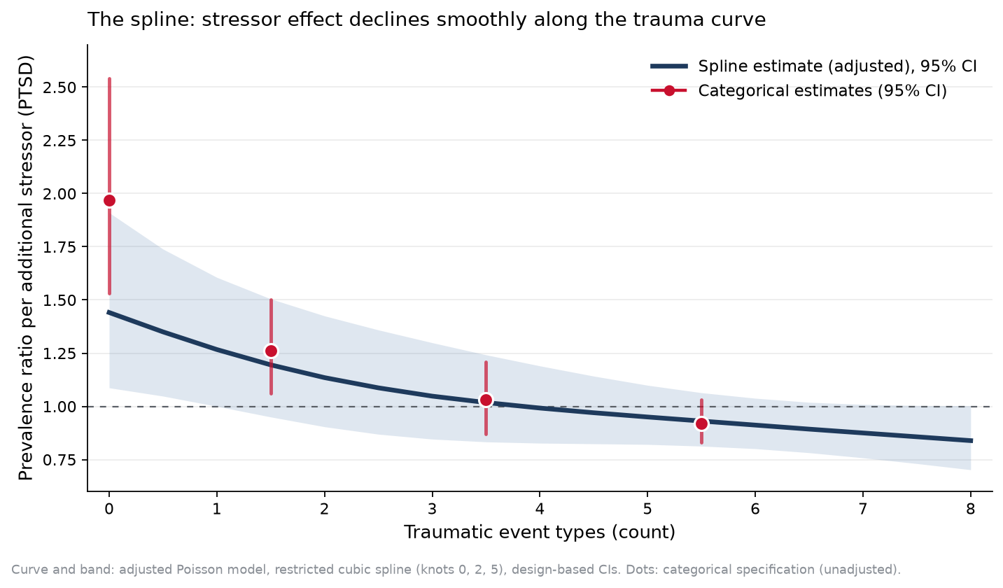
Main Results: Spline Estimate
RESULTS
Notes:
This is the spline itself: the per-stressor prevalence ratio as a continuous function of the trauma count, with its confidence band. The curve was free to rise, stay flat, or fall. It falls smoothly and crosses the null at about four events. The red markers are the categorical estimates, and the two approaches agree on the shape. The spline interaction is significant for all three outcomes: p of 0.003 for PTSD, 0.0001 for depression, and 0.003 for anxiety.

Slide 19
Main Results: Absolute Scale
RESULTS
Change in model-predicted prevalence, 0 → 4 stressors, percentage points (Stata margins; 95% CI)
no trauma exposure
five or more events
+21.8
PTSD
−7.3
◂ to −30.0
+24.1
Depression
+3.5
+17.8
Anxiety
−4.0
−20
−10
0
+10
+20
+30
+40
Notes:
A sceptic would say the ratio fades only because people with heavy trauma already have high prevalence. So here is the same comparison in percentage points, as differences in model-predicted prevalence estimated with margins contrasts. Going from zero to four stressors adds about 22 points of PTSD prevalence among people with no trauma exposure, 24 points of depression, and 18 points of anxiety. Among people with five or more events, the same four stressors add nothing measurable to any of the three. The fading appears in percentage points too, so it is not an artifact of the ratio scale.

Slide 20
Main Results: Prevalence Curves
RESULTS
Model-predicted prevalence (%) by stressor count, at four levels of trauma exposure (Stata margins)
The Stressor Gradient Flattens as Trauma Rises
Notes:
Here is the same result as model-predicted prevalence. Each line is a level of trauma. The red line, no trauma exposure, rises from about 7 percent to 28 percent across four stressors and keeps climbing. Each step up in trauma rotates the line flatter, and at five or more events the line is high and does not rise with stress; if anything it drifts down. The gradient belongs to people with little trauma; the burden belongs to people with a lot. Depression and anxiety fan out the same way.

Slide 21
Sensitivity Analyses
RESULTS
Adjusted spline interaction: PTSD p=0.0027; depression p=0.0001; anxiety p=0.0027
Alternative thresholds: PCL-5≥33 (p=0.0002), PHQ-9≥15 (p=0.0001), GAD-7≥7 (p<0.0001)
Continuous symptom scores — no cutoff at all: all p≤0.0001
Not a ceiling: the 5+ group sits at 30–40% prevalence with a tight confidence interval, estimated over real stressor variation
Categorical and continuous specifications agree; adjusted and unadjusted agree
Notes:
We tried every route to an artifact we could think of. The pattern holds at alternative cut-points: PCL-5 at 33, PHQ-9 at 15, and GAD-7 at 7. It holds in continuous symptom scores, where there is no cut-point at all. The high-trauma group is not at a ceiling; its prevalence is between 30 and 40 percent, not near 100, and its confidence interval is narrow.

Slide 22
Key Results: Hypotheses
DISCUSSION
AIM, ANSWERED
Yes: trauma exposure modifies the stressor association for PTSD, depression, and anxiety
HYPOTHESES
H1 Supported. Trauma × stressor interaction p < 0.0001 for all three outcomes
H2 Supported. The interaction is negative: the PTSD ratio per added stressor falls from 1.97 with no trauma to 0.92 at 5+ events, and depression and anxiety follow the same pattern
Notes:
To return to the objective: trauma does modify how daily stressors relate to all three outcomes. The interaction is significant for PTSD, depression, and anxiety, so the exposures do not simply add; that is hypothesis one. And the direction is negative: with no trauma, each stressor nearly doubles PTSD prevalence, and with five or more events it adds nothing; that is hypothesis two, saturation rather than sensitization.

Slide 23
Key Results: A Graded Pattern
DISCUSSION
The exposures do not simply add (H1), and the interaction runs toward saturation (H2)
The stress gradient sits among adults with little trauma; the heavily exposed are high at every stressor level
Graded, not a switch: sensitivity retained at 1–2 events, flattening at 3–4, gone by 5+
Notes:
The change is graded, not a switch. Sensitivity is retained at one or two events, flattens at three or four, and is gone by five. One reading is that both older theories hold, at different levels of exposure.

Slide 24
Limitations
DISCUSSION
Cross-sectional: saturation is an association pattern, not a causal mechanism; selection and reverse causation cannot be excluded
Lifetime event recall set against current stressors
Sparse data above six events (~60 respondents): extreme-tail predictions unstable, reported only to five events
Screens, not diagnoses — though locally validated, and the pattern holds in continuous scores
Equal sampling weights; design-based clustering (state strata, community PSUs)
Notes:
The limitations: the design is cross-sectional, so selection and reverse causation cannot be excluded; trauma is lifetime recall while stressors are current; data above six events are sparse, so we report predictions only to five; and these are screens, not diagnoses, although they are locally validated and the pattern holds in continuous scores.

Slide 25
Interpretation: Candidate Mechanisms
DISCUSSION
Allostatic exhaustion (McEwen)
Hypocortisolism and blunted amygdala reactivity (Yehuda)
Emotional numbing
Altered world assumptions
Cross-sectional data: a population pattern, not a demonstrated within-person mechanism
Notes:
Several mechanisms could produce this pattern: allostatic exhaustion, in McEwen's sense; blunted cortisol and amygdala responses after chronic trauma, which Yehuda has documented; emotional numbing; and altered assumptions about the world, so that one more hardship no longer registers as a departure from expected danger. These data describe a pattern across people; they do not demonstrate a mechanism within a person.

Slide 26
Interpretation: Implications for Programming
DISCUSSION
One program for everyone serves neither group well
~4 in 5 adults have fewer than three event types and retain stress sensitivity:
  Stress management, livelihood support, Problem Management Plus, community psychosocial support (Rahman 2016; Jordans 2010)
The heavily exposed minority carries 30–40% prevalence at every stressor level:
  Trauma-focused therapies — Narrative Exposure Therapy (Robjant & Fazel 2010), culturally adapted CPT (Bass 2013)
Brief trauma-history screening at program entry could route scarce specialist capacity to where stress reduction cannot substitute for it
Notes:
The practical implication is stratification. About four in five adults in this sample have fewer than three types of trauma and retain stress sensitivity. For them, stress management, livelihood support, Problem Management Plus, and community psychosocial support address something their symptoms respond to. The minority with extensive exposure carries high prevalence whatever their current stress. For them the treatments with evidence are trauma-focused: Narrative Exposure Therapy and culturally adapted Cognitive Processing Therapy. A brief trauma-history screen at program entry could route scarce specialist capacity to the people for whom stress reduction cannot substitute.

Slide 27
Generalisability and Conclusions
DISCUSSION
Trauma exposure modifies what everyday stress does: per-stressor PTSD risk falls from ×1.97 among the unexposed to null at five or more events, across all three outcomes, on both scales, in every sensitivity analysis
Simple dose-response assumptions — and universal psychosocial programming built on them — do not fit these data
Match the intervention to trauma history: stress-focused support where sensitivity is retained; trauma-focused therapy where exposure is extensive
Next: longitudinal designs to establish when saturation develops and whether it reverses with treatment
Six states spanning five forms of violence and a non-conflict comparison; replication in other high-exposure settings is needed
Notes:
Trauma changes what everyday stress does. The risk from each additional stressor falls from nearly double among people with no trauma to nothing among people with five or more events, for all three outcomes, on both scales, and in every sensitivity analysis. These data come from six states spanning five forms of violence and a peaceful comparison; replication in other high-exposure settings, and a longitudinal test of when saturation develops and whether it reverses with treatment, are the next steps. Universal programs built on simple dose-response assumptions do not fit these data; we should match the intervention to trauma history.
[Handover] If need comes in two tiers, the service system has to be built in two tiers. That is a policy question, and Dr. Ojo is the person in Nigeria who has to answer it. Thank you.

